Slide 1

SMART INDIA HACKATHON 2026
AI-Assisted Application Validation & Compliance Screening
Problem Statement ID SIH26261
Problem Statement Title AI-Powered Application Validation, Document Authentication and Regulatory Compliance Verification
Theme [CONFIRM FROM SIH PORTAL]
PS Category Software
Team ID [INSERT TEAM ID]
Team Name Conquerors
Idea Title AI-Assisted Application Validation & Compliance Screening for AICTE Approvals
A first-pass screening layer that reads application documents, cross-checks them against institutional records and flags deficiencies with evidence
so AICTE officials review only the cases that need attention. AI assists, officials decide.

Slide 2

PROBLEM STATEMENT
Conquerors
Problem Statement Title AI-Powered Application Validation, Document Authentication and Regulatory Compliance Verification
The Real Problem, Broken Down
1. Missing, incomplete or expired documents. Affidavits, NOCs and certificates may be absent or past validity, and each gap has to be found by manual scrutiny.
2. Inconsistent information across records. Names, certificate IDs, dates or claimed intake may not match other documents or the institution's previous approval record.
3. Possible alteration or duplication. Altered dates, duplicated documents, inconsistent metadata and mismatched identifiers are hard to spot by eye. They are preliminary signs that need human verification, not proof of misconduct.
4. Slow confirmation from issuing authorities. Verifying a certificate with its original issuer is time consuming, which delays processing and adds administrative effort.
Why It Matters (from the brief)
• The volume and variety of applications and supporting documents makes manual checking time consuming.
• Evidence spans affidavits, NOCs, accreditation details, previous EoA and approval status, approved intake, faculty records, deficiency status and TER payment status.
• AI output must stay decision support statutory scrutiny, inspections and final decisions remain with the competent AICTE authorities.
“The bottleneck is not the officer’s judgement. It is the first-pass checking that comes before it.”

Slide 3
PROPOSED SOLUTION
Conquerors
Proposed Solution First-Pass Screening Layer
Decision support for officials it flags, it never decides
A screening layer in front of AICTE officers it reads each application’s documents, checks them against the category checklist and institutional records, and flags deficiencies with evidence. It never approves or rejects. Final decisions stay with AICTE.
TIER 1 — Built for This Submission
✔ Smart document intelligence — OCR and vision-LLM classification and field extraction (names, certificate numbers, issue and expiry dates)
✔ Completeness and validity checks — configurable checklists by application category flag missing documents and expired certificates
✔ Cross-document contradiction detector — value found, value expected, source document and discrepancy side by side, including claimed vs previously approved intake
✔ Metadata anomaly flags — creation date after issue date, edited after signing, duplicate documents; each labelled a preliminary indicator
✔ Review-priority queue — rule-based high / medium / low with the reason shown officers review, resolve or dismiss flags
✔ Validation dashboard and audit trail — status, deficiencies and open flags per application append-only log of rules run and officer actions
✔ Role-based access — officer, senior officer and admin roles
TIER 2 — Simulated or Scoped Down (Designed In, Not Fully Built)
◎ Issuing-authority verification — simulated a mock verify action with seeded responses and status chips (verified, mismatch, expired, pending, source unavailable, manual review) plus timestamps designed for authorised APIs, quick-response codes and digital signatures
◎ Infrastructure compliance assistance — scoped down to light vision-LLM observations on uploaded photographs trained computer-vision floor-plan analysis is out of scope
◎ Portal and records integration — designed for integration with the AICTE application portal demonstrated against seeded synthetic institutional records
Every simulated component is labelled as simulated. All AI findings are explainable, evidence-linked decision-support outputs. Final regulatory decisions remain with the competent AICTE authorities.
Design Approach & Differentiators
• Evidence-linked by design every flag shows the field, value found, value expected and source document
• Human in the loop flags are preliminary indicators the system never auto approves or rejects
• Explainable review priority a rule-based high / medium / low queue with the reason shown, not an opaque risk score
• Configurable, not hard-coded checklists and rules are editable per application category
• Traceable append-only audit trail of rules applied, records checked, source responses and officer actions
• Honest scope simulated parts are labelled; demonstrated on synthetic or anonymised data as the brief requires

Slide 4










TECHNICAL APPROACH
Conquerors
Technologies Used
• Frontend Next.js / React (officer dashboard, evidence view)
• Backend Express.js + TypeScript (pipeline, rules engine, audit log)
• Database PostgreSQL (applications, documents, flags, audit log)
• AI / OCR Vision-capable LLM API (Claude or GPT) classify, extract, cross-check
• Metadata PDF / image metadata libraries (e.g. pdf-lib, exiftool)
• Verification Mock issuing-authority service (simulated)
• Deployment Render or AWS (backend) / Vercel (frontend), Docker for CI/CD
① Intake &
Checklist
(rules select)
② Read
Documents
(OCR/Vision)
③ Validity
Rules
(missing/exp)
④ Cross-
Check
(intake/prev)
PostgreSQL
Apps · Docs
Flags · Audit
(steps ③-⑦)
⑤ Anomaly
Flags
(metadata/dup)
⑥ Source
Verify
(simulated)
⑦ Dashboard
& Audit
Trail
⑧ Officer
Review
(human)
Legend dashed outline = simulated component
⑧ blue = officer decision (human in the loop)

Slide 5
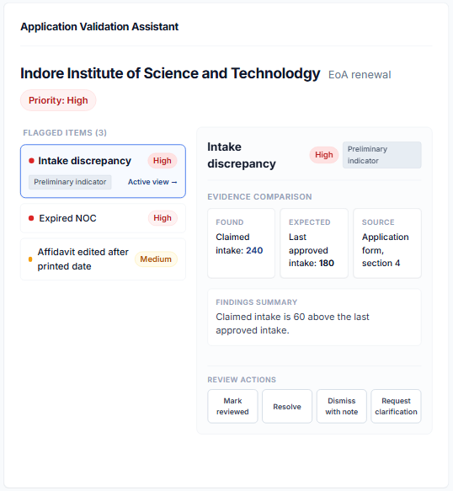
FEASIBILITY AND VIABILITY
Conquerors
UI Prototype -
Analysis of Feasibility
Core pipeline — HIGH feasibility
Document upload, vision LLM / OCR extraction and classification, category checklists, missing / expired / empty field rules
Consistency and anomaly checks — HIGH to MEDIUM
Cross-document and institutional record comparison on seeded data (HIGH) metadata anomaly flags and duplicate detection (MEDIUM, preliminary indicators only)
Dashboard, review queue and audit trail — HIGH
Standard web CRUD, rule-based priority, append-only log role based access kept small (officer / senior officer / admin)
Issuing-authority verification — LOW to build for real, so SIMULATED
No authorised sandbox access in a hackathon mock source with seeded responses and clearly labelled status chips
Infrastructure compliance (computer vision) — LOW, scoped down
Light vision LLM observations on uploaded photos only, trained floor plan analysis is not attempted
Risks and Mitigations
Each risk is named specifically, with how we reduce it.
Overclaiming forgery detection — lead with explainable metadata and consistency checks label every flag a preliminary indicator requiring human verification
No real institutional or issuing-authority data — seed realistic synthetic records, label them as such, and demonstrate verification as simulated
Extraction accuracy on messy scans — test early on varied skewed and low quality documents extractions that fail validation go to manual review, never silent acceptance
Explainability — every flag stores the field, value found, value expected, source document and the rule that fired, so evidence is built in, not retrofitted
Scope creep — the core pipeline is demo-stable first simulated and scoped down parts are not expanded until it is

Slide 6
IMPACT AND BENEFITS
Conquerors
Expected Outcomes — Supported by What Is Built
Earlier identification of missing, expired or inconsistent information
Checklist, validity and cross document checks run at the application stage, so gaps are visible before detailed scrutiny starts.
Designed to reduce repetitive manual scrutiny
Officers open a review queue ordered by priority, with each flag already showing its evidence, instead of reading every page of every application.
Transparency, accountability and auditability
Evidence linked flags and an append-only audit trail of rules applied, records checked and officer actions make every outcome traceable.
Stakeholder Impact
Scrutiny officers First pass checking is automated they review flagged cases with evidence side by side
Senior officers / competent authority Consistent, configurable checks and a traceable record support decisions that remain theirs
Institutions Missing or expired items surface earlier, so they can be rectified where the approval process permits
Not claimed measured accuracy or time savings (the prototype is demonstrated on synthetic data only), verified authenticity through live issuing-authority sources (simulated), and fewer physical inspections through infrastructure analysis (not built).
Note AI output is decision support only; statutory scrutiny, inspections and final regulatory decisions remain with the competent AICTE authorities.
HIGH
Expired mandatory certificate
Major intake discrepancy
MEDIUM
Conflicting information needing clarification
LOW
Minor missing fields
Routine verification pending
Priority only orders the review queue. It never approves or rejects an application.

Slide 7
RESEARCH AND REFERENCES
Conquerors
Evidence Base — What the Brief Establishes
• Manual checking of the volume and variety of applications and documents is time consuming missing or expired documents, inconsistencies and suspected alterations delay processing
Source SIH 2026 Problem Statement 26261 (AICTE, Ministry of Education)
• Records to validate against affidavits, accreditation details, NOCs, previous EoA and approval status, approved intake, faculty records, deficiency status, TER payment status
Source SIH 2026 Problem Statement 26261
• Required safeguards configurable rules, role based access, explainable evidence-linked flags, decision support only
Source SIH 2026 Problem Statement 26261 (Essential Safeguards)
• Evaluation metrics named extraction accuracy, validation accuracy, anomaly-detection performance, source-verification rate, verification time, alert timeliness, reduction in manual effort
Source SIH 2026 Problem Statement 26261 (Prototype Demonstration and Evaluation)
References
1. SIH 2026 Problem Statement 26261 AI-Powered Application Validation, Document Authentication and Regulatory Compliance Verification (AICTE, Ministry of Education) — sih.gov.in
2. AICTE Approval Process Handbook (edition in force, confirm the year) — aicte-india.org

