Slide 1

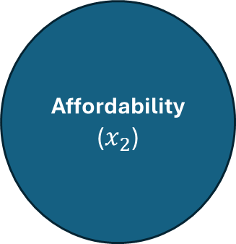
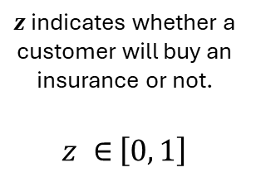
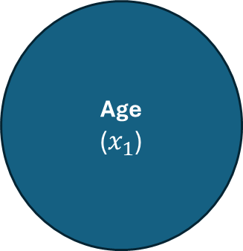


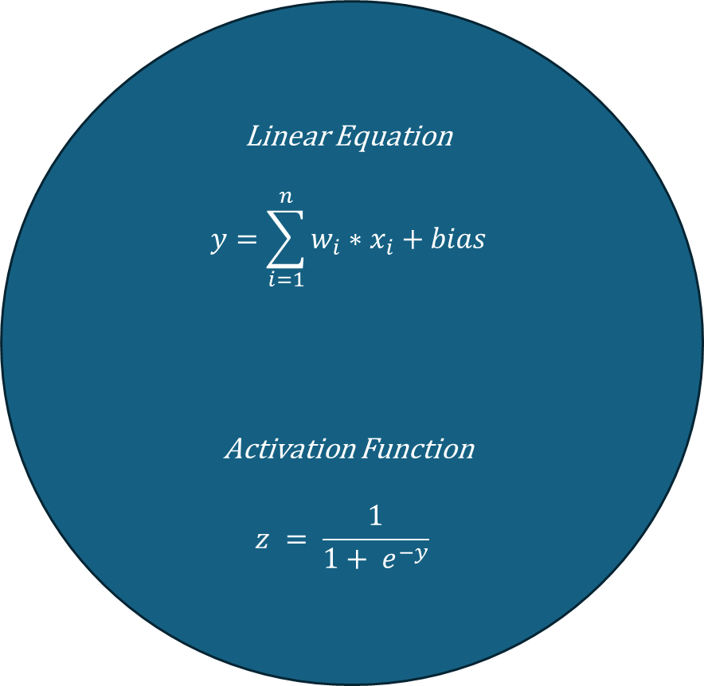
$$y=w_{1}∗x_{1 }+w_{2}∗x_{2}+bias$$
Age
($x_{1}$)
Linear Equation
$$y=\sum_{i=1}^{n}{w_{i}∗x_{i}+bias}$$
Activation Function
$$z = \frac{1}{1+ e^{−y}}$$
$$w_{1}$$
$z$ indicates whether a customer will buy an insurance or not.
$z ∈$ $\left[0, 1\right]$
Affordability
($x_{2}$)
$$w_{2}$$
Single Neuron

Slide 2
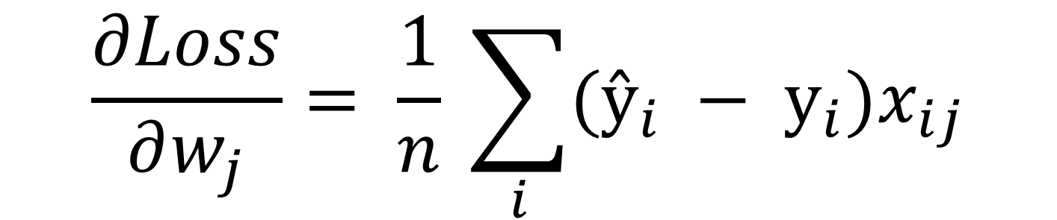
$$\frac{∂Loss}{∂w_{j}}= \frac{1}{n} \sum_{i}{(ŷ_{i} − y_{i})x_{ij}}$$

