Slide 1

Sprocket Central Pty Ltd
The Analytics Team
Data analytics approach
Prathmesh Lonkar, Junior Consultant

Slide 2

Agenda
Introduction
Data Exploration
Model Development
Interpretation

Slide 3
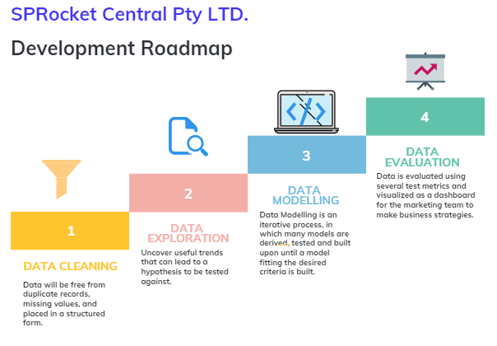
Introduction

Slide 4
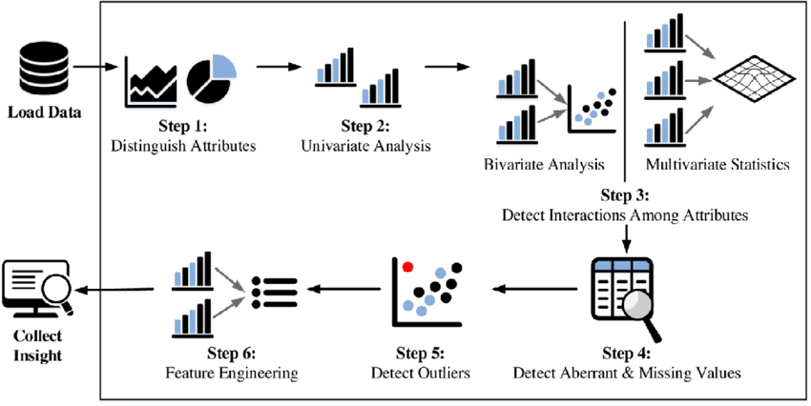
Data Exploration
Significance of performing an EDA:
Data exploration is the first step of data analysis used to explore and visualize data to uncover insights from the start or patterns to dig deeper.
Reduces the risk of imbalance distribution of the dataset by checking the skewness of a particular field.
High Correlation between multiple variables can lead to overfitting problem which can be checked using correlation analysis.
To Infer better variables/predictors out of the existing variables that can turn out to be a good predictor if it correlates with the output variable.
Removes the redundant values from the dataset by treating missing values and outliers.

Slide 5
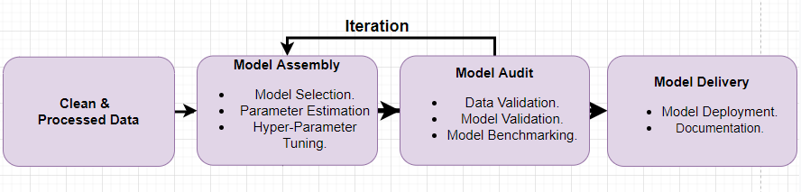
Model development
Model development is an iterative process, in which many models are derived, tested and built upon until a model fitting the desired criteria is built.
The Initial step is to determine a hypothesis questioning the problem statement and then perform statistical testing to determine if the hypothesis is valid or not.
Evaluate the performance of the models using factors such as ROC Curves, Precision, Recall, AUC Curve, Accuracy, F1-score etc.
Finally, deploy and document the best model’s performance, assumptions and certain limitations.

Slide 6
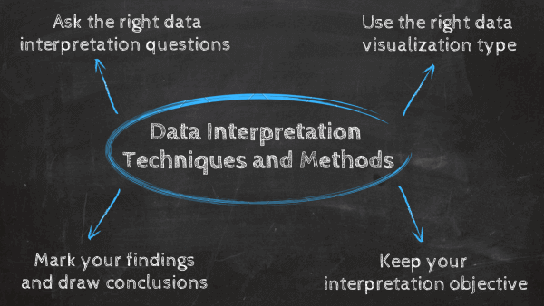
interpretation
Data interpretation is the final step of data analysis where we turn results into a presentable format to gain clear and useful insights for business strategies.
Quantitative and qualitative methods are distinct types of data analyses both offering different type of data interpretation & decision-making abilities.
Data dashboards decentralize data without compromising on the necessary speed of thought while blending both quantitative and qualitative data.
We will be reporting the insightful findings in the form of a dashboard which will demonstrate the Customer Demographic , Target Customers, Top Selling Goods etc. to help the team to make appropriate business decisions.

Slide 7

Thank You

