Slide 1
Mutual Fund Analytics Platform
Capstone Project - Bluestock Fintech
40 Schemes | 46k+ NAV Records | 32k+ Transactions

Slide 2
Project Overview
Objective: Build an end-to-end mutual fund analytics platform.
Data Scale: 40 AMFI codes, 10 AMCs, 3-year historical data.
Features: ETL Pipeline, Star Schema, Analytical Queries, Interactive Dashboard.
Bonus: Auth Gateway, Fund Recommender, PowerBI Connector, Landing Page.

Slide 3
Data Pipeline & Architecture
ETL: Raw CSV + API → Pandas → PostgreSQL (Neon Cloud)
Star Schema: dim_fund, dim_date → fact_nav, fact_transactions, etc.
Auth: FastAPI + Google OAuth 2.0 + JWT Tokens
Dashboard: Streamlit + Plotly (6 interactive pages)
Landing: React + Vite + TailwindCSS with shader animations

Slide 4
Market Overview & Trends
Equity AUM growth: +41% (2023-2025)
SIP milestone: Rs. 31,002 Cr monthly inflows (Dec 2025)
Folio growth: 2.1x expansion in total industry folios
Mid-Cap alpha: +3.2% outperformance vs Large-Cap (3Y)

Slide 5
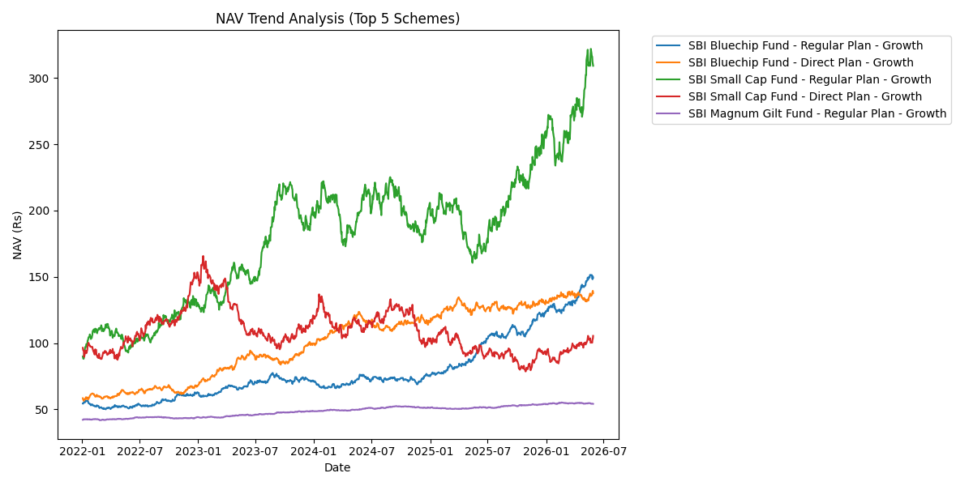
NAV Trend Lines

Slide 6
Fund Performance & Risk
Computed: Sharpe Ratio, Sortino Ratio, Alpha, Beta for all 40 schemes
Maximum Drawdown analysis with peak, trough, and recovery dates
VaR (95%) and CVaR (Expected Shortfall) computed for tail risk
Direct plans consistently outperform Regular plans

Slide 7
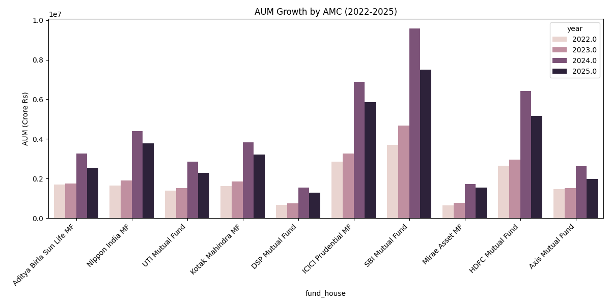
AUM Growth by AMC

Slide 8
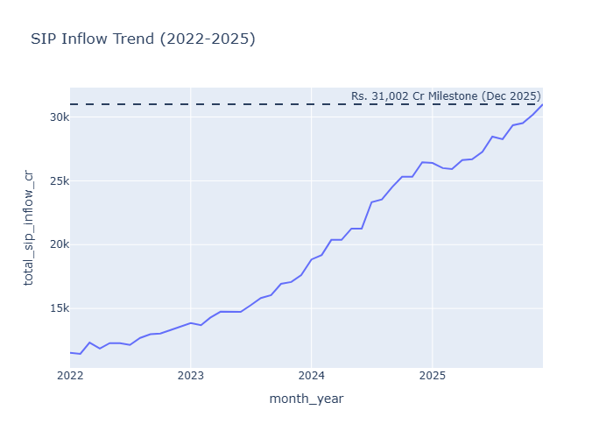
SIP Inflow Trend

Slide 9
Investor Demographics
SIP dominates for 25-35 age group
T30 cities: ~70% of transaction volume
KYC compliance rate: >95% across all tiers
Top states: Maharashtra, Karnataka, Delhi NCR

Slide 10
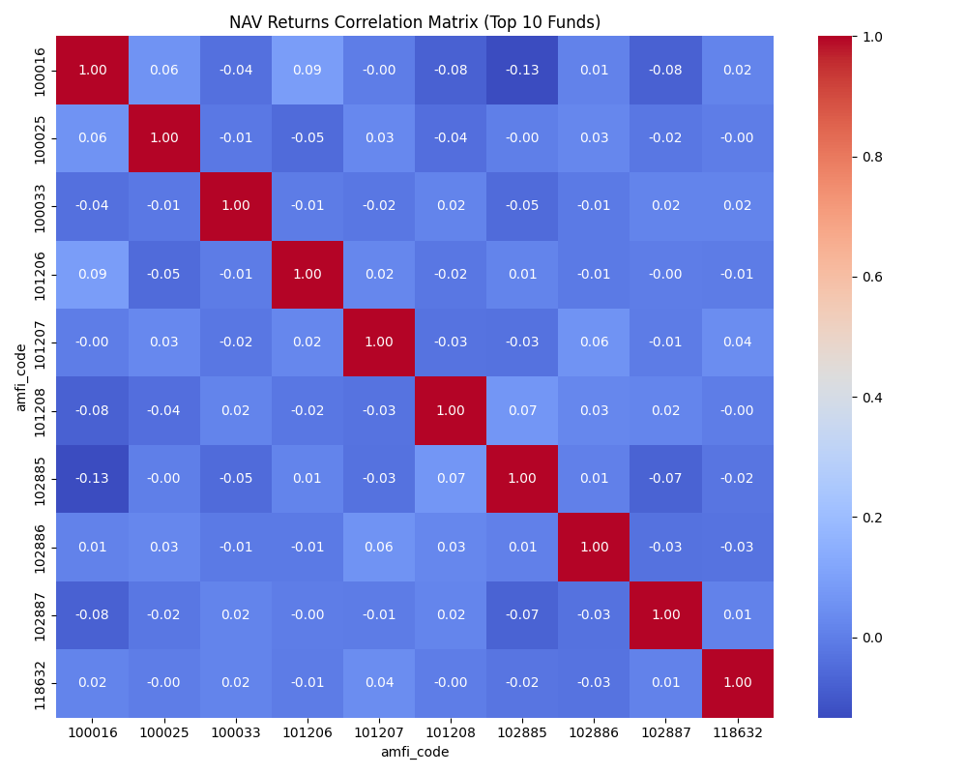
Cross-Fund Correlation Matrix

Slide 11
Fund Scorecard & Recommender
Composite Score (0-100): weighted rank across 5 dimensions
30% CAGR 3Y + 25% Sharpe + 20% Alpha + 15% Expense + 10% Drawdown
Risk-based filtering: Low / Moderate / High
Interactive radar chart comparison of top recommendations
Projected returns calculator (SIP & Lumpsum modes)

Slide 12
Conclusion & Future Scope
All capstone requirements fulfilled with bonus features
Production-grade authentication with Google OAuth 2.0
Future: Real-time streaming, ML predictions, portfolio optimization
Future: Mobile PWA, automated monthly email reports
Disclaimer: Past performance != future returns. Consult a SEBI advisor.

