Slide 1
PBL Presentation
By :
Shailesh Mohite 55
Prathmesh Patil 45
Ruturaj Sankpal 54
Vaishnavi Patil 42

Slide 2
Problem Statement
Friend Suggestion/recommendation – using graph
a. You will be given a graph
b. Each node in the graph will represent a person. Links between nodes will represent the association between persons.
c. The program shall suggest/recommend the friends by considering the association between nodes. If friend is added the considering link shall be added to the adjacency matrix.

Slide 3
What is Graph
A graph is a pictorial representation of a set
of objects where some pairs of objects are
connected by links. The interconnected objects
are represented by points termed as vertices, and
the links that connect the vertices are
called edges.

Slide 4
`
Mutual Friends
If you own a Facebook account, you have probably noticed the mutual friend count below each friend recommendation. When Facebook offers friend suggestions, you will most likely be presented friends in decreasing order by number of mutual friends. We will recreate the mutual friendship counter while attempting to solve this problem with optimal asymptotic complexity.

Slide 5
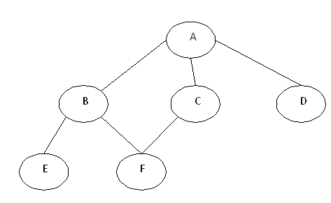
In the above graph, A,B,C,D,E,F are called nodes and the connecting lines between these nodes are called edges. The edges can be directed edges which are shown by arrows; they can also be weighted edges in which some numbers are assigned to them. Hence, a graph can be a directed/undirected and weighted/un-weighted graph.

Slide 6
Solutions
We can solve above problem statement by using two methods:
Adjacency List
Adjacency Matrix

Slide 7
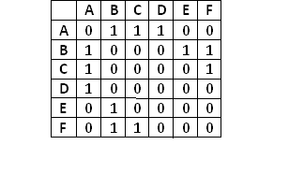
How to represent
1. Adjacency Matrix for the input
It is a two dimensional array with Boolean flags. As an example, we can represent the edges for the above graph using the following adjacency matrix.
In the given graph, A is connected with B, C and D nodes, so adjacency matrix will have 1s in the ‘A’ row for the ‘B’, ‘C’ and ‘D’ column.
The advantages of representing the edges using adjacency matrix are:
Simplicity in implementation as you need a 2-dimensional array
Creating edges/removing edges is also easy as you need to update the Booleans

Slide 8
Implementation
Enter the data of total nodes present in graph.
Enter the adjacency matrix to represent whether the link is present between the nodes.
Find the count of adjacent nodes present for each node.
For each adjacent find count of adjacent nodes.
Add those nodes once in stack.

Slide 9
Implementation(Contd.)
6. If the node is already present in stack then discard the node.
7. Then display the stack.
8. This stack represents the friend suggestion to be given to node.
9. If the request is accepted then change the corresponding value in adjacency matrix.

Slide 10
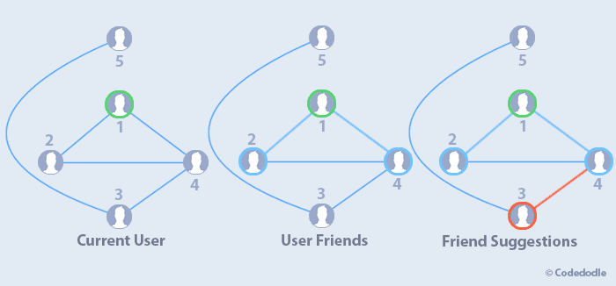
Friend suggestion

Slide 11
Thankyou

