Slide 1


Sales Analysis of Global Electronic Retailer Using SQL
Presented By : Prathmesh M. Patil
Subject : SQL Mastery Module
Date : 02-09-2025

Slide 2
AGENDA
1. Introduction & Objectives
2. Dataset Overview
3. Tools & Methodology
4. SQL Queries & Results
5. Insights & Analysis
6. Conclusion & Recomendation

Slide 3
Introduction : Diving Into Sales Data
•The Global Electronic Retailer dataset includes Sales, Customers, Products, Stores, and Exchange Rates.
• It provides insights into transactions, customer demographics, product details, and store operations.
• SQL queries are used to explore, analyze, and extract meaningful business insights.
Objectives
Apply SQL queries for data-driven decision making.
Analyze sales performance across regions and time.
Study customer demographics and buying behavior.
Evaluate product performance by category and brand.

Slide 4
Dataset Overview : Data Dictionary & Overview
Table Name | Columns / Fields
1.Sales | Order Number, Line Item, Order Date, Delivery Date, CustomerKey, StoreKey, ProductKey, Quantity, Currency Code
2.Customers | CustomerKey, Gender, Name, City, State Code, State, Zip Code, Country, Continent, Birthday
3.Products | ProductKey, Product Name, Brand, Color, Unit Cost USD, Unit Price USD, SubcategoryKey, Subcategory, CategoryKey, Category
5.Stores | StoreKey, Country, State, Square Meters, Open Date
6.ExchangeRates | Date, Currency, Exchange

Slide 5
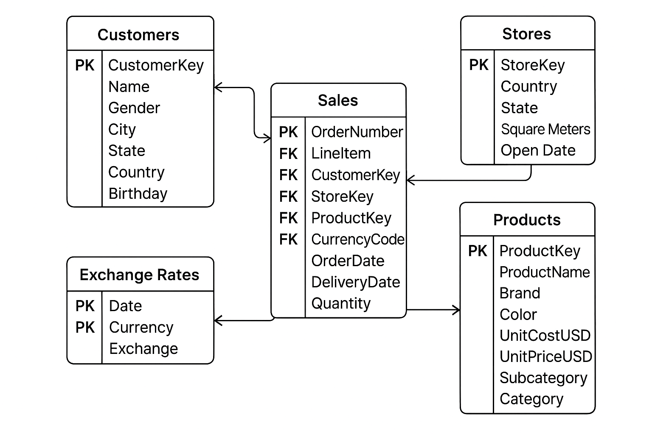
E-R Diagram

Slide 6

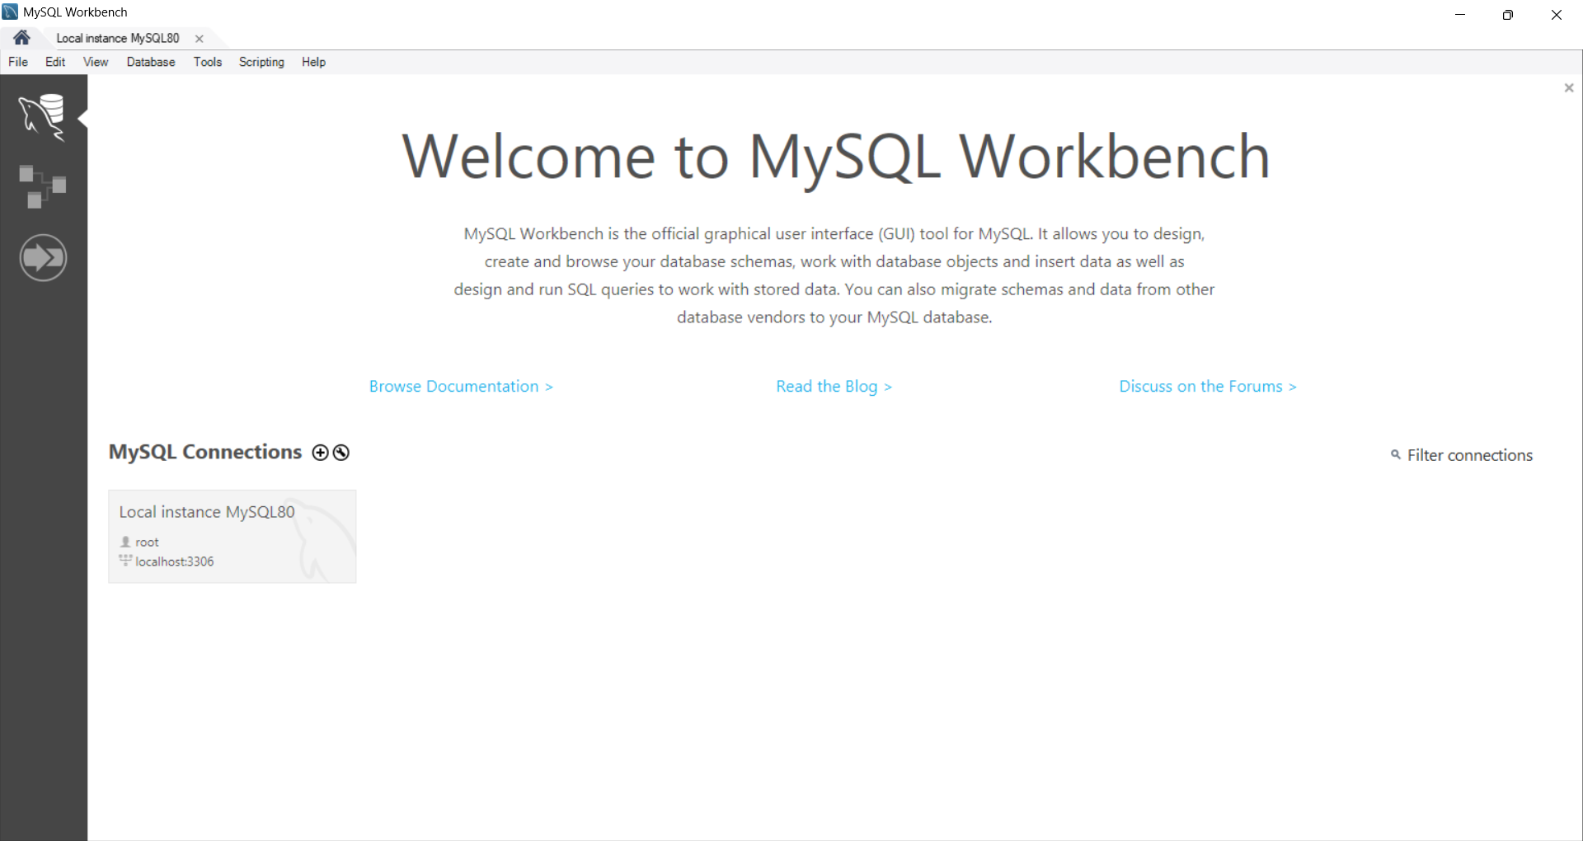
Tools & Methodology
Our analysis relied on standard SQL tools and a hands-on approach to data querying. Ensures transparency and direct interaction with the Raw data.
SQL (MySQL Workbench)
CSV Dataset
Utilized for writing and executing all SQL queries, providing a robust environment for database interaction.
The sales data was provided in a CSV format, which was imported into MySQL for analysis

Slide 7
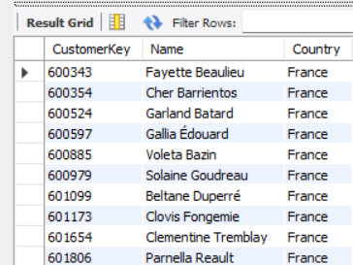
Customers by country
Allows Grouping customers by region for targeted promotions, pricing, and communication.
Query :
Insight :
Useful for regional marketing campaigns or evaluating country-wise demand
SELECT c.CustomerKey, c.Name, c.CountryFROM Customers cWHERE c.Country = 'france';
Result :

Slide 8
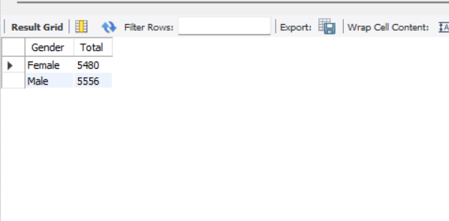
Count how Many Males and Females are in the Table
Helps us know the Gender distribution of Customers
Query :
Insight :
The Dataset has a balanced male-female ratio (≈50:50), Making it suitable for fair and Representative Demographic Analysis
SELECT Count(Gender) AS Total
FROM customers
GROUP BY Gender;
Result :

Slide 9
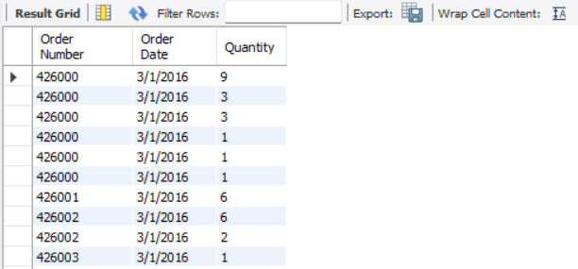
Filter Sales After Certain Date
Useful for comparing Before vs after a campaign, product launch, or policy change
Query :
Insight :
Useful for sales analysis or to focus on Current Trends Instead of old data
SELECT s.`Order Number`, s.`Order Date`, s.QuantityFROM Sales s WHERE
s.`Order Date` >= ‘2016-01-01';
Result :

Slide 10
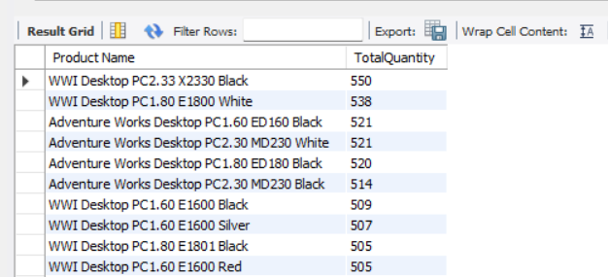
Find Total Sales Quantity by Product
Top-selling products can be promoted more (to boost revenue).
Query :
Insight :
Total sales quantity by product helps identify best-sellers and optimize Business decisions around stock, marketing, and revenue.
SELECT p.`Product Name`,
SUM(s.Quantity)ASTotalQuantityFROM Sales s
JOIN Products p
ON s.ProductKey =p.ProductKey
GROUP BY p.`Product Name`
ORDER BY TotalQuantity DESC;
Result :

Slide 11
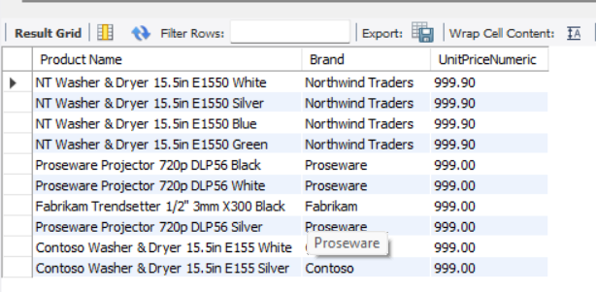
Find High-value Products
Businesses May Promote high-value products to Increase Revenue
Query :
Insight :
SELECT p.`ProductName`, p.Brand, p.`UnitPriceNumeric`FROM
Products p
ORDER BY p.`UnitPriceNumeric` DESC LIMIT 10;
Identifies the Top Premium Products in The Catalog. Helps focus on the products that generate more revenue per sale.
Result :

Slide 12
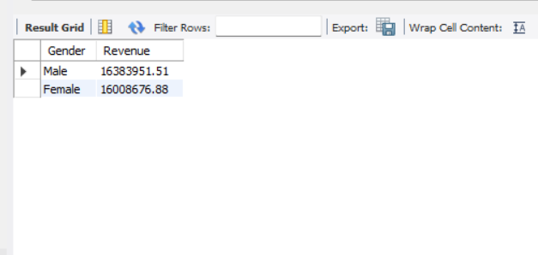
Revenue Contribution By Gender
To Understand how much Revenue each Gender contributes to the Total Sales
Query :
Insight :
The Query Shows the Total Revenue Generated by each gender. From the results, we can see Which Gender contributes the most to overall sales.
SELECT c. Gender,
SUM( s. Quantity * p . UnitPriceNumeric ) AS Revenue
FROM Sales s
JOIN Customers c
ON s . CustomerKey = c .CustomerKey
JOIN Products p
ON s . ProductKey = p . ProductKey
GROUP BY c . Gender
ORDER BY Revenue DESC;
Result :

Slide 13
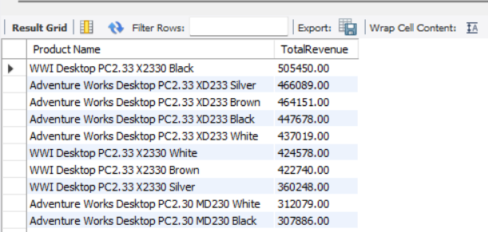
Total Sales Revenue By Product
To Determine How Much Revenue each product Generates. This helps Identify Best-selling and Highest-Revenue Products in our catalog
Query :
Insight :
SELECT p.`Product Name`,
SUM(s.Quantity * p.`unitpricenumeric`) AS TotalRevenue
FROM Sales s JOIN Products p
ON s.ProductKey = p.ProductKey
GROUP BY p.`Product Name`
ORDER BY TotalRevenue DESC;
The Query Identifies Top- and Low-revenue Products, helping focus on best-sellers and plan marketing or inventory strategies.
Result :

Slide 14
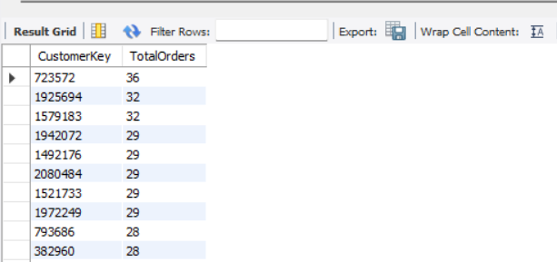
Show Customers Who Have Placed More Than 10 Orders
To Identify Highly active or loyal customers who frequently make Purchases
Query :
Insight :
The Query Highlights Customers with frequent Purchases, Showing which customers drive the most repeat Business. This helps in focusing retention efforts and Personalized offers.
SELECT CustomerKey,
COUNT(`Order Number`) AS TotalOrders
FROM Sales
GROUP BY CustomerKey
HAVING TotalOrders > 10
ORDER BY TotalOrders DESC;
Result :

Slide 15
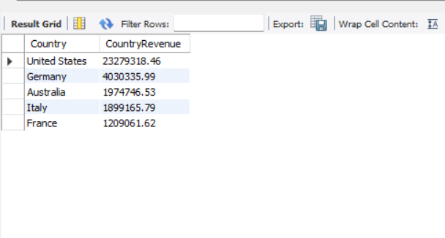
Total Sales by Country
To Analyze how much Revenue each country Generates, helping identify Geographical strengths and weaknesses in sales.
Query :
Insight :
SELECT c.Country,
SUM(s.Quantity * p.`UnitPricenumeric`) AS CountryRevenue
FROM Sales s JOIN Customers c
ON s.CustomerKey = c.CustomerKey
JOIN Products p ON s.ProductKey = p.ProductKey
GROUP BY c.Country
ORDER BY CountryRevenue DESC;
The Query shows which countries Generate the most revenue, helping Identify Top-performing markets and countries with Growth potentia
Result :

Slide 16
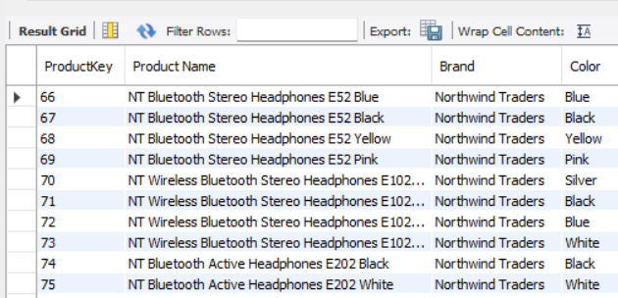
Find All Products with “Phone” in the Name
To identify all products that contain the word ‘Phone’ in their Name
Query :
Insight :
Helps Group or Analyze Product categories (e.g., phones, accessories)
SELECT *FROM Products
WHERE `Product Name` LIKE '%Phone%';
Result :

Slide 17
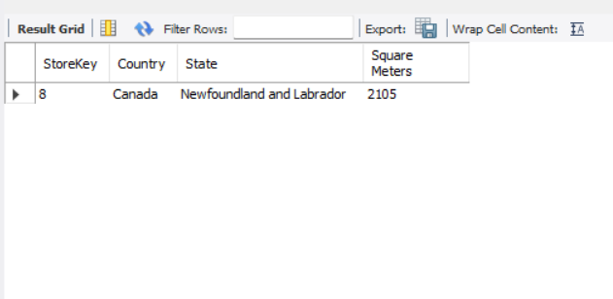
Store With the Largest Square Meter Size
To identify which store(s) have the Largest Physical Space
Query :
Insight :
The query identifies the store(s) with the largest space, highlighting locations with the highest capacity for inventory, product variety, and potential sales
SELECT StoreKey, Country, State, `Square Meters`
FROM Stores
WHERE `Square Meters` = (SELECT MAX(`Square Meters`) FROM Stores);
Result :

Slide 18
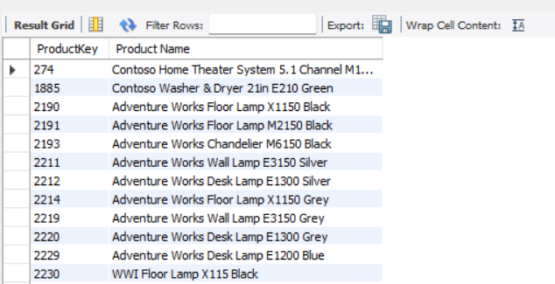
Find Products Never Sold
To identify Products listed in the Catalog that Have Never Been Purchased
Query :
Insight :
This query Identifies Products in the Catalog that have never been sold. These unsold items represent potential issues such as low Demand, poor visibility, or incorrect Pricing.
SELECT ProductKey, `Product Name`
FROM Products
WHERE ProductKey NOT IN
(SELECT DISTINCT ProductKey FROM Sales);
Result :

Slide 19
Conclusion
Customer Insights: France and a few other countries contribute significantly to overall sales, highlighting key markets.
Slight gender imbalance, with males contributing more to revenue, but females represent a sizable segment for targeted marketing.
Frequent buyers, customers with more than 10 orders, showing loyalty patterns.
Product Insights: Best-selling and high-revenue items are clearly identified, prioritizing unsold products to optimize inventory and reduce carrying costs. Explore opportunities for premium products.
Recommendations
Market & Customers: Focus on top countries, loyal buyers Which is helpful for the Sales Performance.
Products & Inventory: Promote best-sellers, reduce unsold stock, and explore premium product opportunities.
Operations: Improve high-volume store efficiency and minimize delivery delays.

Slide 20


