Slide 1

Name : Prathmesh Wake
Topic : Exploratory Data Analysis of Employee Dataset Using Python
Session: MBA Semester – III (2025 -26)
College Name: Wainganga College of Engg & Mgmt.

Slide 2
Introduction
HR departments rely on employee data to make key decisions regarding hiring, retention, promotions, compensation, and training.
Organizations collect and store large volumes of employee-related information.
Exploratory Data Analysis (EDA) is a crucial early step in analyzing this data.
EDA uses visual tools to summarize datasets, detect patterns, and identify anomalies—without making initial assumptions.
It helps uncover insights that support better workforce planning and strategy.
About the Project
This project focuses on analyzing a company's employee dataset using EDA techniques. Dataset Includes:
Employee Names, Gender, Department Type
Job Role, Salary, Work-Life Balance Score
Employee Ratings, Etc.

Slide 3
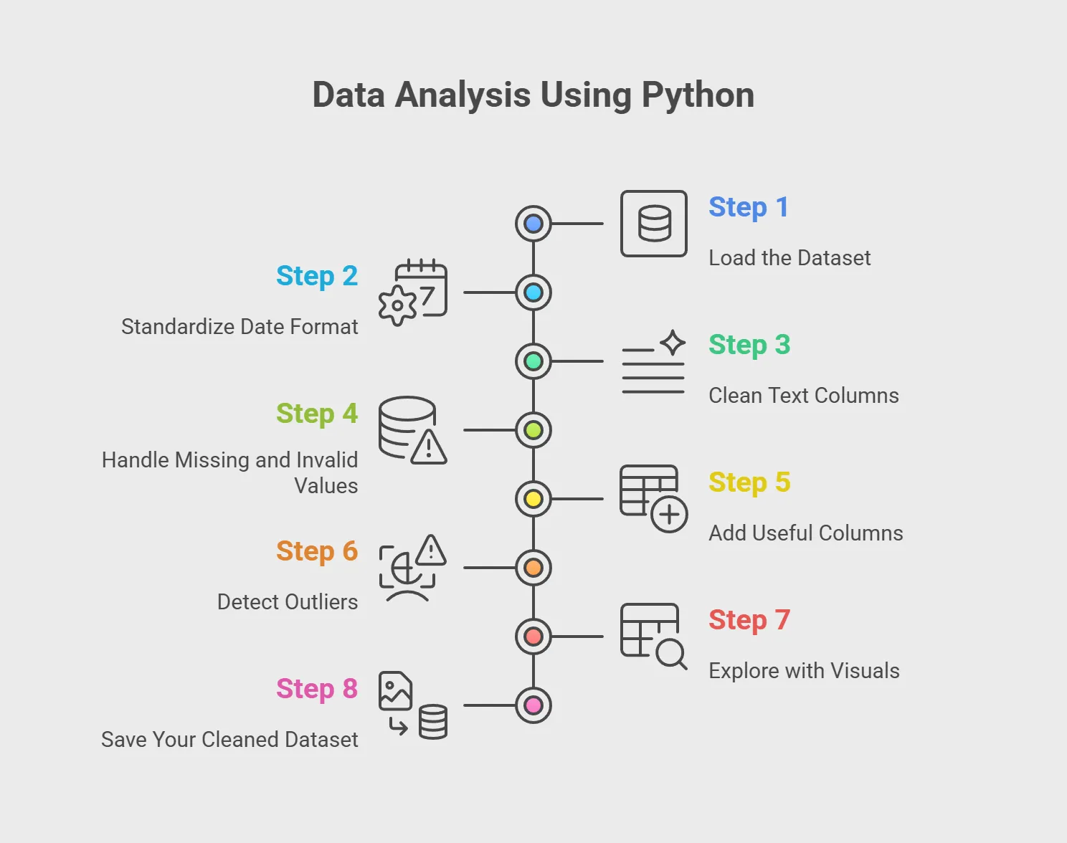

Slide 4
Why EDA is Important
EDA plays a vital role in HR analytics by helping to:
Helps HR identify trends in hiring, retention, and compensation.
Detects gender pay gaps or departmental imbalances.
Improves resource allocation by understanding department size and costs.
Aids in decision-making and predictive modelling.
Identify patterns in employee demographics, such as gender ratios distribution
Visualize salary structures to detect any inequalities or imbalances
Evaluate department-wise performance and resource allocation
Understand employee satisfaction and salaries.
Detect outliers or inconsistencies in employee data (e.g., duplicate entries, missing values, or unexpected salary values)
By applying EDA, companies can make informed decisions related to hiring, workforce planning, promotions, and employee retention.

Slide 5
Dataset Overview
The dataset is imported from an Excel file named Employee_data.xlsx. EDA includes both univariate & bivariate (two-variable) analysis using various visualizations like:
Personal attributes: gender, etc.
Job-related details: department, job role, salary
Performance metrics: Performance Score number, current rating
Cost-related fields: Salaries
Contact fields (e.g., email)
Bar plots
Count plots
Grouped bar charts
Gender-based comparison plots
Department and job role mappings

Slide 6
Tools and Technologies Used
The analysis is carried out using Python, a versatile and powerful programming language widely used in data science. The key libraries used are:
NumPy: For numerical computations and array manipulations
Pandas: For data loading, wrangling, and tabular operations
Matplotlib and Seaborn: For data visualization and plotting charts
Jupyter Notebook: As the development environment for interactive analysis
These tools collectively make it easier to read, preprocess, visualize, and interpret large datasets efficiently.

Slide 7
Outcome of the Project
By the end of this project, we will have aim to:
Performed comprehensive cleaning and preprocessing of employee data
Understand overall employee distribution.
Created visualizations to highlight trends in salary, department strength and gender ratios
Compare salary and performance metrics across demographics.
Visualize departmental structures.
Identify any unusual patterns or inconsistencies.
Compared employee satisfaction and performance metrics across different roles and departments
Identified areas where companies can improve resource allocation or address workforce imbalances
This project serves as a foundation for HR analytics, helping organizations make data-informed decisions that enhance productivity and employee well-being.

Slide 8
Data Collection & Research Methodology
The methodology uses Exploratory Data Analysis (EDA) to:
Understand historical HR data
Identify employee patterns & trend
Focused variables:.
Salary, Job Role, Department, Ratings, Engagement
Python-based tools were used to clean, process, and visualize data
Research Design
Research Type: Quantitative + Descriptive
Purpose: To summarize trends using visual & statistical too
Steps Followed:
Problem Identification
Data Collection (Excel dataset, 3000 rows)
Data Cleaning & Preprocessing
Data Exploration & Visualization
Interpretation of Result

Slide 9
Data Source and Description
File Used: Employee_data.xlsx.
Git Hub link - https://github.com/prathmeshwake/Data-Analysis
Total Records: 3000
Number of Variables: 30+
Sample Fields:
Column | Description
Employee ID | Unique employee identifier
Job Role | Employee's position or title
Gender, Marital Status | Demographic data
Salary, Pay Zone | Compensation-related data
Department Type | HR, IT, Finance, etc.
Engagement Score | Satisfaction level
Performance Score | Numeric & text-based evaluations

Slide 10
Data Cleaning & Preprocessing
Steps Taken:
Removed irrelevant fields (e.g., Bank Account)
Checked and dropped null values (First Name, Email, etc.)
Renamed columns (e.g., Email → org Email)
Converted data types (e.g., Salary: float → int)
Exported cleaned dataset using to_excel()
Analytical Methods Applied
Analysis Type | Description
Univariate | Distribution of one variable (e.g., Salary)
Bivariate | Compare two variables (e.g., Salary vs Gender)
Group Aggregation | Group by Gender, Job Role, etc.
Visualization | Bar plots, Count plots, Histograms
Performance Review | Compare ratings by department
Demographic Review | Gender & location-based segmentation

Slide 11
Research Objectives Addressed
Gender distribution across roles & departments
Fairness in performance evaluation
Salary comparison across gender & roles
Key business roles vs compensation
Gender presence in each department
Work-life balance by department
Recommendations for HR improvement
Justification of Methodology
Based on real employee data (Excel format)
EDA is ideal for pattern discovery
Python ensures scalability & flexibility
Visuals simplify complex HR patterns
No prior hypothesis required – suited for exploration

Slide 12
Limitations of Methodology
Dataset may not be real-time
Incomplete or inaccurate data can affect insights
No ML or predictive models used
Interpretation of visuals can be subjective
Summary
Used a structured and scalable EDA methodology
Cleaned, transformed, and analyzed real employee data
Extracted insights on performance, pay, demographics
Helped uncover trends to support data-driven HR decisions

Slide 13
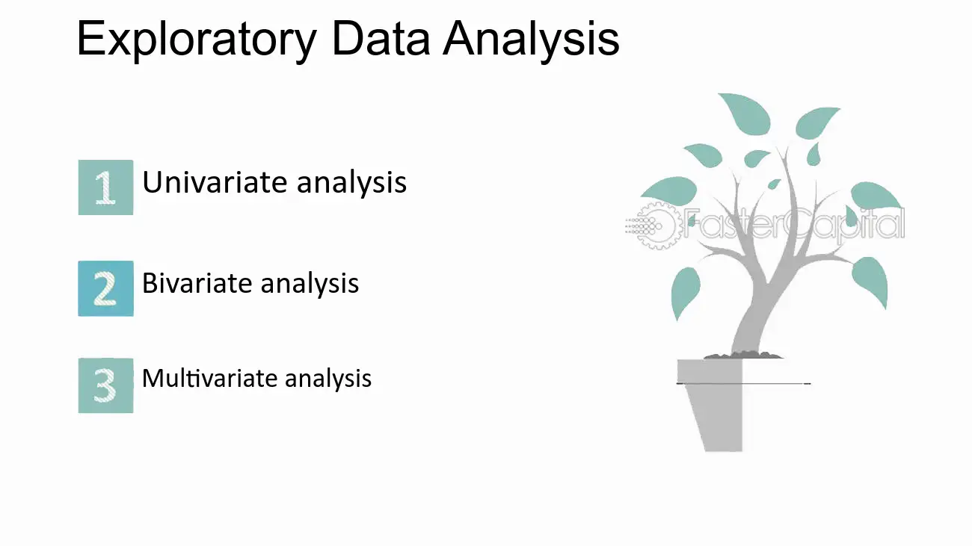
Introduction to EDA
EDA is crucial in any data-driven project.
Helps in pattern discovery, anomaly detection, hypothesis testing, and assumption validation.
HR analytics uses EDA for better workforce decisions.
Dataset: 3,000 employee records with features like salary, department, rating, gender, etc.
Tools: Python, Pandas, Matplotlib, Seaborn

Slide 14
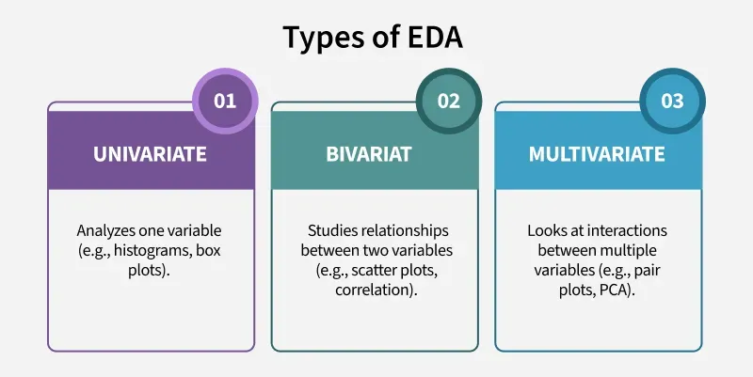

Slide 15
Findings and Insights Based on EDA of Employee Dataset
Key findings derived from EDA on 3,000 employee records
Covered variables: demographics, job roles, salaries, engagement, ratings, departments
Aims to support HR in:
• Workforce optimization
• Talent retention
• Diversity strategy
• Performance improvement

Slide 16
Summary of Key Findings
Gender Distribution
Disproportionate gender representation observed
May stem from industry norms, hiring patterns, or role-specific demands
Diverse teams enhance innovation and collaboration
Insights:
Assess current gender diversity efforts
Promote inclusive hiring and leadership development
Track diversity KPIs in recruitment and promotions
Strategic Recommendations
Establish department-specific gender diversity targets during recruitment.
Rewrite job descriptions to eliminate gender bias and promote inclusivity.
Introduce metrics to track gender diversity in hiring, promotions, and leadership roles.
Launch women's mentorship programs and internal ERGs (Employee Resource Groups).
Implement blind resume screening and structured interviews to reduce unconscious bias.

Slide 17
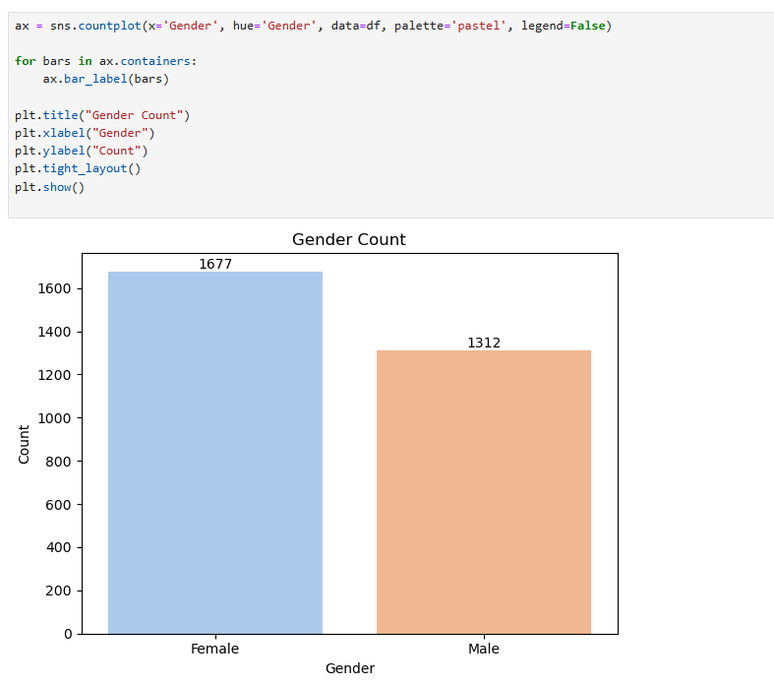

Slide 18
Current Employee Rating Distribution
Over 50% of employees rated as ‘3’ — average performance
Ratings of ‘4’ and ‘5’ are underrepresented
Very few underperformers (ratings 1 & 2)
Insights:
Indicates performance plateau
High-performer recognition may be lacking
Underreporting of poor performance may exist
Need for clearer, more differentiated performance appraisal system
Strategic Recommendations
Shift from a static 5-point scale to competency-based evaluation.
Incorporate peer and subordinate input to reduce rater bias.
Conduct calibration sessions to ensure fair and consistent rating across teams.
Link ratings with career development, bonuses, and learning opportunities.
Create Individual Development Plans (IDPs) to challenge mid-level performers..

Slide 19
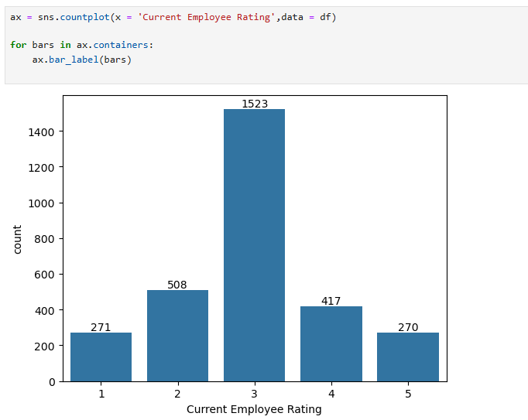

Slide 20
Salary vs Gender
Female employees account for higher total salary (₹953,148 vs ₹715,572)
Likely due to higher numbers or seniority levels among women
Insights:
Understand salary distribution across demographics
Audit promotion and pay equity
Promote gender-inclusive leadership development
Strategic Recommendations
Identify salary disparities across levels, roles, and departments.
Publish pay brackets to reduce speculation and promote fairness.
Analyse internal mobility and ensure women are equally represented in higher-paying roles.
Provide training and sponsorship to prepare women for senior positions.
Shift from tenure-based to contribution-based compensation structures.

Slide 21
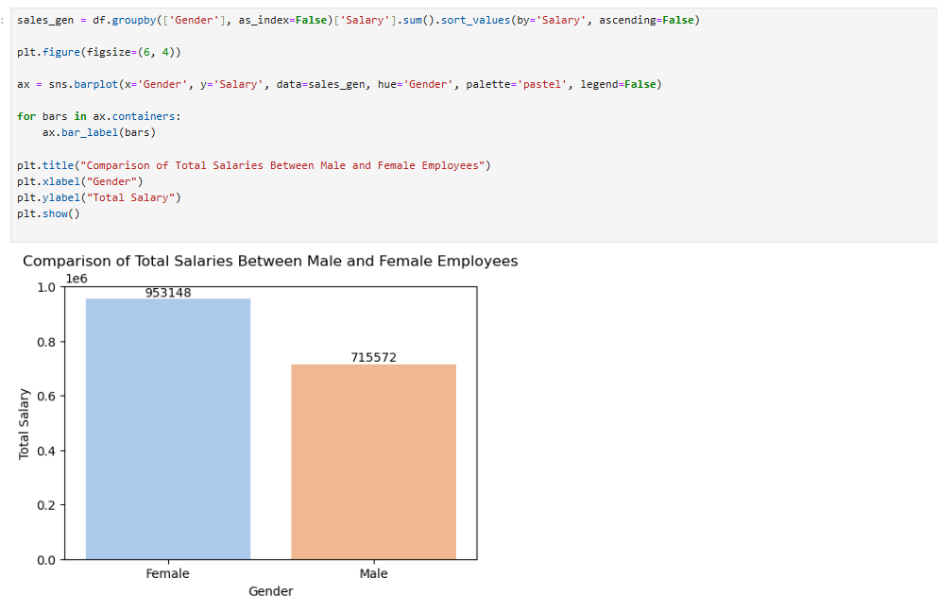

Slide 22
Top 10 Job Roles vs Salary
IT Manager – Infra leads with highest average salary (₹707K)
Leadership, analytics, and sales roles dominate salary rankings
Narrow ₹108K range among top 10 shows pay parity
Insights:
Retain top talent with role-specific incentives
Align compensation with performance and market trends
Avoid pay compression at the top
Strategic Recommendations
Offer customized incentives like flexible benefits, learning budgets, or stock options.
Identify future leaders in key roles and invest in cross-training.
Regularly review compensation against industry standards.
Create additional performance incentives for roles tied directly to business revenue or innovation.
Enable employees in lower-paid roles to transition into high-value ones via training.

Slide 23
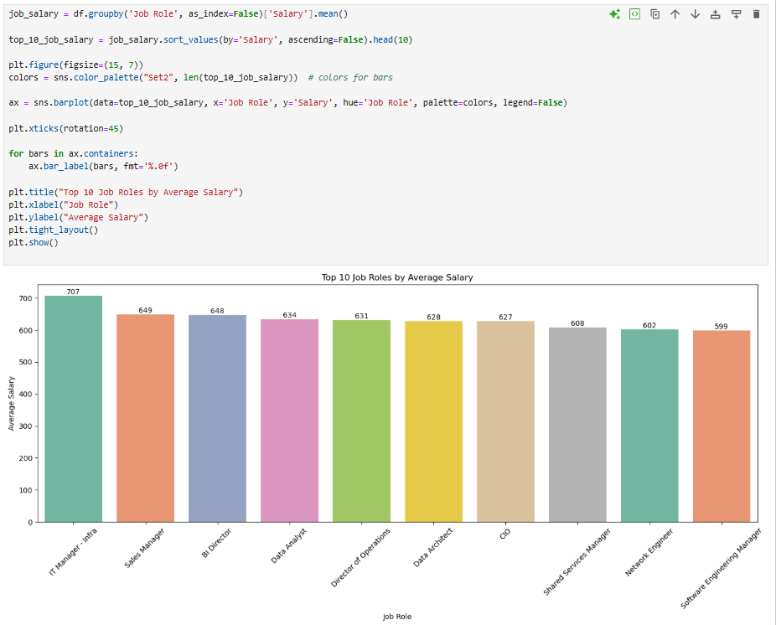

Slide 24
Salary by Job Role and Gender
Salary discrepancies exist across genders in certain roles
Roles like BI Director & CIO favor females; IT Manager – Infra favors males
Some roles show balanced gender pay (e.g., Data Analyst, Sales Manager)
Insights:
Promote pay equity in male-dominated leadership roles
Targeted upskilling & advancement programs for women
Use gender-balanced roles as internal benchmarks
Build female talent pipelines in IT & engineering
Strategic Recommendations
Audit salaries at the role level, not just by gender or department
Create pathways like internships, scholarships, or lateral movements into tech.
Establish clear performance-based promotion frameworks to eliminate bias.
Proactively identify high-potential women for leadership and tech pipelines.
Build real-time tracking of salary trends across gender and departments.

Slide 25
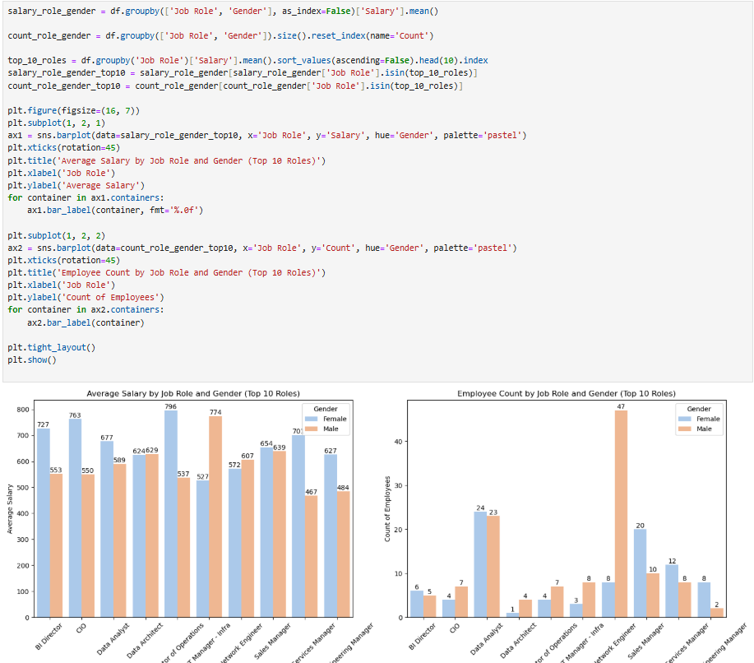

Slide 27
Top 10 Job Roles by Department
Production Technician I & II dominate the workforce
Sales is second-most prevalent based on Area Sales Manager count
Specialist tech roles are fewer but critical
Insights:
Invest in automation and upskilling for production-heavy teams
Reduce over-reliance on production/sales; expand digital capabilities
Develop talent pipelines for critical but scarce roles
Plan for redundancy and cross-functional training in high-volume roles
Strategic Recommendations
Reduce dependency on manpower-heavy production through technology.
Reskill production staff for roles in quality, data, and process optimization
Partner with universities and upskilling platforms to build supply in BI, IT, and analytics.
Analyze headcount vs. value contribution to align resource allocation.
Offer career tracks for employees to move between departments (e.g., production → tech).

Slide 28
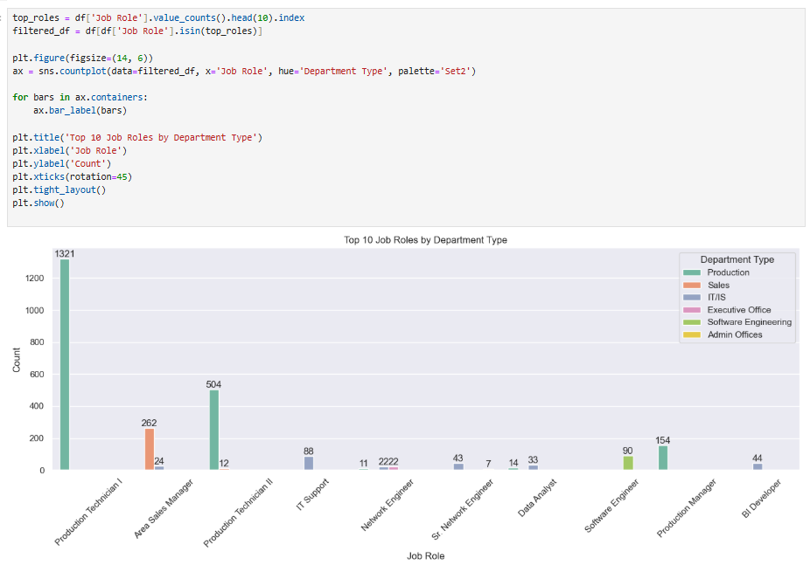

Slide 29
Gender Comparison by Job Role
Male-dominated roles: Production, Engineering, Network
Balanced roles: Data Analyst, Shared Services Manager
Technical/leadership roles lack female representation
Insights:
Run gender-focused recruitment and mentorship programs
Use balanced roles as inclusion success stories
Track equity KPIs at the job-role level
Promote flexibility and unbiased hiring in tech functions
Strategic Recommendations
Monitor diversity not just by department but by individual job roles.
Highlight successful women in male-dominated roles through internal campaigns.
Use targeted outreach, job fairs, and return ship programs for women.
Train teams on inclusive behaviour, especially in tech, field, or operational roles.
Rework job structures (e.g., split shifts, WFH options) to attract diverse candidates.

Slide 30
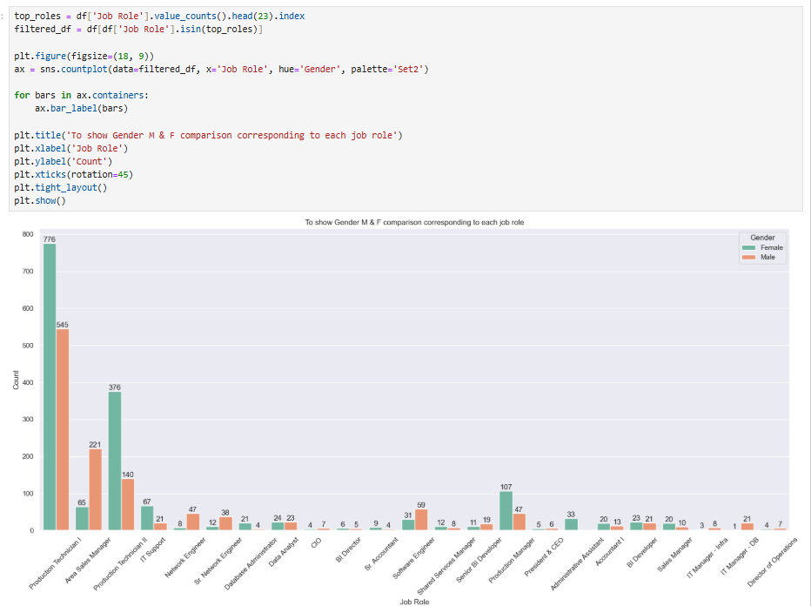

Slide 31
Work-Life Balance by Department
Highest WLB: Executive Office (3.29)
Lowest WLB: Production, IT/IS (< 3.0)
Other departments: Moderate (3.0–3.2) Insights:
Improve WLB in low-scoring departments via flexibility, workload management
Executive team flexibility should be extended across levels
Conduct department-specific WLB audits
Launch targeted wellness and balance programs
Strategic Recommendations
Offer flexible shifts or hybrid models tailored to departmental needs.
Provide mental health resources, counselling, and recharge days.
Optimize processes and workloads in departments with poor WLB.
Appoint individuals to monitor and promote balance at the ground level.
Encourage leadership to visibly practice and promote work-life balance.

Slide 32
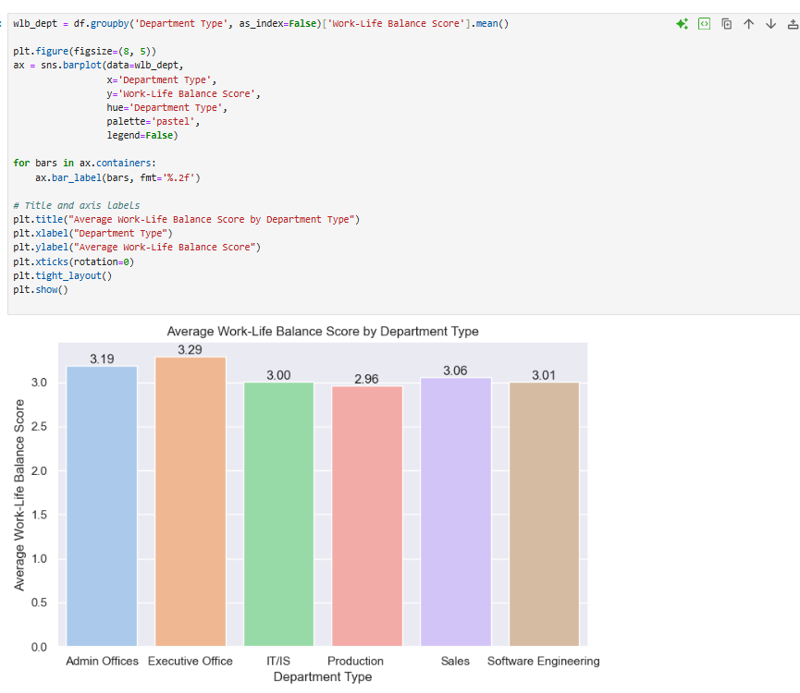

Slide 33
Visual Recap of Findings
EDA Visual Tools Used:
Bar plots: Job roles, departments
Box plots: Engagement and satisfaction
Count plots: Gender, roles, WLB Purpose:
Translating raw data into actionable insights
Enhancing clarity and decision-making via visual exploration
Conclusion
Findings reflect key patterns in demographics, compensation, engagement, and performance
Actionable insights for HR strategy and workforce development
Supports talent retention, diversity, and organizational effectiveness
Sets the stage for policy improvements and strategic planning

Slide 34
Conclusion
Subtitle: Summary of Analysis and Strategic Recommendations
Based on analysis of 3,000 employee records.
Key findings on salary, gender diversity, performance, and job roles.
Focus on data-driven HR improvements.
Exploratory analysis uncovered patterns in demographics, salary, engagement, and performance
This chapter offers actionable insights to boost:
Organizational effectiveness
Employee satisfaction
Equity in compensation and promotions

Slide 35
Strategic Recommendations
Technological Recommendations
Invest in a Real-Time HR Dashboard that visualizes key metrics like satisfaction, salary, and performance.
Use machine learning models to predict attrition and identify high-potential employees.
Adopt cloud-based HR analytics platforms to manage and analyse employee data efficiently
Future Enhancements
Conduct predictive modelling for attrition, promotion likelihood, and engagement scores.
Integrate external benchmarking data for more accurate salary and performance comparisons.
Regularly update and maintain employee datasets to ensure data accuracy for analysis.
Summary
The above recommendations are designed to support the organization’s goal of building a data-informed, equitable, and high-performing workforce. By embracing data analytics in HR decision-making, the organization can move from reactive to proactive talent management resulting in better retention, engagement, and productivity across all levels.

Slide 36
Thank You
Appreciation
Engagement
Feedback
Thank you for your attention.
We value your participation.
Your thoughts are important to us.

