Slide 1
CS335 Project Presentation
By - Pratham Jain (200712),
Gopal Aggarwal (200390),
Het Patel (200440)
Instructor : Swarnendu Biswas
TA : Siddhartha
JAVA compiler :
Input : JAVA code (.java file)
Output : x86_64 code (.s file)

Slide 2
Basic Features Implemented
Primitive data types (e.g. int, long, float, double and boolean)
Multidimensional Arrays
Basic Operators - – Arithmetic operators: +, -, *, /, %, ++, - - – Preincrement, predecrement, postincrement, and postdecrement
– Relational operators: ==,!=, >, <, >=, <= – Bitwise operators: &, |, ˆ, ̃, <<, >>, >>> – Logical operators: &&, ||, ! – Assignment operators: =, +=, -=, *=, /=, &=
– Ternary Operator
Control Flow via if-else, for and while
Methods and method calls, including both static and non-static methods
Support for recursion
Supported the library function println() and print for expressions (except strings)
Support for classes and objects (objects not implemented in milestone 4). For class definitions, supported public and private access modifiers, ignore default and protected.

Slide 3
Basic features that we could not support and reasons for it
Objects (Not only in Milestone 4)
Because we thinked of the implementation of objects in milestone 4 by use of heap memory by assigning heap memory to each object created and access heap memory at the time of object access. But we wasn’t able to implement it within deadline time.

Slide 4
Additional Features
Milestone 1
Except generics and annotations , we implemented everything in our grammar which is in actual JAVA language
Some examples are := 1) do-while and switch constructs 2) multidimensional arrays having dimensions > 3 (JAVA style declarations also included) 3) Support for Strings, including a few operations like concatenation, support for printing 4) Support for Interfaces 5) Type casting 6) Static polymorphism and dynamic polymorphism via method overloading 7) import statements like import java.util.* 8) multiple and nested classes 9) constructor 9) for-each loop for (String fruit : list) {} 10) enum 11) try-catch etc…

Slide 5
Additional Features
Milestone 2 and Milestone 3
-> JAVA style array declarations (like int [][] a)
-> multidimensional array having dimension > 3
-> do-while loop construct
-> type casting
-> support for interface
-> multiple and nested classes

Slide 6
Additional Features
Milestone 4
-> JAVA style array declarations (like int [][] a)
-> multidimensional array having dimension > 3
-> do-while loop construct
-> type casting
-> multiple and nested classes

Slide 7
Command Line and Test Cases
Use the following commands to run the code : -
To run a particular test case
-> change directory to milestone4/src
-> make clean
-> make Java
-> ./run.sh <InputFilePath>
-> ./a.out
To run all test cases in tests folder
-> change directory to milestone4/
->python automate.py
-> ./exec2 (for running executable for tests/test_2.java
The link to the GitHub Repository - https://github.com/praths0909/cs335/tree/master
The Repository contains a folder tests which contains all the test cases.

Slide 8
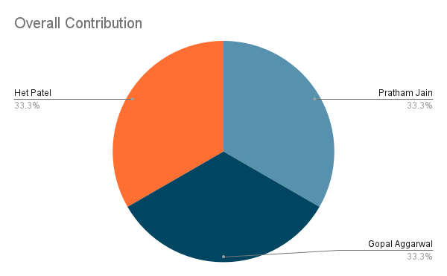
Overall Effort Sheet

Slide 9
Thank you !!

