Slide 1


SMART INDIA HACKATHON 2026
TITLE PAGE
Problem Statement ID – SIH26217
Problem Statement Title- Student Innovation – Renewable/Sustainable Energy
Theme- Renewable / Sustainable Energy
PS Category- Hardware
Team ID- 11
Team Name- Power IQ

Slide 2
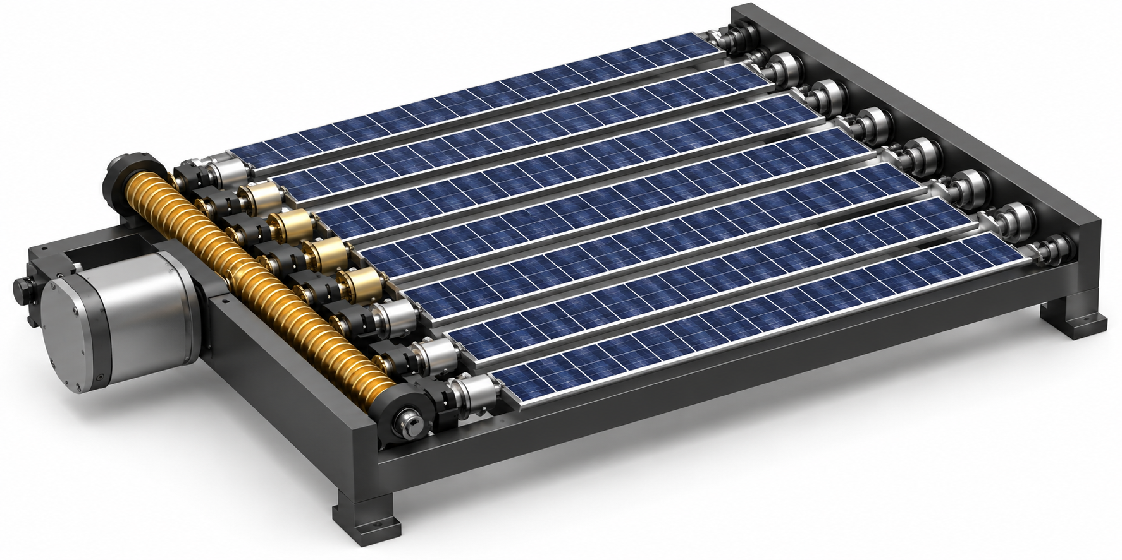
Design and Development of a Multi-Shaft Solar Cell Tracking System
POWER IQ
Proposed Solution
Stationary frame with rotating PV cell rows.
Single motor synchronizes multiple shafts using a worm-drive.
Automatic tracking keeps cells aligned with sunlight.
How It Addresses the Problem
Less moving mass than whole-panel tracking.
Better daily solar energy harvesting.
Innovation & Uniqueness
“Rotate the Cells, Not the Panel.”
Single-drive multi-shaft synchronized tracking architecture.
Designed for compact, energy-efficient and scalable solar tracking.

Slide 3
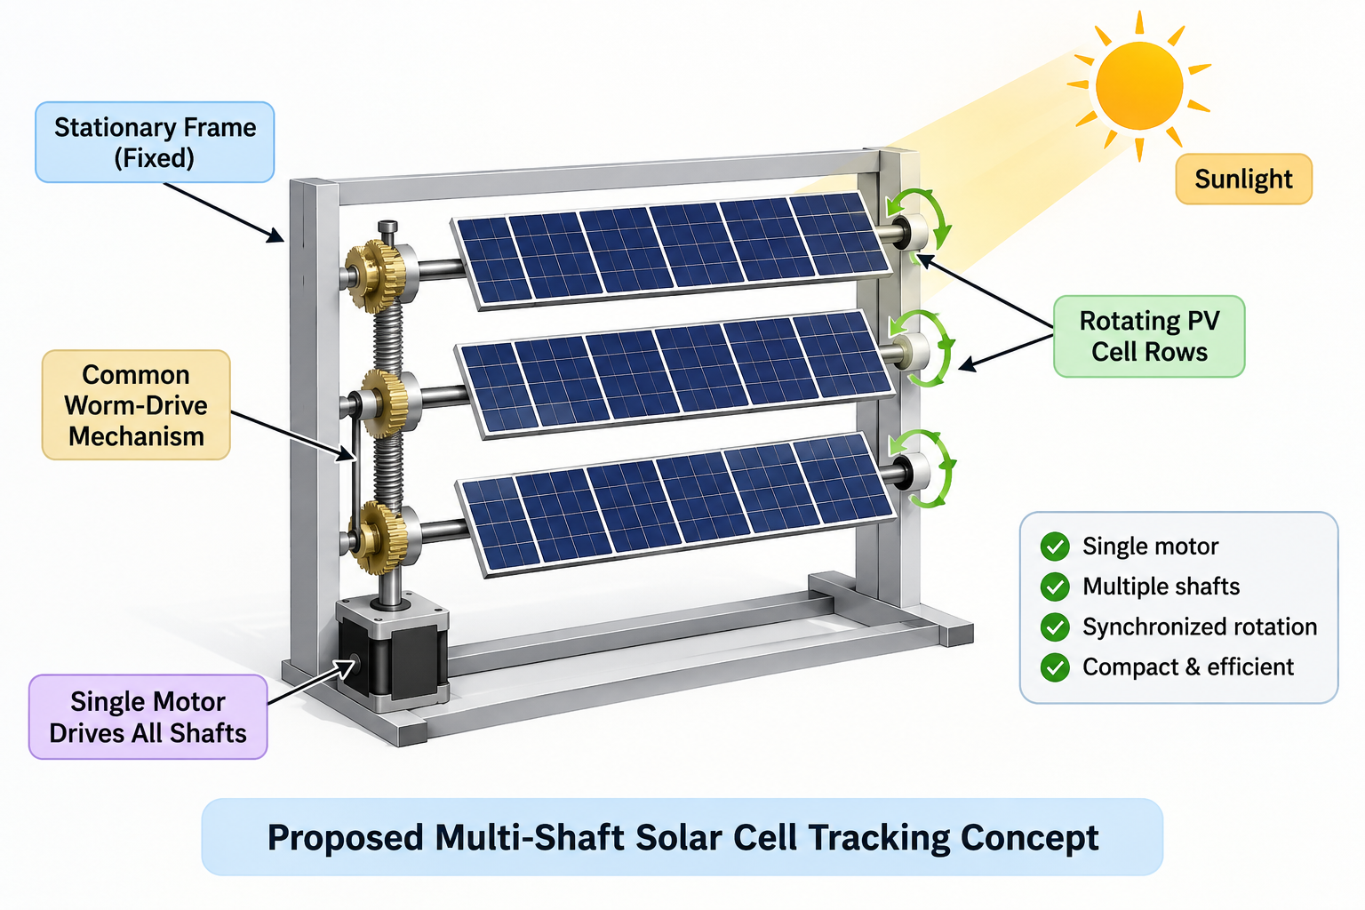
TECHNICAL APPROACH
POWER IQ
Hardware
Solar Cells + Multi-Shaft Worm Gear Mechanism
NEMA17 Stepper Motor + Stepper Driver
STM32 Microcontroller
LDR Sun-Tracking Sensors
Voltage & Current Sensors
Software & Intelligence
Embedded C/C++
IoT Cloud Monitoring
AI-Based Energy Prediction & Fault Detection
Methodology / Working Flow
Sunlight → LDR Sensors → STM32 → Stepper Motor → Worm Drive → Multi-Shaft Rotation
Voltage/Current Sensors → IoT Cloud → AI Analysis

Slide 4
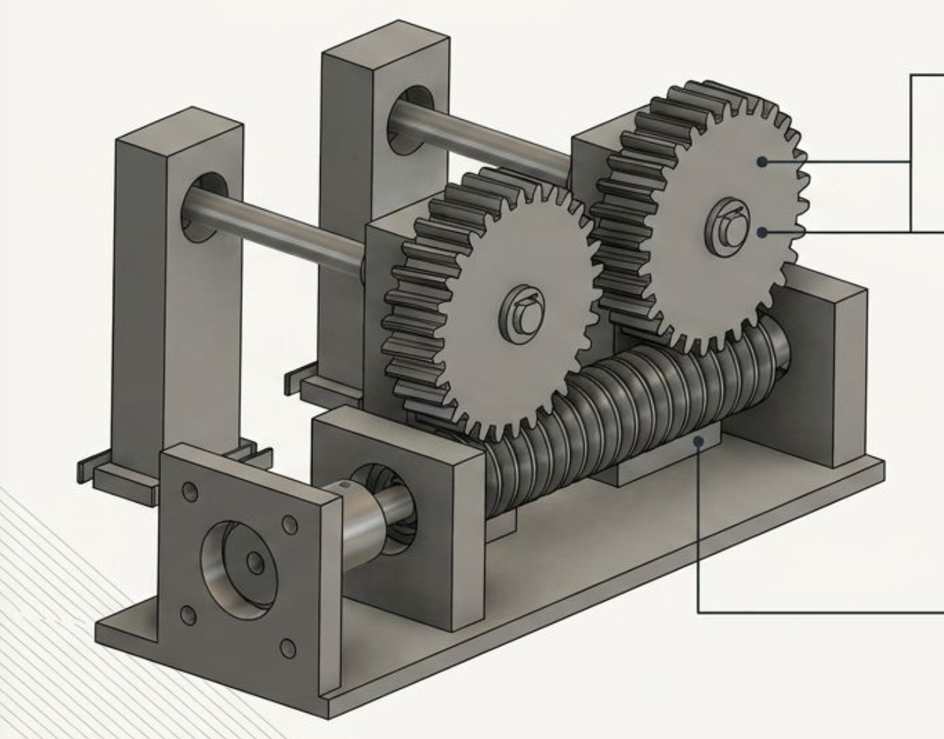
FEASIBILITY AND VIABILITY
POWER IQ
Feasibility
Single motor operates multiple solar-cell shafts.
Uses standard, low-cost and easily available components.
Initial multi-shaft mechanical mechanism successfully tested.
Modular design allows easy scaling and maintenance.
Challenges & Risks
Gear backlash and shaft synchronization errors.
Mechanical alignment and increased load with multiple shafts.
Motor power consumption may reduce net energy gain.
Outdoor dust, heat and weather may affect reliability.
Flexible wiring and proper cable routing to prevent wire damage
Strategies to Overcome
Precision gear alignment with bearing-supported shafts.
Step-by-step load and synchronization testing.
Intermittent tracking to minimize motor energy consumption.
IoT monitoring for performance and fault detection

Slide 5
IMPACT AND BENEFITS
POWER IQ
Potential Impact
More daily energy from the same solar cells.
Useful for On-Grid, Off-Grid, Hybrid and EV Charging systems.
Better solar power generation in limited installation space.
Future use for high-power loads such as AI & Data Centers.
Economic & Practical Benefits
Higher energy output can reduce the solar capacity needed for the same daily energy demand.
Single motor tracks multiple PV cell rows, reducing the moving mechanism.
Tracking mechanism can be built inside the solar module, making installation simple.
Ready-made tracking panels can be installed by regular solar technicians, without complex tracking structures.
Environmental & Smart Benefits
More solar energy means less dependence on conventional grid power.
IoT: Live Voltage, Current, Power & Energy monitoring.
AI: Generation prediction, fault detection & maintenance support.
• More Solar Energy • Less Space • Simple Installation • Smart Monitoring

Slide 6
RESEARCH AND REFERENCES
POWER IQ
1. Solar Tracking Technologies – Review of mechanisms, challenges and future directions
IEEE, 2024 | Document: 10845331
2. Automated Dual-Axis Solar Tracking System Using Fuzzy Logic Control
IEEE, 2023 | Document: 10373468
3. IoT / Automated Solar Tracking Research
IEEE Xplore | Document: 10690428
4. Solar Tracking & PV Performance Research
IEEE Xplore | Document: 9850454
Reference Links:
ieeexplore.ieee.org/document/10845331
ieeexplore.ieee.org/document/10690428
ieeexplore.ieee.org/document/10373468
ieeexplore.ieee.org/document/9850454

