Slide 1

ARTIFICIAL INTELLIGENCE AND MACHINE LEARNING INTERNSHIP
-------- MILEAGE PREDICTION BY REGRESSION ANALYSIS --------
K PRATHVI RAO (4MW20CS032)

Slide 2
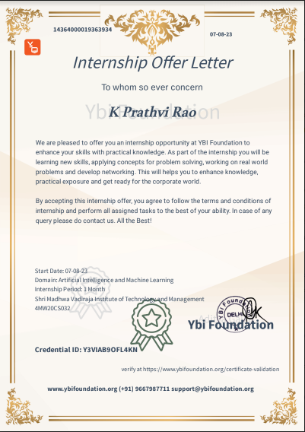
OFFER LETTER

Slide 3
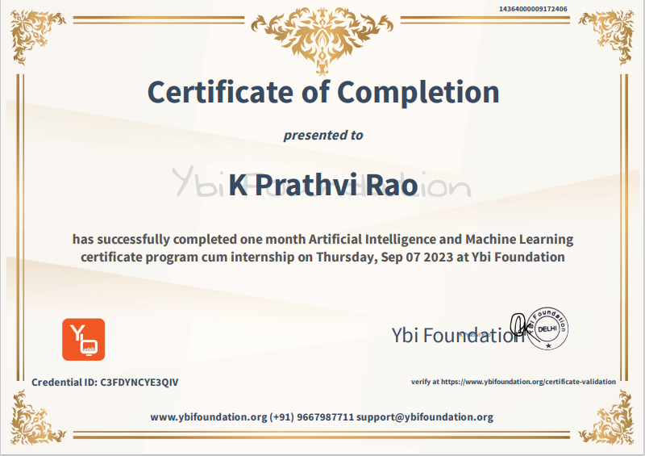
CERTIFICATE

Slide 4
CONTENTS
INTRODUCTION
INDUSTRY INFORMATION
TASKS PERFORMED
RESULTS
CONCLUSION

Slide 5
INTRODUCTION
The internship at YBI Foundation was centered around the exploration and application of Artificial Intelligence (AI) and Machine Learning (ML) in solving real-world problems. The dataset used in the project was originally part of the 1983 American Statistical Association Exposition. Linear Regression was used for the Prediction. The result interpretation helped to understand the impact of different features.

Slide 6
OBJECTIVES
Gaining practical experience in AI and ML
Developing and deploying AI and ML solutions
Contributing to the advancement of AI and ML

Slide 7
INDUSTRY INFORMATION
COMPANY NAME: YBI FOUNDATION EXTERNAL GUIDE: Dr. ALOK YADAV
YBI Foundation, based in Delhi, helps young people learn about new technologies. They have free and paid programs like online courses and internships. Their aim is to connect what students learn with what companies need, so they offer hands-on learning.
Dr. Alok Yadav is the Director of YBI foundation. As a dedicated educator and researcher, Dr. Yadav plays a pivotal role in mentoring students and guiding projects in the field of computer science.

Slide 8


TASKS PERFORMED W-1
Day 1: Introduction to Artificial Intelligence and Machine Learning.
Day 2: AI and Data Skills and it’s importance.
Day 3: Introduction to python and analytics.
Day 4: Introduction to Python IDEs.
Day 5: Introduction to Google Colab.
Day 6: Reading the datasets.

Slide 9
TASKS PERFORMED W-2
Day 1: Introduction to Numpy.
Day 2: Introduction to Pandas.
Day 3: Introduction to Sklearn & Matplotlib.
Day 4: Table creation in Google Colab.
Day 5: Data Analysis Steps.
Day 6: Data Analytics Types or Techniques.

Slide 10
TASKS PERFORMED W-3
Day 1: Zen of Python philosophy
Day 2: Creation of First Notebook and other basics.
Day 3: Program to convert files with different datatypes into Dataframe.
Day 4: Using the main 3 functions (head,info,describe) after importing.
Day 5: Demo of basic steps for writing programs in Colab.
Day 6: Program- Train Test Split.

Slide 11
TASKS PERFORMED W-4
Day 1: Scikit and Keras – Build the Predictive Models
Final Project Allotted - Mileage Prediction - To develop an AI/ML project using NumPy, pandas, Matplotlib, and Seaborn to predict vehicle mileage (MPG) through regression analysis.
Day 3: Submission of Final Project work : Mileage Prediction
Day 4: Evaluation by the External Guide
Day 5: Final MCQ Quiz and Feedback.
Day 6: Certificate of Completion.

Slide 12
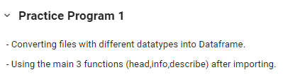

RESULTS

Slide 13
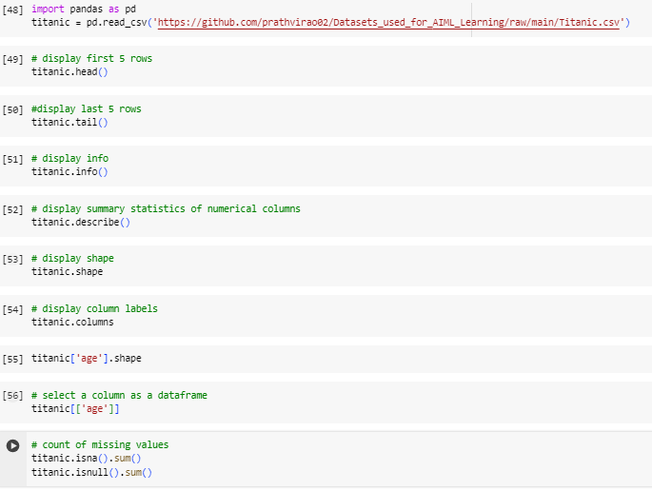
RESULTS

Slide 14
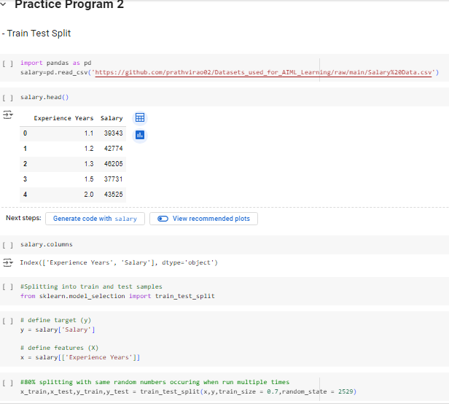
RESULTS

Slide 15

RESULTS
Dataset Collection.
Importing Libraries and Data.
Data Preprocessing.
Removing Missing Values.
Data Visualization.
Defining Target variables.
Model Evaluation.

Slide 16
RESULTS
DATA COLLECTION:
MPG Dataset – Kaggle Dataset.
Originally taken from the StatLib library.
Maintained at Carnegie Mellon University.
The dataset was used in the 1983 American Statistical Association Exposition.
Data was split into a testing set and training test, where 70 percent of data was put in the training test and the
remaining 30 percent was put in the testing set.

Slide 17
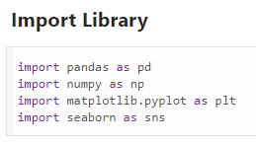
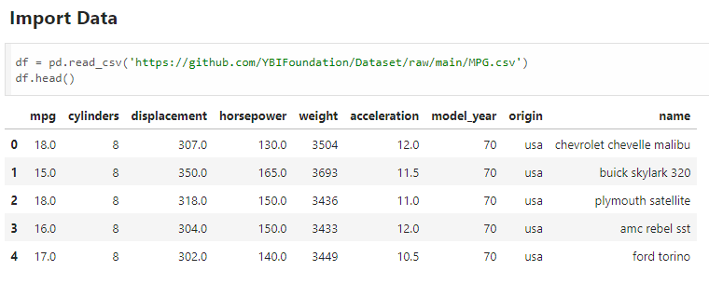
RESULTS

Slide 18
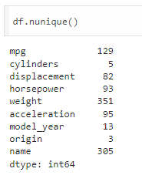
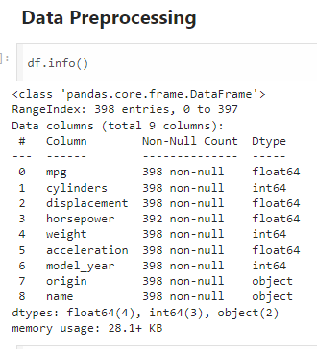
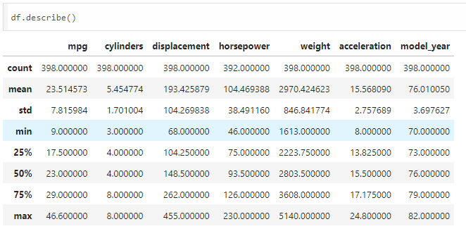
RESULTS

Slide 19
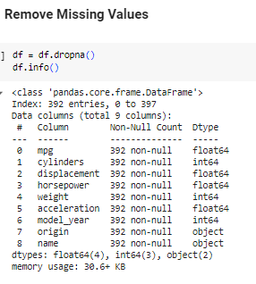
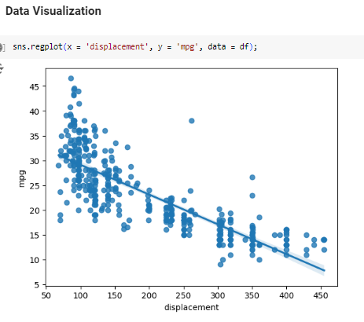
RESULTS

Slide 20
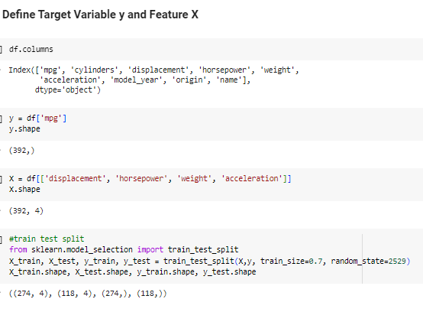
RESULTS

Slide 21
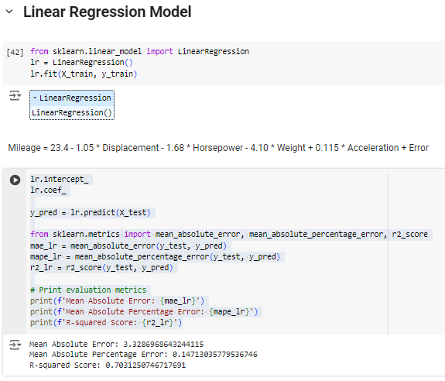
RESULTS

Slide 22
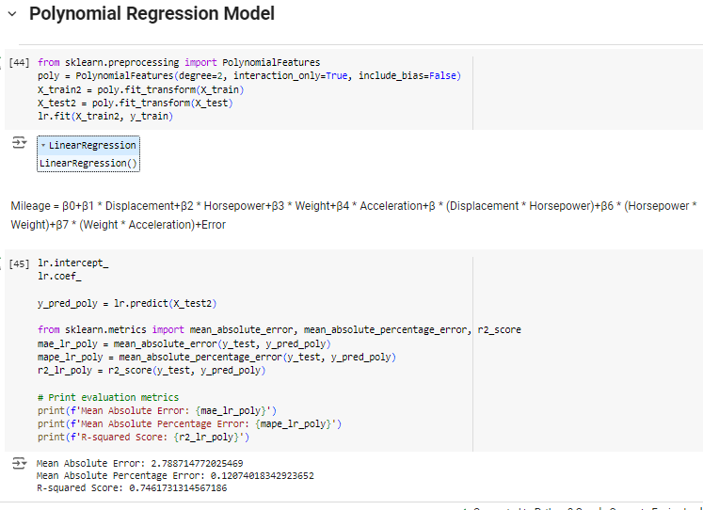
RESULTS

Slide 23
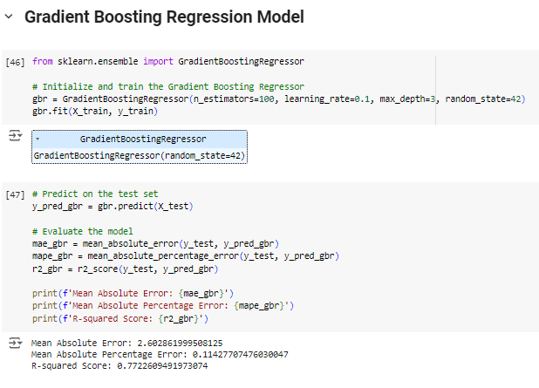
RESULTS

Slide 24
RESULTS
Initially, the Linear Regression Model was used to make the predictions.
Later, other models were selected and evaluated.
Polynomial Regression and Gradient Regression Models.
Overall, the best model accuracy observed was
in the range of 70% to 77%.

Slide 25
RESULTS
MODELS EVALUATED:
1.Linear Regression Model: 70% of the variance in the MPG can be explained by the features in the model
2.Polynomial Regression Model: 75% of the variance in the MPG can be explained by the features in the model
3.Gradient Boosting Regression Model: 77% of the variance in the MPG can be explained by the features in the model

Slide 26
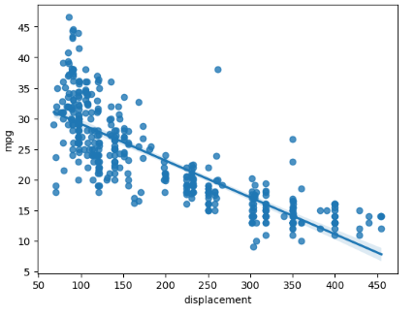
RESULTS
DATA VISUALIZATION

Slide 27
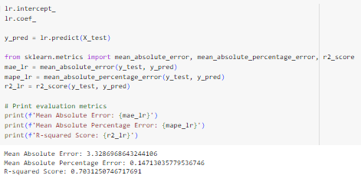
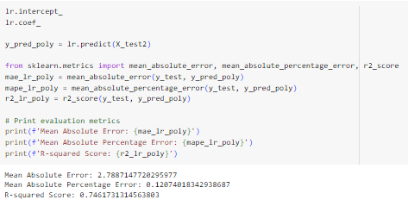
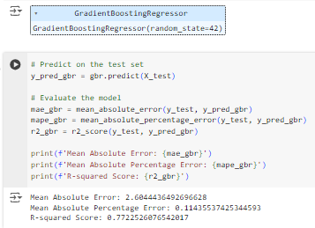

RESULTS
Figures: Mean Absolute Error,
Mean Absolute % Error,
and R-Squared Score
Of the Model used.
A higher R-squared value indicates a better fit of the model to the data.

Slide 28
CONCLUSION
The internship at YBI Foundation enhanced my skills in AI and ML, including data analysis and model development.
Hands-on experience with essential libraries like NumPy, Pandas, Matplotlib, and Scikit-learn was invaluable.
Completing a project on vehicle mileage prediction made me apply theory knowledge to real-world problems. It highlighted the industry relevance of AIML, and data analysis.
Implementation of some Regression models and Model Evaluation for better analysis.
Accuracy calculation with the help of values obtained by different metrics.

