Slide 1
Stack Overflow Question Rating Classification
Team:
Deshmukh, Prathmesh
Lewis, Gavin Henry
Katapally, Manognya
Data Mining (CSCI-B 565 Spring 2022)

Slide 2
Presentation Outline
Introduction
Exploratory Data Analysis
Data Cleaning
Implementation of Classification Model
Results
Conclusion & Future Work

Slide 3
Introduction
The project covers classification on the “60k Stack Overflow Questions with Quality Rating” data set that is available on Kaggle.
Full network pre-trained model – ALBERT to implement the classification model.
Projecting the data to a lower dimension to preform clustering using TSNE.

Slide 4
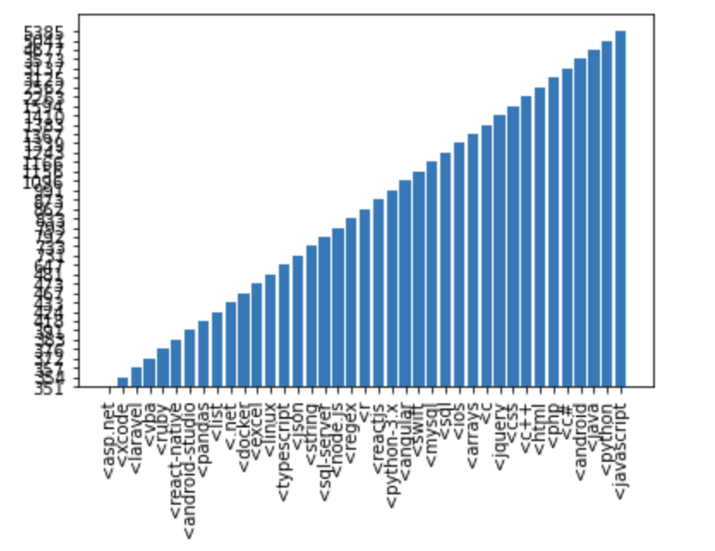
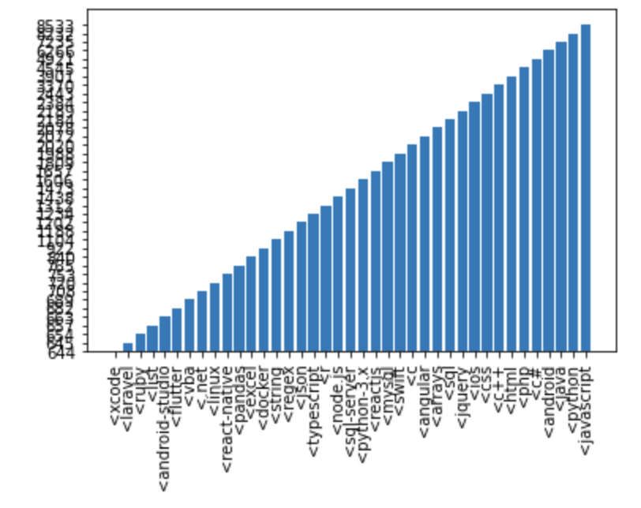
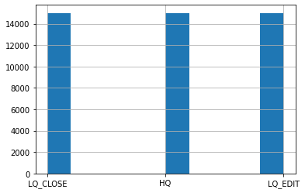
Exploratory Data Analysis
Explored the relation between the ‘Tags’ attribute and the target class ‘Y’
Visualized the frequency of individual ‘tag’ elements.
Visualized the distribution of the Target attribute ‘Y’. The attribute is thus balanced.

Slide 5
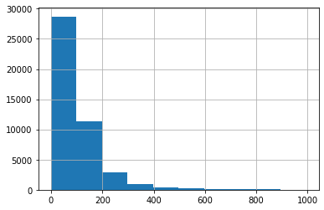
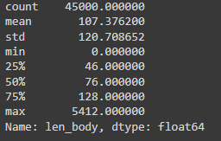
Plotted the histogram for the length of the body string removing the outliers in the data.
The following is the distribution of the length of the body string.
Since the mean is 107, we have taken the embedding size as 128.

Slide 6
Data Cleaning
Explored the usage of two separate approaches for data cleaning:
Html2text: This approach was initially used to check and remove the unwanted html tags in the ‘body’ attribute in the data.
Using Regular Expression and Contraction: This approach filters the tags as well as removes the shortened words in the data.
We are using the second approach as it provides us with better results.

Slide 7
Implementation
We have tried the implementation of two models:
BERT
ALBERT
We have decided to use the ALBERT model as it is computationally more optimal to use this.
The ALBERT model has far much lower trainable parameters and thus would train faster.

Slide 8
Results
ALBERT model performed best on the configuration of 20 epoch for training with learning rate of 3e-5 and weight decay of 5e-6.
The model had an average loss of 0.0201 on the train data and a minimum loss of 0.3538 on the test data.
Best model is chosen using the metric of minimum loss on the test data.
Class | Model Evaluation on Test | Accuracy
LQ_CLOSE | 2686/3340 | 0.8042
LQ_EDIT | 3065/3335 | 0.9190
HQ | 2980/3375 | 0.8830
Total Accuracy on Test |  | 0.8688

Slide 9
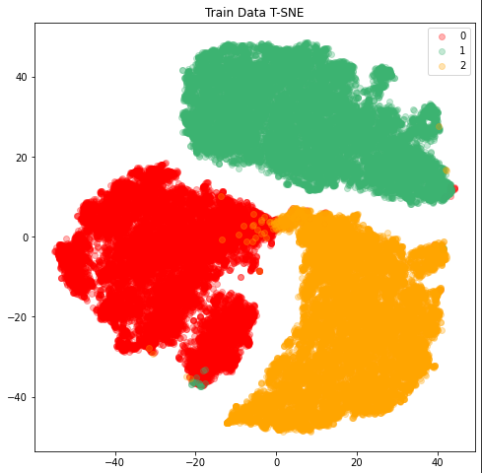
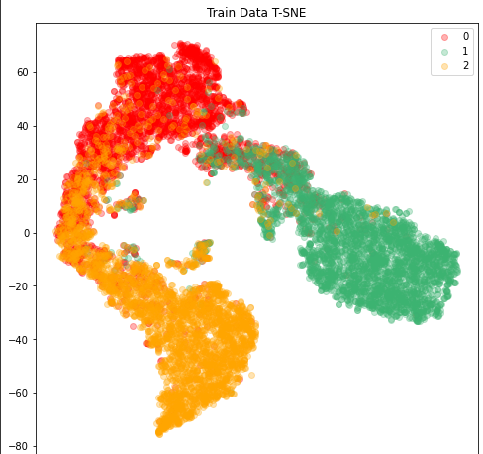
TSNE Plots on the data
Test Data TSNE plot

Slide 10
Conclusion & Future Work
The pre-trained models have prior knowledge of English language and thus they perform better when trained on the 45000 rows in the given dataset.
We tried implementation of BERT but due to GPU/TPU memory limitation and longer training times we opted for ALBERT model.
The ALBERT model is efficient for producing results quickly and with training time as it has 11M trainable parameters.
We can explore further implementation of BERT and GPT2 models on the dataset which have trainable parameters of 110M and 1.5B respectively.

