Slide 1


Slide 2
Problem Statement
Lending Club is a Consumer Finance company for who is interested to understand if a new loan application can be accepted or rejected.
We have a dataset with loan data that are currently active, paid off or charged-off.
We are advising the company with driver variables to avoid credit loss using EDA.
We have done univariate and bivariate analysis on the dataset. We have derived metrics which is required.
We have made assumptions based on publicly available domain information.
As data imputations can’t be reliably done, this step is skipped and the columns with empty values are dropped from analysis.
We have also not considered the loan data for the currently active loans as we can’t predict drivers from this.
Also, we have dropped customer behavior variables as this will be unique and can’t be used to generalize/ aggregate the data.

Slide 3
EDA Approach
We have done univariate and bivariate analysis on the dataset. We have derived metrics which is required.
We have made assumptions based on publicly available domain information.
As data imputations can’t be reliably done, this step is skipped and the columns with empty/NA values are dropped from analysis.
We have also not considered the loan data for the currently active loans as we can’t predict drivers from this.
The customer behavior variables are not available at the time of loan application, and thus they cannot be used as predictors for credit approval.

Slide 4
Considered Variables
Loan Amount
Term
Interest rate
Grade
Subgrade
Insights to approve loan
Insights to reject loan
Annual Income
Debt-to-Income Ratio
Employment Length
Purpose of Loan
Home Ownership
Verification Status

Slide 5
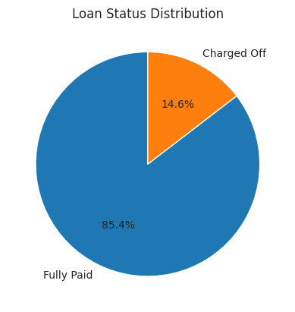
Loan Status Distribution
14% of the loans were defaulted in total

Slide 6
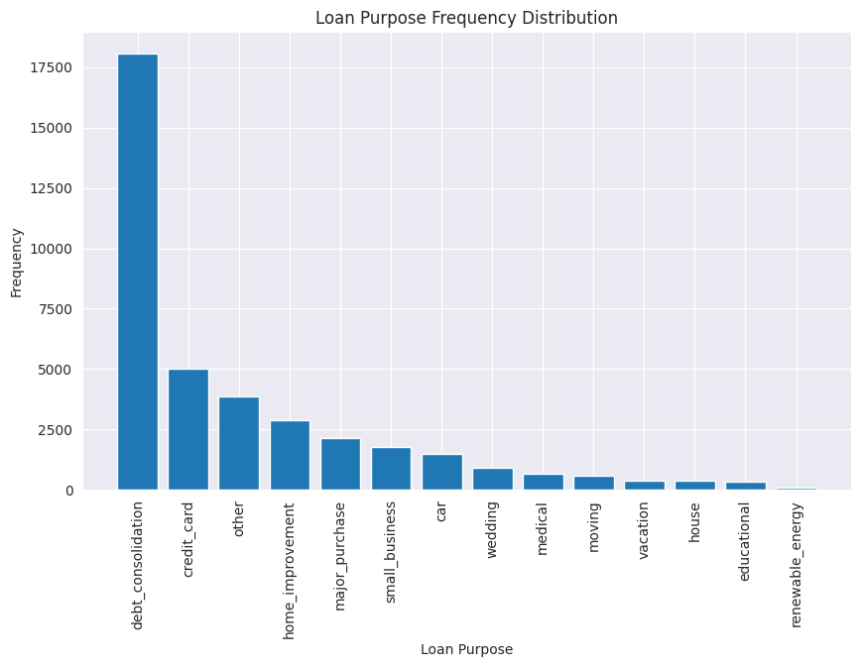
Loan Purpose Frequency Distribution
Loans were requested mostly for Debt Consolidation and Credit Card

Slide 7
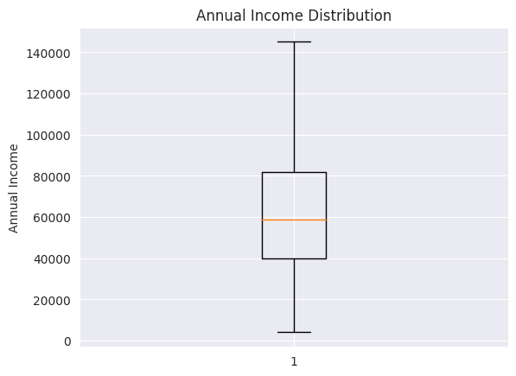
Annual Income Distribution
Median annual income is around 58000 USD

Slide 8
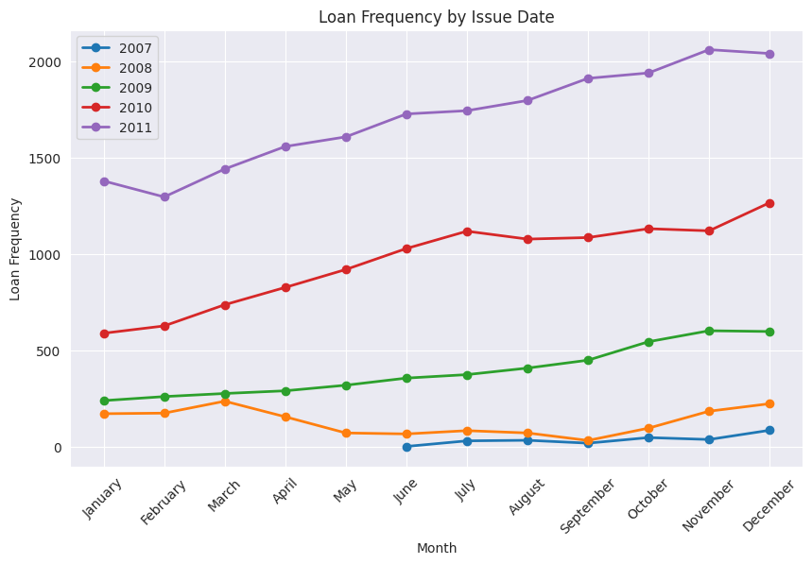
Issue Date Distribution
- Most of the loans get funded in December
- The company has grown steadily as the funded loans show a steady increase over the years

Slide 9
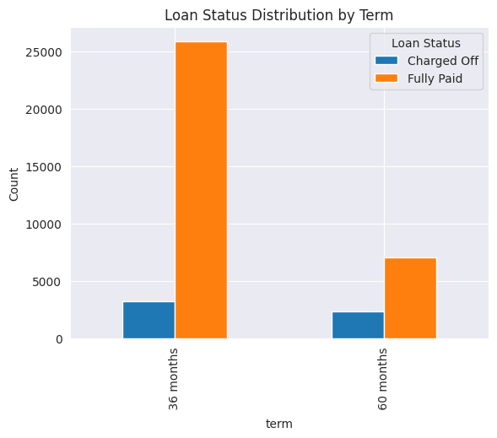
Loan Status Distribution By Term
Shorter tenure loans are more likely to get defaulted

Slide 10
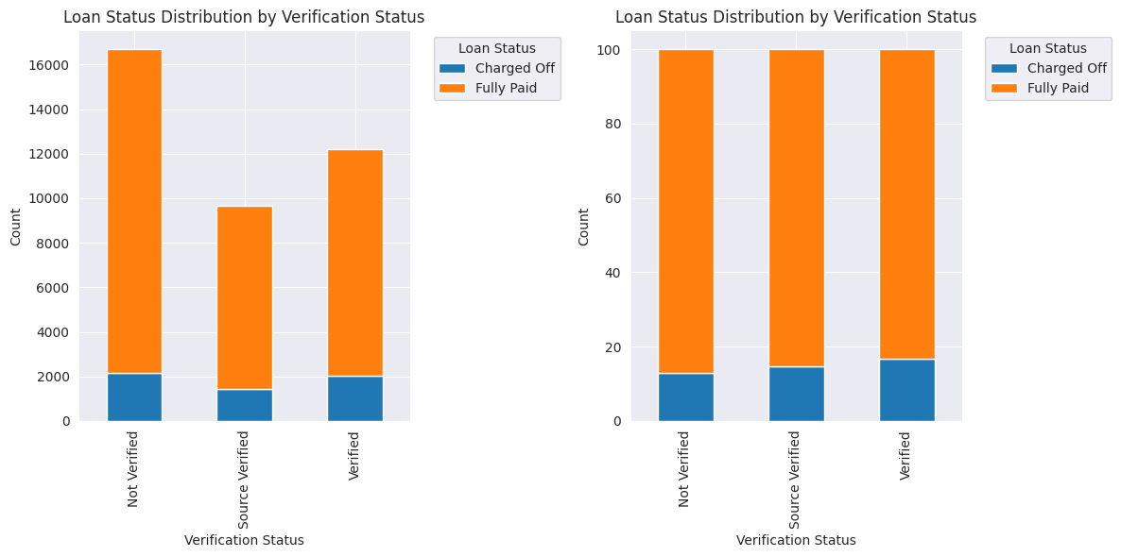
Loan Status Distribution By Verification Status
There was no visible correlation between verification status and the loan default

Slide 11
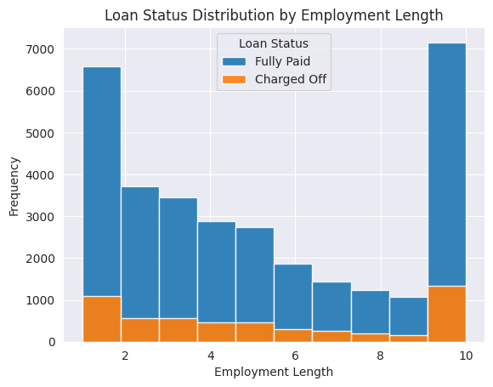
Loan Status Distribution By Employment Length
Lesser employment tenure and more than 10 years employment tenure could default on the loan

Slide 12
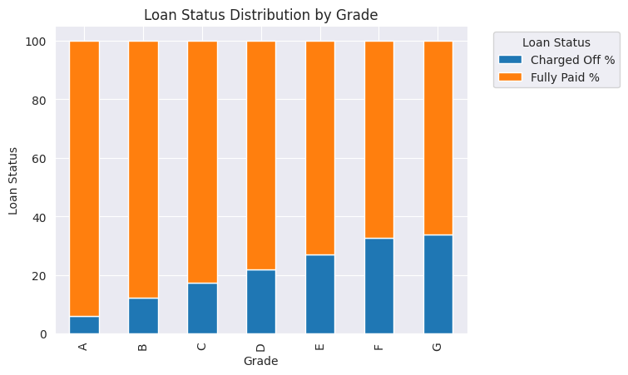
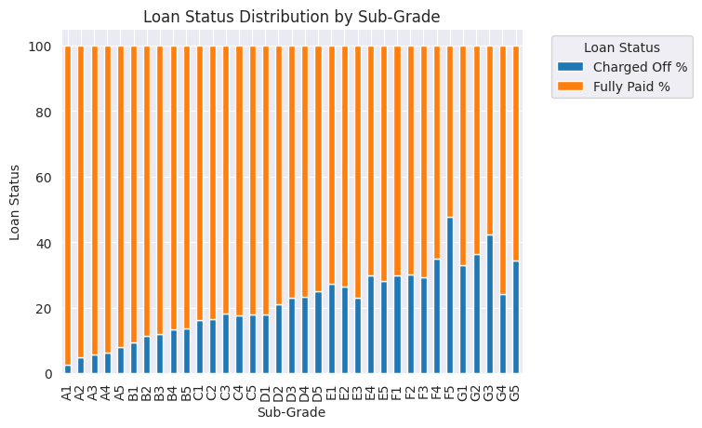
Loan Status Distribution By Grade and Sub-Grade
Loans graded F and G tend to default more. As the category progresses from A to G, risk of default also increases.

Slide 13
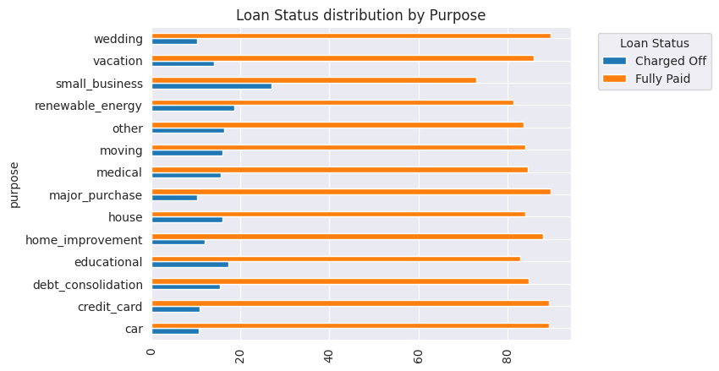
Loan Status Distribution By Purpose
Loans taken for small business, renewable energy and educational purposes tend to default more

Slide 14
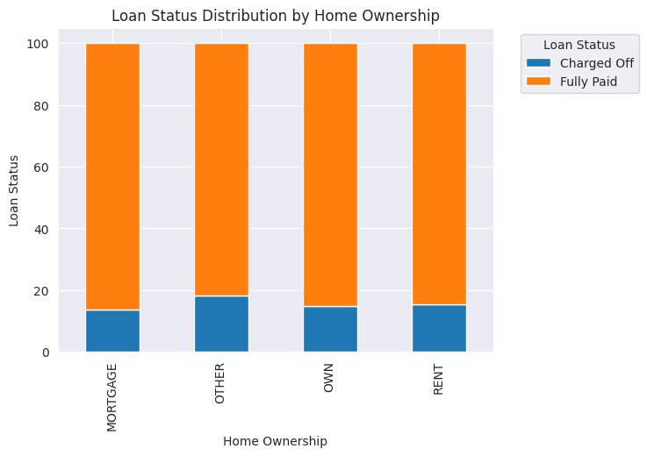
Loan Status Distribution By Home Ownership
Renters are more likely to default than home-owners and people with mortgaged homes

Slide 15
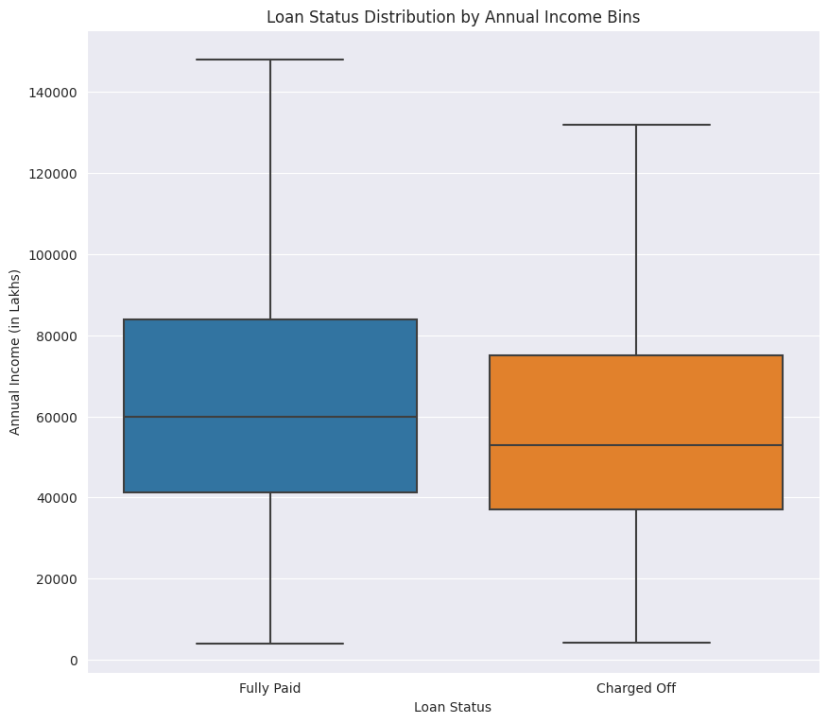
Loan Status Distribution By Annual Income
Lesser the annual income, higher the risk of default

Slide 16
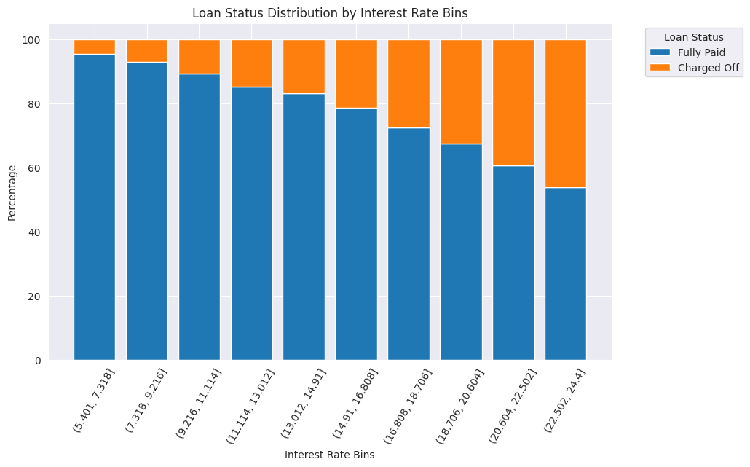
Loan Status Distribution By Interest Rate
Higher interest rate loans are more likely to be defaulted

Slide 17
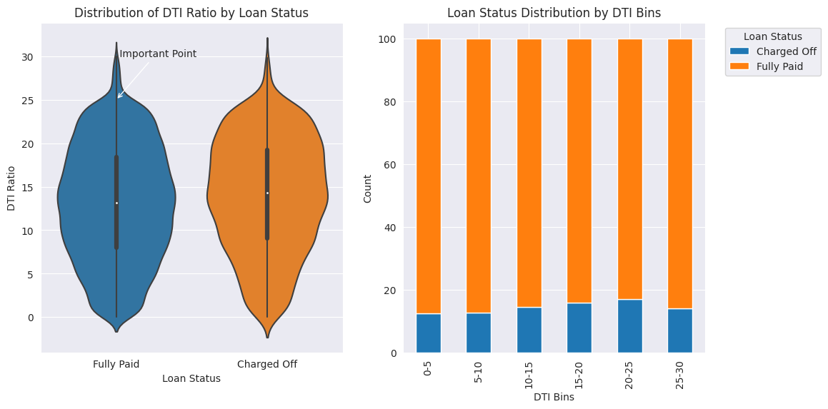
Loan Status Distribution By DTI Ratio
When DTI increases, loans are likely to be defaulted but only until 25. When DTI is higher than 25, loan is not likely to be defaulted

Slide 18
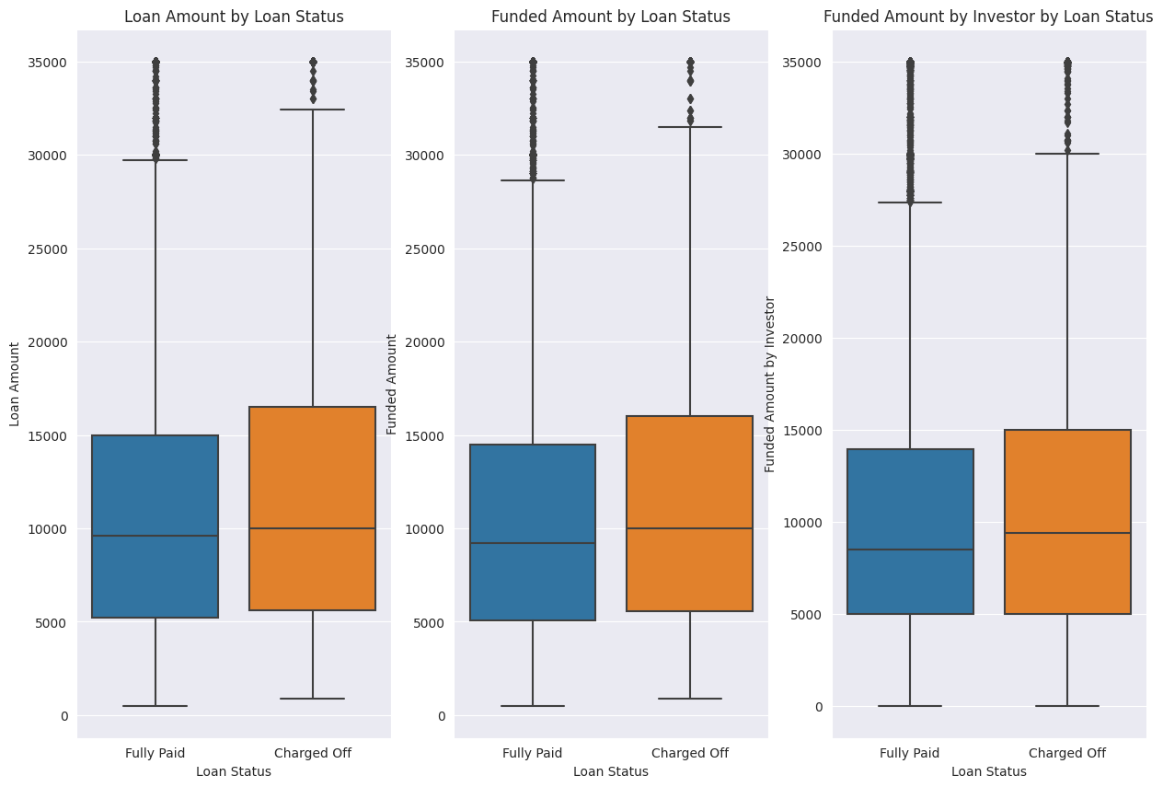
Loan Status Distribution By Loan, Funded and Investor Funded Amounts
Correlation between Loan amount, Funded amount and Funded amount by Investors

Slide 19
Contact Information -
Prathyusha Thenepalli
prathyusha.thenepalli@sap.com
Kiruthiga Bose
kiruthiga.bose@sap.com

