Slide 1
Project-106 “Daily” Data Analysis for a Product listed on Amazon
Group-4

Slide 2
Exploratory Data Analysis
Data Visualization is the most beautiful part of data analysis
through which we describe the data interactively and visually.
It is that magical technique that can convey information to larger
masses at a single glance and tell interesting stories from the data

Slide 3

Data Analysis for a Product listed on Amazon
Business Objective:
Need to get daily Analysis of a product such as emotions, sentiment etc. using Amazon data
Product :
Amazon Echo Dot (3rd Gen)

Slide 4
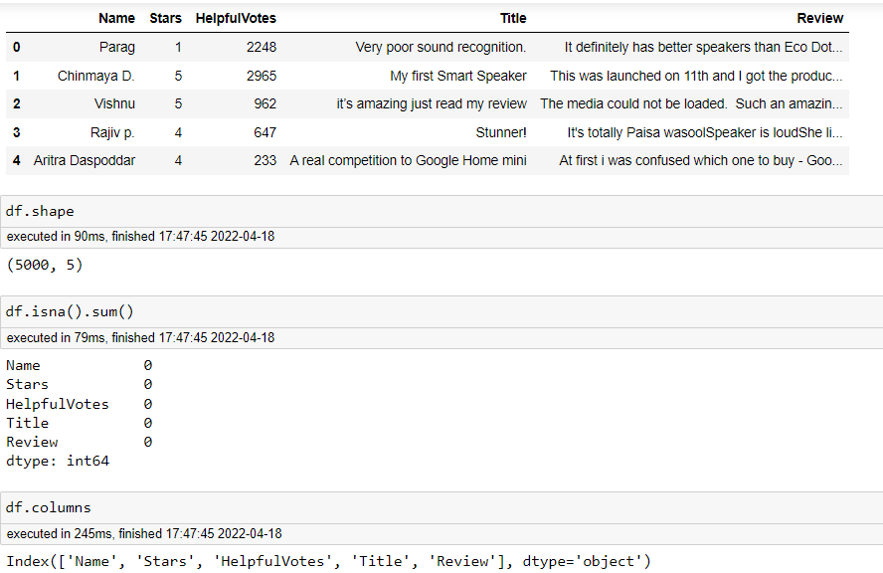
Basic Data Inputs
Data format ,total shape of data ,column names are as shown below

Slide 5

Libraries used for Visualization
import pandas as pd
import numpy as np
import seaborn as sns
import matplotlib.pyplot as plt
%matplotlib inline
import plotly as py
from plotly.offline import iplot
import cufflinks as cf

Slide 6
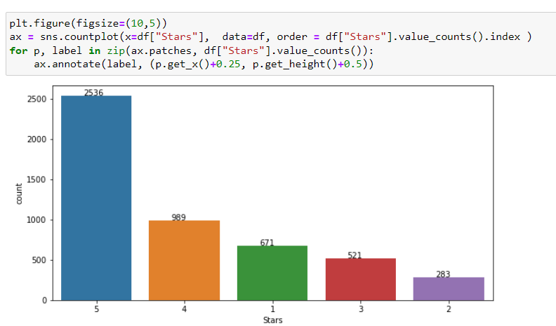
Visualizing number of customers given number of ratings

Slide 7
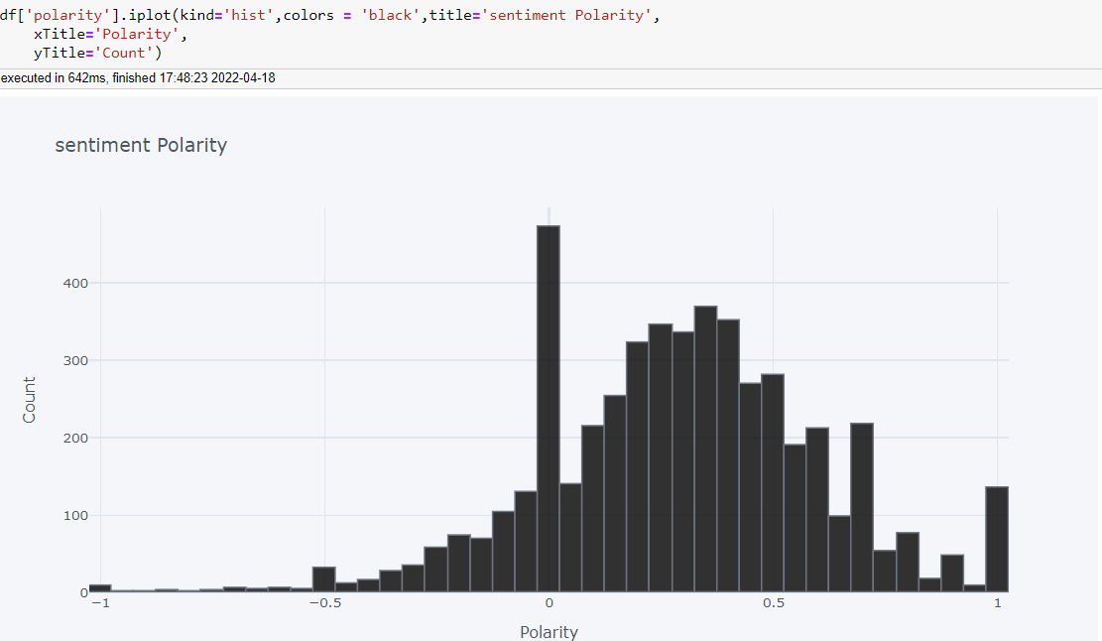
By Using Text Blob added below three columns into dataframe
polarity
review length
wordcount
Below plotted hist plot of Polarity

Slide 8
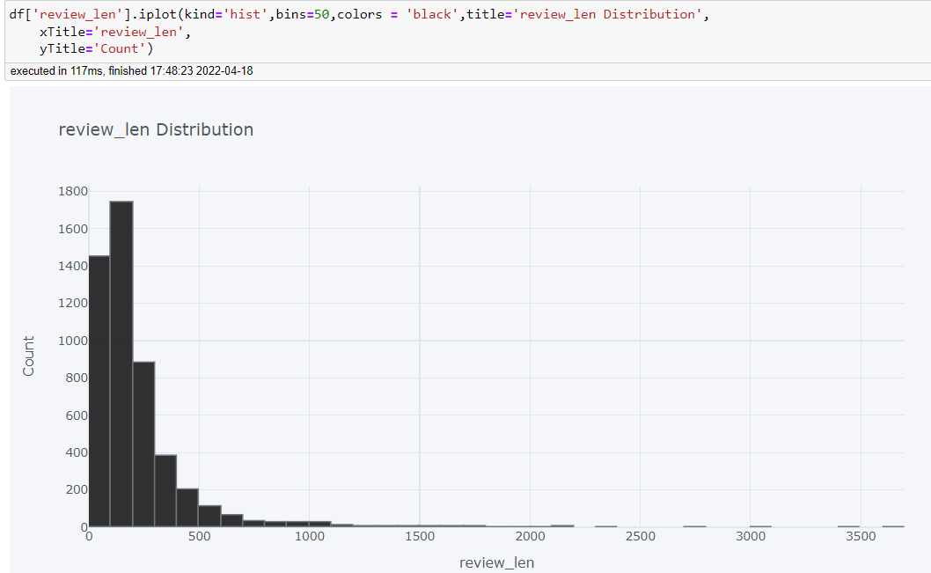
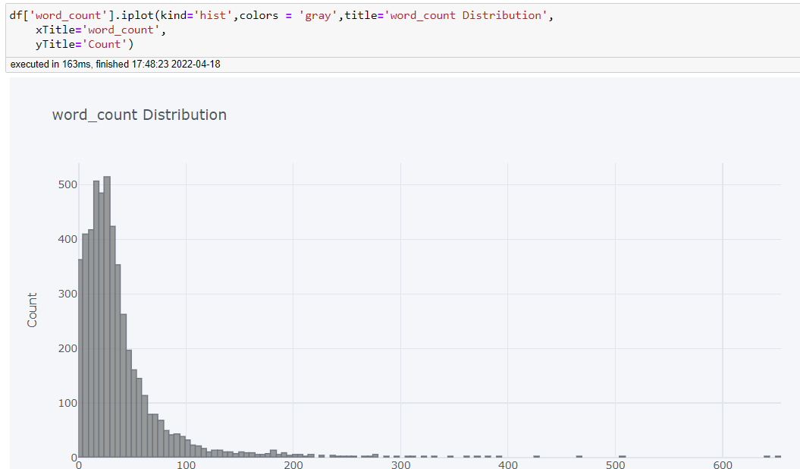
Below are respective plots of review length,wordcount

Slide 9
Distribution of Unigram,Bigram and Trigram
Example
x = 'he is a great athlete'
#unigram = he is, a,great,athlete
#bigram = he is, a, a great,athlete
#trigram = he is a ,a great, a athlete
Defining Top Words
def get_top_n_words(x,n):
vec = CountVectorizer().fit(x)
bow = vec.transform(x)
sum_words = bow.sum(axis=0)
words_freq = [(word, sum_words[0, idx]) for word, idx in vec.vocabulary_.items()]
words_freq = sorted(words_freq,key = lambda x: x[1],reverse= True)
return words_freq[:n]

Slide 10
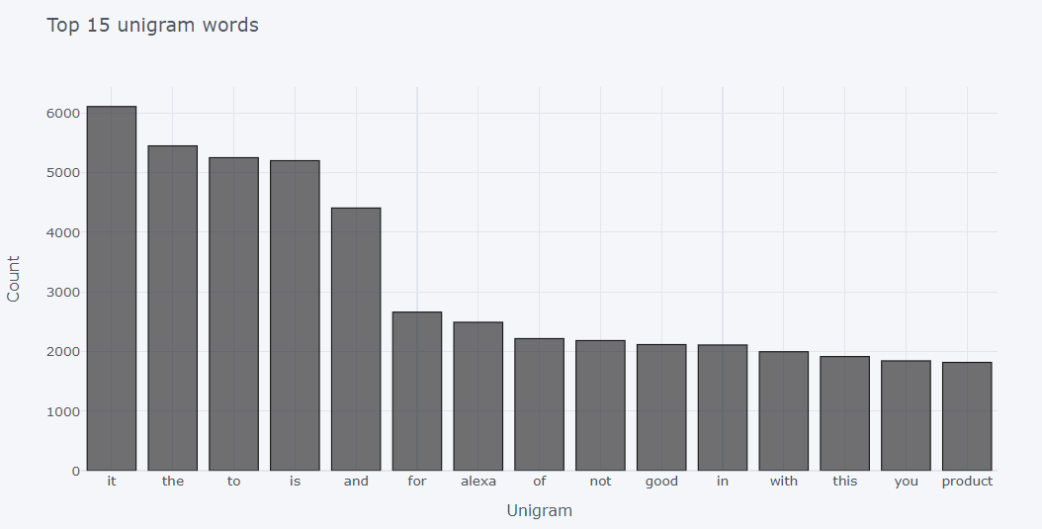
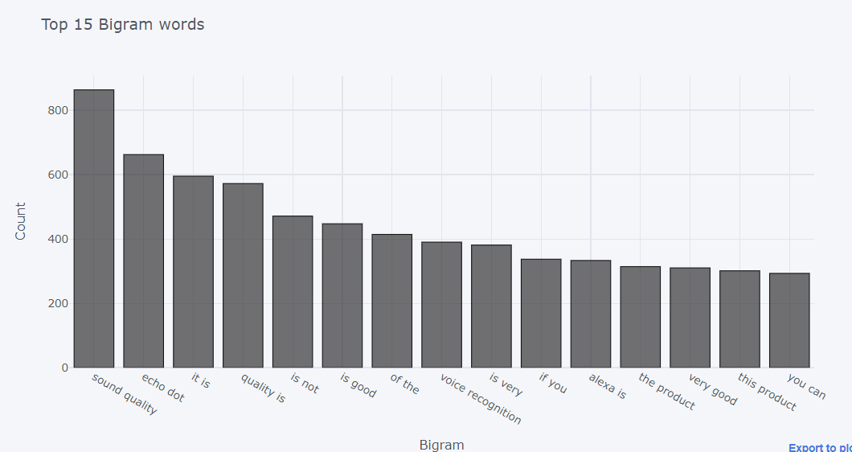
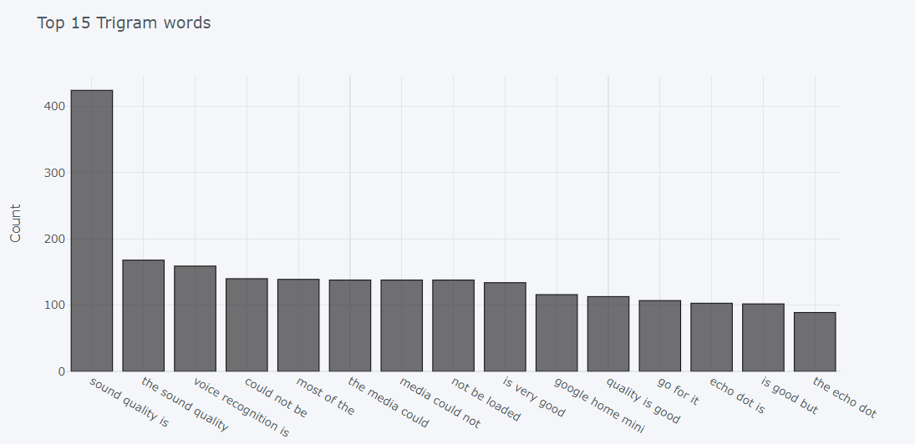
Plotting with stop words

Slide 11
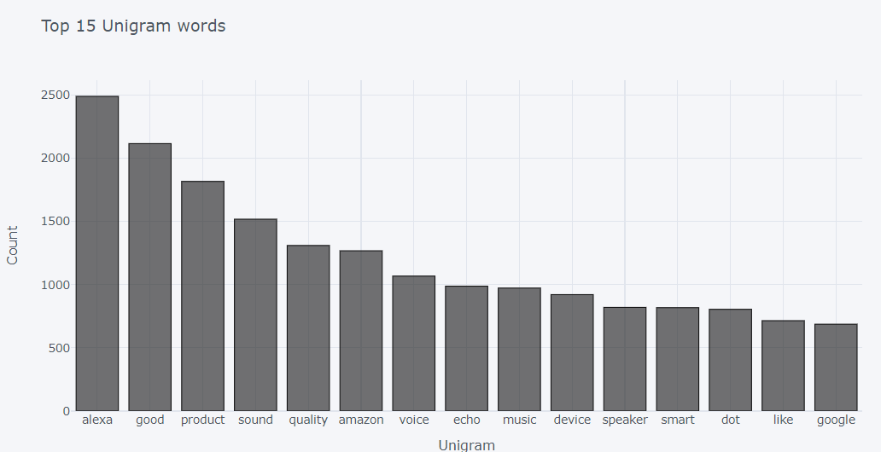
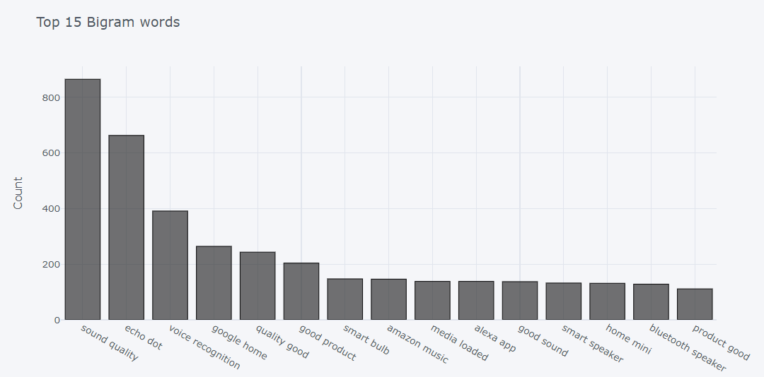
Plotting without stop words

Slide 12
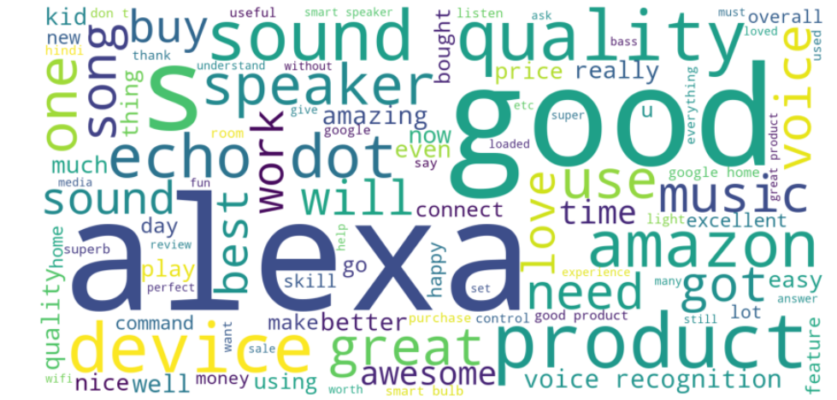
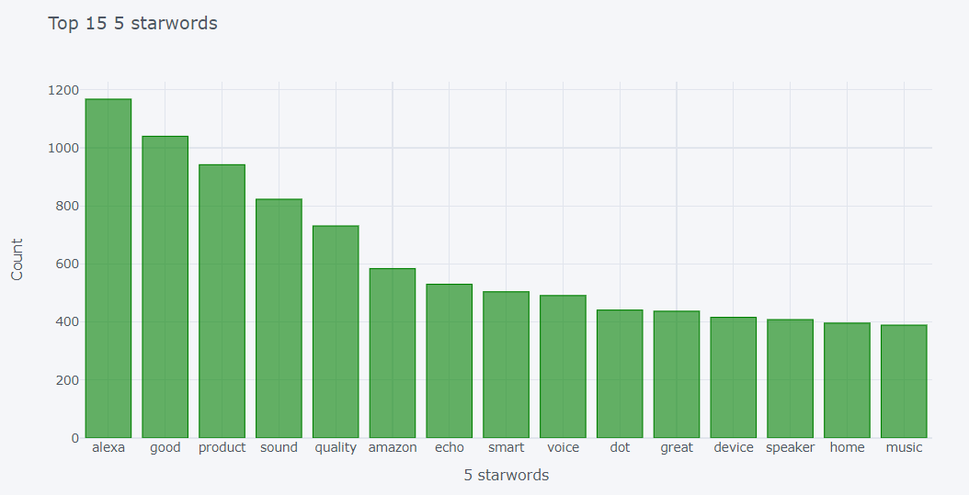
WordCloud according to Ratings
5 stars rating words

Slide 13
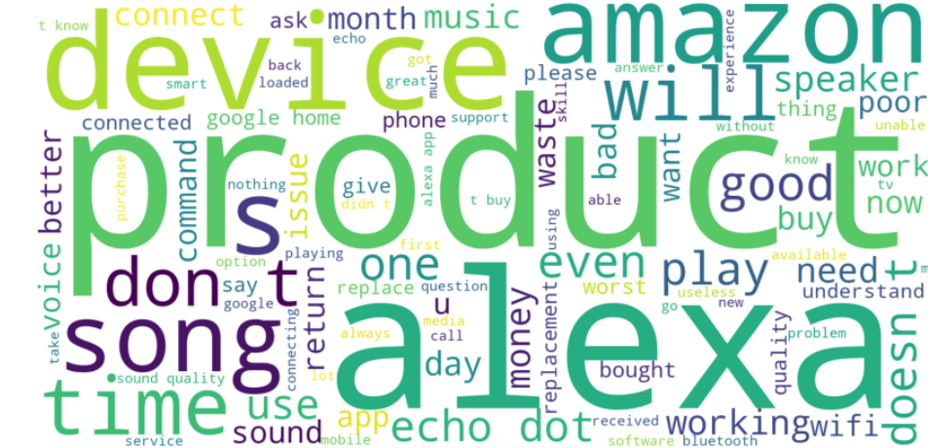
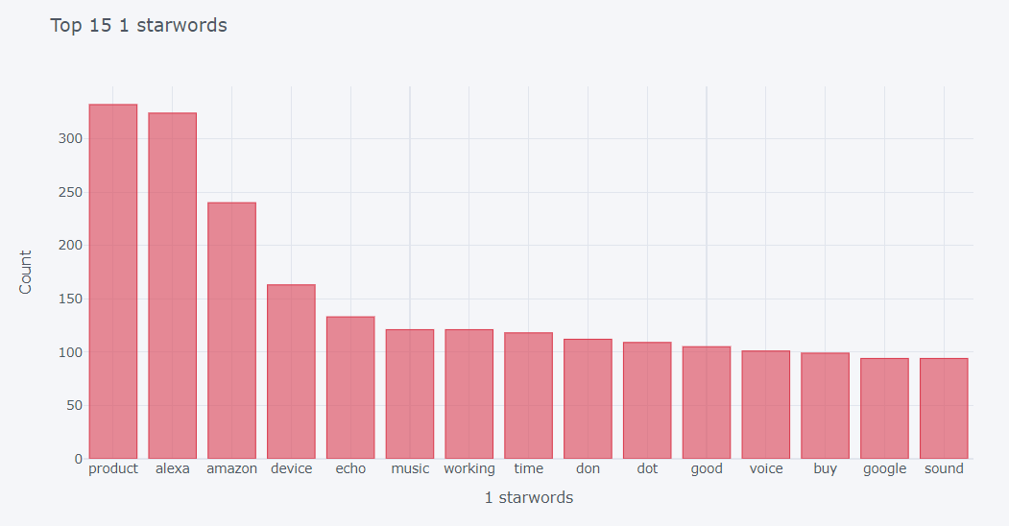
1 stars rating words

