Slide 1



SUperStoreReport_BI_Service
View in Power BI
Last data refresh:
7/26/2024 3:53:51 AM UTC
Downloaded at:
7/26/2024 3:58:14 AM UTC

Slide 2
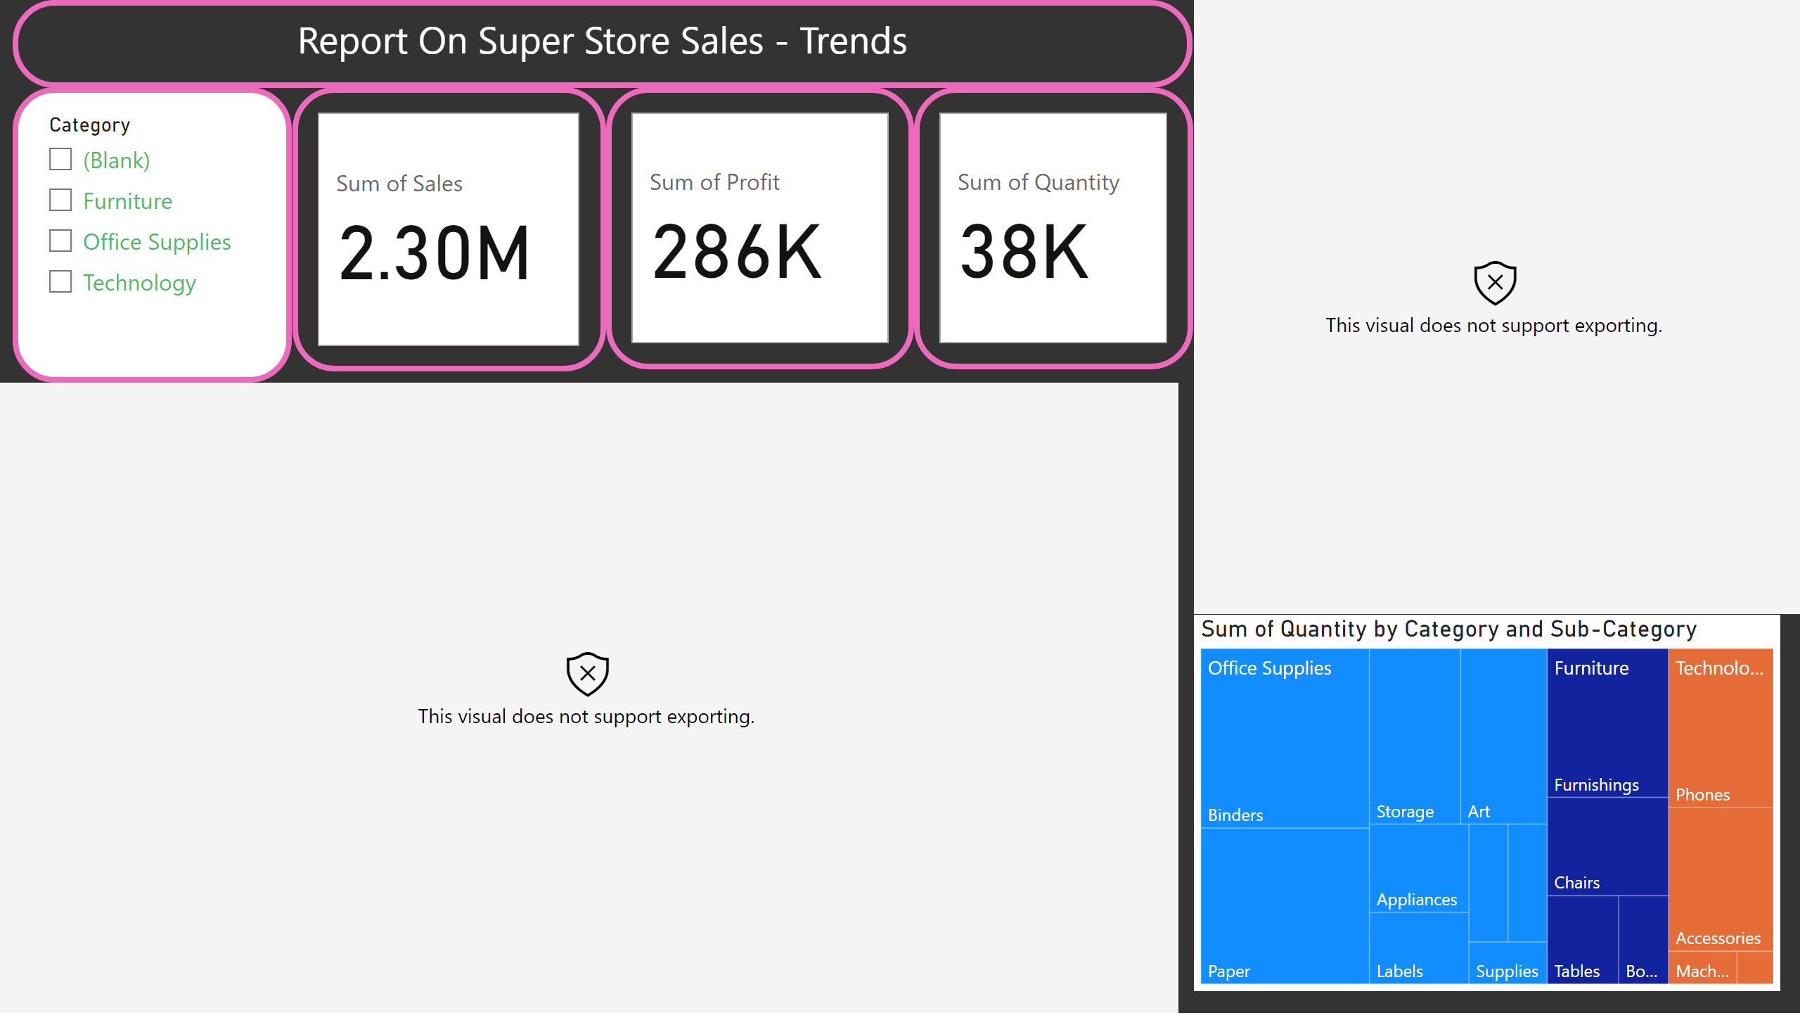
Page 1
Notes:
textbox
No alt text provided
slicer
No alt text provided
cardVisual
No alt text provided
cardVisual
No alt text provided
cardVisual
No alt text provided
Sales By Region Over 4 years
No alt text provided
esriVisual
No alt text provided
treemap
No alt text provided

