Slide 1
TRI-OCTET LOCAL NEIGHBORHOOD DIFFERENCE PATTERNS
CSE3018
CONTENT BASED IMAGE AND VIDEO RETRIEVAL
Shaik Nazeer – 15BCE1057
Y S Prathyusha – 15BCE1302

Slide 2
Abstract
A new image retrieval technique using tri-octet local neighbourhood difference pattern (TO-LNDP) has been proposed for local features.
The conventional local binary pattern (LBP) transforms every pixel of image into a binary pattern based on their relationship with neighbouring pixels.
The proposed feature descriptor differs from local binary pattern as it transforms the mutual relationship of all neighbouring pixels in a binary pattern. Both LBP and TO-LNDP are complementary to each other as they extract different information using local pixel intensity.
In the proposed work, both LBP and TO-LNDP features are combined to extract the most of the information that can be captured using local intensity differences.

Slide 3
Scope of the project
In this project, we have worked on a new texture feature TO-LNDP.
The main focus of the project is to increase the precision and recall of a given CBIR system by implementing TO-LNDP.
Study on previously worked out methods like LBP, LNDP is done thoroughly.
Different types of feature matching techniques and distance metric techniques are studied and the best and appropriate one is implemented

Slide 4
LOCAL NEIGHBORHOOD DIFFERENCE PATTERN
A new feature extraction method called local neighbourhood difference pattern (LNDP), has been proposed in the present work
This method extracts the local features based on neighbourhood pixel differences and form a binary pattern to represent each pixel in the image.
For each pixel, a 5 × 5 block has been chosen for pattern calculation as the closest neighbouring pixels are less in number and give more related.
For each pixel we would get 3 values, from the three octets formed by 24 pixels around the centre pixel, i.e., 5x5 block.

Slide 5
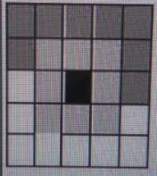
LNDP (Continued..) Three octets for each pixel:

Slide 6
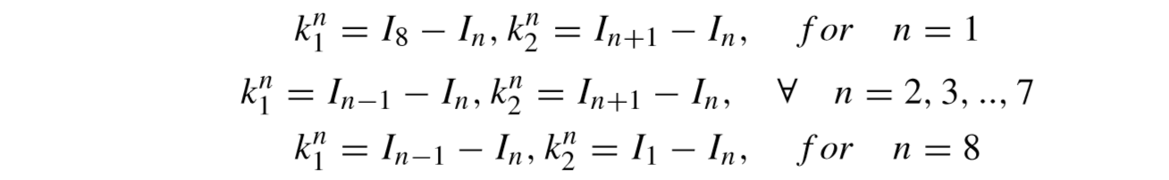
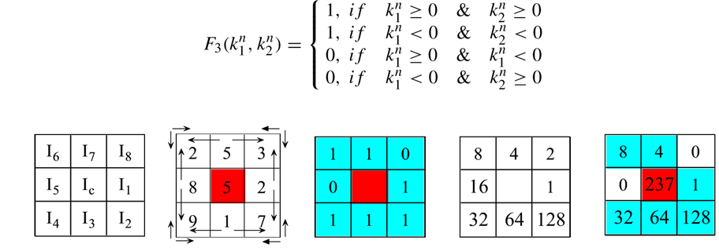
LNDP (Continued..) Calculation:

Slide 7
Methodology
Upload the image and convert it into a gray scale image if it is a color image.
Compute local neighborhood difference pattern of the image (1st Octet).
Compute local neighborhood difference pattern of the image (2nd Octet).
Compute local neighborhood difference pattern of the image (3rd Octet).
Create histograms of obtained three octets.
Concatenate all the three histograms as feature descriptor.
Compute the distance of the query image feature vector with all database image feature vectors using Manhattan distance.

Slide 8




Image Database
100 images of sunset as sample database is chosen.
Some of them include:

Slide 9
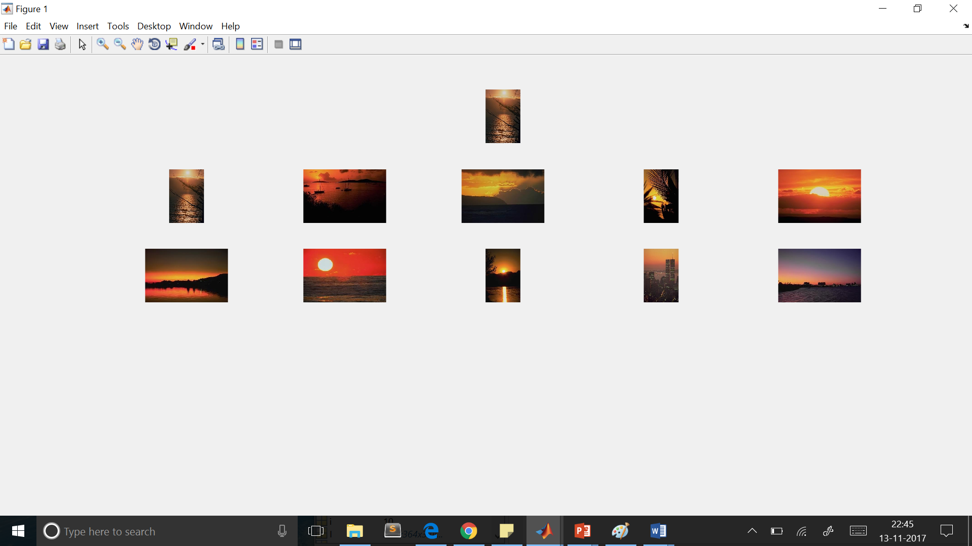
Results

Slide 10
Conclusion
The proposed local feature descriptor, TO-LNDP, is a complementary method over LBP as it extracts the relationship among neighboring pixels by comparing them mutually.
The proposed method has been applied in content based image retrieval of texture and natural image datasets.
The proposed feature descriptor extracts features based on the texture, hence, it can be utilized for texture feature based image recognition systems, e.g., palmprint, fingerprint, knuckle print, leaf, iris, etc.
The proposed feature descriptor can be utilized with an appropriate region detector for object or region specific image retrieval and scene recognition problem.

Slide 11
Thank You

