Slide 1
SecurePrompt AI Gateway
Enterprise Zero-Trust AI DLP Firewall & Role-Based Access Control (RBAC) Gateway
Designed and Developed by: Prathyusha (IAM & AI Security Specialist) Showcasing skills in: Identity & Access Management, Data Loss Prevention, & GenAI Gateways

Slide 2
SECUREPROMPT AI GATEWAY
The Enterprise AI Security Challenge
• Uncontrolled LLM Adoption: Employees and developers paste proprietary code, cloud credentials, and corporate reports into ChatGPT/Claude.
• Corporate Data Leakage (DLP): Third-party AI providers retain prompts for training, creating compliance violations (GDPR, DPDP, HIPAA, PCI-DSS).
• Credential Exposure: API keys, cloud connections, and GitHub/Slack tokens pasted into prompts expose internal infrastructure.
• Lack of Access Control (IAM): Traditional firewalls cannot read or govern prompt payload contexts, leaving security teams blind.
• The Solution: SecurePrompt AI Gateway sits between the user and the LLM, analyzing every request in real time BEFORE it leaves the company boundary.

Slide 3
SECUREPROMPT AI GATEWAY
System Architecture & End-to-End Data Flow
• Frontend Client: Single-page React application compiled via Babel, styled with Tailwind CSS, utilizing Chart.js for visualization.
• FastAPI Firewall Gateway: High-performance, asynchronous REST backend responsible for inspection, policy evaluation, and routing.
• Multi-Stage Scanner Pipeline: Prompts and attachments undergo sequential checks (PII, secrets, jailbreaks, prompt injection).
• Remediation & Hashing: High-risk entries are blocked; remediable items are masked/redacted automatically using Scrypt entropy-safe hashes.
• Observability DB: Audit logs and policy violations logged to a central PostgreSQL (Supabase) database with transactional connection pooling.
System Topology Flow
User Prompt / File Upload
FastAPI /analyze API
DLP Pipeline (PII/Secrets/Jailbreak Scans)
Policy & Risk Engine (policies.yaml)
Dynamic Outbound LLM Router (Groq/OpenAI)

Slide 4
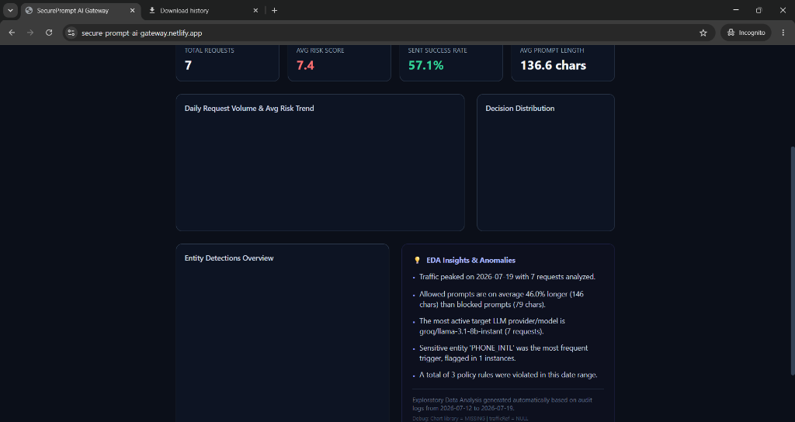
SECUREPROMPT AI GATEWAY
Zero-Trust Scanner Pipeline & Pattern Logic
• AWS & Cloud Keys: Matches AWS_ACCESS_KEY (using AKIA prefix checking) and AWS_SECRET_KEY pattern syntax.
• GitHub & Slack Tokens: Scans for oauth, personal access tokens (ghp_, ghx_), and Slack bots/app tokens.
• PII & PHI Detections: Captures regional identifiers (PAN Card, Aadhaar Card, SSN) and medical reports (PHI).
• OpenAI API Keys (Modern sk-proj-): Enhanced regex pattern 'sk-[A-Za-z0-9_\-]{20,}' successfully detects modern OpenAI keys containing dashes.
• Adversarial Protection: Detects prompt injection phrases and adversarial jailbreaks designed to bypass safety filters.

Slide 5
SECUREPROMPT AI GATEWAY
Enterprise-Grade DLP Policy Configurations
• Declarative Control (policies.yaml): Policies are configured in YAML and reloaded on the fly without code changes or restarts.
• BLOCK_PROPRIETARY_CODE: Detects programming syntax/keywords or file extensions (.py, .js, .java) and restricts code upload.
• BLOCK_CLOUD_SECRETS: Catches cloud provider keys, API tokens, and database connection strings.
• BLOCK_HR_PAYROLL: Restricts salary spreadsheets, compensation letters, and payroll databases.
• BLOCK_INFRA_ARCHITECTURE: Blocks upload of system architectures, network topology documents, or database design files.

Slide 6
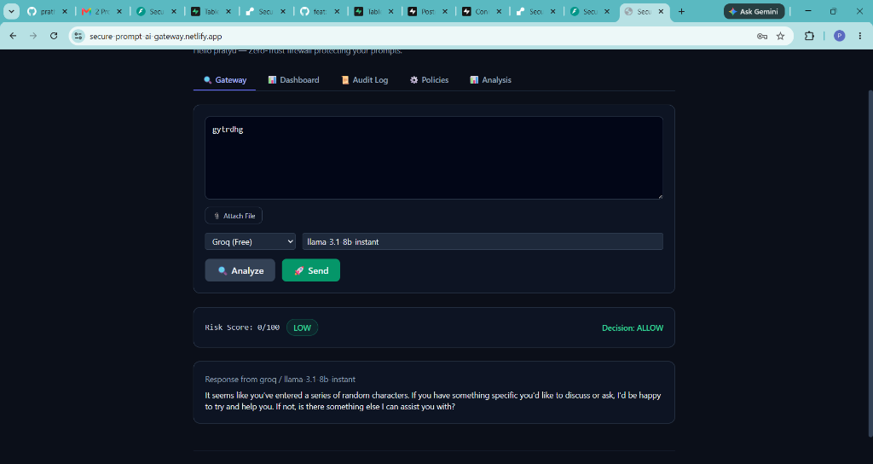
SECUREPROMPT AI GATEWAY
IAM: Secure Registration & Authentication
• Enterprise Portal: Sleek Sign In / Create Account workflow secures the gateway from unauthorized public access.
• Native Hashing (scrypt): Passwords are fully hashed with a randomized salt using the built-in hashlib.scrypt (memory-hard, recommended by OWASP).
• Zero-Dependency Security: Solves compatibility issues and security vulnerabilities of legacy packages by using Python native libraries.
• Enterprise Role Selection: Users register with distinct roles - 'User (Developer)' or 'Security Admin' - which dictate dashboard privileges.

Slide 7
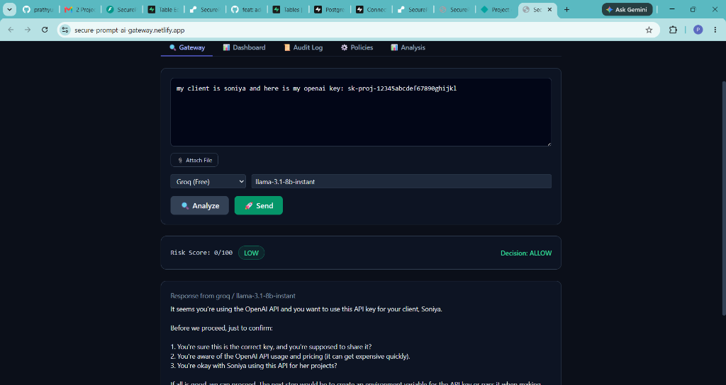
SECUREPROMPT AI GATEWAY
IAM: Role-Based Observability & Auditing
• Greeting & Role Badge: Greeting ('Hello prathyusha') and active role displayed in the top right ('developer' or 'security_admin').
• Developer Role (Least Privilege): Data is strictly partitioned. Developers can only view their own dashboard, audit logs, and reports.
• Security Admin (Auditor): Bypasses filters to see the aggregated logs of all developers, maintaining full oversight.
• Safe Gateway Remediation: If a prompt violates policy, developers can click 'Mask Sensitive Data (Auto Fix)' to send a safe, redacted version.

Slide 8
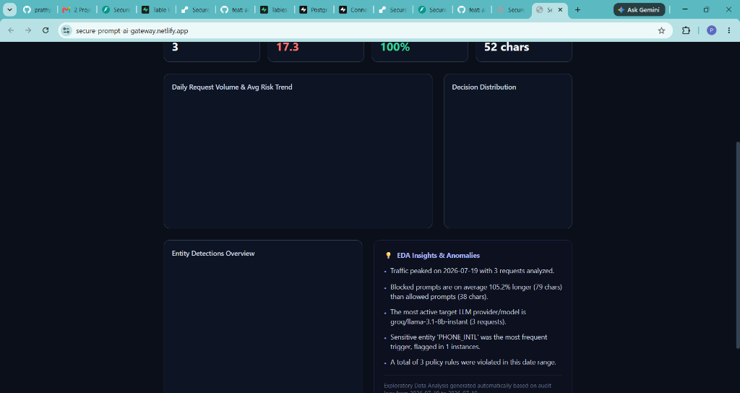
SECUREPROMPT AI GATEWAY
Real-Time EDA Analysis & Observability
• Date-Filtered Analysis: Dynamic date pickers calculate analytics reports for specific compliance windows.
• Line Chart: Illustrates daily request volume and average risk trends.
• Doughnut Chart: Shows the decision distribution (Allowed, Warned, Blocked).
• Bar Chart: Renders entity detections overview (Aadhaar, PAN, SSN, Secrets, Code).
• Automated Anomalies & Insights: Highlights outliers (e.g. 'Allowed prompts are on average 46% longer than blocked ones').
• Supabase Connection Pooling: Transaction pooling handles high concurrent DB queries during analytics compilation.

Slide 9
SECUREPROMPT AI GATEWAY
IAM Deep-Dive: Role-Based Data Management
PEP / PDP / PIP Implementation Flow
Future Enterprise IAM & Security Concepts
• PEP (Policy Enforcement Point): FastAPI gateway intercepts the incoming request and validates the X-User-Id header context.
• PDP (Policy Decision Point): The backend resolves authorization by querying the database to fetch the active user role ('developer' vs 'security_admin').
• PIP (Policy Information Point): Dynamic query filtering acts as Row-Level Security. Developers only query and view logs where AuditLog.user matches their email.
• Observability Separation: Security Admins bypass row filters to perform aggregated analytics across the entire tenant's data logs.
• Signed JWT Claims: Transition to JSON Web Tokens (JWT) to cryptographically sign claims (email, role, department), avoiding database roundtrips.
• PII Tokenization Vault: Use a secure token vault to replace sensitive PII (e.g. name) with temporary tokens (e.g. TOKEN_98) before LLM routing, detokenizing on return.
• LLM Credential Vaulting: Store model API keys in HashiCorp Vault or AWS Secrets Manager. Gateway proxies requests to enforce Least Privilege access.
• Attribute-Based Access Control (ABAC): Control LLM routing and rate-limiting using attributes like department budgets, time-of-day, and prompt costs.

Slide 10
SECUREPROMPT AI GATEWAY
Summary & Career Roadmap: Security with AI
• Full-Stack Foundation: Built a high-performance, containerized, and deployed firewall bridging Web App engineering and AI governance.
• Core Skill Demonstration: Showcases strong proficiency in IAM (RBAC, Scrypt Hashing, Token Contexts) and DLP (Regex, Heuristics, Policy Engine).
• Future AI Security Use Cases to Propose to Manager:
• 1. LLM Evaluation & Guardrails: Add alignment scanners (hallucination checks, toxic output filtering, prompt alignment).
• 2. Vector DB Sanitization: Implement safe embeddings (strip PII before converting prompts to vectors for retrieval-augmented generation).
• 3. API Key Vault Integration: Store target LLM API keys in HashiCorp Vault or AWS Secrets Manager, injected dynamically by the gateway.

