Slide 1
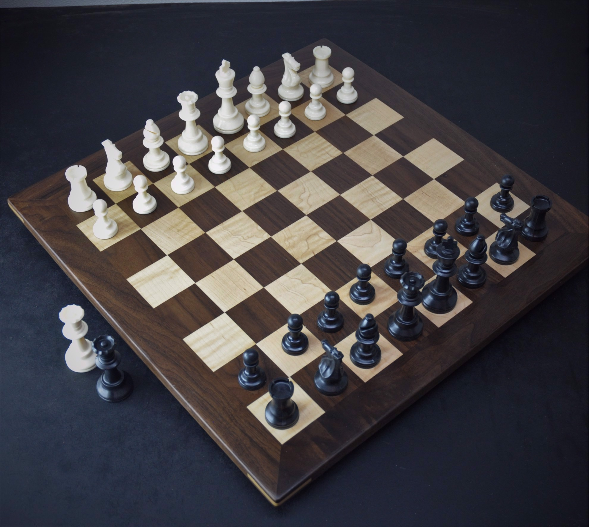
Draw Chess Board Using Turtle in Python
In this presentation, we will explore how to use the Turtle library in Python to
create a visually stunning chessboard.

Slide 2
What is Turtle in Python?
Interactive Library
Simple and Fun 🎨
Great for Beginners 🚀
Turtle is a graphics library that allows for interactive drawing and animation in Python.
With its intuitive commands, Turtle makes it easy to create beautiful designs and art.
Turtle is beginner-friendly and provides instant feedback on your code.

Slide 3
Setting up the Environment
Installing Python and Turtle 🐍
1 2
Importing the Turtle Library
We'll import the Turtle library into our Python script, enabling us to access its rich functionality.
We'll install Python and Turtle, ensuring that we have the necessary tools to create our chessboard.

Slide 4
Program:
import turtle
# Constants
SCREEN_SIZE = 400
SQUARE_SIZE = SCREEN_SIZE // 8
# Function to draw a square
def draw_square(color):
turtle.begin_fill()
turtle.fillcolor(color)
for _ in range(4):
turtle.forward(SQUARE_SIZE)
turtle.right(90)
turtle.end_fill()
# Function to draw the chessboard
def draw_chessboard():
for row in range(8):
for col in range(8):
if (row + col) % 2 == 0:
draw_square("black")
else:

Slide 5
Program Cont..
draw_square("white")
turtle.forward(SQUARE_SIZE)
turtle.backward(8 * SQUARE_SIZE)
turtle.right(90)
turtle.forward(SQUARE_SIZE)
turtle.left(90)
# Set up the turtle screen
turtle.speed(0)
turtle.hideturtle()
turtle.bgcolor("white")
turtle.title("Chess Board")
turtle.setup(SCREEN_SIZE, SCREEN_SIZE)
# Move to starting position
turtle.penup()
turtle.goto(-SCREEN_SIZE / 2, SCREEN_SIZE / 2)
turtle.pendown()
# Draw the chessboard
draw_chessboard()
# Keep the window open
turtle.done()

Slide 6
Breakdown of the code:
Import turtle module: import turtle allows you to use the turtle graphics library.
Define Constants: SCREEN_SIZE and SQUARE_SIZE are constants used to determine the size of the turtle window and each square on the chessboard.
Define draw_square Function: This function takes a color as an argument and uses the turtle to draw a filled square of the specified color.
Define draw_chessboard Function: This function uses nested loops to draw an 8x8 chessboard. It calls the draw_square function to draw each square, alternating between black and white based on the row and column indices.

Slide 7
Cont..
Set up Turtle Screen: Configure the turtle screen with the desired size, background color, and title.
Move to Starting Position: Use turtle.penup() and turtle.pendown() to control the turtle's pen. Move to the starting position at the top-left corner of the chessboard.
Draw the Chessboard: Call the draw_chessboard function to draw the entire chessboard.
Keep the Window Open: turtle.done() ensures that the window remains open until closed by the user.
Run this script, and you should see a graphical window displaying a chessboard drawn using the turtle graphics library. The black and white squares alternate, creating a simple chessboard pattern.

Slide 8
Conclusion
1
Recap of the Steps
We'll summarize the steps involved in creating a beautiful chessboard using Turtle in Python.

Slide 9
THANK YOU

