Slide 1
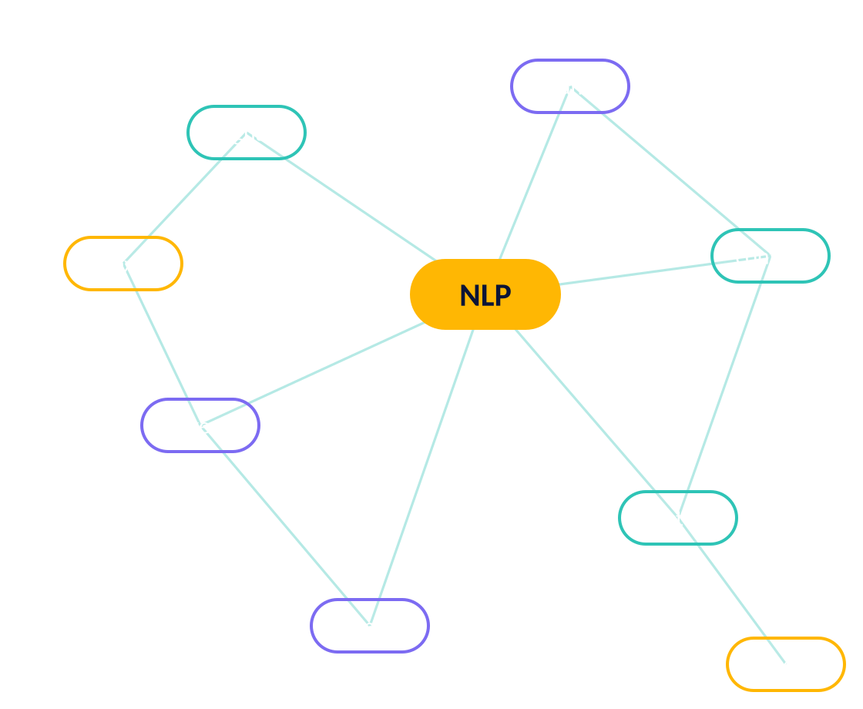
NATURAL LANGUAGE PROCESSING
Introduction to NLP
NLTK vs Spacy
Mohammad Azam
Hands-on companion notebook included
Notes:
Speaker Notes: Welcome everyone! Today we’ll dive into Natural Language Processing—often called NLP. It’s the field of AI that enables computers to understand, interpret, and generate human language.

Slide 2
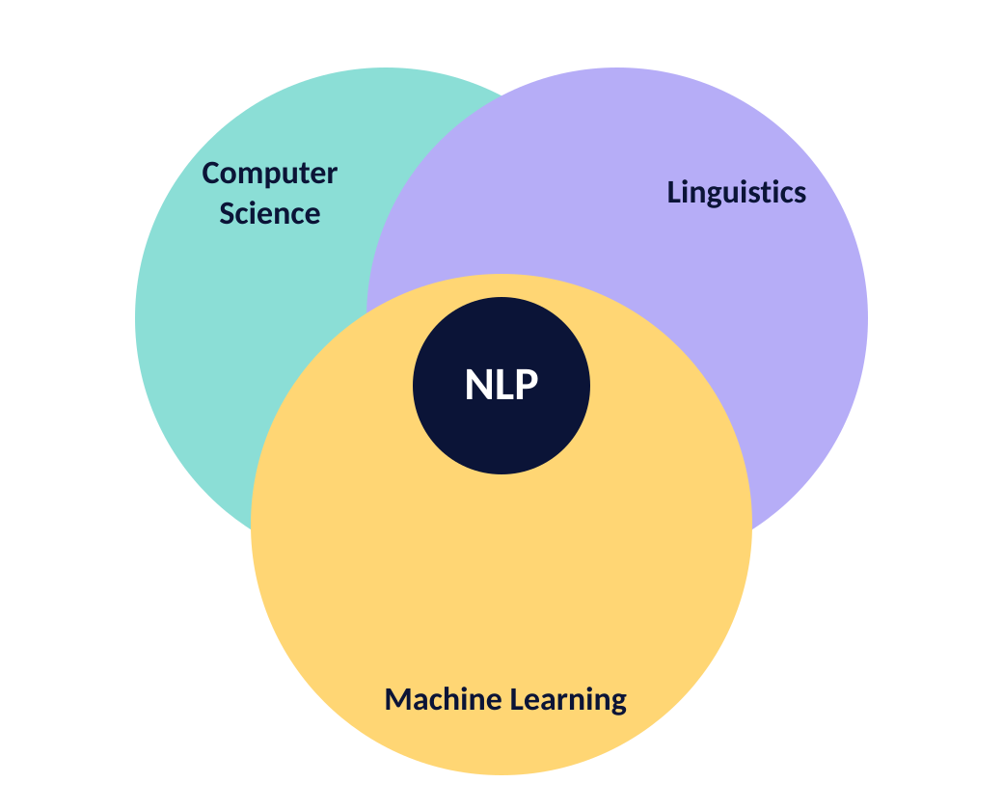



FOUNDATIONS
02
What is NLP?
Branch of AI & linguistics
Focused on human-computer communication using natural language
Converts unstructured text into structured insights
“Teaching computers how to speak human.”
Notes:
At its core, NLP is a branch of artificial intelligence and linguistics. It sits at the intersection of computer science, linguistics, and machine learning. The goal is simple but ambitious: to enable computers to understand, interpret, and even generate human language. Think about all the different forms of language—spoken words, text messages, emails, books, tweets—and imagine how varied they are. NLP tries to unify that complexity into a system that computers can process. Another way to think about it is: NLP is about teaching computers how to “speak human.”

Slide 3



MOTIVATION
03
Why is NLP Important?
80% of world’s data is text-based (emails, articles, chats)
80%
Enables search engines, chatbots, translations
Drives personalization & automation
Without NLP, the majority of the world’s information is invisible to machines.
Notes:
Why do we care about NLP? Because the vast majority of the world’s data—close to 80%—is in text form. That includes everything from emails and news articles to medical records and social media posts. Without NLP, this data is basically invisible to machines. But with NLP, we can unlock insights, automate repetitive tasks, and enable entirely new ways of interacting with technology. For example, Google uses NLP to make search results smarter. Netflix uses NLP to personalize recommendations. Businesses use it to analyze customer feedback at scale. Simply put, NLP is the key to making sense of the world’s information.

Slide 4





THE LANDSCAPE
04
Key NLP Tasks
Text classification
Named Entity Recognition (NER)
Spam vs. not-spam, topic labels
People, places, organizations
Sentiment analysis
Machine translation
Positive, negative, neutral
English → Spanish, Chinese …
ONE PIPELINE, MANY TASKS
Question answering
from transformers import pipeline
clf = pipeline("sentiment-analysis")
clf("NLP is incredibly useful!")
Siri, Alexa, search snippets
Notes:
NLP is a big field, but most applications fall under a handful of core tasks. Text classification is the ability to categorize documents, like sorting emails into spam and non-spam. Named Entity Recognition identifies proper nouns like people, places, and organizations. Sentiment analysis tries to detect the emotion behind text, whether it’s positive, negative, or neutral. Machine translation enables us to go from English to Spanish or Chinese instantly. And question answering allows systems like Siri or Alexa to respond directly to queries. Mastering these tasks gives us the foundation for building advanced NLP applications.

Slide 5
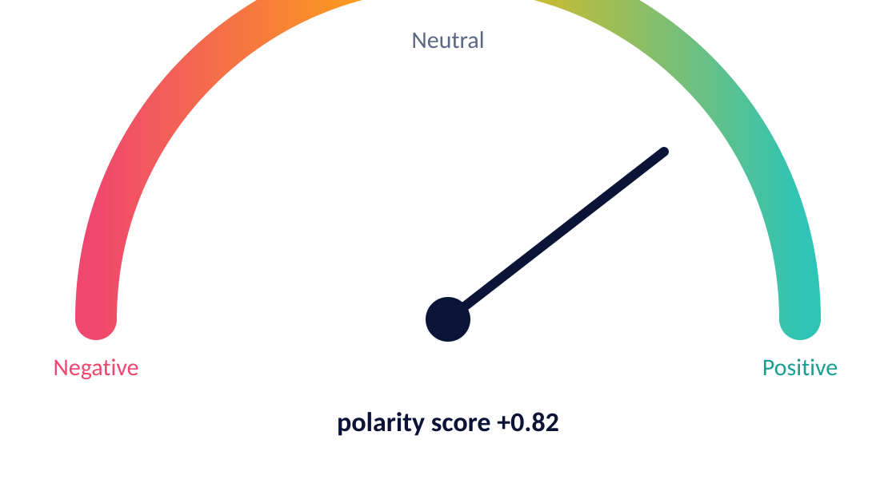
EXAMPLE
05
Example: Sentiment Analysis
“The new iPhone is amazing!”
Positive
“The food was cold and bland.”
Negative
RULE-BASED BASELINE WITH NLTK VADER
import nltk; nltk.download("vader_lexicon")
from nltk.sentiment import SentimentIntensityAnalyzer
sia = SentimentIntensityAnalyzer()
sia.polarity_scores("The new iPhone is amazing!")
# {'neg': 0.0, 'neu': 0.47, 'pos': 0.53, 'compound': 0.6239}
Notes:
Speaker Notes: Here’s a simple but powerful application: sentiment analysis. If someone tweets, “The new iPhone is amazing!”, an NLP system can label that as positive. If another person writes, “The food was cold and bland,” that’s negative. While this might seem trivial, imagine doing it across millions of reviews or tweets. Companies use sentiment analysis to measure brand reputation, understand customer satisfaction, and detect potential PR crises before they spiral. For instance, airlines and hotels monitor Twitter feeds in real time so they can quickly respond to complaints.

Slide 6
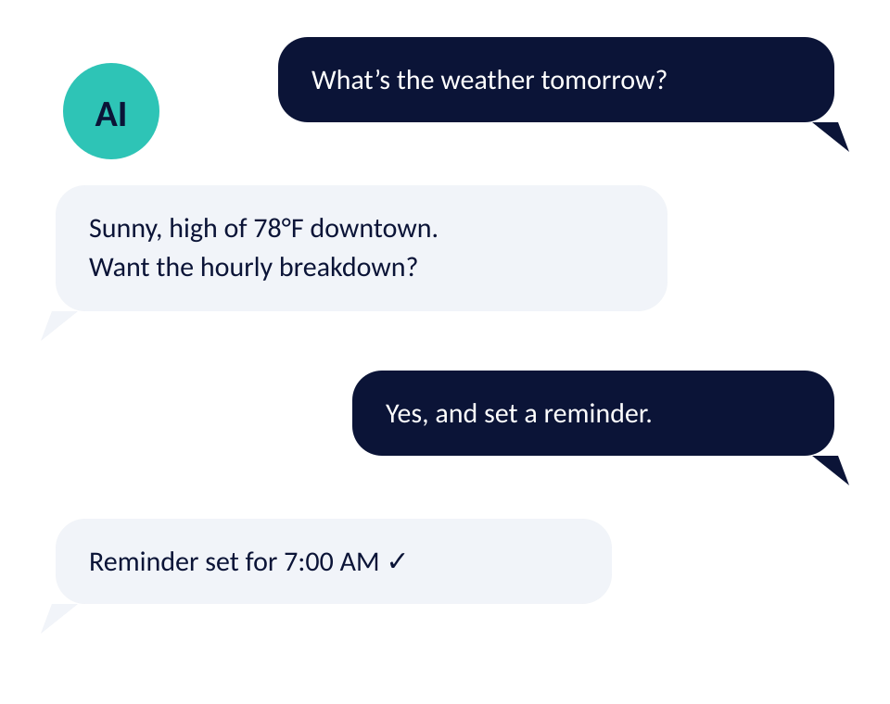


EXAMPLE
06
Example: Chatbots
Virtual assistants
Siri, Alexa, Google Assistant
Customer service bots
Instant answers, fewer tickets
Healthcare support bots
Reliable info and reminders
Notes:
Speaker Notes: Another everyday application is chatbots. Think about Siri, Alexa, or Google Assistant. These systems rely on NLP to understand natural questions like “What’s the weather tomorrow?” or “Play some jazz music.” Beyond virtual assistants, many businesses now deploy chatbots for customer service, answering common questions instantly and reducing the need for human agents. In healthcare, NLP-powered bots can provide patients with reliable information and reminders. Chatbots are one of the clearest examples of how NLP is already part of our daily lives.

Slide 7
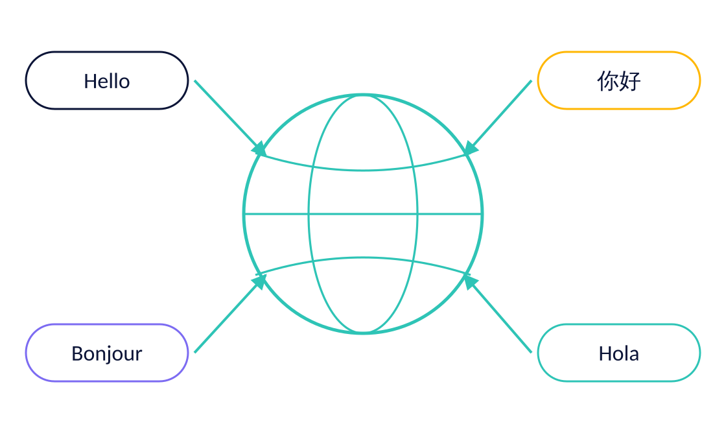
EXAMPLE
07
Example: Machine Translation
Google Translate
Real-time multilingual communication
Breaking down language barriers
TRANSLATION IN A FEW LINES (HUGGING FACE)
from transformers import pipeline
translator = pipeline("translation_en_to_fr")
translator("Natural language processing is powerful.")
# [{'translation_text': 'Le traitement du langage naturel est puissant.'}]
Notes:
Speaker Notes: Machine translation is another very visible use of NLP. Tools like Google Translate or DeepL allow people to communicate across languages almost instantly. These systems don’t just replace words; they have to understand context, grammar, and cultural nuances. Translation is especially valuable in breaking down barriers for travel, international business, and education. For example, students in non-English-speaking countries can now access English research papers with much less friction. The accuracy of translation has improved dramatically over the last decade thanks to NLP and deep learning.

Slide 8
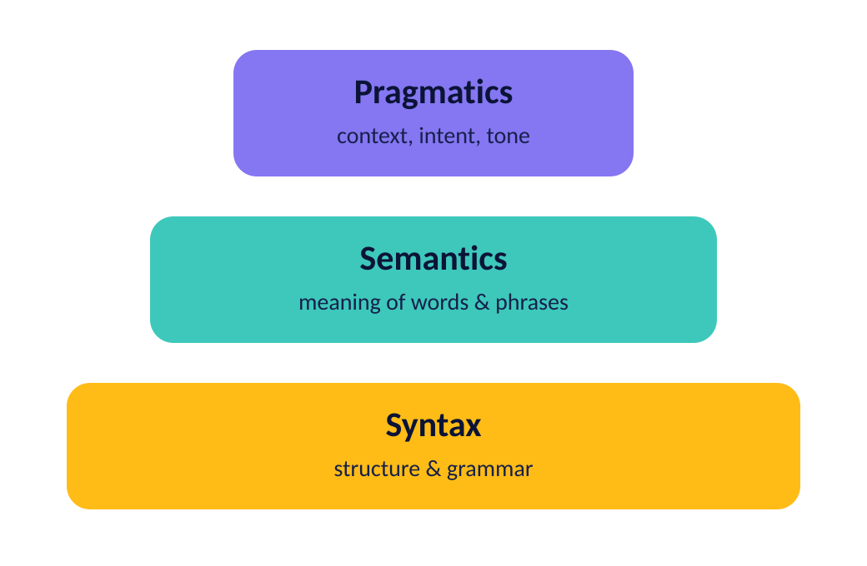
FOUNDATIONS
08
Core Components of NLP
Syntax (structure)
How words are arranged into sentences
Semantics (meaning)
What those words actually refer to
Pragmatics (context)
Tone, situation, culture — “Nice job” as praise or sarcasm
Notes:
Speaker Notes: When we talk about NLP, it helps to think in terms of three components. Syntax deals with structure—how words are arranged to form sentences. Semantics is about meaning—understanding what those words actually refer to. Pragmatics adds another layer: context. The same sentence can mean different things depending on tone, situation, or cultural background. For example, the phrase “Nice job” could be genuine praise or sarcasm, depending on context. NLP systems must navigate all three to truly understand language.

Slide 9
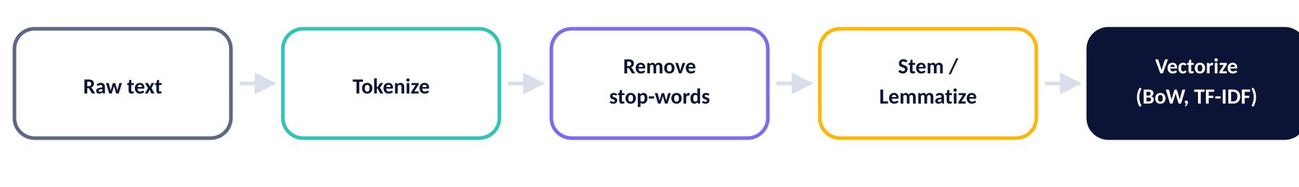
CLASSIC TOOLKIT
09
Traditional NLP Techniques
Tokenization
Stop-word removal
Stemming & Lemmatization
Split text into words or sub-words
Drop “the”, “and”, “of” …
“running” → “run”
TF-IDF IN THREE LINES
Bag-of-Words (BoW)
TF-IDF
from sklearn.feature_extraction.text \
import TfidfVectorizer
X = TfidfVectorizer().fit_transform(docs)
Text as word counts
Weight words by how distinctive they are
Notes:
Speaker Notes: Before the deep learning revolution, NLP relied on traditional techniques. Tokenization splits sentences into words. Stop-word removal gets rid of common words like “the” or “and.” Stemming and lemmatization reduce words to their root form, so “running” becomes “run.” Bag-of-Words models treat text as a collection of word counts. And TF-IDF measures how important a word is in a document relative to a collection of documents. While these techniques are relatively simple, they remain useful, especially for smaller projects or as preprocessing steps.

Slide 10
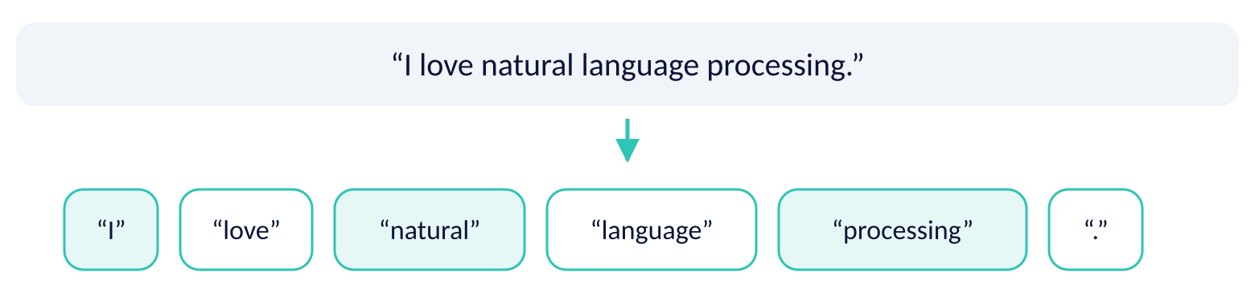
EXAMPLE
10
Example: Tokenization
NLTK
SPACY
import nltk
nltk.download("punkt")
from nltk.tokenize import word_tokenize
s = "I love natural language processing."
word_tokenize(s)
# ['I', 'love', 'natural', 'language',
# 'processing', '.']
import spacy
nlp = spacy.load("en_core_web_sm")
s = "I love natural language processing."
doc = nlp(s)
[t.text for t in doc]
# ['I', 'love', 'natural', 'language',
# 'processing', '.']
Notes:
Speaker Notes: Let’s look closer at tokenization, because it’s usually the first step in any NLP pipeline. Take the sentence “I love natural language processing.” Tokenization breaks it down into units: [“I”, “love”, “natural”, “language”, “processing”]. By splitting text into pieces, we give the computer manageable chunks to analyze. More advanced tokenization can also handle punctuation, compound words, or subwords. For instance, in modern deep learning models, we often tokenize words into smaller parts so the system can handle new or rare words.

Slide 11
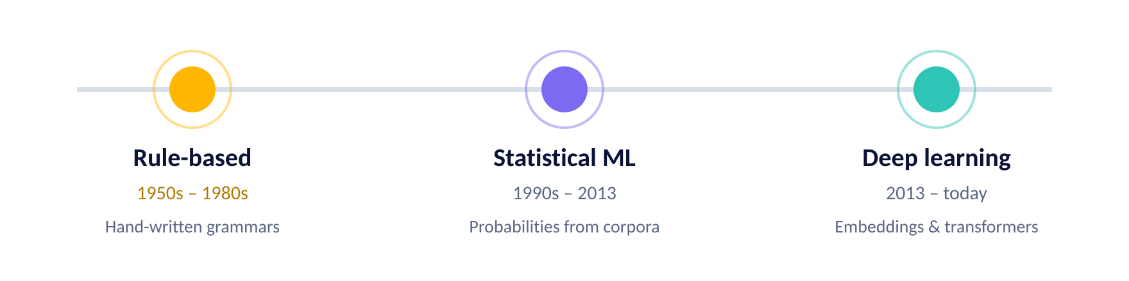
EVOLUTION
11
From Rules to Machine Learning
Early NLP: hand-written grammar rules
Modern NLP: statistical models + machine learning
Deep learning revolution
Precise, but brittle and impossible to scale
Learn probabilities from large corpora
Patterns learned directly from raw text
Notes:
Speaker Notes: NLP has gone through three major phases. In the early days, systems were rule-based. Linguists wrote grammar rules by hand, which worked for limited tasks but didn’t scale. Then came the statistical era, where we used probabilities and simple machine learning algorithms trained on large text corpora. Finally, deep learning changed the game by enabling models to learn complex patterns directly from raw text. This shift is why NLP performance has skyrocketed in recent years—machines can now capture nuances of language without us explicitly telling them the rules.

Slide 12
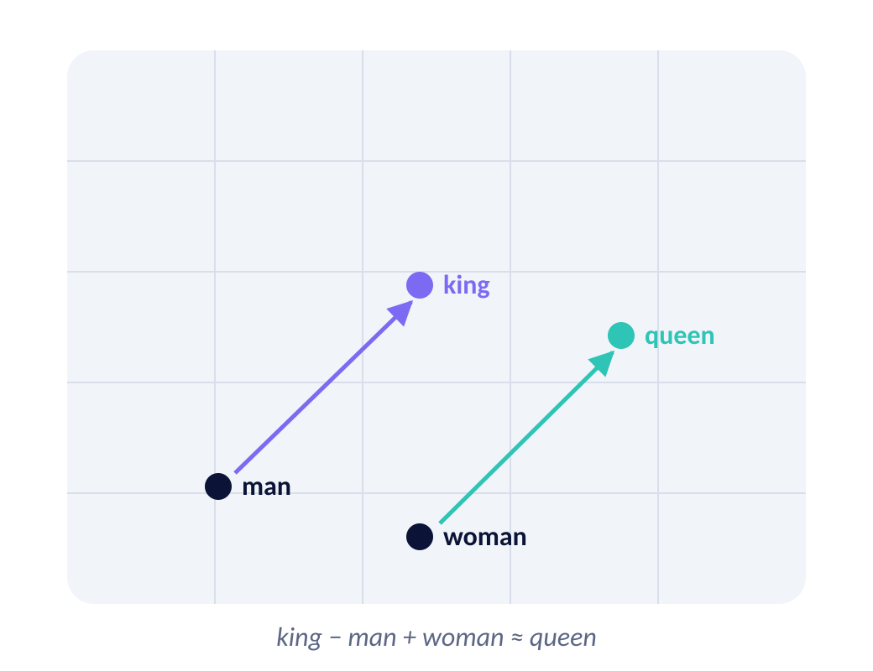
REPRESENTATION
12
Word Embeddings
Word2Vec, GloVe, FastText
Represent words as vectors
Captures semantic meaning (“king – man + woman ≈ queen”)
TRAIN YOUR OWN WITH GENSIM
from gensim.models import Word2Vec
model = Word2Vec(sentences, vector_size=100,
window=5, min_count=2)
model.wv.most_similar(
positive=["king", "woman"],
negative=["man"]) # -> [('queen', 0.78), ...]
Similar words end up close together in vector space.
Notes:
Speaker Notes: A major breakthrough in NLP was word embeddings. Models like Word2Vec, GloVe, and FastText represent words as vectors in a multi-dimensional space. The beauty of embeddings is that they capture semantic meaning. For example, the famous equation: king – man + woman ≈ queen. This shows how relationships between words are preserved in the vector space. Embeddings gave computers a way to “understand” analogies and relationships, enabling much better performance on downstream tasks like translation or classification.

Slide 13
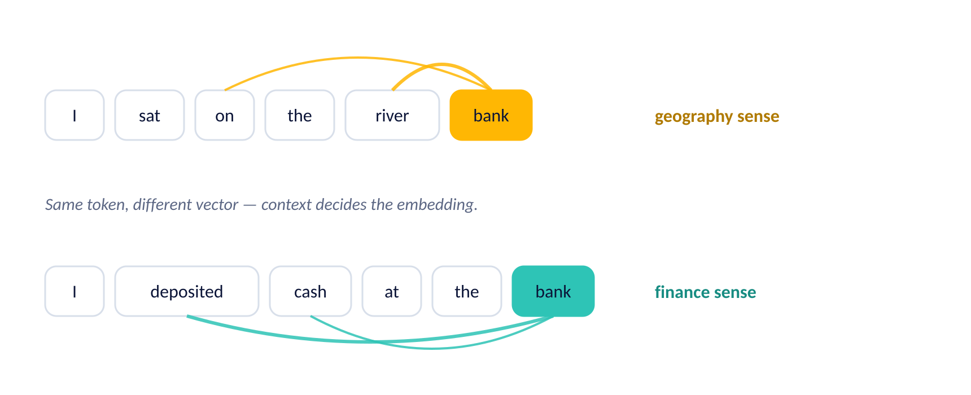
STATE OF THE ART
13
Transformer Revolution
BERT, GPT, T5
CONTEXTUAL EMBEDDINGS WITH BERT
from transformers import AutoTokenizer, AutoModel
name = "bert-base-uncased"
tok = AutoTokenizer.from_pretrained(name)
model = AutoModel.from_pretrained(name)
ids = tok("river bank", return_tensors="pt")
out = model(**ids).last_hidden_state
out.shape # one 768-d vector per token
Contextual embeddings
State-of-the-art performance
Notes:
Speaker Notes: Then came the transformer architecture, which completely reshaped NLP. Models like BERT, GPT, and T5 introduced contextual embeddings. Unlike Word2Vec, which gave each word one fixed meaning, transformers understand that words can mean different things depending on context. For example, the word “bank” means something different in “river bank” vs “bank account.” This context-awareness is what powers modern systems like ChatGPT. Transformers are now the backbone of almost all state-of-the-art NLP systems.

Slide 14



IN PRODUCTION
14
Real-World Applications
Healthcare
Finance
Disease prediction from clinical notes
Fraud detection and market sentiment
Legal
Marketing
Contract analysis and case research
Customer insights and personalization
Not futuristic — running today in hospitals, banks, law firms and marketing teams.
Notes:
Speaker Notes: NLP is no longer just academic—it’s everywhere. In healthcare, NLP extracts symptoms from clinical notes and helps predict disease progression. In finance, it’s used for fraud detection and analyzing market sentiment. In the legal field, NLP automates contract review and case research. Marketing teams rely on NLP to understand customer behavior and personalize campaigns. These aren’t futuristic ideas—they’re happening right now in hospitals, banks, law firms, and businesses around the world.

Slide 15


ECOSYSTEM
15
Tools & Libraries
NLTK
spaCy
Hugging Face Transformers
Classical NLP toolkit — built for teaching and research
Modern, production-ready library — fast and opinionated
Thousands of pre-trained models, one API
GET SET UP
pip install nltk spacy transformers scikit-learn
python -m spacy download en_core_web_sm # small English model
Notes:
Speaker Notes: If you want to work with NLP, there are a few essential libraries. NLTK is the classic educational toolkit—it’s great for learning and experimenting with basic tasks. spaCy is a modern, industrial-strength library that’s fast and production-ready. Hugging Face Transformers provides easy access to powerful pre-trained models like BERT and GPT. Together, these tools cover everything from teaching fundamentals to deploying advanced applications in the real world.

Slide 16
DEEP DIVE
16
NLTK Overview
Great for teaching & research
NLTK IN PRACTICE
import nltk
from nltk.tokenize import word_tokenize
from nltk.corpus import stopwords
from nltk.stem import WordNetLemmatizer
text = "The striped bats are hanging"
tokens = word_tokenize(text.lower())
# 1. drop stop-words
stop = set(stopwords.words("english"))
tokens = [t for t in tokens if t not in stop]
# 2. lemmatize + POS tag
lem = WordNetLemmatizer()
roots = [lem.lemmatize(t, "v") for t in tokens]
nltk.pos_tag(roots)
# [('striped','JJ'), ('bat','NN'), ('hang','VB')]
Includes tokenization, stemming, POS tagging
Slower, not designed for production
Think of NLTK as your training wheels — excellent for learning how NLP works under the hood.
Notes:
Speaker Notes: NLTK, or the Natural Language Toolkit, has been around for years and is often the first library students encounter. It provides functionality for tokenization, stemming, part-of-speech tagging, and more. It’s incredibly useful for learning how NLP works under the hood. But it’s slower and less optimized for production-scale projects. Think of NLTK as your training wheels—it’s excellent for teaching and prototyping, but you’ll likely move to other tools once you need performance and scalability.

Slide 17
DEEP DIVE
17
spaCy Overview
Industrial-strength NLP
ONE PASS, MANY ANNOTATIONS
import spacy
nlp = spacy.load("en_core_web_sm")
doc = nlp("Apple is hiring engineers in Austin")
# named entities
for ent in doc.ents:
print(ent.text, ent.label_)
# Apple ORG | Austin GPE
# POS tags and dependencies, precomputed
for tok in doc[:3]:
print(tok.text, tok.pos_, tok.dep_)
# Apple PROPN nsubj | is AUX aux | hiring VERB
doc.vector.shape # document embedding
Optimized in Cython → very fast
Easy integration with deep learning frameworks
Pre-trained models
The industry choice when you need speed, accuracy and scale.
Notes:
Speaker Notes: spaCy is designed for the real world. It’s written in Cython, making it very fast. It comes with pre-trained models out of the box for tasks like NER and POS tagging. It integrates easily with deep learning frameworks like TensorFlow and PyTorch, so you can build custom models. The API is simple and elegant, which makes it great for developers who want to focus on building applications rather than dealing with complexity. In short, spaCy is the industry choice when you need speed, accuracy, and scalability.

Slide 18
HEAD TO HEAD
18
NLTK vs spaCy
Feature | NLTK | spaCy
Purpose | Teaching, research | Production, industry
Speed | Slower | Very fast
Models | Basic | Pre-trained, deep learning ready
Community | Academic | Industry & open-source
Learning curve | Beginner-friendly | Developer-friendly
NLTK is great for learning. spaCy is great for doing.
Notes:
How do NLTK and spaCy compare? NLTK is fantastic for research and education—it has a wide range of tools, but it’s slower and more complex to use. spaCy, by contrast, is streamlined, fast, and built for production deployment. If you’re teaching or experimenting, NLTK is a good fit. If you’re building something that needs to run in a real business environment, spaCy is the way to go. In short: NLTK is great for learning, spaCy is great for doing.

Slide 19
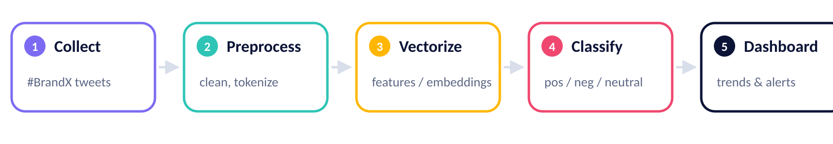
CASE STUDY
19
Case Study: Twitter Sentiment
Collect tweets with hashtags (#BrandX)
Use spaCy for preprocessing
Classify as positive/negative/neutral
PREPROCESS + CLASSIFY
import spacy, re
nlp = spacy.load("en_core_web_sm")
def clean(tweet):
tweet = re.sub(r"http\S+|@\w+", "", tweet)
doc = nlp(tweet.lower())
keep = [t.lemma_ for t in doc
if not t.is_stop and t.is_alpha]
return " ".join(keep)
clf.predict(vec.transform([clean(tweet)]))
Real-time monitoring turns a bad launch into a fast response.
Notes:
Speaker Notes: Let’s apply this to a real-world case. Imagine a company wants to track how people feel about their brand on Twitter. Using spaCy, they can preprocess tweets—clean them up, remove stop words, tokenize, and extract features. Then, a classifier can label each tweet as positive, negative, or neutral. This allows the company to see trends in real time. For example, if a new product launch receives overwhelmingly negative sentiment, they can quickly investigate and respond. This kind of real-time monitoring is invaluable for managing reputation.

Slide 20
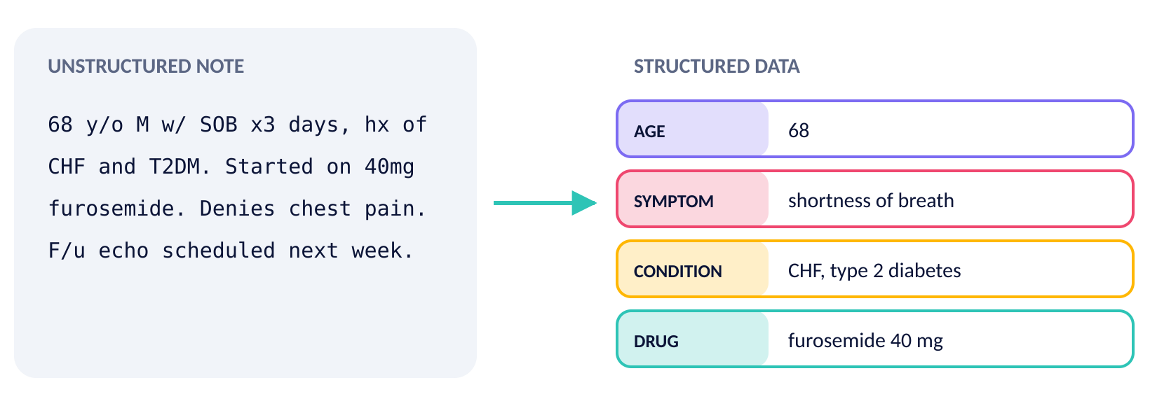
CASE STUDY
20
Case Study: Healthcare NLP
Extract symptoms from clinical notes
Detect disease progression
Assist in diagnosis
Turning free text into structured data saves clinicians time and improves patient care.
Notes:
Speaker Notes: Healthcare is another powerful domain for NLP. Doctors’ notes are often unstructured and full of shorthand, but NLP can extract key information like symptoms, diagnoses, or medications. This data can then be used to track disease progression, support clinical decision-making, or even predict patient outcomes. For example, an NLP system might detect that multiple patients in a region are showing the same unusual symptom, which could help identify emerging health threats. By turning free text into structured data, NLP saves doctors time and improves patient care.

Slide 21


REALITY CHECK
21
Challenges in NLP
Ambiguity of language
Sarcasm & irony
One phrase, many possible readings
“Nice job” — praise or insult?
Low-resource languages
Bias in training data
Billions of speakers, little training data
Models reproduce and amplify what they learn
These are not just technical problems — they carry ethical and social weight.
Notes:
Despite all the progress, NLP faces serious challenges. Language is ambiguous—one phrase can mean different things depending on context. Sarcasm and irony are especially hard for machines to detect. Many languages are underrepresented in training data, leading to poor performance for billions of speakers. And then there’s bias: if models are trained on biased data, they can reproduce or even amplify those biases. These are not just technical problems—they have ethical and social implications.

Slide 22

WHAT’S NEXT
22
Future of NLP
Dozens of languages in one system
More multilingual models
Intent and tone, not just words
Better handling of context & reasoning
Assistants that hold a thread
Conversational AI (ChatGPT, Claude)
Systems we can actually trust
Ethical & fair AI systems
Not just smarter models — models we can trust.
Notes:
Speaker Notes: Looking ahead, we see a few major directions for NLP. One is multilingual models—systems that can handle dozens of languages seamlessly. Another is improved context handling, so models understand not just words but intent, tone, and relationships. Conversational AI is also advancing quickly; tools like ChatGPT or Claude are early examples. Finally, there’s a growing emphasis on fairness and ethics. The future of NLP isn’t just about smarter models—it’s about building systems we can trust.

Slide 23


RESPONSIBILITY
23
Ethical Considerations
Bias in language models
Misinformation generation
Privacy concerns
Training data shapes who the model serves well — and who it fails
Fake articles and misleading reviews at scale
Medical records and private conversations are text too
Ethics is no longer optional — it is central to the field.
Notes:
Speaker Notes: As NLP grows more powerful, we need to confront its ethical challenges. Large language models can reflect biases present in their training data, leading to unfair outcomes. They can also be used to generate misinformation, like fake news articles or misleading reviews. And there are privacy concerns when processing sensitive text data, such as medical records or private conversations. Developers must take responsibility for how their models are trained, deployed, and used. Ethics is no longer optional—it’s central to the field.

Slide 24

WRAPPING UP
24
Recap
NLP = AI + linguistics
From rules → ML → Transformers
Language understood at machine scale
Three eras, each a step change
Tools: NLTK, spaCy, Hugging Face
Real-world impact in many industries
Learn, ship, and stand on pre-trained models
Healthcare, finance, legal, marketing
NLP helps us make sense of human language at scale.
Notes:
Speaker Notes: Let’s quickly review what we’ve covered. NLP is the intersection of AI and linguistics. It has evolved from hand-written rules to statistical models to deep learning and transformers. We looked at core tasks, from classification to translation, and explored real-world applications across healthcare, finance, legal, and marketing industries. We compared tools like NLTK and spaCy, and we discussed challenges and ethics. The big picture is this: NLP helps us make sense of human language at scale, and it’s reshaping how we interact with technology.

Slide 25
HANDS-ON
1 · Setup & installation
Run every example yourself
2 · Tokenization, stop-words, lemmatization
nlp_examples.ipynb — a companion notebook with the full, runnable version of every snippet in this deck.
3 · BoW and TF-IDF from scratch
4 · Sentiment analysis: VADER, sklearn, transformers
5 · Named entity recognition with spaCy
6 · NLTK vs spaCy speed benchmark
Thank you · Questions?
7 · Embeddings & contextual vectors
Notes:
This slide is a pointer to the companion Jupyter notebook, nlp_examples.ipynb. Everything shown in the deck is reproduced there in runnable form, section by section, so the audience can follow along after the talk. Open the floor for questions here.

