Slide 1

Smart
PA (My Personal Assistant)

Slide 2
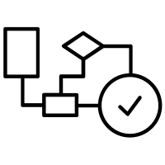
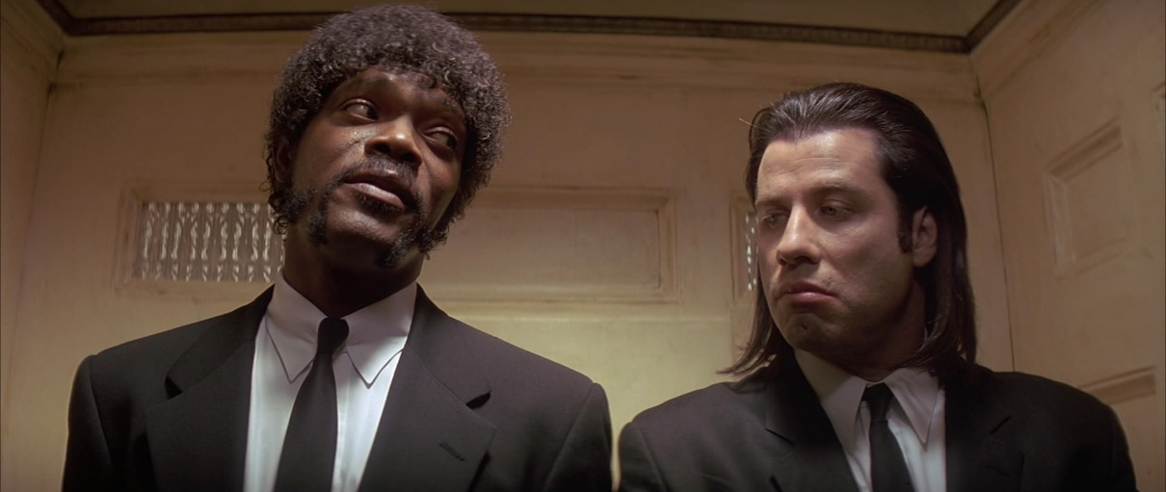
Problem Statement?
Do you have personal assistant?

Slide 3
Problem Statement?
Daily Boring Tasks
Zero Motivation
Quick Responses

Slide 4
Core Functionality
Web Surfing
WhatsApp
Play Hacker Music of the Day
Entertainment
Motivation
Instant Emailing
Make Todo List

Slide 5








Solutions

Slide 6
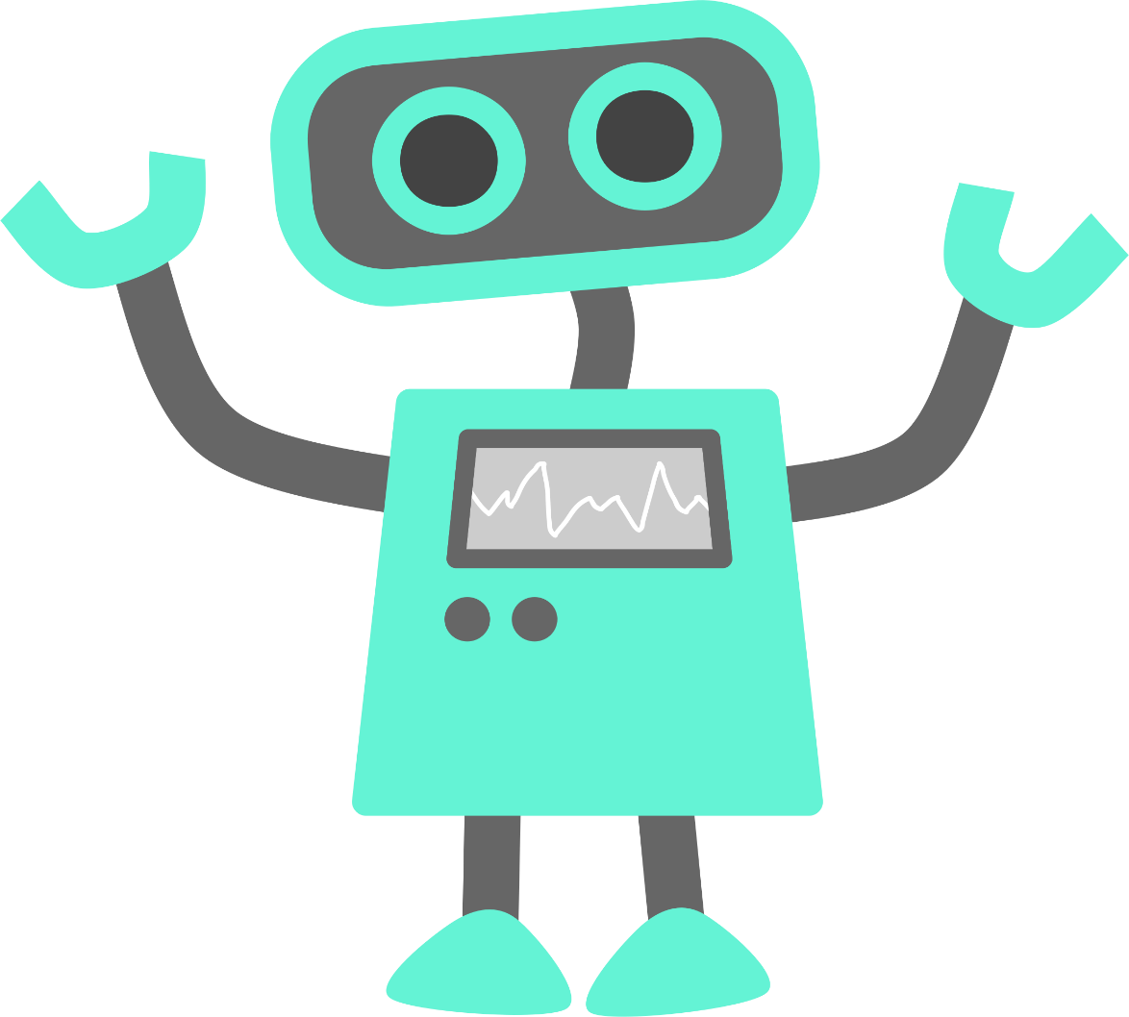
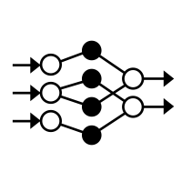
Based on rules
Based on AI

Slide 7
Concepts Used
Web Scrapping
Loguru
Multiprocessing
SMTPlib
Twilio
Oops
Flask
Webapp
Pandas
Requests
Beautiful Soup
Exception Handling

Slide 8
Architecture
vector
Play
Search
Mailbot
To Do List
Yes,
hi
what’s
up?
encoder
decoder

Slide 9



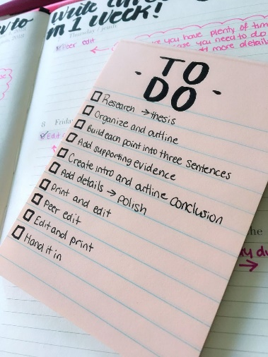


Architecture
Hey, Genie Be My Personal Assistant and
App
Bot
Parser. Handler
Actions
Feedback
_ main_bot.py
def talk(txt): engine.say(txt) engine.runAndWait()
classifier
client
API

Slide 10

Live Demo

Slide 11
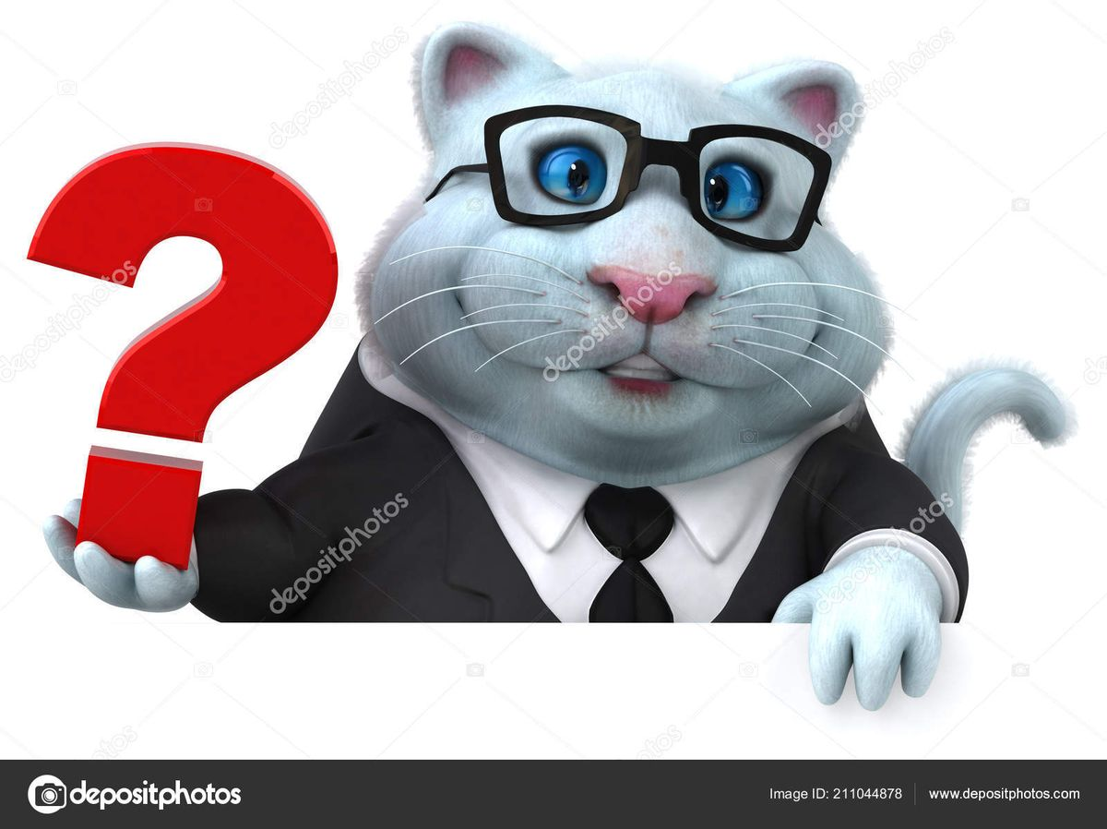
Questions

