Slide 1

Smart Home Products Online Store Database
Group-8
Dhwani Vaishnav
Phue Thant
Pratiksha Yadav

Slide 2
AGENDA
Introduction and Purpose of the project
Project Flow and Functionality
Entity Relationship Diagram (ERD)
Referential Integrity / Normalization
DDL, DML, PL/SQL, ORDB snippets
Lessons learnt from the project
Room for Improvements

Slide 3
INTRODUCTION
Complete solution for businesses to manage customer, order, product, order item, and employee data.
Streamlines the process of handling smart home product information.
Track employee activities, process orders, and monitor customer information.
Handle both in-house manufactured and supplier-provided products.
Reference guide for developers, administrators, and stakeholders to effectively manage and maintain the online store's data structure, components, and functionality.

Slide 4
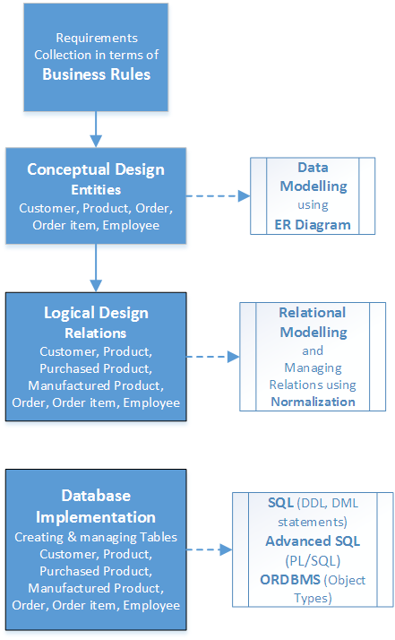
PROJECT FLOW
AND
FUNCTIONALITY

Slide 5
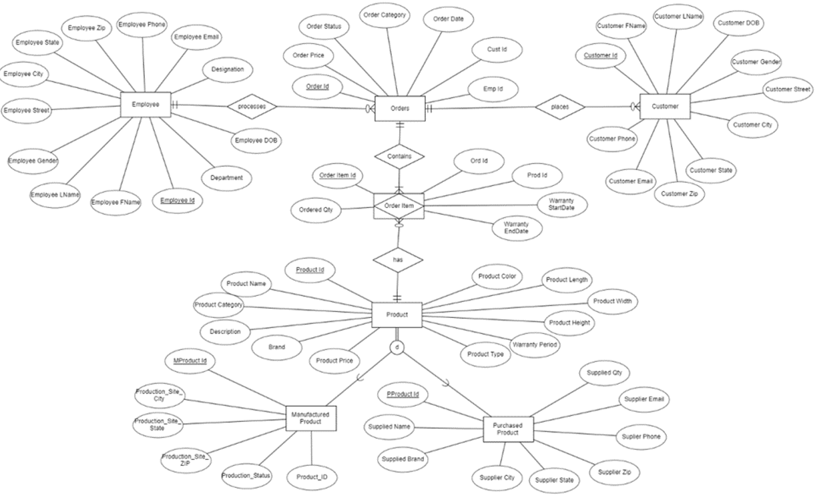
Entity Relationship Diagram (ERD)

Slide 6
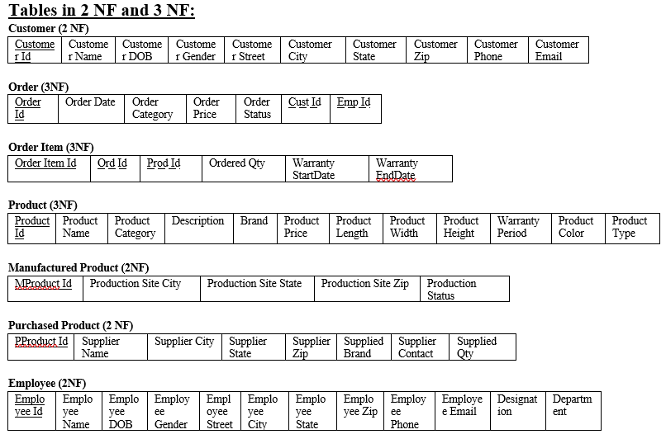
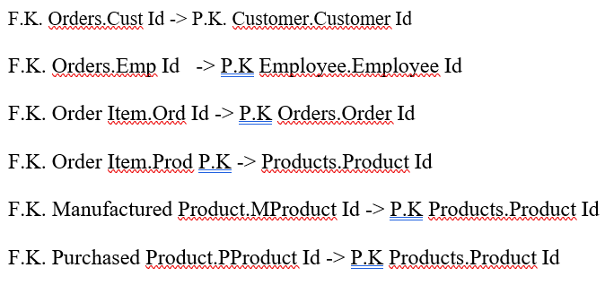
Referential Integrity and Normalization

Slide 7
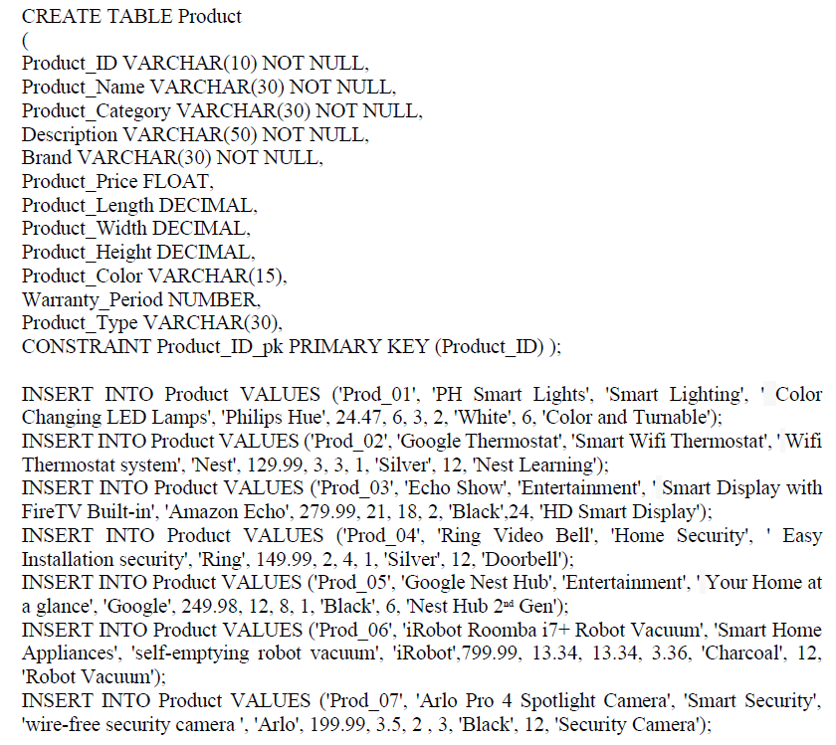
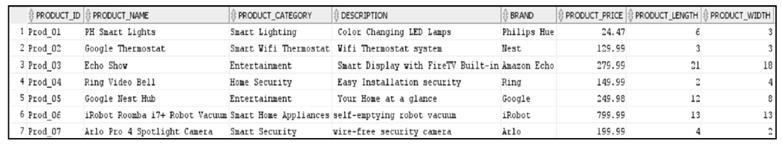
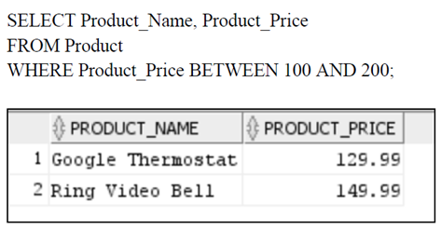
CREATE TABLES, INSERT ROWS, SELECT, WHERE Statement
CREATE Table and INSERT INTO
SELECT * FROM PRODUCT;
Using WHERE Statement List all the Products of the company that have a price between $100 and $200.

Slide 8
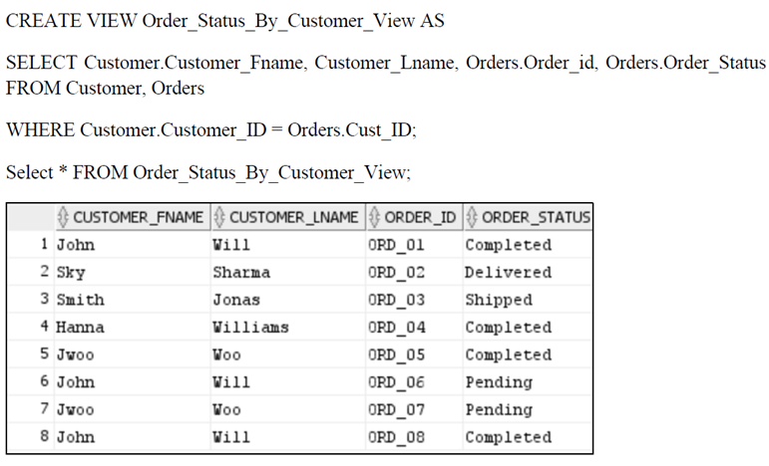
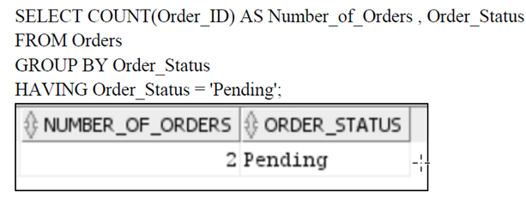
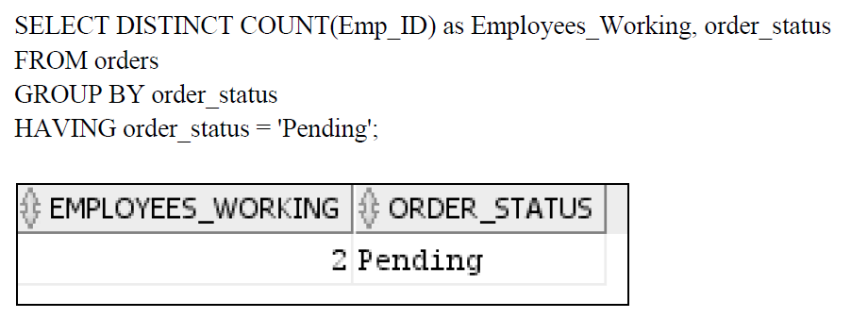
CREATE VIEW, GROUPBY & HAVING STATEMENT
Creating a View of Customer Order Status
Using GROUPBY & HAVING clause retrieve Orders have the Pending Order Status?
How many employees are currently working on the “Pending” orders?

Slide 9
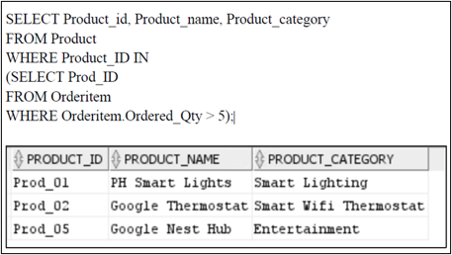
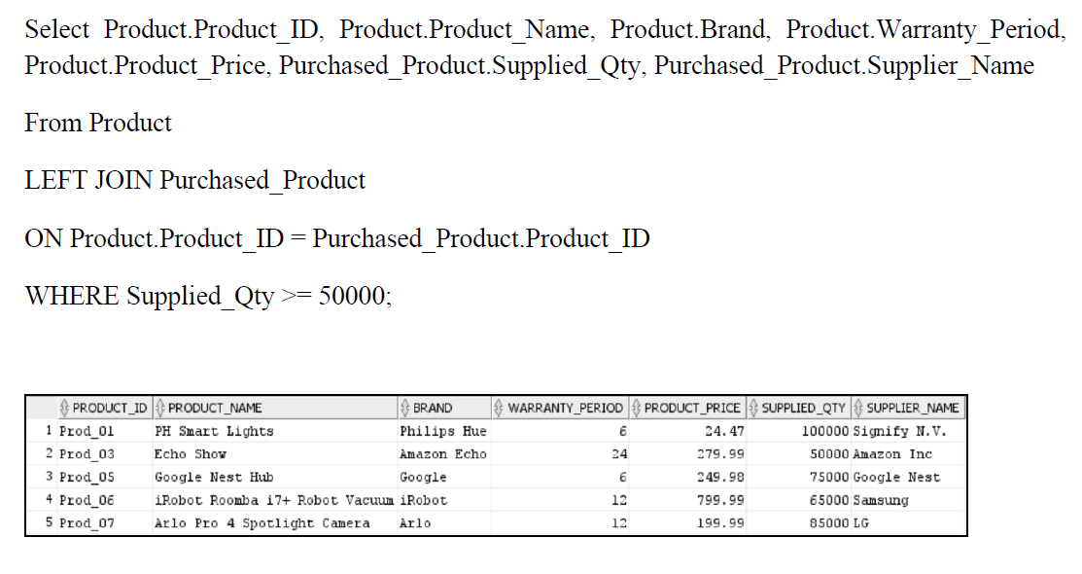
SUBQUERY AND JOIN Statement
SUBQUERY to Retrieve the names and categories of products that have been ordered in quantities greater than 5
Using JOIN statement to retrieve Product Details and Supplier Information for Products with Supplied Quantity of 50,000 or More

Slide 10
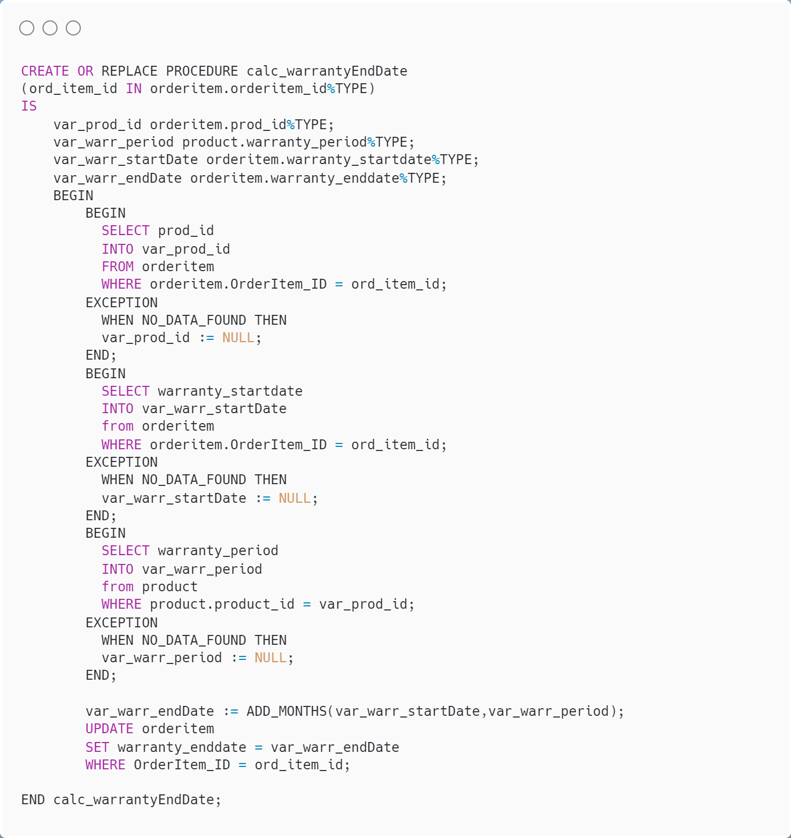
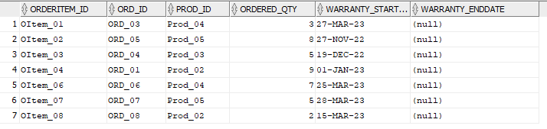
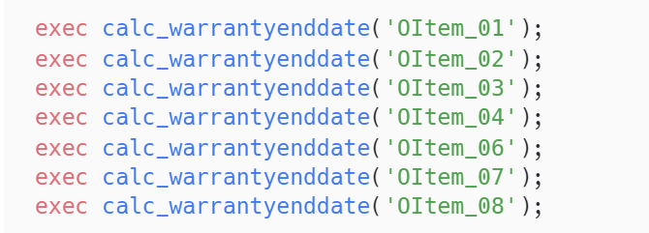
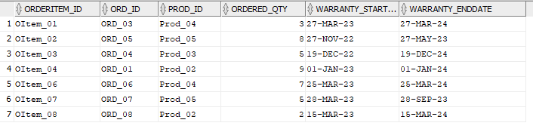
PL/SQL Procedure
Procedure calc_warrantyEndDate calculates the Warranty End Date based on Warranty Start Date & Product Warranty Period
Updates the value of "Warranty_Enddate" column of OrderItem Table
Table OrderItem before execution:
Executing the Procedure calc_warrantyEndDate
Table OrderItem before execution:

Slide 11
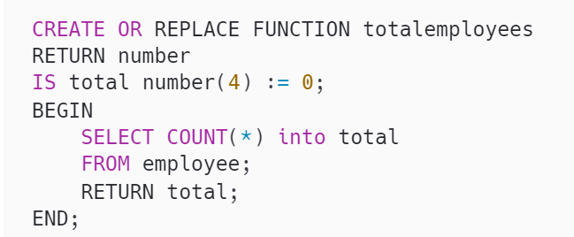
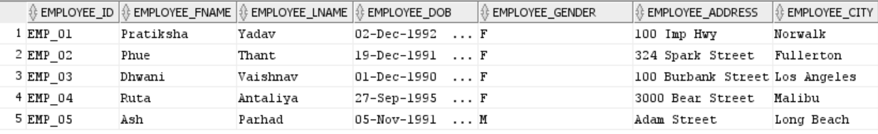
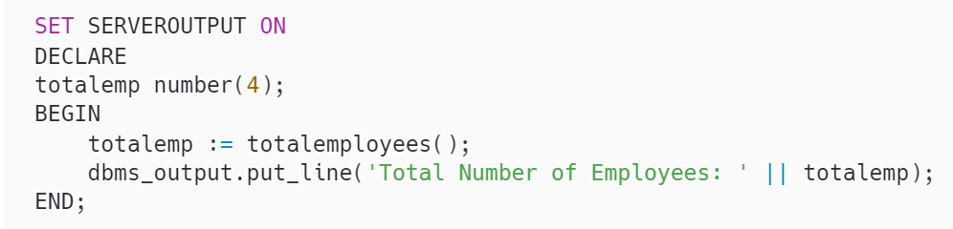
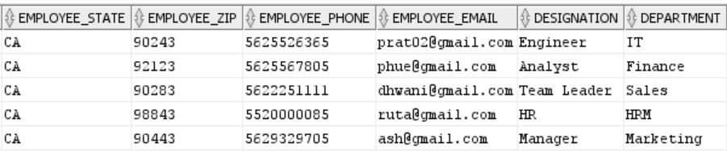
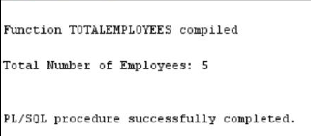
PL/SQL Function
Function to Count total number of employees
Employee Table (For reference of the output)
Function Call
Output

Slide 12
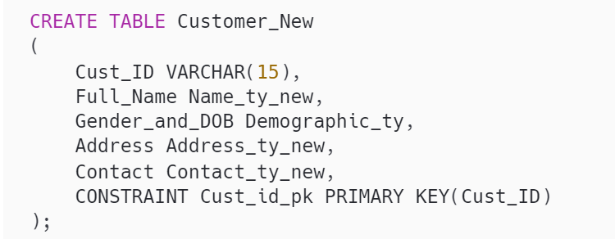
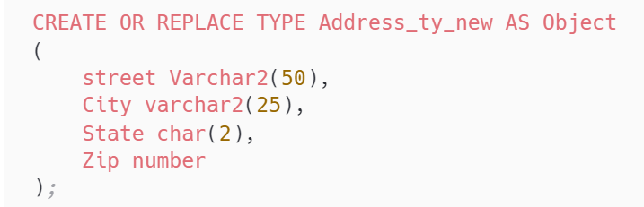
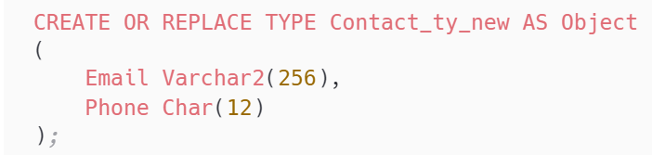
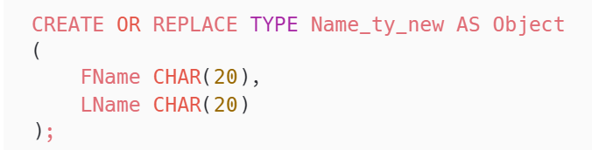
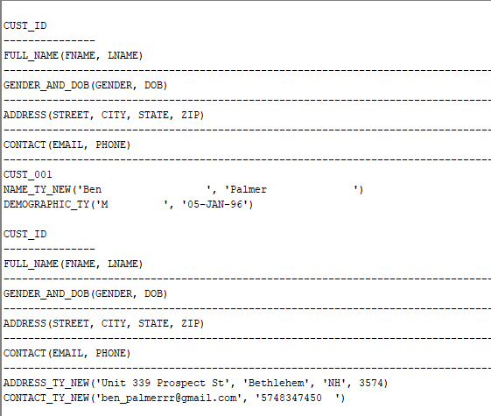
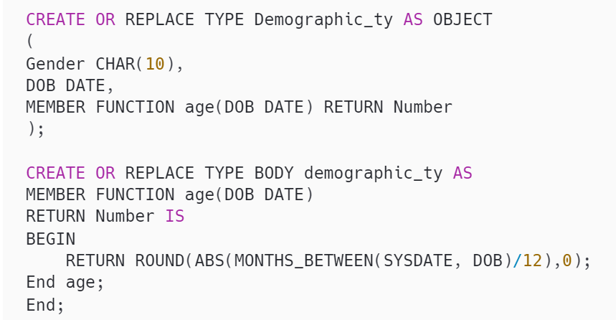

ORDB Snippets
Creating Table using Object Types
Object Address_ty
Object Contact_ty
Inserting Data into the Table
Object Name_ty
Selecting Data from the Table
SELECT Output
Calling the function age()
Object Demographic_ty with member Function age()
FUNCTION Output

Slide 13


Lessons Learnt from Project development
Got to apply what we learnt in the class - advanced database concepts using PL/SQL and ORDBMS concepts
Query optimization using Object Types – examples: address, contact, full name & demographic details
Creative thinking from business point of view & attention to details
Programmable solutions for required calculations – example: PL/SQL procedure for calculating warranty end date
Improvements Identified
By using ORDB concepts in the beginning only for creating all the tables, we could have modeled the database schema in a more flexible & efficient manner and achieved better performance

Slide 14

Thank You!

