Slide 1
A Project On Employee Retention
Using MS Excel, My SQL, Tableau
By-
Pratibha Verma
Sunke Jahnavi Bindu
Akshay Surendra Indapurkar

Slide 2
Employee Retention Project
We performed an analysis on HR data for employee retention having 50,000+ records and drawn KPI from it using excel, my SQL and also used visualization tools like tableau and also used power bi to make dynamic dashboard.
We got some insights regarding attrition of employees with respect to department, monthly income, work life balance, years of promotion etc.

Slide 3
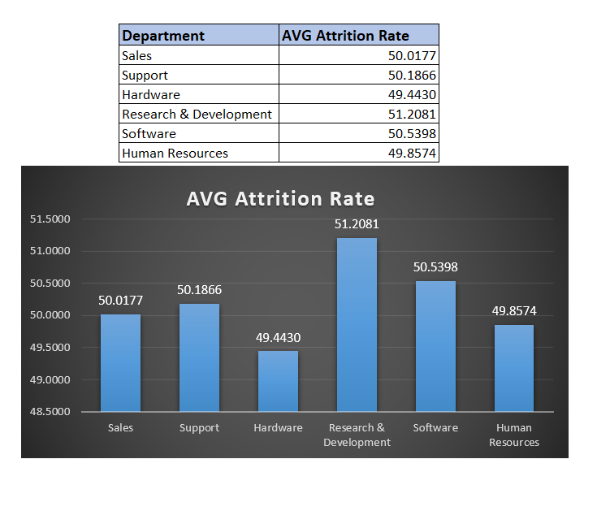
1. Average Attrition rate for all Departments
The insights driven using excel is shown here:
Data shows that Research & Development department has highest attrition rate while hardware has lowest.
We can see salary hike is not the reason of attrition cause R&D department getting good percentage salary hike.
In this department attrition of Females are more.
In HR, software department attrition of male is higher than female, while in other department female attrition rate is higher than male.
Work life balance is good for this department.
Attrition is more who has more working years in current role.
One reason can be the manager they are working under.

Slide 4
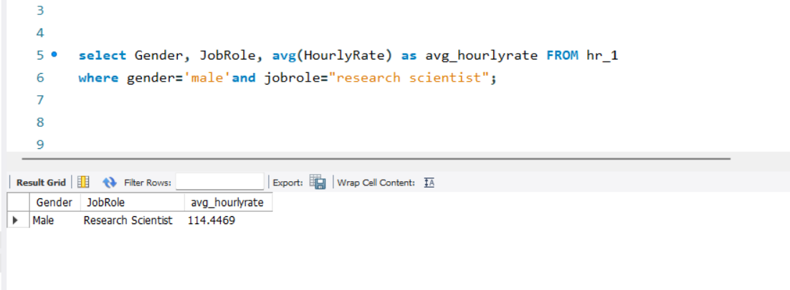
2. Average Hourly rate of Male Research Scientist
The insights driven using my SQL is shown here:
Min hourly rate = 30
Max hourly rate = 200
AVG hourly rate of male research scientist is coming as 114.45
While for female its 115.9
Work life balance for research scientist is average.

Slide 5
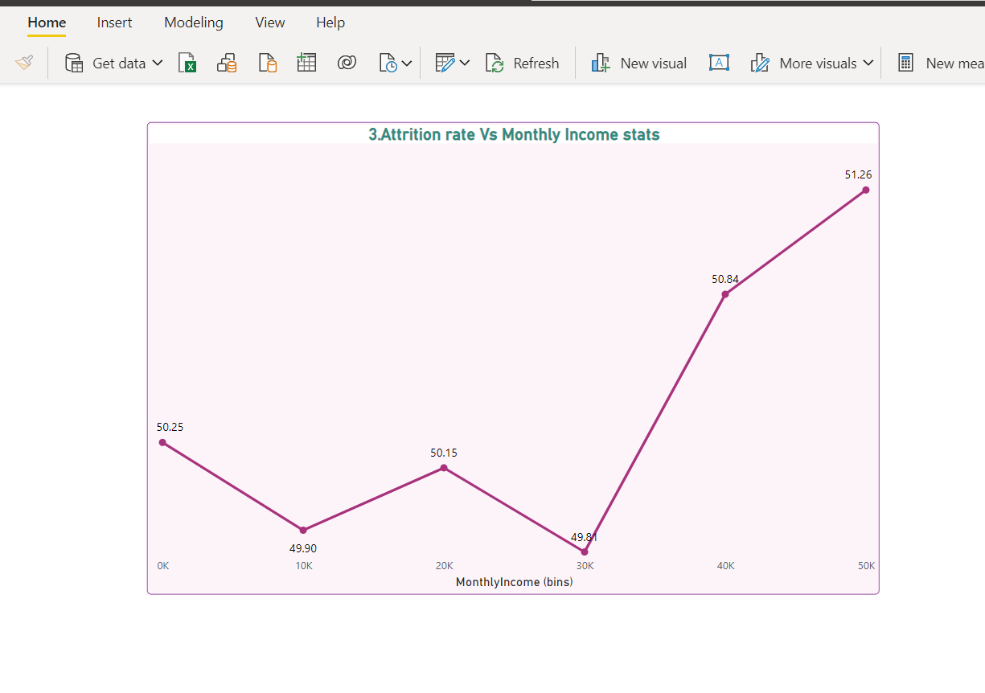
3. Attrition rate Vs Monthly income stats
The insights driven using power bi is shown here:
Min salary =1001
Max salary = 50999
Maximum salary hike is for 20-30k salary bin.
Max attrition is from 40-50k salary bin.
That may be because they are getting better salary
option in other company for the same work

Slide 6
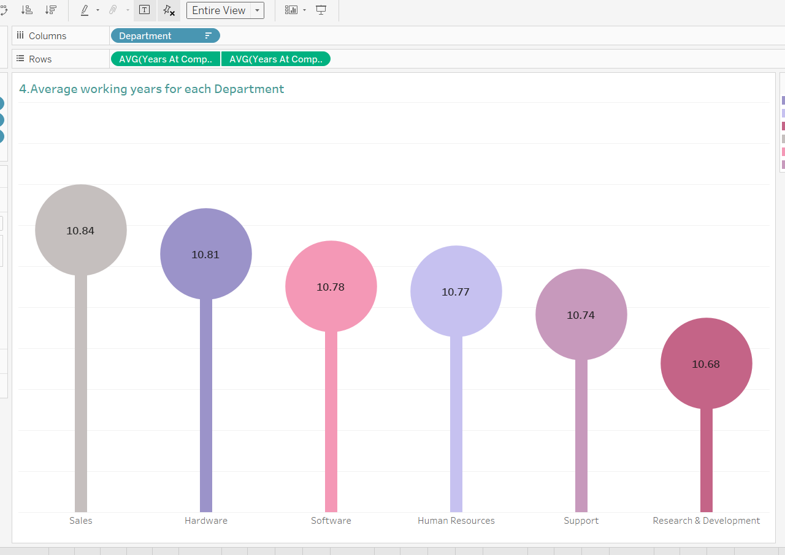
4. Average working years for each Department
The insights driven using Tableau is shown here:
Avg. working year for Sales department is highest and for R&D department its lowest.
But sales dept. has the lowest salary hike.
We have to work on R&D dept

Slide 7
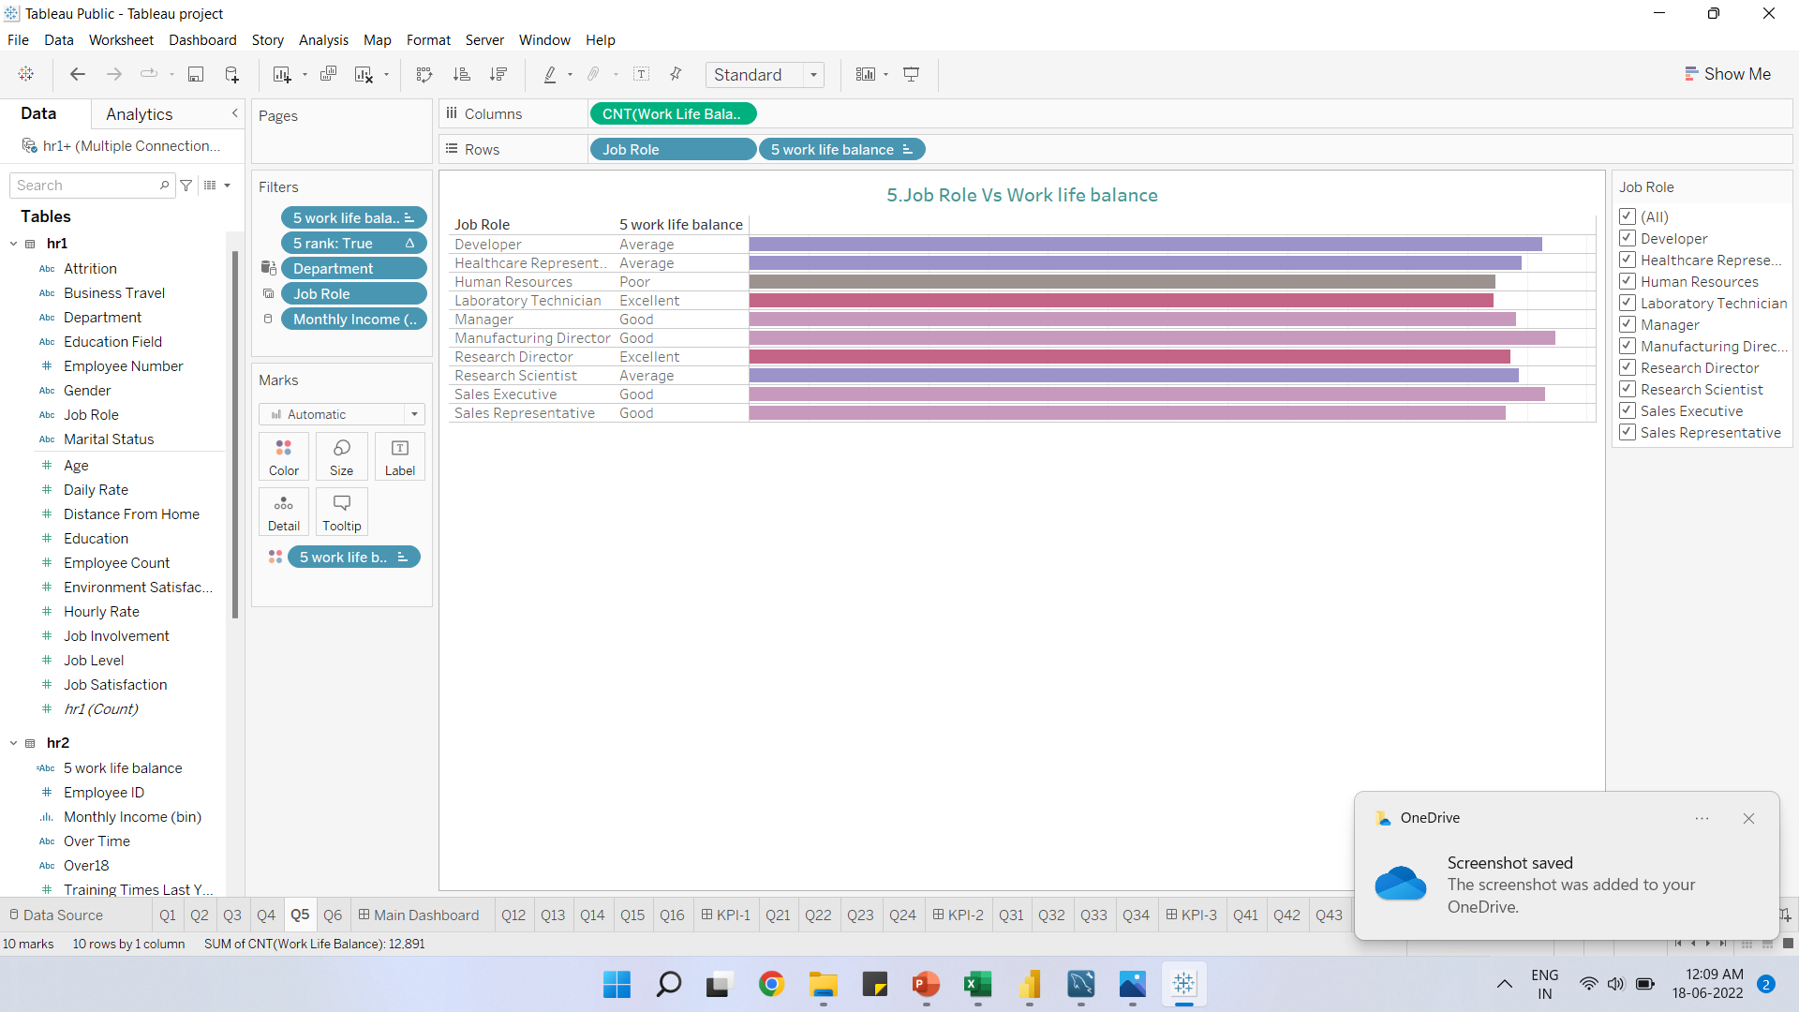
5. Job Role Vs Work life balance
The insights driven using Tableau is shown here:
We can see that Laboratory technician and research director are having excellent work life balance.
While HR is having poor work life balance.
Employees from HR department are not getting promotion frequently and they are getting less monthly income.

Slide 8
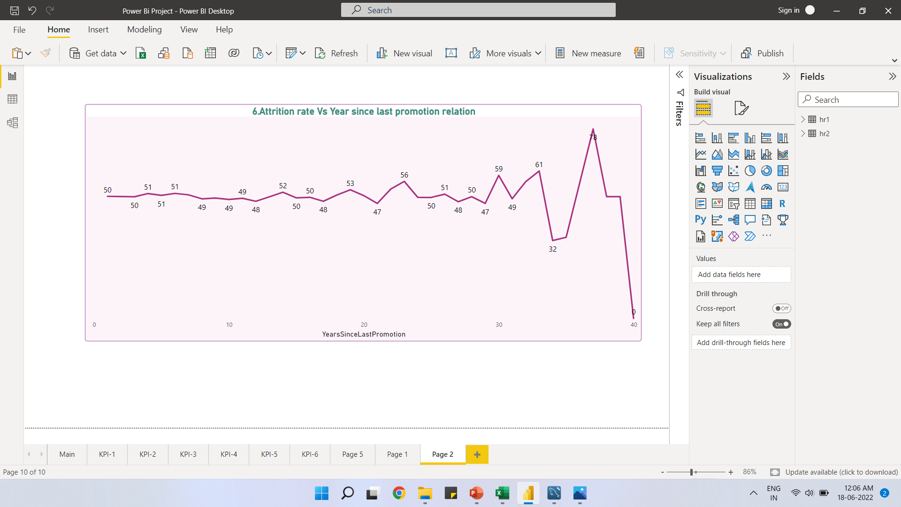
6. Attrition rate Vs Year since last promotion relation
The insights driven using Power bi is shown here:
The graph shows slight fluctuation for attrition of around 50% for the employee who have recently got promotion.
While the employees who have not got promoted for more than 20 years they shows more fluctuation in attrition graph.

Slide 9
THANK YOU

