Slide 1

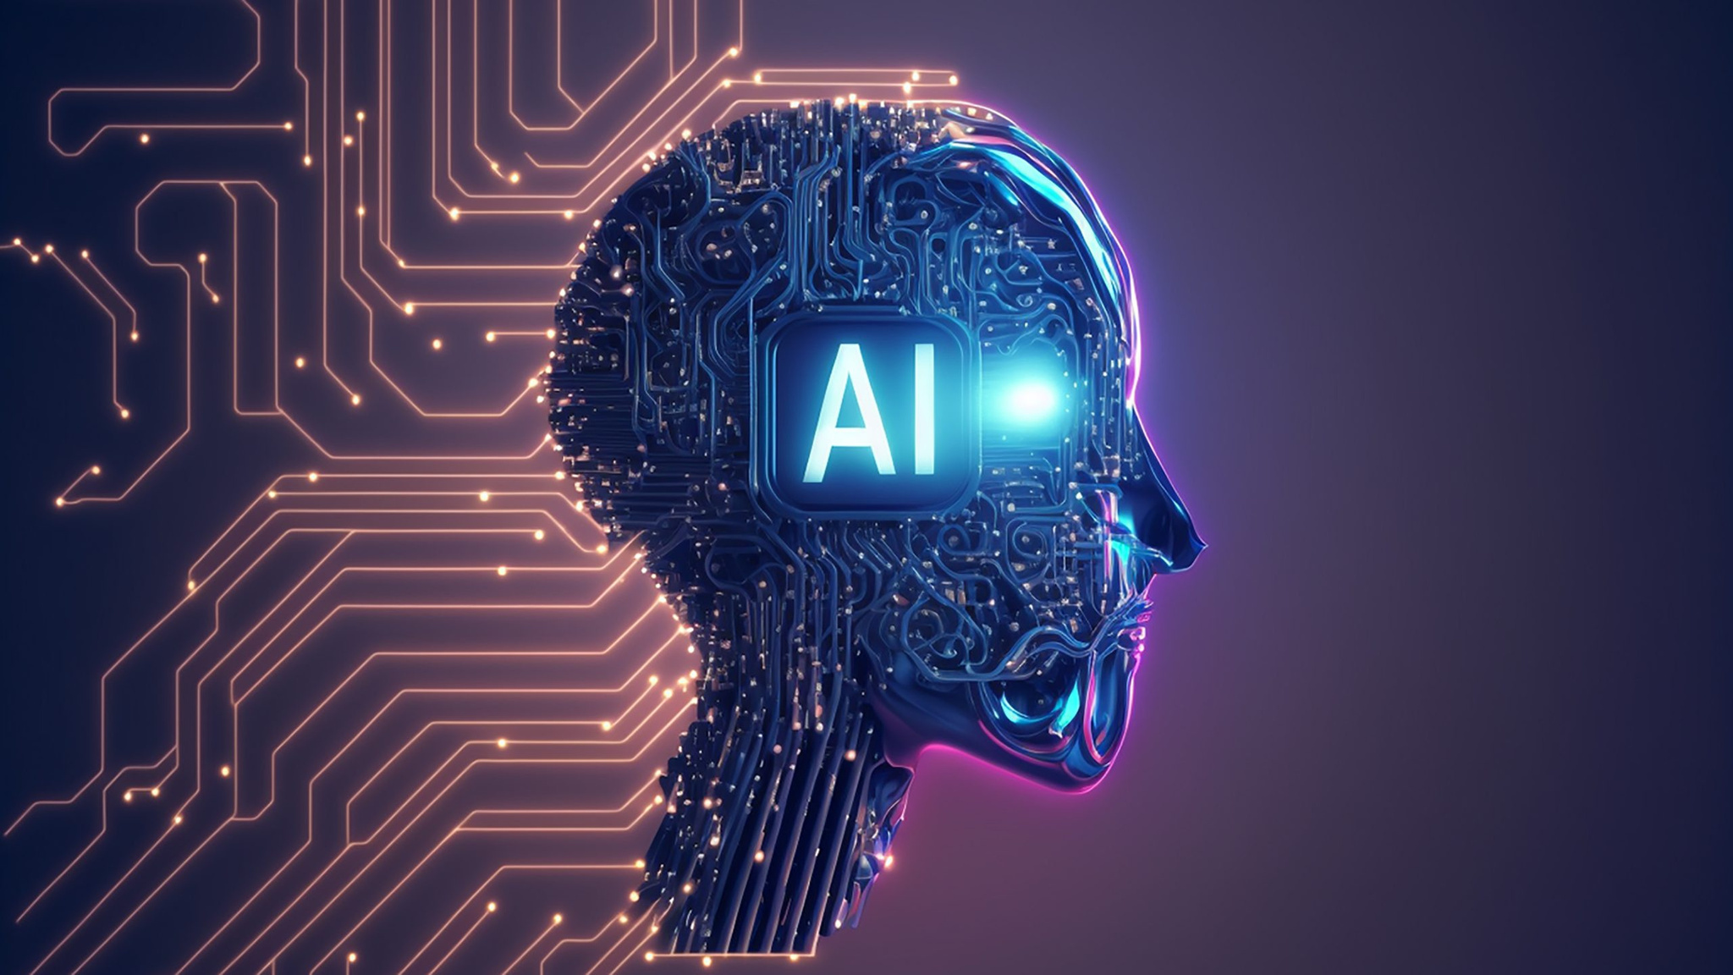
Artificial Intelligence
MoS GURU
What is Artificial Intelligence (AI) ?
Artificial Intelligence (AI) is technology that enables machines and software to learn, think, analyze, and make decisions like humans.
AI helps people understand information, generate ideas, automate routine work, and make everyday tasks easier.
Instead of replacing people, AI helps us become more productive.

Slide 2


AI Workflow
MoS GURU
How AI works ?
Data
AI learns from large amounts of information available across the internet
Learning
Algorithms identify patterns and improve over time.
Decision
AI predicts, recommends, or automates actions.
How users need to work with AI?
Provide a Clear Prompt
AI Understands the Prompt
AI Processes the Information
AI Generates a Response
Provide a Clear Prompt
Describe your question or task in simple and specific language.
AI reads your input and analyzes it using trained models and patterns.
It identifies relevant context, relationships, and knowledge to understand your request.
Based on its analysis, AI creates a relevant answer, suggestion, or solution.
AI Generates a Response

Slide 3



Evolution of AI
MoS GURU
BASIC
INTERMEDIATE
ADVANCE
Meeting scheduling and summaries
Automating approvals (leave, finance)
Get AI-powered suggestions to support better decisions, help doctors detect diseases faster with AI
AI for Business & Enterprise
Automate customer support with AI chat assistants
Analyze business data to find useful insights
Create smart reports and interactive dashboards
Support hiring, onboarding, and HR tasks
Provide instant IT help and troubleshooting
Automate repetitive business processes
Predict future trends and business outcomes
Faster email drafting
Recap of the meetings with downloadable forms.

Slide 4
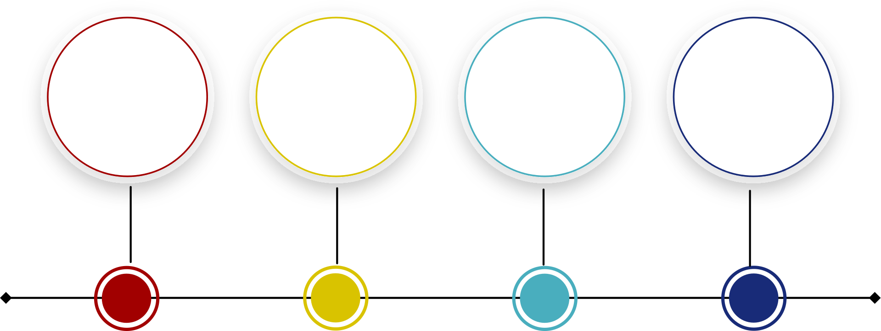




AI Tools & Use Cases
MoS GURU
AI Tools
Real World Use cases & Advantages
Healthcare : Detect diseases earlier , Support faster diagnosis
IT Support : Resolve issues quickly , Automate service requests
Finance: Detect fraud instantly , Analyze financial data
Manufacturing : Monitor equipment health , Improve product quality
Saves time and effort
Improves productivity
Reduces manual work
Supports better decision-making
CHATGPT
COPILOT
GEMINI
CLAUDE
Content creation & summarization
Productivity & Microsoft integration
Research & knowledge assistance
Document analysis & writing assistance

Slide 5

MoS GURU
Continue Your AI Journey
Explore the Al Enterprise Portal
Discover AI tools, learning resources, and best practices.
Stay updated with the latest AI initiatives and training.
Explore more on AI
Support
Need Help?
Request access to internal AI systems.
Schedule a team deep-dive training session.
Contact us at:

