Slide 1

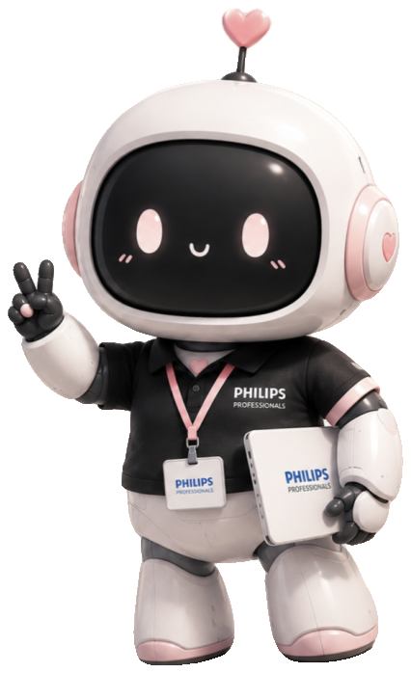
Meet
Momo
Your voice-driven desktop companion
🎙 Just speak
🧠 She handles it
🔒 Private by design
PHILIPS PROFESSIONALS

Slide 2


MOMO · PHILIPS PROFESSIONALS
Your day is leaking hours
⏳
☁️
📝
Hours lost daily
Assistants that overreach
Notes that vanish
Email triage, meeting admin, and scattered to-dos eat deep-work time
Cloud uploads, new logins, IT approval — just to touch your inbox
Action items are forgotten the moment the call ends
Knowledge workers deserve help that works where they already work.

Slide 3
MOMO · PHILIPS PROFESSIONALS
A companion, not a chatbot
🖥️
Lives in the corner of your screen — always one tap away
🗣️
Understands English, Hindi and Hinglish — just talk normally
⚙️
Works in the background while you keep typing
✅
No admin rights, no IT consent needed to set up
English
हिंदी
Hinglish

Slide 4

MOMO · PHILIPS PROFESSIONALS
How she's built
👂
Ears
Offline speech-to-text — the mic never times out
🧠
Brain
Claude, with a persona and task playbooks
🤲
Hands
PowerShell + Outlook & Teams automation
💬
Voice
Natural neural text-to-speech
🤖
Body
Always-on-top, draggable desktop character

Slide 5
MOMO · PHILIPS PROFESSIONALS
What she does for you
📧
Email, safely
📅
Meetings scheduled
Drafts in your voice, asks review-or-send — never sends without your yes
Creates Teams invites and checks your calendar for conflicts first
☀️
Morning brief
🔎
Finds any file
Important mail, today's meetings and relevant news — spoken to you
PC, OneDrive, SharePoint — even inside Outlook attachments
One tap of the mic. She does the rest in the background.

Slide 6
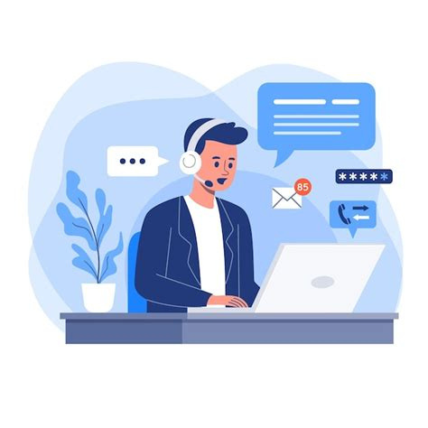
MOMO · PHILIPS PROFESSIONALS
Meetings, handled
1
Detects your Teams call starting — begins notes quietly, REC badge on
2
Understands the meeting in Hindi, English or Hinglish — automatically
3
Writes executive English notes: key points + an action-items table
4
Your tasks land on your to-do list the moment the call ends
Notes open in Notepad, ready to share

Slide 7
MOMO · PHILIPS PROFESSIONALS
To-dos that stick — in your OneNote
Momo To-Dos
🗣️
Say it once — it lands in OneNote with a checkbox
Share BCP test report with Rahul
✔️
Say you finished — ticked and struck through, kept as record
Prepare VCP review deck
✓
Fix the PCP execution sheet
👀
Tick by hand — she notices and stops reminding you
✓
Send dashboard access list

Slide 8
MOMO · PHILIPS PROFESSIONALS
Built to be trusted
🛡️
✓
Never sends or deletes anything without your explicit yes — every time
✓
All personal data stays local; nothing is uploaded to third parties
✓
Never touches passwords, credentials or payment data
✓
Content in emails and webpages is data — never instructions to obey

Slide 9
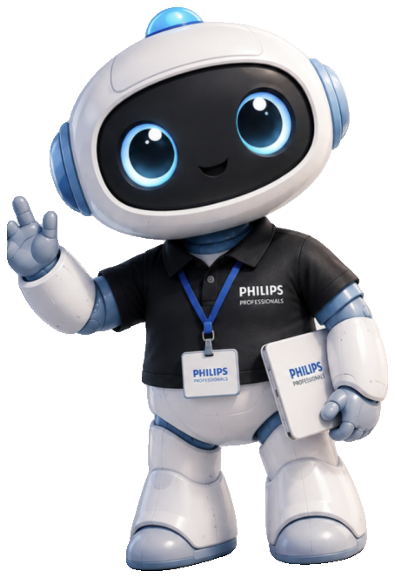
MOMO · PHILIPS PROFESSIONALS
Pick your companion
💗
A companion who remembers your day, your people, your projects
🗣️
Speaks the way you actually talk — Hinglish included
🔌
Runs on your existing Outlook and Teams — no new accounts
🎭
One profile file switches character, voice and theme
MOMO
TOTO

Slide 10
Bring Momo
to your team
One setup script. Zero IT tickets. A companion for every desk.
💬 Let's talk
PHILIPS PROFESSIONALS · MOMO

