Slide 1
JSPM College Of Engineering
Project Title
Design of Microstrip Patch Antenna for wireless applications
Presented By
Kalyani Tonge
Under the Guidance of
Prof.S.K Bhatiya mam

Slide 2
Contents
Introduction
Problem Statement
Literature Survey
Methodology
References

Slide 3
PROBLEM STATEMENT
Now-a-days multiple antennas are very popular, however embedding many antennas closely in a compact PCB will raise the issue of mutual coupling between them which will decrease their performances.
This project concerned enhancing the isolation in a dual port antenna.

Slide 4
INTRODUCTION
A novel couple-fed dual-bands MIMO antenna is proposed for WLAN 2.4/5.2/5.8 GHz bands.
We proposed a built-in isolation/decoupling method to improve the performance (such as throughput) of two-antenna system for WLAN 2.4/5-GHz bands applications.
A capacitive coupling feed is proposed to assist bandwidth to easily cover the 2.4/5 GHz bands operation

Slide 5
LITERATURE SURVEY
A MIMO Antenna with Built-In Isolation for WLAN USB Dongle Applications- to generate in built isolation without incorporating any external isolation technique.
Reducing Mutual Coupling of MIMO Antennas with Parasitic Elements for Mobile Terminals-to reduces electromagnetic interferences between MIMO antennas with the help of parasitic antennas.
Antennas with two isolated feeds for dual-module applications-
To use two ports for feeding with isolation

Slide 6
SELECTION OF PAPER
I have selected design and fabrication of MIMO antenna for WLAN application with built in isolation.
I have selected MIMO based antenna because multiple antennas are trending implementation in today's era.
I am willing to learn Antenna design and fabrication.
To fabricate antenna for applications such as WLAN, Mobile Network, etc.

Slide 7
STUDY OF SOFTWARE
CST, CAD Feko, HFSS etc are software's available in the market.
CST is best software for Antenna designing and used widely.
Various tools and simulated examples available in software.

Slide 8
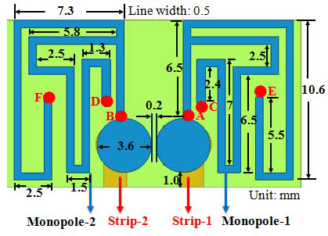
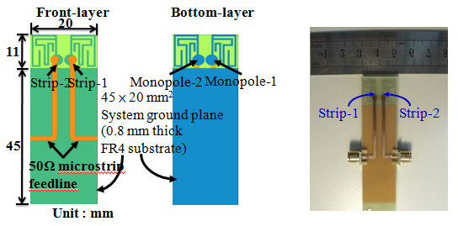
IMPLEMENTATION & SIMULATION OF SOFTWARE

Slide 9
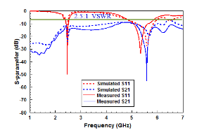
S-parameters and VSWR

Slide 10
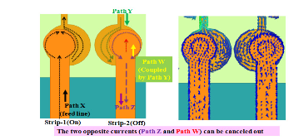
The current distribution of feeding strips

Slide 11
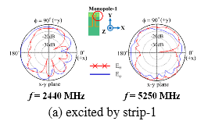
2D radiation pattern at 2440 MHz

Slide 12
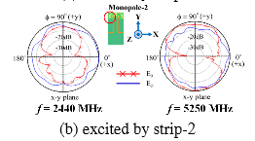
2D radiation pattern at 5250 MHz

Slide 13
Parameters of design 1
Parameters | Specifications
Dielectric Substrate | FR4
Dielectric constant | 4.4
Substrate Height | 1.6 mm
Substrate Length | 55 mm
Substrate Breadth | 15 mm
Feed Radius | 0.1 mm
Frequency Range | 2GHz To 4GHz
Gain | 2.4dB
Directivity | 1.68dB

Slide 14
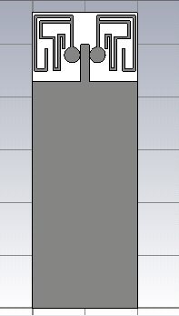
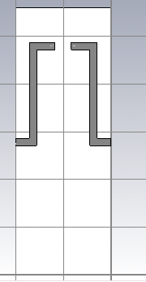
DESIGN 3
FRONT VIEW
BACK VIEW

Slide 15
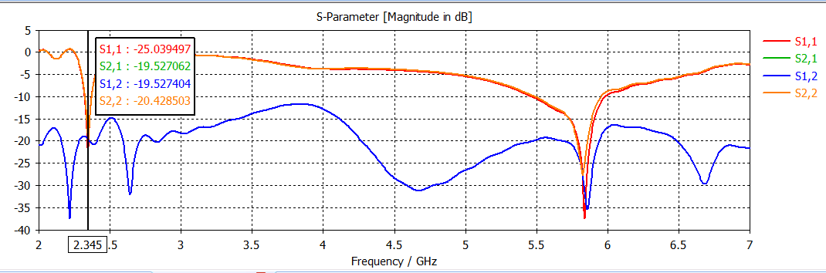
S PARAMETERS

Slide 16
Parameters of design 3
 | FREQUENCY 1 2.345 GHz | FREQUENCY 2 5.84 GHz
Return Loss S11 | -25.03dB | -37.42dB
S22 | -20.42dB | -24.84dB
S21 | -19.52dB | -31.38dB
S12 | -19.52dB | -31.38dB
VSWR | 1.11dB | 1.12dB
Gain | 3.23dB | 2.62dB
Directivity | 3.62dB | 5.31dB
Impedance | 34.59dB | 33.79dB

Slide 17
REFERENCES
1.Lih-Tyng Hwang, T.-S. Jason Horng, Shun-Min Wang, "A MIMO Antenna with Built-In Isolation for WLAN USB Dongle
Applications” 978-1-4799-1472-2/13/$31.00 ©2013 IEEE
2. Z. Li, Z. Du, M. Takahashi, K. Saito, and K. Ito, “Reducing
Mutual Coupling of MIMO Antennas with Parasitic Elements
for Mobile Terminals, ” IEEE Trans. Antennas Propagate., vol.
60, No.2, Feb. 2012.
3 .C.-Y. Huang, H.-C. Lin, and J.-S. Kuo,“Dual-Band Monopole
Antenna Excited by A Capacitive Coupling Feed for WLAN
Applications,􀄁Micro. Opt. Technol. Lett., Vol. 49, No. 5, May
2007, pp. 1135-1138.

Slide 18
THANK YOU

