Slide 1
SECURE DATA HIDING IN IMAGES USING STEGANOGRAPHY
CAPSTONE PROJECT
Presented By : Pratik Madhukar Pawar
Student Name : Pratik Madhukar Pawar
College Name & Department : Sinhgad College of Engineering , Computer Engineering Department

Slide 2
OUTLINE
Problem Statement
Technology used
Wow factor
End users
Result
Conclusion
Git-hub Link
Future scope

Slide 3
Problem Statement
With the increasing number of cyber threats, data breaches, and unauthorized access, securing sensitive information has become a critical challenge. Traditional encryption methods alone may not always be sufficient, making it necessary to explore alternative techniques. This project leverages steganography to embed confidential data within images, providing an additional layer of security for data transmission. By concealing information within media files, it ensures that sensitive data remains undetectable to unauthorized users.

Slide 4
Technology used
Python Programming Language (Python 3.13.1)
OpenCV Library for image processing
OS Library for file handling
Developed using PyCharm IDE on Windows 11
RAM : 8 GB
Processor : Intel i5

Slide 5
Wow factors
Combines encryption with steganography for enhanced data security
Lightweight code that runs efficiently without heavy resource usage
Cross-platform compatibility due to Python’s flexibility
Clear and structured code for easy maintenance and future upgrades
Saves encrypted images and passcodes securely

Slide 6
End users
Government Agencies – To securely transmit classified or sensitive documents.
Military & Defense Organizations – For covert communication and secure intelligence sharing.
Journalists & Whistleblowers – To hide confidential information from surveillance and censorship.
Banking & Financial Institutions – For protecting sensitive transactional data from cyber threats.
Forensic Experts & Law Enforcement – To hide and retrieve crucial evidence securely

Slide 7
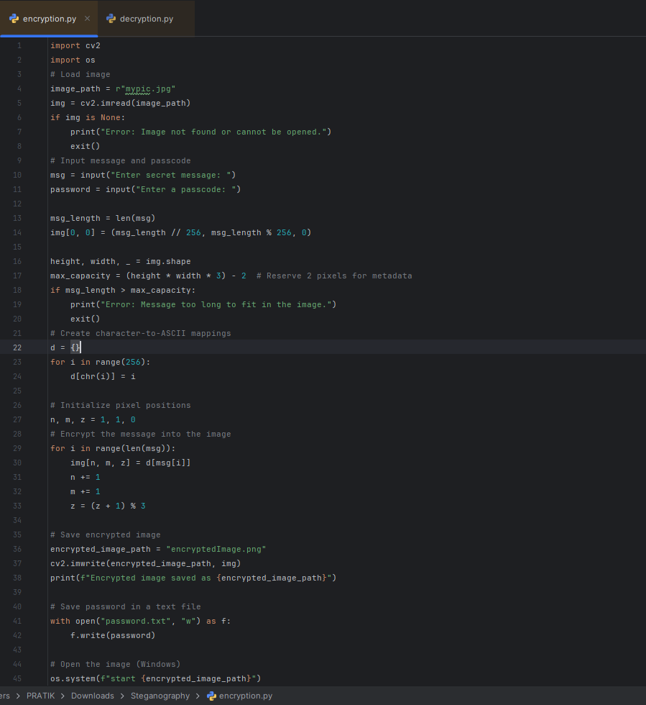
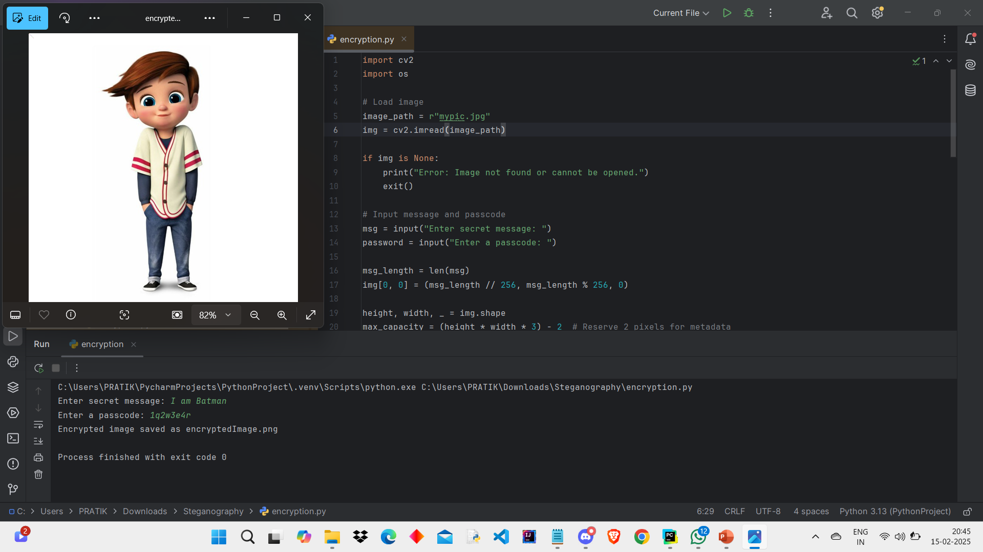
Results
Encryption Code :
Encryption Output :

Slide 8
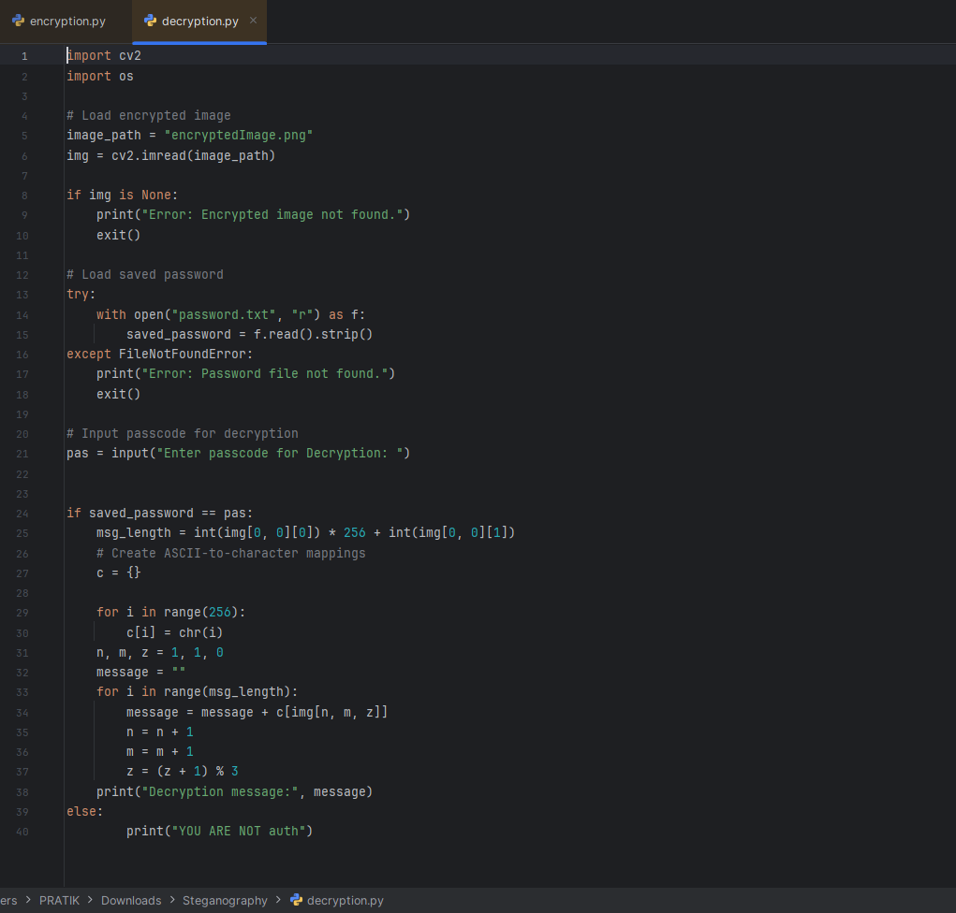
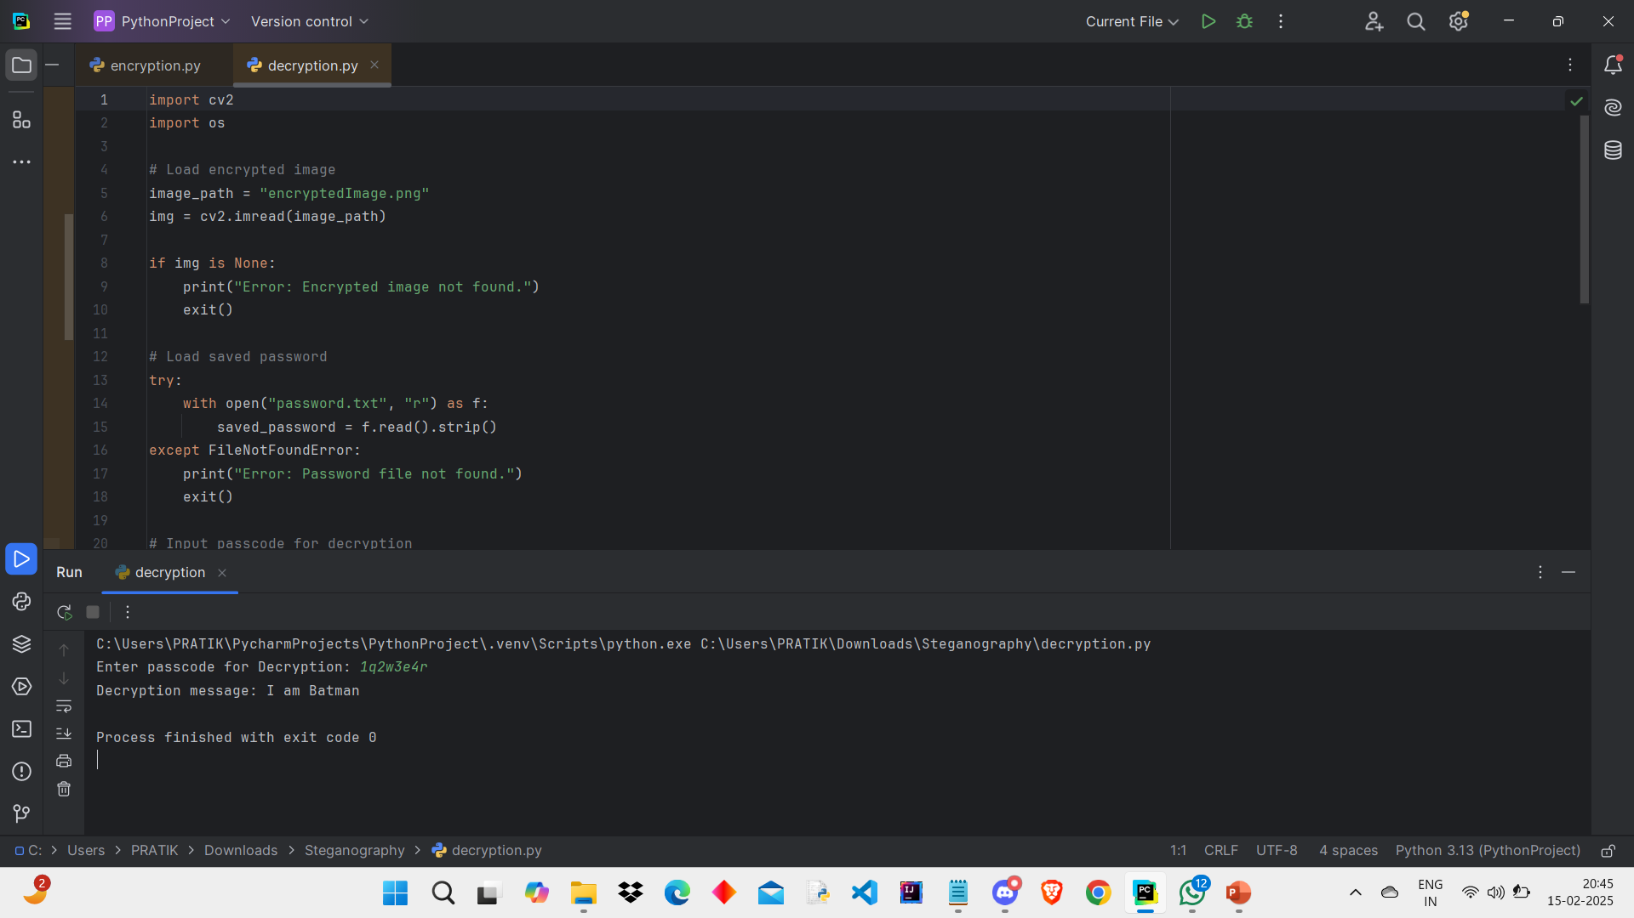
Results
Decryption Code :
Decryption Output :

Slide 9
Conclusion
This project successfully demonstrates secure data hiding in images using steganography.
It ensures that sensitive information is concealed and protected during transmission, mitigating risks of data breaches.
The implementation showcases the practicality and efficiency of steganography, making it suitable for real-world applications in secure communication and data protection.

Slide 10
GitHub Link
https://github.com/pratik-028/Steganography.git

Slide 11
Future scope
Integration with cloud storage platforms for secure cloud data transmission
Implementing advanced encryption algorithms for added security
Creating a graphical user interface (GUI) for better user experience
Integrating watermarking for content authentication
Automating testing and validation of hidden data integrity

Slide 12
THANK YOU

