Slide 1
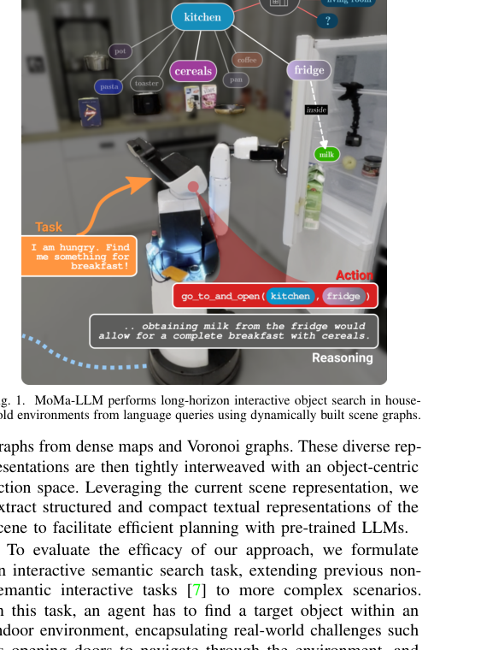
MoMa-LLM: Language-Grounded Dynamic Scene Graphs for Interactive Object Search
Honerkamp et al. (IEEE RA-L 2024) | Presenter: Pratik Adhikari
Goal: show how to make LLM planning actually executable on a real robot
Notes:
CUE NOTE: Bold text is for you only — do NOT read it aloud.
(0:00-1:30)
Hook the room. Start with a concrete contrast: many robotics demos assume a known map and a short plan. Here, the agent is dropped into an unknown apartment where doors are closed and objects can be hidden in receptacles. That is already a POMDP in practice, even if we do not dwell on equations.
State the thesis of the paper: LLMs are not magic planners; they are good at reasoning over structured facts. So MoMa-LLM builds those facts on the fly (dynamic scene graph) and forces the LLM to pick from a limited action menu. This is the 'LLM-as-policy-over-abstract-state' pattern.
Light humor: "We are not letting the LLM drive the robot like a teenager with a new license. We give it a map, a rulebook, and a speed limiter."
Set expectation: I will explain (1) representation, (2) grounding/action interface, (3) why AUC-E is a smart metric, (4) what breaks.

Slide 2
Problem: interactive object search in unknown homes
Find a target object when the environment is partially observed
Targets may be behind doors / inside drawers and cabinets
Requires navigation + manipulation + exploration decisions
Show nice image, video, …
Notes:
CUE NOTE: Bold text is for you only — do NOT read it aloud.
(1:30-3:00)
Define the task precisely: interactive object search. The target is specified by language (and in extensions, by fuzzy language). The environment is partially explored and the robot must decide where to go next and what to open. Key twist: in real homes, doors block traversability, and many objects are not visible until you open something.
Make it concrete with an example: "Find milk" may require reaching the kitchen, opening the fridge, and then checking inside. "Find keys" might require opening drawers near entryway furniture. The planning horizon can be tens of high-level decisions.
Point out what makes this different from classic semantic navigation: the task requires physical interaction and changes the observability of the state.
Humor: "If you have ever lost your phone in your own apartment, you already know this is a hard benchmark."

Slide 3
Why naive LLM planning fails
LLMs reason well, but need a grounded state and action interface
Unconstrained text actions -> hallucinations / invalid actions
We need: (1) compact world model, (2) constrained action set
Notes:
CUE NOTE: Bold text is for you only — do NOT read it aloud.
(3:00-4:30)
Explain failure modes of naive LLM robotics: (a) the LLM invents entities, (b) it suggests impossible actions, (c) it over-commits to a wrong hypothesis because the prompt has no notion of exploration state.
The paper demonstrates this by an 'unstructured LLM' baseline: same underlying graph, but provided as a JSON-like dump. Result: many infeasible actions and poorer efficiency.
PhD angle: this is not a prompt trick. This is state abstraction and action abstraction. If you cannot write down your state and action spaces, you cannot debug your system.
MBA angle (brief): in production robotics, we do not ship systems that rely on unconstrained generative outputs. We ship systems with contracts: valid inputs, valid outputs, measurable failure cases.
Humor: "LLMs hallucinate. Robots crash. Combining them without guardrails is a very expensive hobby."

Slide 4
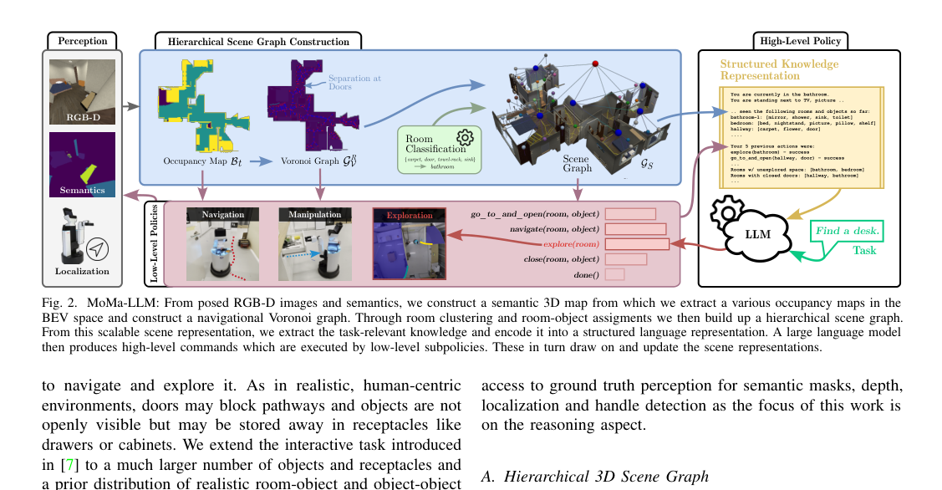
Core idea: dynamic scene graph + structured grounding
Build a hierarchical 3D scene graph while exploring
Extract task-relevant knowledge into a structured prompt
LLM selects from an object-centric action space
Notes:
CUE NOTE: Bold text is for you only — do NOT read it aloud.
(4:30-7:00)
Walk through Fig. 2 at high level. Left: perception gives RGB-D plus semantic labels and localization. Middle: the system builds a map and then a hierarchical representation. Right: the LLM receives a structured knowledge representation and returns a high-level action.
The key design is the separation of responsibilities:
- The robot stack handles sensing, mapping, and execution.
- The LLM handles high-level decision making over a symbolic-ish state.
Emphasize 'dynamic': the scene graph is updated as the robot explores and opens things. This is what enables long-horizon tasks in unknown spaces.
Video cue: mention that the demo shows the loop repeatedly: explore, update, decide, open.
Humor: "This is like giving the LLM a live spreadsheet of the world. Sadly, the robot still does not get an 'Undo' button."
PhD drill (quick):
- What is the state variable here (graph vs map vs text)?
- What breaks first: perception, execution, or reasoning? Why?
- If you had to remove one module to simplify, which one would you remove and what would you lose?

Slide 5
Scene representation stack (what is actually built?)
Posed RGB-D + semantics -> semantic 3D map
BEV occupancy -> navigation Voronoi graph
Door-wise room clustering -> room nodes + object nodes
Notes:
CUE NOTE: Bold text is for you only — do NOT read it aloud.
(7:00-9:30)
Go one level deeper into the representation stack. The paper uses posed RGB-D frames to build a semantic 3D voxel map. From that, it creates a BEV occupancy map. Then it computes a generalized Voronoi diagram to obtain a navigation graph.
Why Voronoi? It is compact, robot-centric, and gives safe clearance from obstacles. It is also a convenient substrate for exploration frontiers.
Then, room separation: they do door-wise separation of the Voronoi graph into room regions and assign objects to rooms. This becomes a hierarchical scene graph: room nodes, object nodes, with attributes like open/closed state for articulations.
PhD question to anticipate: does this depend on perfect door detection? Discuss that segmentation can be imperfect; that is why they later compare to Hydra-style separation.
Humor: "We are basically turning the apartment into a graph. Because if it is not a graph, did it even happen?"
PhD drill (quick):
- What is the state variable here (graph vs map vs text)?
- What breaks first: perception, execution, or reasoning? Why?
- If you had to remove one module to simplify, which one would you remove and what would you lose?

Slide 6
Structured knowledge representation for the LLM
Not raw pixels; not raw JSON dump
Text summary of: rooms, objects, states, frontiers, history
Only includes entities that exist in the current graph
Notes:
CUE NOTE: Bold text is for you only — do NOT read it aloud.
(9:30-11:30)
Now the grounding interface: what does the LLM see? Not raw maps. Not full graphs. It sees a compact, structured text summary: current room hypothesis, list of rooms with semantic labels, objects per room, what is already opened, and what frontiers remain.
Two principles:
1) Only mention entities that exist in the current scene graph. This prevents the LLM from inventing objects.
2) Keep the format stable. Stable formatting lets you audit and ablate state features like any other algorithm.
Explain why JSON is not enough: large dumps are hard for the LLM to parse reliably and encourage pattern completion rather than reasoning.
Humor: "If you hand a PhD a 5,000-line JSON, they also hallucinate. They call it 'skimming'."
PhD drill (quick):
- What is the state variable here (graph vs map vs text)?
- What breaks first: perception, execution, or reasoning? Why?
- If you had to remove one module to simplify, which one would you remove and what would you lose?

Slide 7
Action space: keep the LLM on a leash (the good kind)
High-level actions only:
go_to_and_open(room, object), close(room, object)
navigate(room, object), explore(room), done()
Notes:
CUE NOTE: Bold text is for you only — do NOT read it aloud.
(11:30-13:30)
Action space is the second half of grounding. List the actions and explain what each means operationally.
- explore(room): go to a frontier in that room, expand the map.
- navigate(room, object): move to a pose where the object can be inspected.
- go_to_and_open(room, object): move and execute an opening subpolicy (door, drawer, fridge).
- close(room, object): optionally restore state.
- done(): terminate when target is found.
Stress: the LLM does not output velocities, poses, or trajectories. That would be both unsafe and unnecessary.
PhD angle: this is equivalent to defining options in hierarchical RL. The novelty is using an LLM as the policy over options, grounded by a scene graph.
Humor: "Think of it as giving the LLM five buttons. It can be clever, but it cannot freestyle breakdance."
PhD drill (quick):
- What is the state variable here (graph vs map vs text)?
- What breaks first: perception, execution, or reasoning? Why?
- If you had to remove one module to simplify, which one would you remove and what would you lose?

Slide 8
Execution: low-level policies do the dirty work
Navigation policy: reach frontier / object location
Manipulation policy: open doors/drawers (handle-based)
Closed-loop: after each action, update graph and replan
Notes:
CUE NOTE: Bold text is for you only — do NOT read it aloud.
(13:30-15:30)
Execution details (brief, but credible). Navigation uses standard local planning; manipulation uses an opening policy (the paper mentions N2M2 for real-world). The important part is that execution can fail, and failures are fed back into the loop.
Example from the paper/video: if the gripper slips on a handle or the base bumps into something, the system can re-issue go_to_and_open or choose a different exploration step. This is a key reason they can transfer to real hardware.
Make an industry point: closed-loop replanning is not optional in the real world. If your planner assumes perfect execution, it is a simulation-only project.
Humor: "Robots are like interns: you must assume they will fail, and you design processes to recover."
PhD drill (quick):
- What is the state variable here (graph vs map vs text)?
- What breaks first: perception, execution, or reasoning? Why?
- If you had to remove one module to simplify, which one would you remove and what would you lose?

Slide 9
Evaluation setup and baselines
Simulation: iGibson interactive apartments (unseen at test time)
Real world: Toyota HSR in a 4-room apartment
Baselines: heuristics, RL (HIMOS), ESC-Interactive, unstructured LLM
Notes:
CUE NOTE: Bold text is for you only — do NOT read it aloud.
(15:30-17:30)
Evaluation setup. In simulation, they use iGibson interactive apartments and test on unseen scenes. Mention that episodes are procedurally generated with randomized start poses and target objects, to avoid overfitting to a fixed script.
Baselines:
- Random and Greedy heuristics (sanity checks).
- ESC-Interactive: exploits co-occurrence priors.
- HIMOS: hierarchical RL approach adapted for this setting.
- Unstructured LLM: same graph, but dumped in JSON format.
Real-world: Toyota HSR in a 4-room apartment. They use a pre-recorded LiDAR map and annotated semantics; AR markers are used for handle detection, which is a pragmatic engineering choice.
Humor: "Yes, AR markers. Because sometimes the fastest path to science is a sticker."
PhD drill (quick):
- What is the state variable here (graph vs map vs text)?
- What breaks first: perception, execution, or reasoning? Why?
- If you had to remove one module to simplify, which one would you remove and what would you lose?

Slide 10
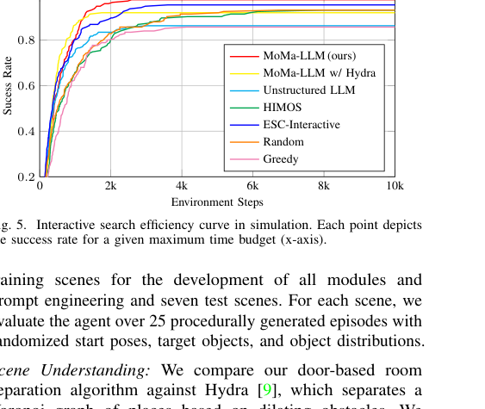
Metrics: SR, SPL, and AUC-E (why AUC-E matters)
Success Rate (SR): fraction of episodes that find the target
SPL: success weighted by shortest path length
AUC-E: area under success-vs-budget curve (full efficiency curve)
Notes:
CUE NOTE: Bold text is for you only — do NOT read it aloud.
(17:30-20:00)
Metrics. SR is easy but hides efficiency. SPL adds path optimality but still collapses behavior into a single budget.
Their key metric is AUC-E: area under the success-vs-budget curve. Explain it in plain terms: for each budget of environment steps, compute how often the robot would have succeeded by then; integrate the curve. This rewards methods that succeed quickly and consistently.
Why PhDs should care: many papers cherry-pick a budget (e.g., 5k steps). AUC-E forces evaluation across all budgets, reducing 'pick the budget where my method looks best'.
Point at the curve: MoMa-LLM rises faster and saturates higher.
Humor: "AUC-E is basically saying: do not just pass the exam, pass it quickly so you can go home."
PhD drill (quick):
- What is the state variable here (graph vs map vs text)?
- What breaks first: perception, execution, or reasoning? Why?
- If you had to remove one module to simplify, which one would you remove and what would you lose?

Slide 11
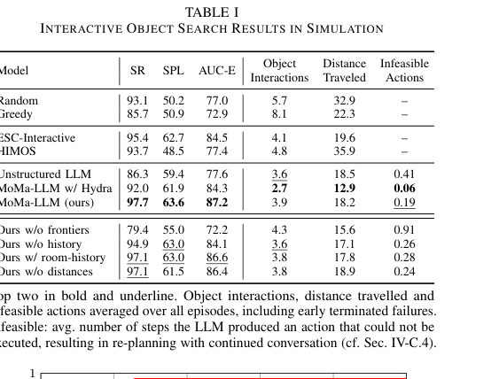
Simulation results: efficiency wins
MoMa-LLM achieves best AUC-E and strong SPL
Fewer object interactions and less distance traveled
Unstructured LLM makes many infeasible actions
Notes:
CUE NOTE: Bold text is for you only — do NOT read it aloud.
(20:00-22:30)
Simulation results slide. Use Table I to state the headline: MoMa-LLM (ours) achieves SR 97.7, SPL 63.6, AUC-E 87.2, with low object interactions and low distance traveled. MoMa-LLM with Hydra room separation is slightly worse on AUC-E.
Interpretation: MoMa-LLM is not just successful; it is efficient. It opens fewer things and walks less. Unstructured LLM shows more infeasible actions (invalid outputs), validating the grounding argument.
If someone challenges the numbers: clarify that SR can be high for some baselines but AUC-E differentiates efficiency. This is the paper's main evidence.
Humor: "The robot is basically doing what we do in a new building: check the obvious rooms first, but with fewer existential crises."
PhD drill (quick):
- What is the state variable here (graph vs map vs text)?
- What breaks first: perception, execution, or reasoning? Why?
- If you had to remove one module to simplify, which one would you remove and what would you lose?

Slide 12
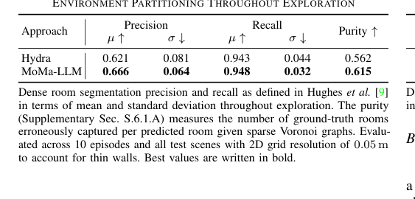
Room partitioning: why door-wise separation helps
Compare to Hydra-style room separation during exploration
Better precision/recall and higher region purity
Stability over time matters for long-horizon planning
Notes:
CUE NOTE: Bold text is for you only — do NOT read it aloud.
(22:30-24:00)
Room partitioning results (Table II). Explain why this matters: if your room segmentation is unstable, the LLM will get inconsistent state descriptions, and planning becomes brittle.
MoMa-LLM's door-wise separation improves precision, recall, and region purity compared to Hydra. The claim is not that Hydra is bad; it is that door cues and semantics make the partitioning more robust in household layouts with corridors and furniture.
Make the conceptual link: good abstractions upstream improve reasoning downstream. This is the systems lesson.
Humor: "Turns out, when you tell the robot where the doors are, it stops thinking the hallway is part of the kitchen. Relatable."
PhD drill (quick):
- What is the state variable here (graph vs map vs text)?
- What breaks first: perception, execution, or reasoning? Why?
- If you had to remove one module to simplify, which one would you remove and what would you lose?

Slide 13
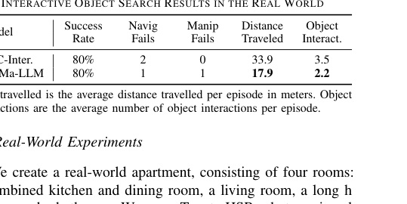
Real-world results: transfer to Toyota HSR
Both ESC-Interactive and MoMa-LLM succeed in 8/10 episodes
MoMa-LLM travels much less and interacts less
Handles subpolicy failures by replanning
Notes:
CUE NOTE: Bold text is for you only — do NOT read it aloud.
(24:00-26:00)
Real-world results (Table III). Both ESC-Interactive and MoMa-LLM succeed in 80% (8/10). The differentiator is efficiency: MoMa-LLM travels about 17.9 m vs 33.9 m for ESC, and uses fewer object interactions (2.2 vs 3.5).
Explain why that matters: on hardware, every extra meter is time, battery, and risk of collision. Less interaction also reduces manipulation failures.
Video cue: show a short clip where HSR opens a drawer/door and continues after a small failure. Emphasize replanning.
Note the caveat: they rely on pre-recorded map and semantic labels plus AR markers for handles. This is not end-to-end perception; the contribution is the reasoning and representation, not handle detection.
Humor: "Industry translation: cutting distance in half is how you convince a product manager that this is not just cool, but shippable."
PhD drill (quick):
- What is the state variable here (graph vs map vs text)?
- What breaks first: perception, execution, or reasoning? Why?
- If you had to remove one module to simplify, which one would you remove and what would you lose?

Slide 14
Ablations/analysis: what information the LLM needs
Frontiers matter: removing them hurts exploration quality
History matters: even coarse visited-room history helps
Distances/nearby objects help but are secondary
Notes:
CUE NOTE: Bold text is for you only — do NOT read it aloud.
(26:00-27:30)
Ablations/analysis slide. Deliver the message: the prompt content is an algorithmic choice.
What matters most per the paper: encoding frontiers (so the LLM understands remaining unexplored space) and encoding history (to avoid revisiting). A coarse visited-room list is already beneficial. Distances and nearby-object context help, but they are not the main driver.
PhD angle: this suggests a research direction: learn the state abstraction (what to include) automatically, but keep the interface structured.
Humor: "We call it prompt engineering because 'state abstraction design' sounds like a qualifying exam."
PhD drill (quick):
- What is the state variable here (graph vs map vs text)?
- What breaks first: perception, execution, or reasoning? Why?
- If you had to remove one module to simplify, which one would you remove and what would you lose?

Slide 15
Limitations (what will PhDs grill you on)
Assumes reasonably good semantic perception + localization
Action library is hand-designed (coverage vs scalability tradeoff)
Complex articulation and clutter can break subpolicies
Notes:
CUE NOTE: Bold text is for you only — do NOT read it aloud.
(27:30-29:00)
Limitations and likely questions.
1) Perception assumptions: the system needs object detections and reasonably stable localization. In clutter or with missed detections, the graph can be wrong.
2) Action library scalability: hand-designed skills limit what tasks can be executed. Extending to new interactions requires new subpolicies.
3) Long-tail articulation: weird handles, heavy doors, or stacked clutter break opening policies.
Offer a balanced stance: these are not fatal; they are the normal reality of mobile manipulation. The paper's contribution is showing a clean integration pattern.
Humor: "If you want a robot to open every cabinet in a real German kitchen, you will need more than GPT-4. You will need prayer."
PhD drill (quick):
- What is the state variable here (graph vs map vs text)?
- What breaks first: perception, execution, or reasoning? Why?
- If you had to remove one module to simplify, which one would you remove and what would you lose?

Slide 16
Takeaways and discussion questions
Takeaway: LLMs become useful when treated as a policy over a structured state
Scene graphs are the right abstraction layer for long-horizon household tasks
Questions: scaling action libraries? learning better state abstractions?
Notes:
CUE NOTE: Bold text is for you only — do NOT read it aloud.
(29:00-30:00)
Close with takeaways and leave discussion questions.
Takeaway 1: LLMs are best treated as a high-level policy over a structured, audited state.
Takeaway 2: dynamic scene graphs are a strong abstraction for long-horizon household tasks.
Takeaway 3: evaluation should measure efficiency across budgets (AUC-E), not just success.
Discussion prompts for PhDs:
- How would you learn the action space/options rather than hand-code it?
- Can we learn to compress graphs into minimal sufficient statistics for planning?
- How robust is this under realistic perception noise?
Humor: "Final thought: the robot does not become intelligent. The interface becomes intelligent. That is the real engineering."
Extra Q&A ammo (read if ahead of time):
1) 'Is this just prompt engineering?' Answer: treat it as state abstraction; the representation defines what the LLM can reason about.
2) 'Why not learn an end-to-end policy?' Answer: data and generalization; this is zero-shot and modular.
3) 'What would I do next?' Answer: integrate uncertainty estimates (object existence/confidence) and close the loop with active perception.
Close with a light line: 'The robot is not smart because it has GPT; it is smart because it has receipts.'

