Slide 1
Ai plays Flappy Bird Name: Pratik TIwari rollno: 1932377 department: bca(science) language used: python

Slide 2
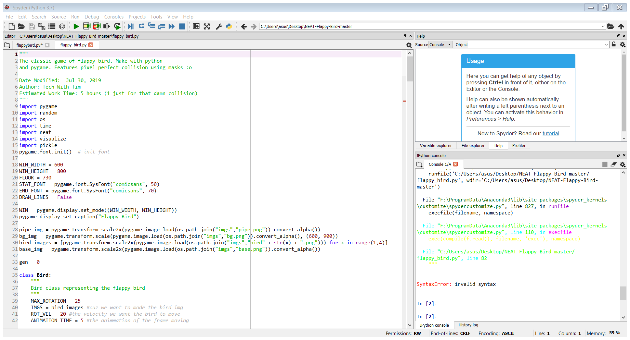
This is mainly used to import different libraries that is needed in the project pygame – library used for game development os - The OS module in Python provides a way of using operating system dependent functionality. Neat - NEAT is a method developed by Kenneth O. Stanley for evolving arbitrary neural networks.
IMPORTING LIBRABIES

Slide 3
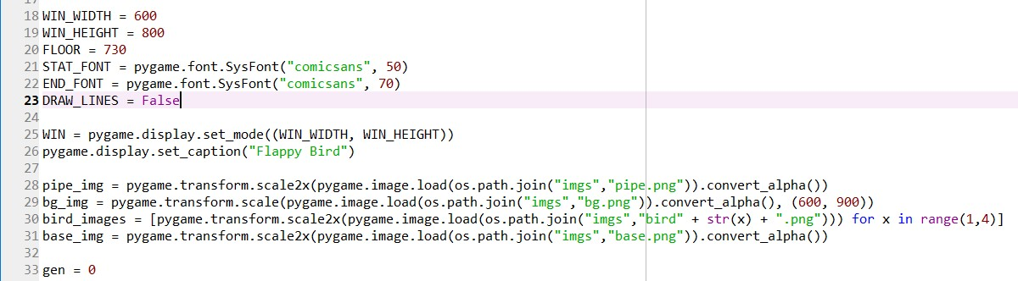
- This part takes care of the width and the height of the frame in which the game will be played - display set is used to set the width and height and set caption is used to put a caption below as a heading - the line 28,29,30,31 is used to take the images that we will use in game and transform it ito 2x size as the image is small in size - there are 4 images used here pipe_img for the pipe image, bg_img for the background image, bird_img for the bird image as there are 3 images of the bird for loop iis used and x is used to take 3 images in 1 sentence, and a base_img just for the base image

Slide 4
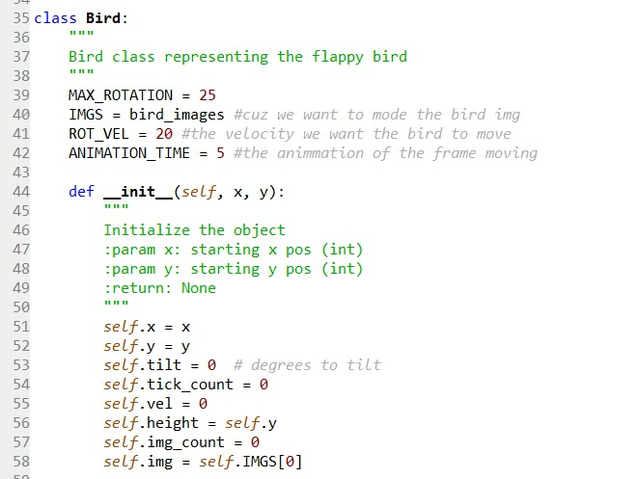
- We have created a class bird - Max rotation is used for the rotation so that the bird doesn’t tilt much while jumping - rot_vel is the velocity of the bird that the bird will move - the frame moving time is animation time - lets create the constructor first initialize the value - self.x and self.y is the x and y coordinate value of the bird. - slf.titlt is the degree to be tilted wewant the bird to be straight first - self.tick_count whenever the the bird moves its is incremented - slef.vel is velocity, self.hieght = self.y bcuz the height is considered on the y plane - self.img count to have an idea which image is selected - self.img = self.Imgs[0] t select the first image

Slide 5
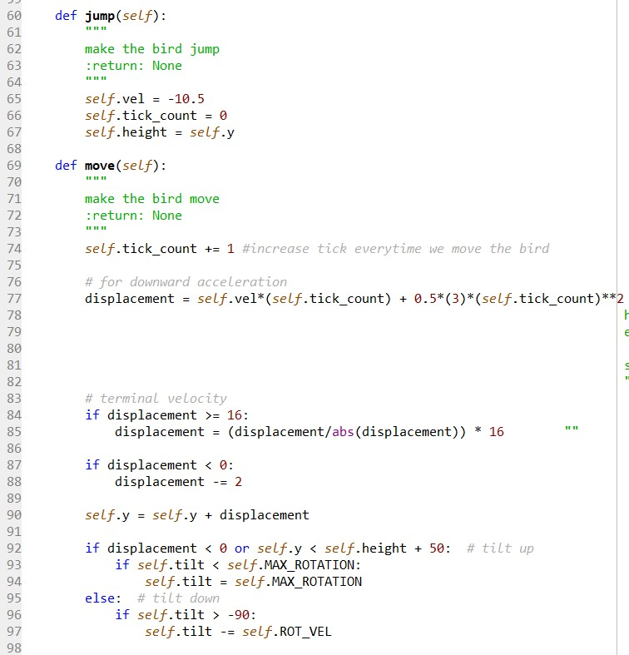
- Now we have a function jump to make the bird jump -hence We made a function jump which sets the velocity of the bird to -10.5 bcuz the (0,0) coordinate in the screen is the top left corner so if the bird move forward by jumping it is jumping to upward is –ve velocity and height same as the y coordinates -self.tickcount is set 0 it measures how much the bird is moved -now new method is move to make the bird move - tick count is incremented as the birds move once - d tells us how much we are moving up and down it is formula for displacement tick acts as time here - if we calculate here the first displacement comes out to the first d comes out to be -9 so it is lower to the first d so its keep getting down until it reaches 0 and then goes down hence makes a parabola will makes the bird move forward - terminal velocity is used to control the velocity so that we do not goo much higher - if d is greater than 16 we have to keep moving up and if d is less than 0 keep moving down - than we will set the y coordinates as the displacement happens - now we have if we are moving up or down so according to that we will decide if we want to tilt bird up or down - now we check if displacement is < 0 so the bird is going up hence we have to tilt bird to 25 to make it go up - if its not going up and self.y is less then self.height + 50 that means it is going down hence we have to make the bird go down completely so that it looks like it is going downward

Slide 6
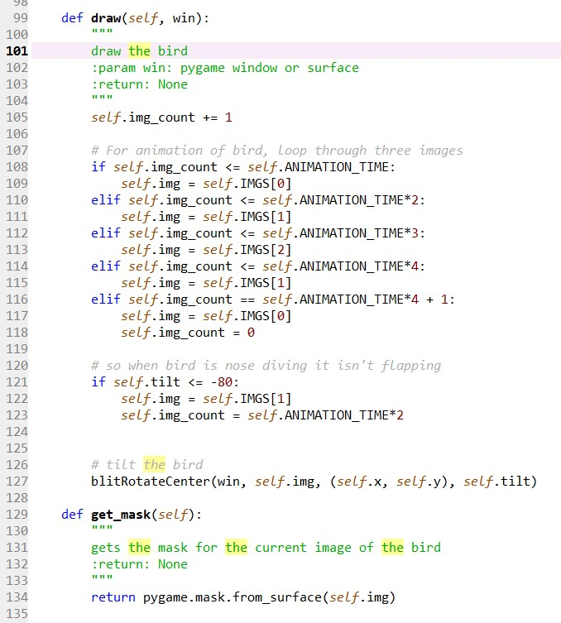
- The draw function is used to display the bird img according to their movement to make them look like flying - here the condition says if the img_count that is the time for which the bird is moving is less than self.animation_time i.e 10 show first image hence the bird is not flipping its wings - as the animation time exceeds 10 its time the bird to flip the wings so make the 2nd image show - now 3rd then again 2nd 1st to make it look like its flipping the wings - now if the bird is going down the tilt degree should be less than 80 then we check that if that is the condition show first picture where the wings are straight and use bitrotatecentre to tilt the pic down to make it look like its going down - thet get-mask is used to handle collisions of the bird with pipe

Slide 7
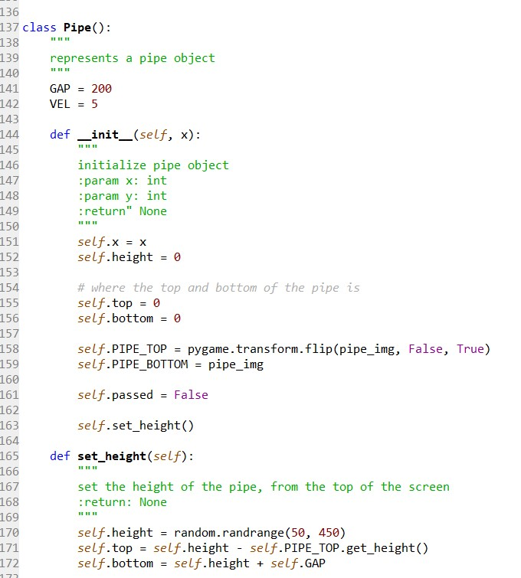
- NOW WE WILL CREATE A CLASS PIPE TO MANAGE PIPE LIKE LAYOUT ITS VELOCITY ETC - GAP IS USED TO SET GAP BETWEEN PIPE AND VEL IS USED TO SET THE VELOCITY OF HOW THE PIPE WILL MOVE - TO AND BOTTOM IS TAKEN TO HAVE AN IDEA WHERE THE PIPES ARE DRAWN IN TOP AND BOTTOM - PIPE_TOP IS TRANSFOREMED AND FLIPED TO MAKE IT INVERTED BECAUSE THE PICTURE OF THE PIPE IS STRAIGHT , AND THE BOTTOM CAN BE TAKEN AS IT IS - SELF.PASSED IS USED IF THE BIRD PASSED THE PIPE GAP OR NOT AND SET.HEIGHT() IS GONNA DEFINE WHERE THE TOP AND THE BOTTOM OF THE PIPE IS AND HOW TALL IT IS AND GAP - NOW IN HEIGHT() THE HEIGHT OF THE PIPE CAN BE ANYTHING WE DON’T CARE ABOUT THE HEIIGHT SO IT IS TAKEN RANDOM - NOW HERE THE SELF.TOP HERE WE ARE CONSIDERING LEFT POINT OF THE TOP OF THE PIPE WHICH IS INVERTED SO HERE WE SUB THE HEIGHT WITH THE PIPE_TOP THAT IS THE HEIGHT - NOW THE BOTTOM IS JUST HEIGHT + THE GAP THAT IS GIVEN

Slide 8
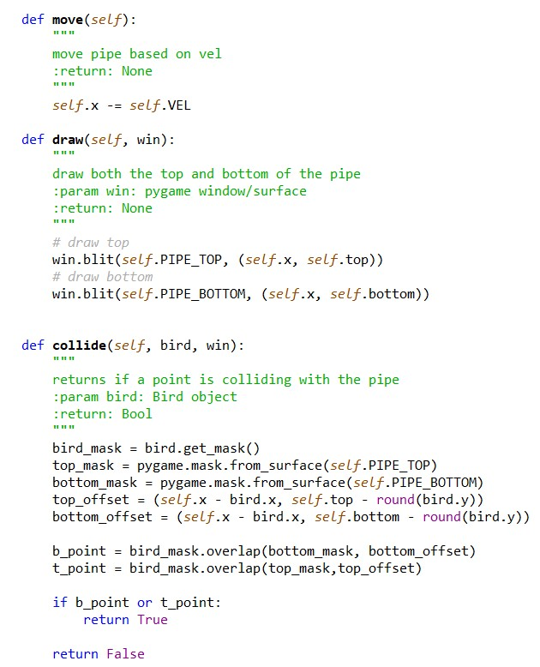
- HERE IN MOVE() EVERY TIME THE VALUE OF THE X COORDINATE SHOULD GO LEFT CONSIDERING THE VELOCITY OF THE PIPE THAT IS SET HENCE IT IS ALWAYS SUBTRACTED FROM X - DRAW() WILL DRAW OUR PIPE BOTH UP AND DOWN WIN IS WINDOW AND HERE THE PLACES IS PASSED WITH SELD.PIPE-TOP AND SELF.PIPE_BOTTOM AND THE X COORDINATE - COLLIDE() CHECKS IF THE BIRD COLLIDES WITH THE PIPE MASK IS USED TO GET PRECISION OF THE PIXELS WHAT ARE BIRDS AND NOT TAKE ALL THE PIXELS OF THE BOXES AS BIRD HENCE WE MASK THE BIRD - WE ALSO CREATE THE MASK FOR THE TOP AND THE BOTTOM PIPES - THE OFFSET CHECKS HOW FAR AWAY ARE THESE PIPES FROM THE BIRD THAT ALLOWS TO MAKE THEM A DECISION IF THE BIRD COLLIDED OR NOT - NOW TO CHECK IF THE BIRD COLLIDES WE WILL USE OVERLAP TO SEET IF THE BIRDS PIXELS OVERLAPS THE PIPES PIXEL - THIS RETURN TRUE IF THEY COLLIDES IF THEY DON’T IT RETURN NONE -NOW CHECK IF THE B_POINT AND T_POINT ARE TRUE IF IT IS IT COLLIDED AND IF IT DOESN’T IT DIDN’T COLLIDE

Slide 9
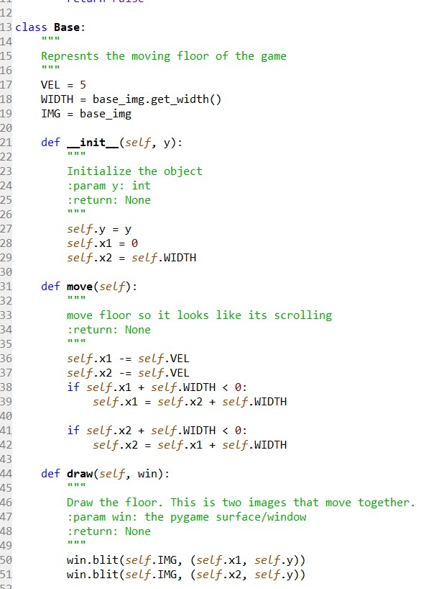
- NOW LETS CONSIDER THE BASE. HERE THE VELOCITY, WIDTH OF THE IMAGE OF THE BASE AND IMG IS TAKEN AS VARIABLES - FIRST CONSTRUCTOR IS CREATED WE DON’T TAKE X HERE AS IT IS MOVING TOWARDS LEFT - HERE WE ARE TAKING TWO X FOR TWO IMAGE TO MAKE THE ROTATION EASY AND REPEAT THE IMAGES LIKE 1 RUNS 2 IS FOLLOWED BY IT AND 1 IS AGAIN FOLLOWED BY 1 SO IT LOOKS LIKE THEY ARE MOVING - THAT IS WHY X1 = 0 AND X2 = SELF.WIDTH AT THE ENDING OF X1 - THE IFS STATEMENTS ARE TO CHECKK IF THEY ARE OFF THE SCREEN - NOW WE DRAW THE BASE USING DRAW() BLIT() IS USED TO DRAW HERE X1 AND X2 IS DRAWN SELF.Y IS USED BCUZ X DOESN’T MATTER HERE BCUZ IT IS OCCUPING THE WHOLE X

Slide 10
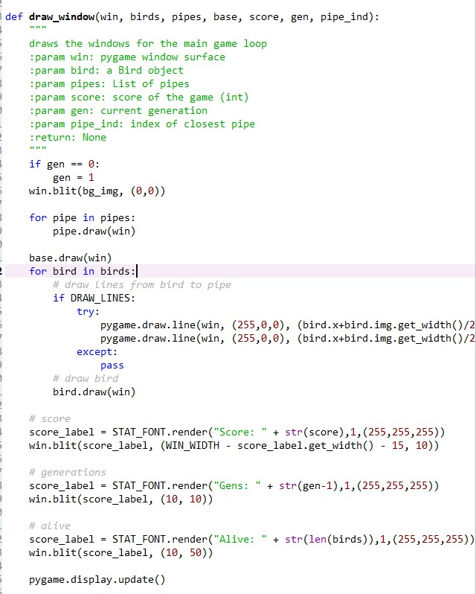
- This function is used to display the whole game hence it has win the window, birds the bird, pipes , base of the frame, score to see the score, gen number of generations - first if loop is used to see if gen becomes 1 draw the background - now draw the pipes aswell here there are more than 1 pipes hence we haved used list here - draw the base now - now this if loops is used to draw the lines that is used by the algorithm to trace gap - now the bird is drawn using base.bird - score label is used to print the score of the bird currently active also the generatition and alive birds

Slide 11
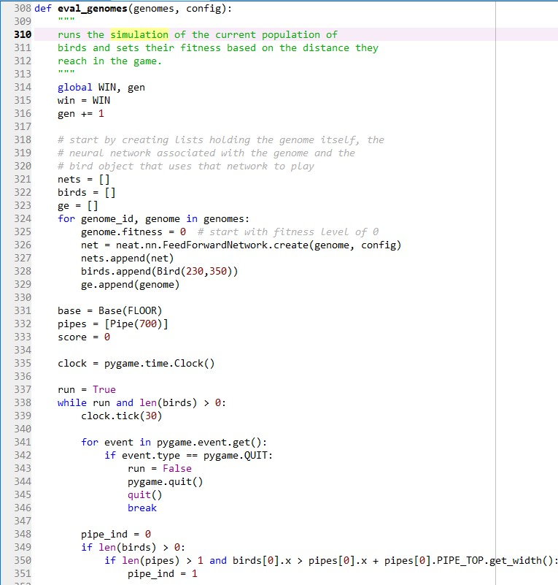
- runs the simulation of the current population of birds and sets their fitness based on the distance they reach in the game. - win is an variable to store the window and gen is a variable to check the generations of the birds that currently active it is incremented every time eval_genomes is called() - nets list is used to create a neural network for each bird that is created and bird[] for every bird object that uses that network to play and ge is used to stored genomes that are created - for loop is used to create neural network for every gnome created - intitally the fitness value is equal to 0 -new created gnome, net and bird is appended in their respective list - run variable is used to see if the birds are running or not - now clock is used to control the frame per second the bird drops or how birds move - if the birds are more than one or the the birds are running set clock.tick(30) to 30 so 30 fps or quit the game - this sees the pipe index amd also whether to use the first or second this is checked only if pipes in the windows are more than 1 - if the conditions is true the bird jumps in respect to the next pipe hence pipe index is set 1

Slide 12
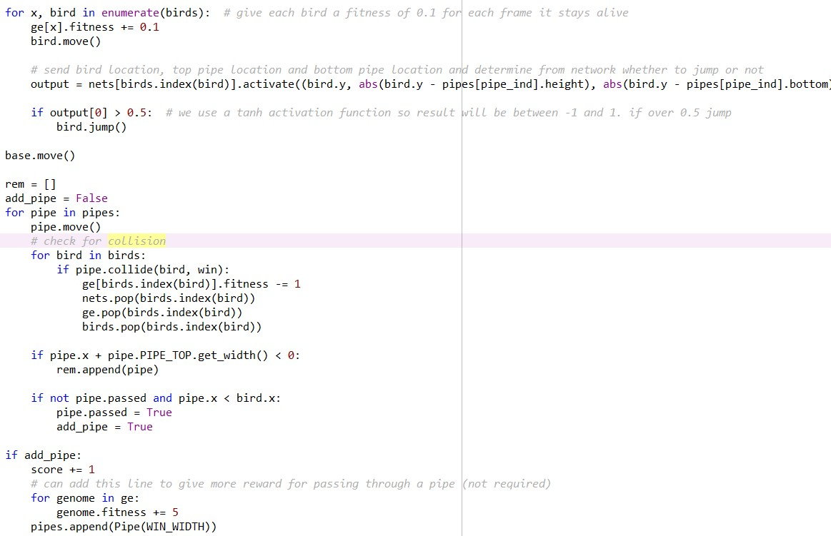
- As a bird moves 1 frame it is incremented by 0.1 fitness value - now the output variable is calculated by the location of the bird the location of the top and bottom of the pipe to the netowk and decided whether to jump or not - here tanh function is used in the nets so the value is between -1 and 1 so if the value of output is greater than 0.5 the bird will jump - rem is a list for the birds to be removed. Here pipes are moved by a for loop and birds are moved in the same manner if the bird collides the pipe its fitness is decreased and it is removed from birds nets and genomes list - the next if statements checks if the pipe x coordinate and width is less than 0 zero that is out of frame we will remove the pipe by appending it to rem - now if not tackles with situation if the b.ird.x passed the pipe.x that if it passed the pipe generate a new pipe - now if we passed the pipe we will give a point to the bird by incrementing the score of the pipe laso inrement the fitness by 5 as It passed the pipe successfully - now append a pipe i.e create a pipe

Slide 13
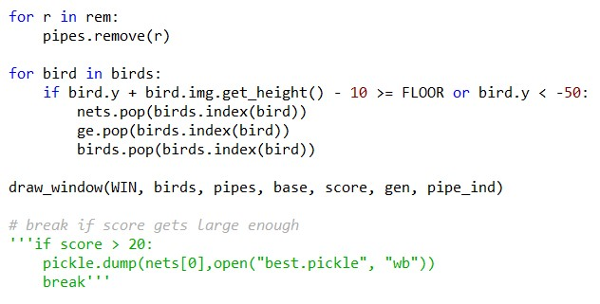
- We have to delete all the pipes that passed so we will pop them from the rem list - now this for loop see if the bird has hit the ground - if the y coord or the height of the image of the bird is grater than floor or less than -50 that is the base - the bird has fallen and we will pop it its genome and its net also - now the final function draws the main window of the game

Slide 14
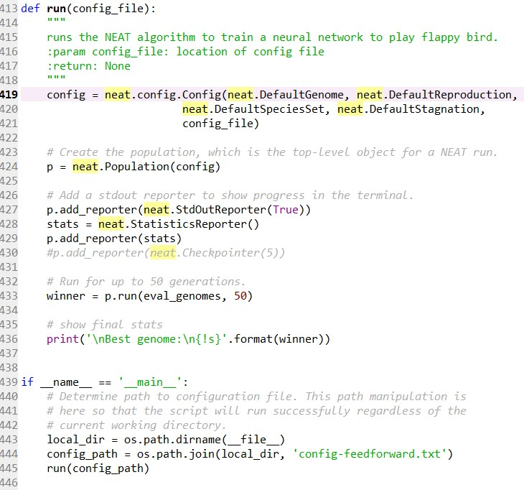
- SO HERE WE ARE DEFINING A FUNCTION CALLED RUN WHICH RUNS THE NEAT ALGORITHM - CONFIG TAKES THE NEAT.CONFIG.CONFIG() WHICH TAKES MANY PARAMETERS WHICH ARE THE PROPERTIES OF THE NEAT ALGORITHM WHICH IS STORED IN THE CONFIG FILE - THE NEAT.POPULATION() CREATES THE POPULATION FOR THE ALGORITHM - P.ADD.REPORTER() BLOCK ADDS THE STATISTICS THAT HAPPENS BEHIND THE ALGORITHM VISIBLE TO US - P.RUN() FUNCTIONS GENERATES THE EVAL_GNOMES THAT IS THE FUNCTION USED TO START THE GAME AND THE SECOND PARAMETER IS HOW MANY TIMES DOES WE WANT IT TO HAPPEN - SO THIS PASSES THE POPULATION THE CONFIG FILE AND ALL THE PROPERTIES OF NEAT ALGORITHM TO THE EVAL_GNOMES FUNCTION - NOW WE ARE GONNA PRINT THE FINAL STATS AFTER THE ALGORITHM IS APPLIED AND THE OUTPUT IS GENERATED - THE IF STATEMENT BELOW FINDS THE PATH OF THE CONFIG FILE AND PASSES IT TO THE CONFIG_PATH VARIABLE AND SENDS TO THE ALGORITHM

Slide 15
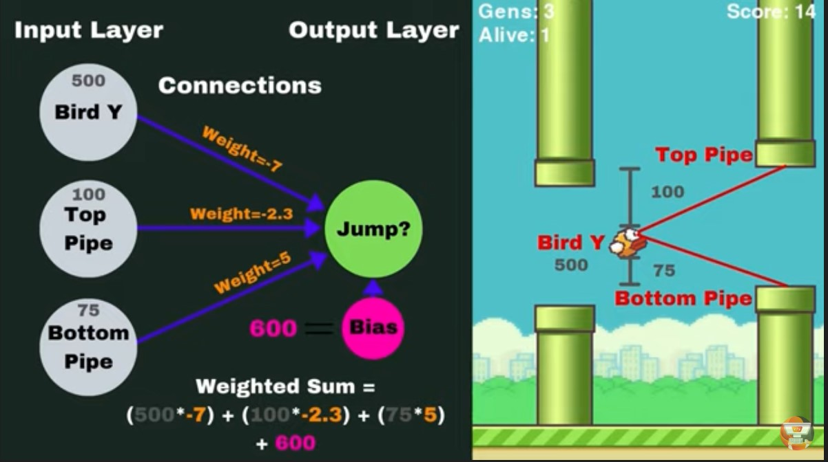

Slide 16
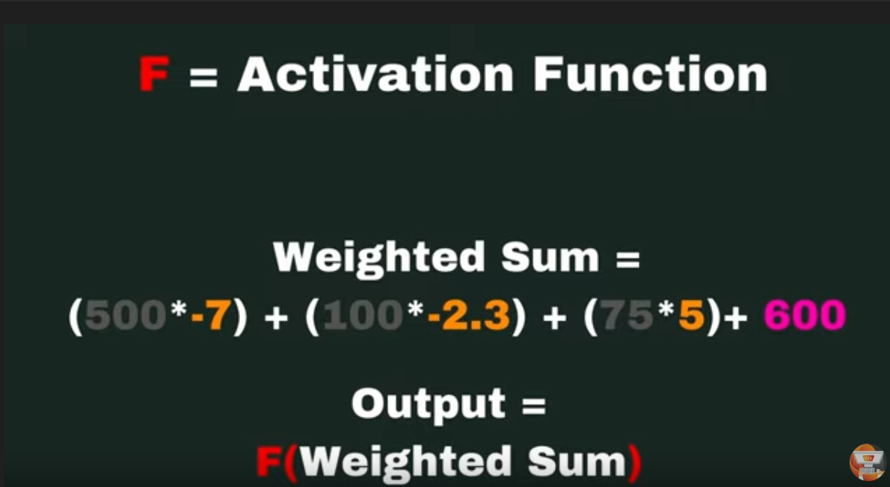

Slide 17
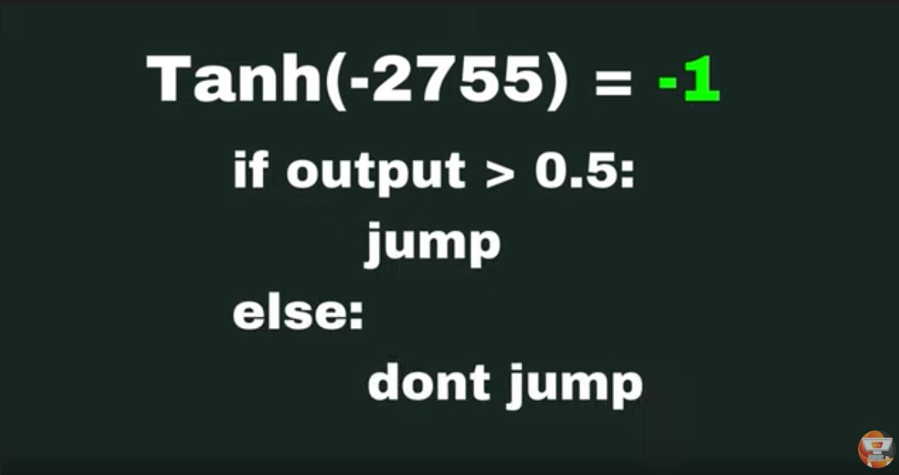

Slide 18
Thank you!

