Slide 1

Computer Engineering Department A.P. Shah Institute of Technology G.B.Road,Kasarvadavli, Thane(W), Mumbai-400615 UNIVERSITY OF MUMBAI Academic Year 2019-2020

Slide 2
A Project Report on Real Time Bare Skinned Image Classification Using CNN Submitted in partial fulfillment of the degree of Bachelor of Engineering(Sem-7) in Computer Engineering By Pratik Jain(16102060) Tina Shah(16102019) Kshitija Shah(16102027) Under the Guidance of Prof.Jaya Gupta

Slide 3
1.Project Conception and Initiation

Slide 4
1.1 Abstract
This project proposes the image classification model applied for identifying the display of daunting pictures on the internet.
The proposed model uses the Convolutional Neural Network (CNN) to identify these images and filter them through different blocks of the network, so that it can be classified accurately.
The input data for the model are images we collected online through various resources. Our model will work as an extension to the web browser and will work on all websites when activated.
The output of the proposed model is blurring the images and deactivating the links. This means that it will scan the entire web page and find all the daunting images present on that page. Then we will blur those images before they are loaded and the children could see them.
Apart from it, we will also disable any clickable links present. This ensures protection from disturbing images and links, to the children.

Slide 5
1.2 Objectives
The model will offer child proof surfing on the internet without parent intervention. So thatparents do not have to worry about their children coming across nude images at such an early age without knowing the actual meaning of it.
That is it will monitor every page and filter all the images, hiding their details from the children and disabling their activation upon any click.Even if the people in the image is not completely nude, may it be just the upper or lower half of the persons body;thus ensuring guaranteed protection.

Slide 6
1.3 Literature Review
The Convolutional Neural Network (CNN) classifies the image regions as a collection of either skin or non-skin regions, it also classifies it based on the curves and edges it encounters in the image.
Earlier work on nude identification focused on human skin detection, in which the idea is that greater amounts of detected skin would lead to higher probabilities of nudity within the image, hence characterizing the content as nude.
Symmetric model uses a single classifier for both the classes whereas asymmetric model uses two separate classifiers for skin and non-skin pixels that are separately trained using respective features. Advantage of asymmetric skin classifier is that it increases the distances in certain skin related features between a positive (skin) and a negative (non-skin) image, with disadvantage of increased time complexity for training two classifiers.
Thus by using a CNN classifier we have improved the separability between these two classes, eliminating additional time complexity that is needed in asymmetric classifier.

Slide 7
1.4 Problem Definition
The main problem faced with CNN is training the model with the images it needs to identify. So in this study we train the model only on one type of image, which contains of exposed skin of humans, using a classifier. The classifier will differentiate the image based on its type.
An image classified as positive by the classifier equals a nude or daunting image. Any other type of image will be filtered right through it. Thus this classifier makes the work easier, as we dont have to make two different classifiers for identification and filtering.

Slide 8
1.5 Scope
This project proposes the image classification model applied for identifying the display of daunting pictures on the internet. In order to differentiate them from images containing humans from other images of any type we train our model on those images.
Our scope is to writeour own CNN model for training the images to classifiy whether the dauting images.
Model will be able to classify whether the image is nude or non-nude for further processing.Even if the people in the image is not completely nude, may it be just the upperor lower half of the persons body,the model should also be classify such type of images as nude images.
Also CNN Model should classify images with good accuracy for better results.

Slide 9
1.6 Technology stack
Our technology is built on different APIs which help us detect the nude pictures on the web pages. There is an API for face detection and different APIs for nude body detection. Apart from this our model mainly uses Convolutional Neural Network (CNN) for classifying the images correctly.
All this code is written in Colab, a platform which allows importing python libraries and uploading data from our computer or any other source. We have also used OpenCV-Python whichmakesuseof Numpy, which is a highly optimized library for numerical operations.
Keras Library of Tensor Flow is used for writing CNN modules.
We are also using NVIDIA a graphics processing units for the gaming and professional markets, as well as system. It is a chip unit for the mobile computing and automotive market.

Slide 10
1.7 Benefits for environment & Society
This project would work as an excellent child proof surfing on the internet without us monitoring their usage 24*7. Not only the child would not come across extreme pictures and videos at such an early age where their minds are growing and has the most grasping power.
But it will also help the parents to not waste their time and worry about their child getting exposed to nudity at such an early age.Thus benefitting the society as a whole in multiple ways the project mainly ensures protection of the children from a number of things while surfing on the internet.

Slide 11
2. Project Design

Slide 12
2.1 Proposed System
Convolution Neural Network (CNN) is one of the most popular and effective technology for image recognition and image classification. The CNN classifier takes an image as a input,processes it and classifies it under certain categories.
Our main aim is to disable the view of daunting images and get the link inactivated so that children do not get redirected tosome irrelevant content which they are not ready to get exposed to at such an early age.We will first be training the CNN model (VGG16/VGG19) on bare skinned images as well as advertisements of any other type.
Once the model is trained with a good accuracy of prediction and filtering,a chrome extension will be created for the same, which will capture all the images on the websites and if it comes across any such image, the image will be blurred, also automatically disabling any redirect able links.

Slide 13
2.2 Design(Flow Of Modules)
First Step is the collection of dataset of both kind of nude and non-nude images.Images will be scrapped from the internet using the links of that particular image using concept of Beautiful Soap in python.Approximately 25000 images will be used in dataset for moreaccurate results.
Next step is the classification of images, done by using Convolution neural network. The training of CNN would be done on two kinds of images positive and negative;positive being the nude images and negative being the images of any other type.
Testing will be done for the same, so that we come to know how accurate the prediction is.Extension will be created just like any other Google extension, which will blur and disable the images on the website visited.This extension will work 24*7 and provide the safest browsing experience on the internet to the kids.

Slide 14
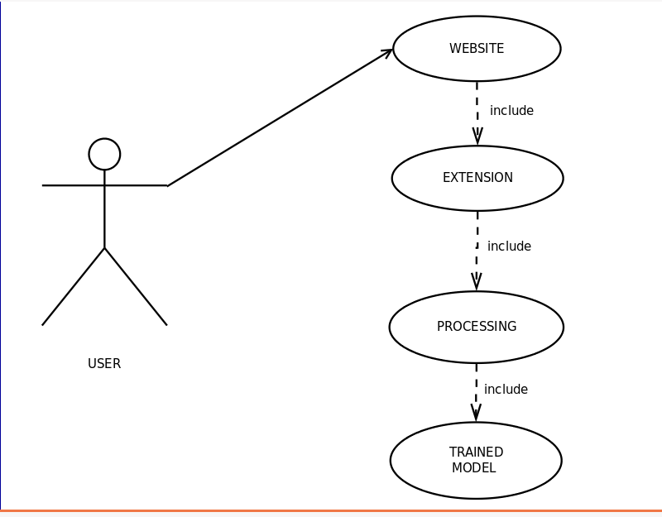
2.3 Use Case Diagram

Slide 15
2.4 Description of Use Case Diagram
The above representation of our project is in the form of a Use Case diagram. This diagram represents the flow and the working of each model in the diagram. The diagram depicts that when the user accesses the website through the Google Chrome, the extensions workingcomes into the picture.
The extension processes the entire webpage differentiating the imagesand blurring the positive images (nude images). This work is done on the basis of a trained model which the extension works upon to complete the desired action.

Slide 16
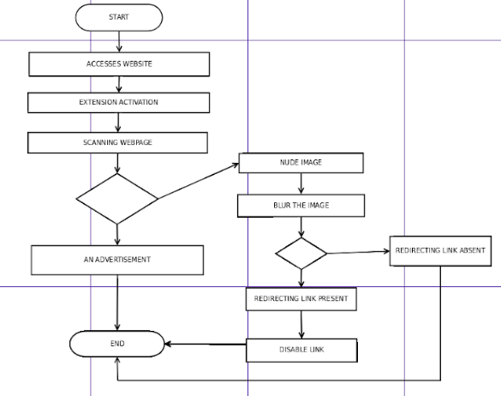
2.5 Activity diagram

Slide 17
2.6 Module-1 :Classification Of Images Using CNN
Our model proposes the use of VGG16/VGG19 model. Training is done on a dataset of approximately 25000 images for more accurate and correct results.The dataset of 25000 images was not easy to find for one reason; it was not readily available on any website like Kaggle for example which is a source of various types of datasets. So now we had to prepare our own dataset. For this purpose we used a concept known as BeautifulSoup ormore commonly known as Scrapping.
Now that the data is collected we had to train the model from the same. For this we cannot use our regular computers because their configuration cannot handle such a large amount of data. So you will have to use a computer with a GPU. We will use a computer containing NIVIDIA system in order to train the model.

Slide 18
Module-2 : Testing of Trained Model
Once we have trained the model on the bare skinned images, the next step is to test the model that is to see whether the model is providing the appropriate output we are hoping for or not.
We will be passing both a set of bare skinned images and a set of any image which does not pose nudity of any kind. If the model detects any bare skinned image it will assign a value of one to that image, if not then the value greater than one will be assigned to it.
For testing we do not require any special computer, as the testing data is comparatively very small in front of the training data and our personal computers can handle it.

Slide 19
Module-3 : Creating the required extension
We will try to put our trained model on the web browser itself so that it works on all thewebsites. Thus being said we will provide it in the form of an extension which when activated would work for all the websites you visit while it is activated.
The extension would work in Google Chrome as any other extension you may use or see. You will have to download and add it to the Google Chrome and give it the required permissions to scan the pages you visit while surfing on the internet.
Disabling the link is the next step that follows in our process. Just blurring the images does not serve theentire purpose, as clicking on image may redirect us to some other website. So the extensioncreated will not only blur the image but also disable the links.

Slide 20
2.7 References
[1] 2017 9th International Conference on Knowledge and Systems Engineering(KSE) Adver-
tisement Image Classification Using Convolutional Neural Network
[2] https://machinelearningmastery.com/how-to-develop-a-convolutional-neural-network-
to-classify-photos-of-dogs-and-cats/
[3] https://medium.com/@alkeshab/face-detection-using-opencv-in-google-colaboratory-
a7529a2bb921
[4] https://www.analyticsvidya.com/blog/2017/06/architecture-of-convolution-neural-
networks-simplified-demystified/
[5] https://neurohive.io/en/popular-networks/vgg16/
[6] https://www.pyimagesearch.com/2018/09/24/open-cv-face-recognition/
[7] https://www.willberger.org/cascade-haar-explained/

Slide 21
3.Planning for next semester

Slide 22
Planning
Our scope is to blur all the extreme images and deactivating their links. This means that it will scan the entire web page and find all the extreme images present on that page. Then we will blur those images before they are loaded, so that the children would not be able to see them.
This will be done in a 2 step process first it will identify the image as nude or non-nude image. If identified as nude it needs to be blurred, if not keep the image as it is and display it.
Apart from it, we will also disable any clickable links present on or below those images. This ensures double protection of children from the disturbing images andlinks that are easily available on en-number of websites we visit from day to day. Our model will try to do this in the most minimum amount of time possible

Slide 23
Thank You

