Slide 1
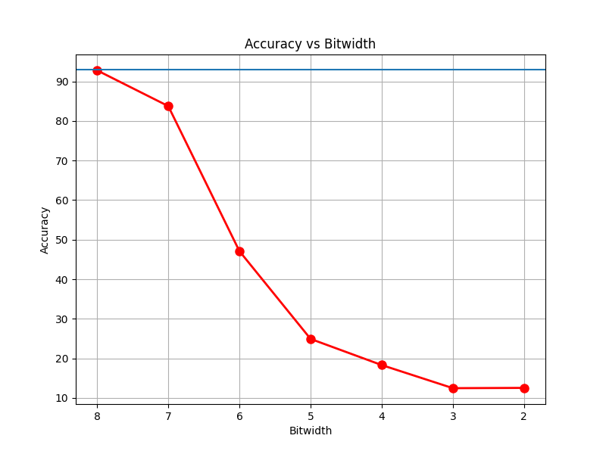
Accuracy vs Bitwidth
Blue: Base Line Model (fp-32)
Red: Quantized Model

Slide 2
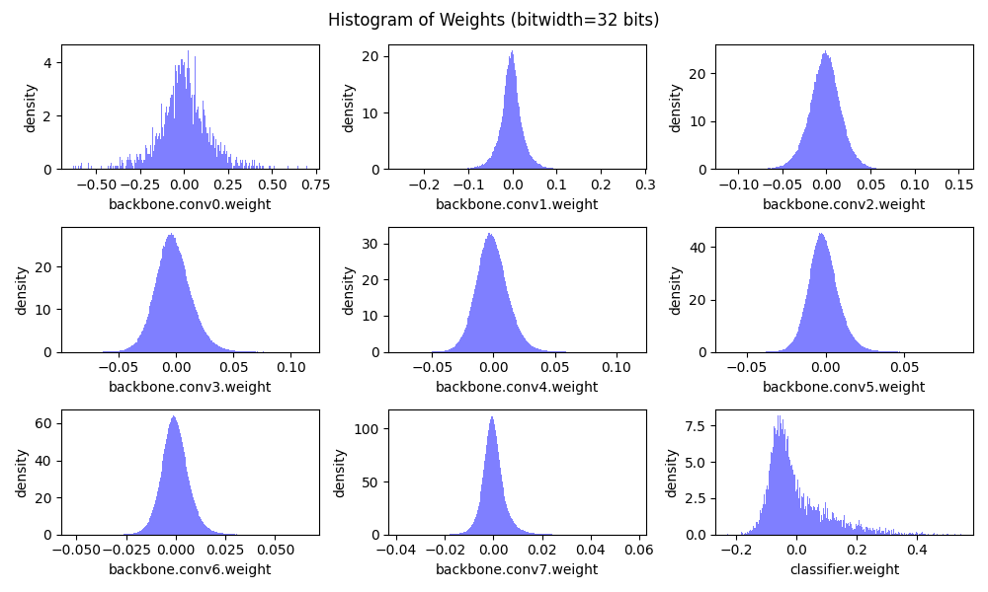
Weight Distribution of Base line model is already zero mean (except for classifier) so we take Z(zero-point = 0)

Slide 3
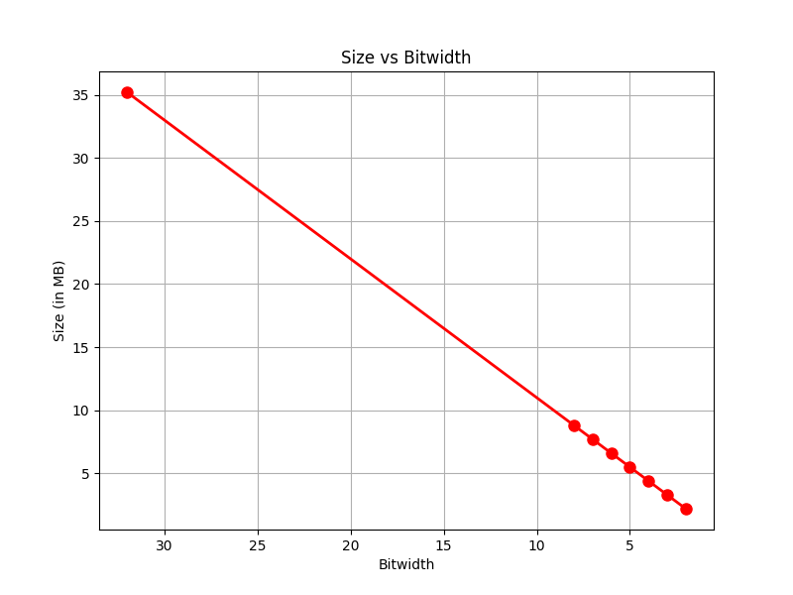
Size VS Bit

Slide 4
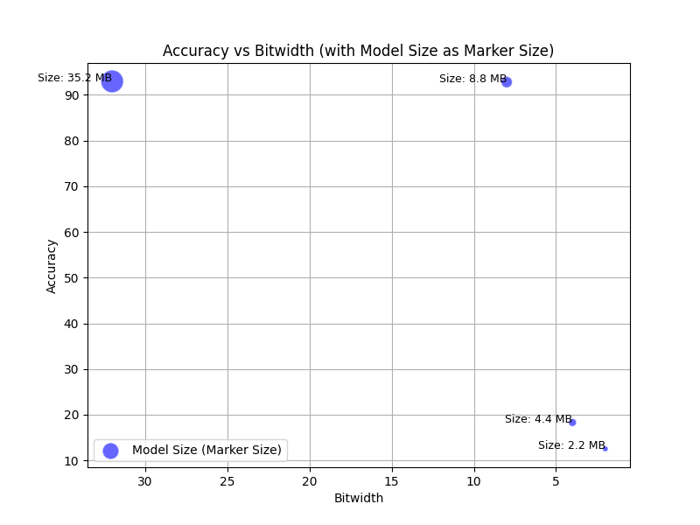
Accuracy_Size_Bits Graph

Slide 5
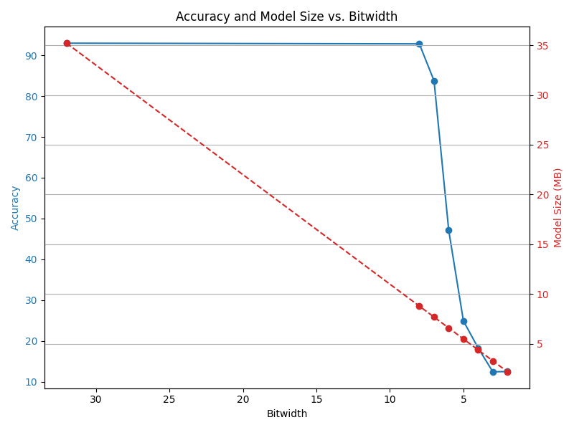
Accuracy & Model Size VS BitWidth

