Slide 1
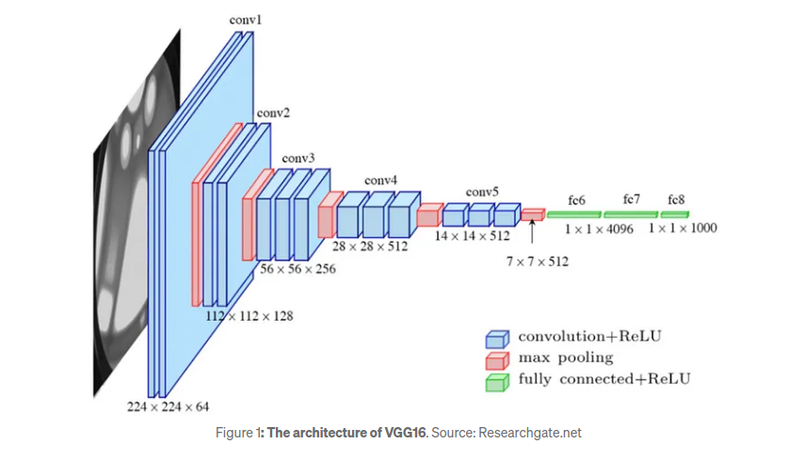
VGG16-Arch

Slide 2
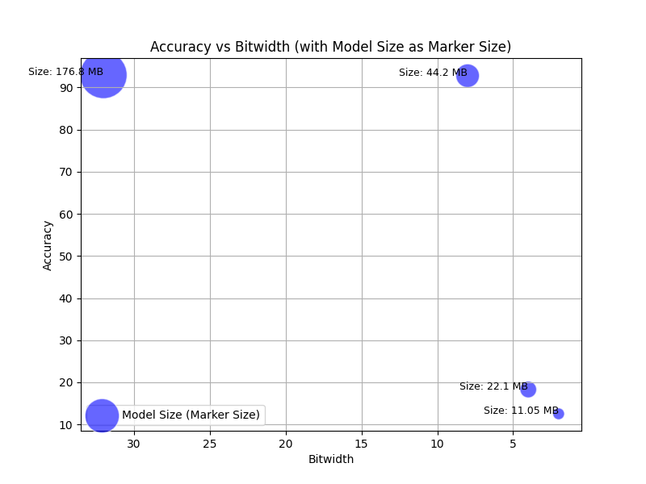
Acc_Vs_Bitwidth (with size as marker size)

Slide 3
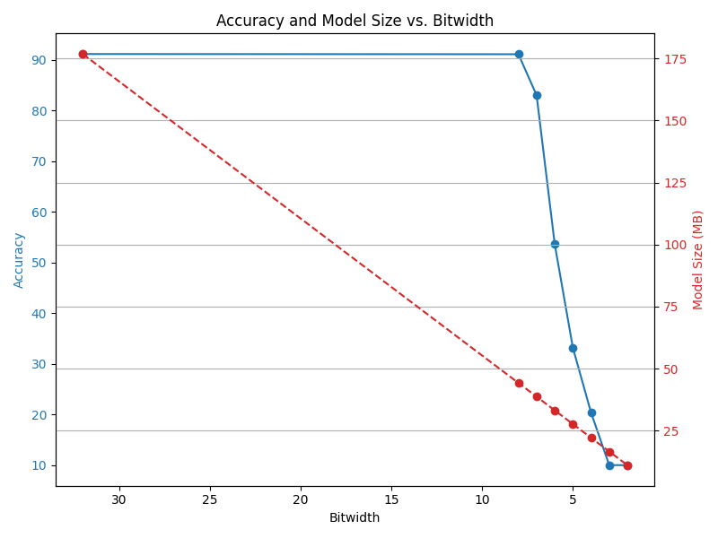
Acc_Vs_Size_Vs_Bitwidth

Slide 4
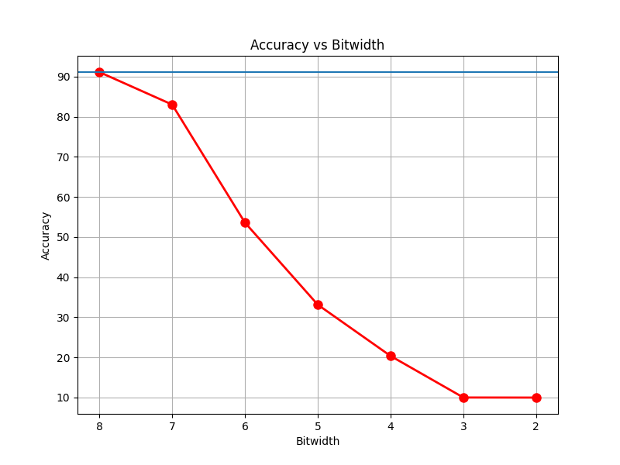
Acc_vs_Bits (only Quantized Models)

Slide 5
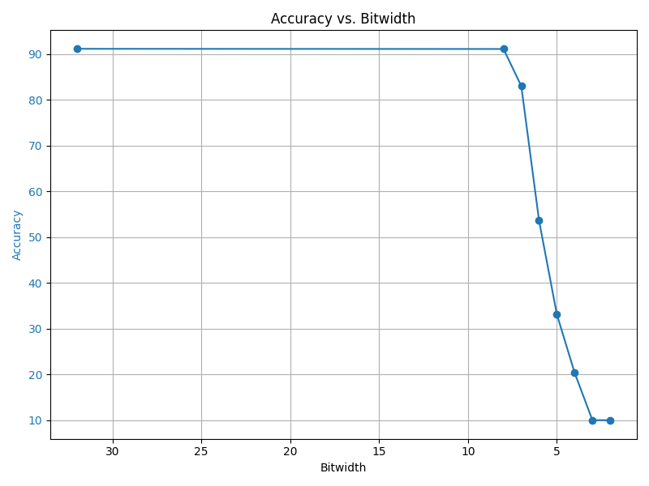
Acc_Vs_Bits

Slide 6
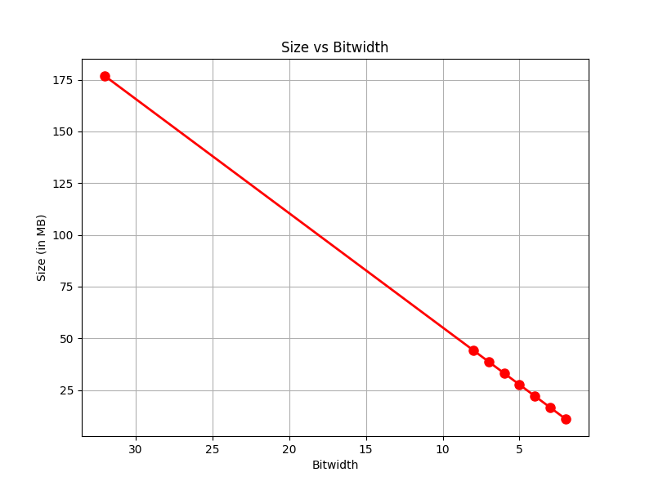
Size_vs_Bits

