Slide 1


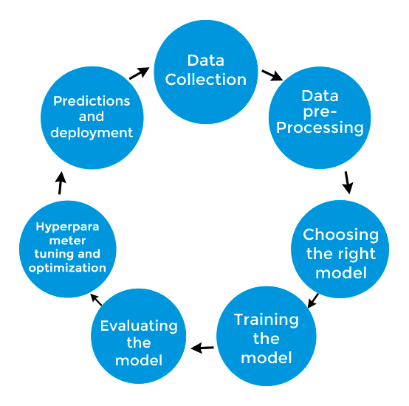






TEAM
DECYPHER
Loan Default Prediction – AI/ML Solution

Slide 2
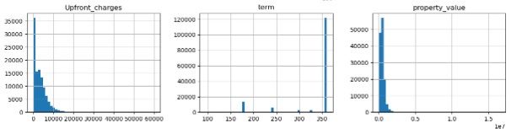
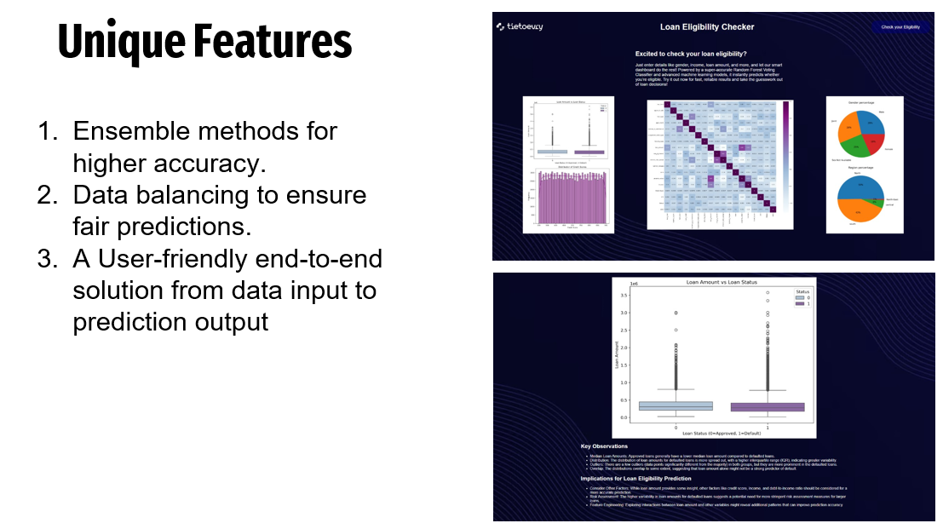
Challenges Faced
How We Overcame Then
Skewness of Several Features
Imbalanced Dataset
We used log values to normalize the Features
Using Oversampling, we generated values in the minority class.
Unique Features
Ensemble methods for higher accuracy.
Data balancing to ensure fair predictions.
A User-friendly end-to-end solution from data input to prediction output

Slide 3
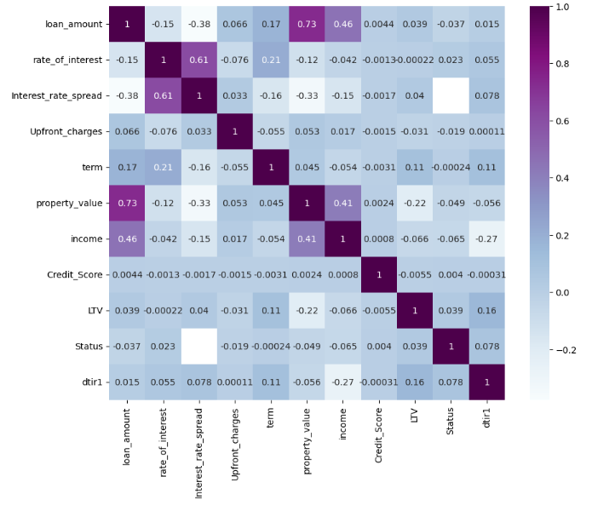
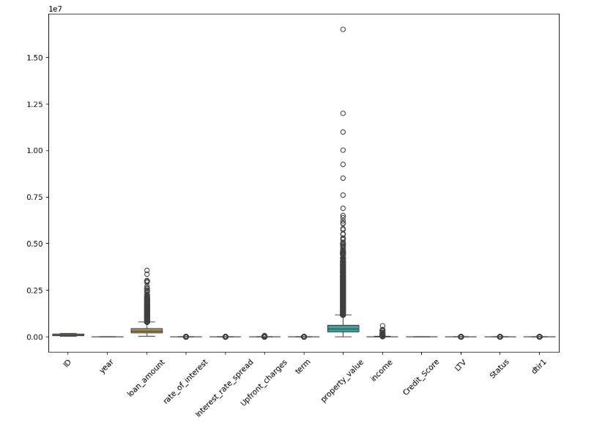
Key Features
Initial Models Used:
Random Forest, K-Nearest Neighbors, Decision Tree, Logistic Regression
01
Loan Amount
02
Income
We trained our dataset on an ensemble of models using Voting Classifier and Stacking Classifier to improve accuracy
(99%+ accuracy)
03
Property Value
04
Debt-to-income Ratio
05
Term of loan
06
Occupancy Type
07
Property Value
08
Single Installment
Data Cleaning and Pre-Processing
09
Credit Score

