Slide 1




SMART INDIA HACKATHON 2026
BIS Saarthi
Problem Statement ID – SIH26107
Problem Statement Title - Al-powered Intelligent Assistant for Indian Standards and BIS Services for Industries and Consumers
Theme - Smart Automation
PS Category - Software
Team ID -
Team Name - HexaMinds

Slide 2





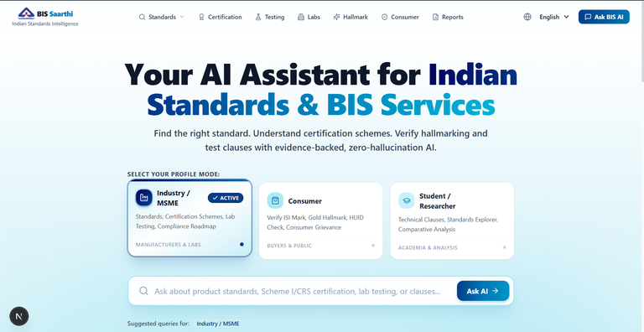





BIS Saarthi
Proposed Solution
How it Addresses the Problem
Uses RAG, LLMs, and document analysis to help understand Indian Standards
Finds Missing or Non-compliant requirements
Ask in Simple Natural Language
Guides through Certifications, Licenses, etc.
Find Relevant Standards
One- stop solution for standards, analysis and mre
Compliance Assistance
Uses RAG to Ensure Accurate and Relevant Information
Simplifies Complex Information
BIS Saarthi
2
Notes:
2

Slide 3








TECHNICAL APPROACH
TECH STACK
RETRIEVE FIRST
REASON SECOND
CITE EVERYTHING
KEY FEATURES AND WORKFLOWS
Frontend:
Next.js 14, React 18, Tailwind CSS,
shadcn/ui, TanStack Query,
Lucide React, Recharts
3-Panel AI Workspace
User: MSME / Consumer / Researcher
/chat - evidence drawer, citation badges, confidence indicator
Backend API:
NestJS, TypeScript, REST APIs,
Passport JWT, bcrypt,
class-validator, Swagger/OpenAPI
Find My Standard
apps/web - Next.js App Router
/standards/recommend - product profiler matches IS codes
Tailwind CSS · shadcn/ui · TanStack Query
Certification Roadmap
Database:
PostgreSQL 16, pgvector,
Prisma ORM
apps/api - NestJS API Gateway
/certification - Scheme I/II/Hallmarking timeline
Passport JWT · class-validator · Swagger / OpenAPI
Testing Requirements DB
AI & RAG:
Gemini / OpenAI / deterministic engine,
Langchain, multilingual embeddings,
cross-encoder reranking
/testing - routine vs type tests, sampling rules
Auth & RBAC Module
Role-based access control
AI Agent Orchestrator
Tool caller / routing
Hybrid RAG Engine
Retrieve rerank ground
Labs Finder
/laboratories - NABL & BIS recognized labs
Multilingual:
Indic pipeline - all 22 Eighth-Schedule
languages + English + Hinglish
Hallmarking Assistant
BACKEND SERVICES
/hallmarking - HUID validator, fineness grades
Standards & Profiler Service
Certification Roadmap Service
Testing Requirements Service
Recognized Labs Finder
Consumer Protection Hub
Testing:
Jest, ts-jest, Supertest, Playwright E2E
Hallmarking & HUID Service
Consumer Hub & ISI Verifier
Compliance Report Generator
Analytics & Feedback Engine
/consumer - ISI mark check, CM/L verification
Deploy:
Docker, Docker Compose
AI & RETRIEVAL PIPELINE
Compliance Report
Indic Language Detector
22 languages + Hinglish
PostgreSQL + pgvector
BM25 exact keyword match
Cross-Encoder Reranker
Hybrid relevance scoring
Grounding Validator
Zero-hallucination + citations
/reports - downloadable PDF evidence trail
Analytics Dashboard
/dashboard - query intent, latency, accuracy
User Query
Indic Pipeline
pgvector Retrieval
Cross-Encoder Rerank
Grounding Validator
LLM Reasoning
Cited Response
Multilingual Pipeline
22 language + Hinglish
Protects IS 10500, HUID,
CM/L IDs
Multilingual embeddings +
Postgres 16
Top-K evidence chunks
scored
Claim source match
check
Gemini / OpenAI / Local
Engine
Clause, page, source URL,
confidence
22 Indic languages + Hinglish, clause-safe
BIS Saarthi
3
Notes:
3

Slide 4














FEASIBILITY AND VIABILITY
FEASIBILITY
VIABILITY
Existing BIS data sources
Large target audience
BIS standards, product information and certification data provides reliable sources for AI-based information retrieval
India has 6.3+ crore MSMEs, creating significant demand for simpler access to standards and compliance information.
AI + RAG technology
Consumer Awareness
Retrival-Augmented Generation can provide accurate answers by grounding responses in verified BIS documents.
An AI assistant can help consumers understand ISI/BIS certifications, product standards and safety requirements.
Multilingual accessibility
MSME Compliance Support
AI-based translation and voice interfaces can make BIS information accessbile to users across multiple Indian languages.
Simplifies AI guidedance can reduce the time and effort required for MSME’s to understand applicable standards.
Cloud-ready architecture
Government & Industry parternships
Cloud deployment enables scalable document storage, AI processing and access for growing numbers of MSMEs and consumers.
Collaboration with BIS, MSME’s and industry bodies can improve adoption and provide verified domain knowledge
CHALLENGES AND MITIGATION
Large number of BIS documents
RAG-based document indexing + semantic search
Language Barrier
Multilingual translation available
Complex technical standards
AI converts technical language into simple, user-friendly explanations.
BIS Saarthi
4
Notes:
4

Slide 5








IMPACT AND BENEFITS
For Industries & MSMEs:
For Students & Researchers:
Simplifies certifications, access testing requirements, and reduce document navigation time.
Explore Indian Standards faster, understand complex clauses, and access reliable source-backed references.
For Consumers:
Trust & Credibility:
Easily understands ISI Mark, Hallmark & BIS services, to get quick answers, and interact in preferred languages.
Enhances consumer’s trust and brand reputation through recognized certifications.
Market Expansion:
Ease of Doing Business:
Reaches a wider customer base by demonstrating compliance and quality.
Bureau Of Indian Standards
Streamlines processes and makes regulations clear to reduce barriers to market entry.
BIS Saarthi
5
Notes:
5

Slide 6



























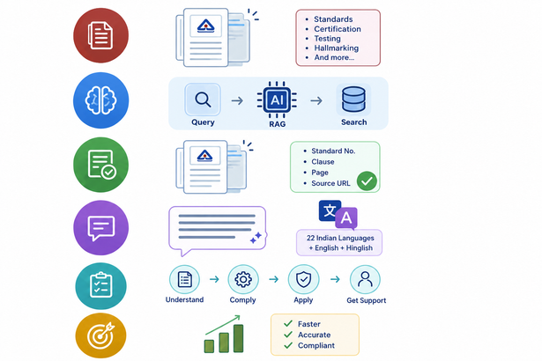
RESEARCH AND REFERENCES
BIS DOMAIN RESEARCH
EXISTING RESOURCES & REFERENCES
Complex BIS Information
Indian Standards & Standardization: Studied standards and their applicability to products.
BIS Portal
Scattered across multiple sources, technical language and complex documents.
Standards Catalogue
Certification & ISI Mark: Reviewed BIS certification and marking requirements.
AI + RAG + Search
BIS Care and Manakonline
Understands your query, retrieves relevant information, and reasons using trusted sources.
Testing & Conformity: Explored testing and conformity assessment procedures.
Consumer Services: Studied BIS services for consumer protection and complaints.
Certification & Testing
Relevant Evidence
Grounded in authoritative BIS documents with clause, page and source references.
KEY RESEARCH INSIGHTS
Simple Explanation
Scattered Information: BIS information is distributed across multiple portals and documents which makes it difficulty to access.
Complex technical information explained in clear, easy-to-understand languages.
Standard Discovery: Finding the correct standard for a specific product can be challenging, especially when multiple standards and related requirements apply.
Actionable Guidance
Technical Complexity: Standards use technical terminology that is difficult for consumers/MSMEs to interpret, making requirements and procedures harder to understand.
Step-by-step workflows, requirements, next actions and relevant services.
Need for Simple and Reliable References: Users need a simpler way to understand standards, certification, and procedures which should be presented with clear and trustworthy source references.
Faster & Better Compliance Decisions
Save time, reduce confusion, and make informed decisions with confidence.
BIS Saarthi
6
Notes:
6

