Slide 1




SMART INDIA HACKATHON 2026
Manak Setu
  Problem Statement ID – SIH26108
  Problem Statement Title - AI-Powered Recommendation Engine for Identifying Applicable Indian Standards for Procurement Specifications
  Theme - Smart Automation
  PS Category - Software
  Team ID - 179663
  Team Name - _HexaMinds_

Slide 2








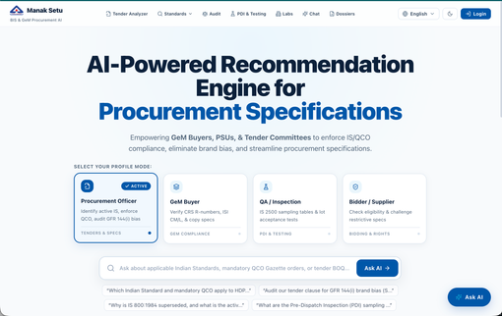
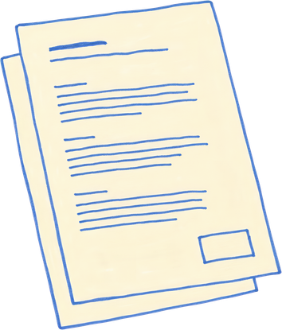









Manak Setu
Proposed Solution
How it Addresses the Problem
Manak Setu:
Al-Powered Recommendation Engine
Which standards apply to this specification → Applicable Standards Recommendation
Ask in Simple Natural Language
Finds Missing or Non-compliant requirements
Accept Procurement
Upload product descriptions, tender documents etc
Latest Version & Ammendments:
Identifies the latest published version and relevant amendments
Analyze:
Extract product,technical and procurement requirements
Semantic Standard Recommendation
Guides through Certifications, Licenses, etc.
Allied & Normative Standards:
Find test methods,safety, installation and related standards
Recommend Applicable Standards
Procurement Specification Assistance
One- stop solution for standards, analysis and mre
Tender Specification Analysis: Detects missing or outdated references
Find Allied Standards
Mandatory Certification: Suggest applicable BIS certification,CRS etc
Specification Gap Detection
Uses RAG to Ensure Accurate, Relevant and Supported Information
Specification Gap Analysis:
Identifies missing standards, incomplete requirements and
outdated references
Evidence Backed Recommendation: Shows BIS sources
Innovation and Uniqueness
Grounded AI
Retrieves relevant BIS information and validates recommendations against available evidence.
Tracable Recommendation
Every recommended standard is linked to its supporting evidence.
Multilingual Support
Supports English, Hindi, Hinglish and Indian Languages with support for identifiers.
Multi-step Decision Support:
End-to-end all standards ecosystem support in 1 platform.
Notes:
2

Slide 3











































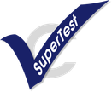








TECHNICAL APPROACH
TECH STACK
RETRIEVE FIRST
REASON SECOND
CITE EVERYTHING
User:
Procurement Officer / PSE / Industry
Frontend
Next.js App Router
Tailwind CSS · shadcn/ui · TanStack Query
Next.js
React
Tailwind
Shadcn
TanStack
Lucide
Backend
Next.js API Gateway
Passport JWT · class-validator · Swagger / OpenAPI
NestJS
TypeScript
Rest APIs
Passport
Swagger
JWT
Database
Auth & RBAC Module
Role-based access control
AI Agent Orchestrator
Tool caller / routing
Hybrid RAG Engine
Retrieve rerank ground
PostgreSQL
pgvector
Prisma ORM
AI & RAG
Cross-
encoder
reranking
BACKEND SERVICES
Gemini
OpenAI
LangChain
Multilingual
Standards & Profiler
Service
QCO and Standards Directory
Testing & PDI
Service
Recognized Labs Finder
Indic pipeline - all 22 Eighth-Schedule language + English + Hinglish
GFR 144(i) Anti-Bias Audit Service
Tender Specification Analyzer
Dossier Generator
Analytics & Feedback Engine
Testing
Jest
ts-jest
Supertest
Playwright E2E
AI & RETRIEVAL PIPELINE
Deploy
Docker
Docker Compass
Indic Language Detector
22 languages + Hinglish
PostgreSQL + pgvector
BM25 exact keyword match
Cross-Encoder Reranker
Hybrid relevance scoring
Grounding Validator
Zero-hallucination + citations
Notes:
3

Slide 4



















FEASIBILITY AND VIABILITY
FEASIBILITY
VIABILITY
Existing BIS data
Reduces Manual Search
Indian standards, metadata, references and certification information provide the knowledge base.
Reduces the need to manually inspect large number of standards and references. Also helps identify current amendments.
Mature AI Technologies
Pocurement Standardization
Hybrid retrieval, embeddings, reranking and RAG are established technologies for semantic document retireval.
Helps procurement teams systematically identify relevant standards while preparing specifications.
Graph Based Reference Expansion
MSME Compliance Support
Standards can be represented as relationships between primary standards and normative/allied refernces.
Simplifies AI guidedance can reduce the time and effort required for MSME’s to understand applicable standards.
Cloud-ready architecture
Government & Industry parternships
Cloud deployment enables scalable document storage, AI processing and access for growing numbers of MSMEs and consumers.
Collaboration with BIS, MSME’s and industry bodies can improve adoption and provide verified domain knowledge
CHALLENGES AND MITIGATION
Similar or overlapping standards
RAG-based document indexing + hybrid semantic retrieval + scope comparison
Language Barrier
Multilingual translation available
Complex tender documents
Document parsing ⟶ requirement extraction ⟶ standard mapping
IMPLEMENTATION
READINESS
Verified Data
Proven AI Tech
Ready User Base
Scalable Architecture
Existing BIS Sources
RAG, Multilingual AI
MSMEs, consumers,
government.
Cloud deployment
Notes:
4

Slide 5












































IMPACT AND BENEFITS
POTENTIAL IMPACT ON TARGET AUDIENCE
BENEFITS OF THE SOLUTION
Procurement Officials
Faster compliance
Procurement
Benefits
Semantic identification of applicable standards, Detection of missing standards and references, Latest version & amendment verification
Data-driven
decisions
Operational Benefits
Less paperwork
Saves time & cost
Faster preparation of technical specifications
Automated analysis of tender documents
24 x 7
Support
Government Departments/PSEs
Multilingual support
Reduced manual standards research
Semantic matching instead of keyword-only search
Faster preparation of tender specifications, Correct IS references, Reduced ambiguity in procurement documents
Quick & simple answers
Better identification of applicable IS standards
Latest version and amendment identification
Better awareness
Detection of missing normative references
Allied and cross-referenced standard discovery and Certification requirement identification
Private Organizations
Reliable references
Faster technical specification preparation, Consistent standards-based procurement, Better vendor/product comparison
Faster Tender Preparation
Research & learning
Trust & Accuracy
Organisational
Benefits
Collaborate
Standardize
Grow
Standards & Compliance Teams
Correct IS References
Normative and allied standard discovery, Test, safety, installation & terminology references, Certification requirement identification
Evidence-backed standard recommendations
Standardizes procurement specification preparation
Consistent information
Clause and source references
Creates a common standards reference across departments
Support policy outreach
Current version/amendment verification
BIS
Tender/ Technical Team
Reduces dependency on manual standards research
Technical specification gap detection, Standards-backed recommendations, Procurement-ready specification support
Reduced Ambiguity
Confidence score for every recommendation
Wider adoption
Trusted
information
Improves consistency across tenders
Drives market growth
Human verification before final tender use
Drives market growth
HOW IT CREATES IMPACT
AI
Specification
Analysis
Semantic Standards Matching
Related Standards Discovery
Version &
Certification
Check
Evidence-Based Recommendation
Procurement Officer
Verification
Procurement
(Input)
Notes:
5

Slide 6





























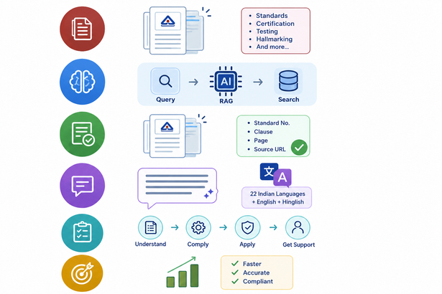
RESEARCH AND REFERENCES
PROJECT RESOURSE
DOMAIN RESEARCH
Official. Accurate. Up-to-date.
DEPLOY LINK
Product and Tender Information
Indian Standards & Standardization:Studied standards and their applicability to products.
Live application (hosted on Vercel)
Product descriptions, technical specifications, tender documents and natural-language queries.
Manak-Setu
Certification & ISI Mark: Reviewed BIS certification and marking requirements.
GITHUB REPOSITORY
View souce code, contribute and explore
AI Semantic Understanding + RAG
Testing & Conformity: Explored testing and conformity assessment procedures.
Manak Setu - SIH26108
Understands product requirements semantically and retrieves relevant information from authoritative BIS sources.
DEMO VIDEO
Consumer Services: Studied BIS services for consumer protection and complaints.
Watch the project in action
demo video
Relevant Indian Standards
Recommends the most relevant IS based on product characteristics, technical requirements and intended use.
KEY RESEARCH INSIGHTS
Allied and Related Standards
Identifies normative references, test methods, terminology, safety, installation and related product standards.
Scattered Information:
Relevant standards and associated references may need to be identified across large BIS information sources.
Specification to Standard Gap:
Procurement requirements are often expressed in product/commercial terminology rather than formal IS terminology.
Version, Certification & Compliance
Highlights the latest standard, amendments and applicable mandatory certification requirements.
Multiple Applicable Standards:
A single product may require a primary product standard plus testing, safety, terminology, installation or other related standards.
Need for Explainable Recommendations:
Procurement officials need to know why a particular standard was recommended and what evidence supports it.
Accurate Tender Specification
Provides clear standard recommendations and compliance guidance for faster, higher-quality procurement decisions.
6
Notes:
6

