Slide 1
Data Store Android

Slide 2
Basics
Why to migrate?
Setup
Read/write
Demo
Questions?

Slide 3
Data Store
Latest way to store preference/typed objects -Its a data storage solution that allows you to store key-value pairs or typed objects
Its not a Database. - Ideal for small, simple datasets and does not support partial updates or referential integrity

Slide 4
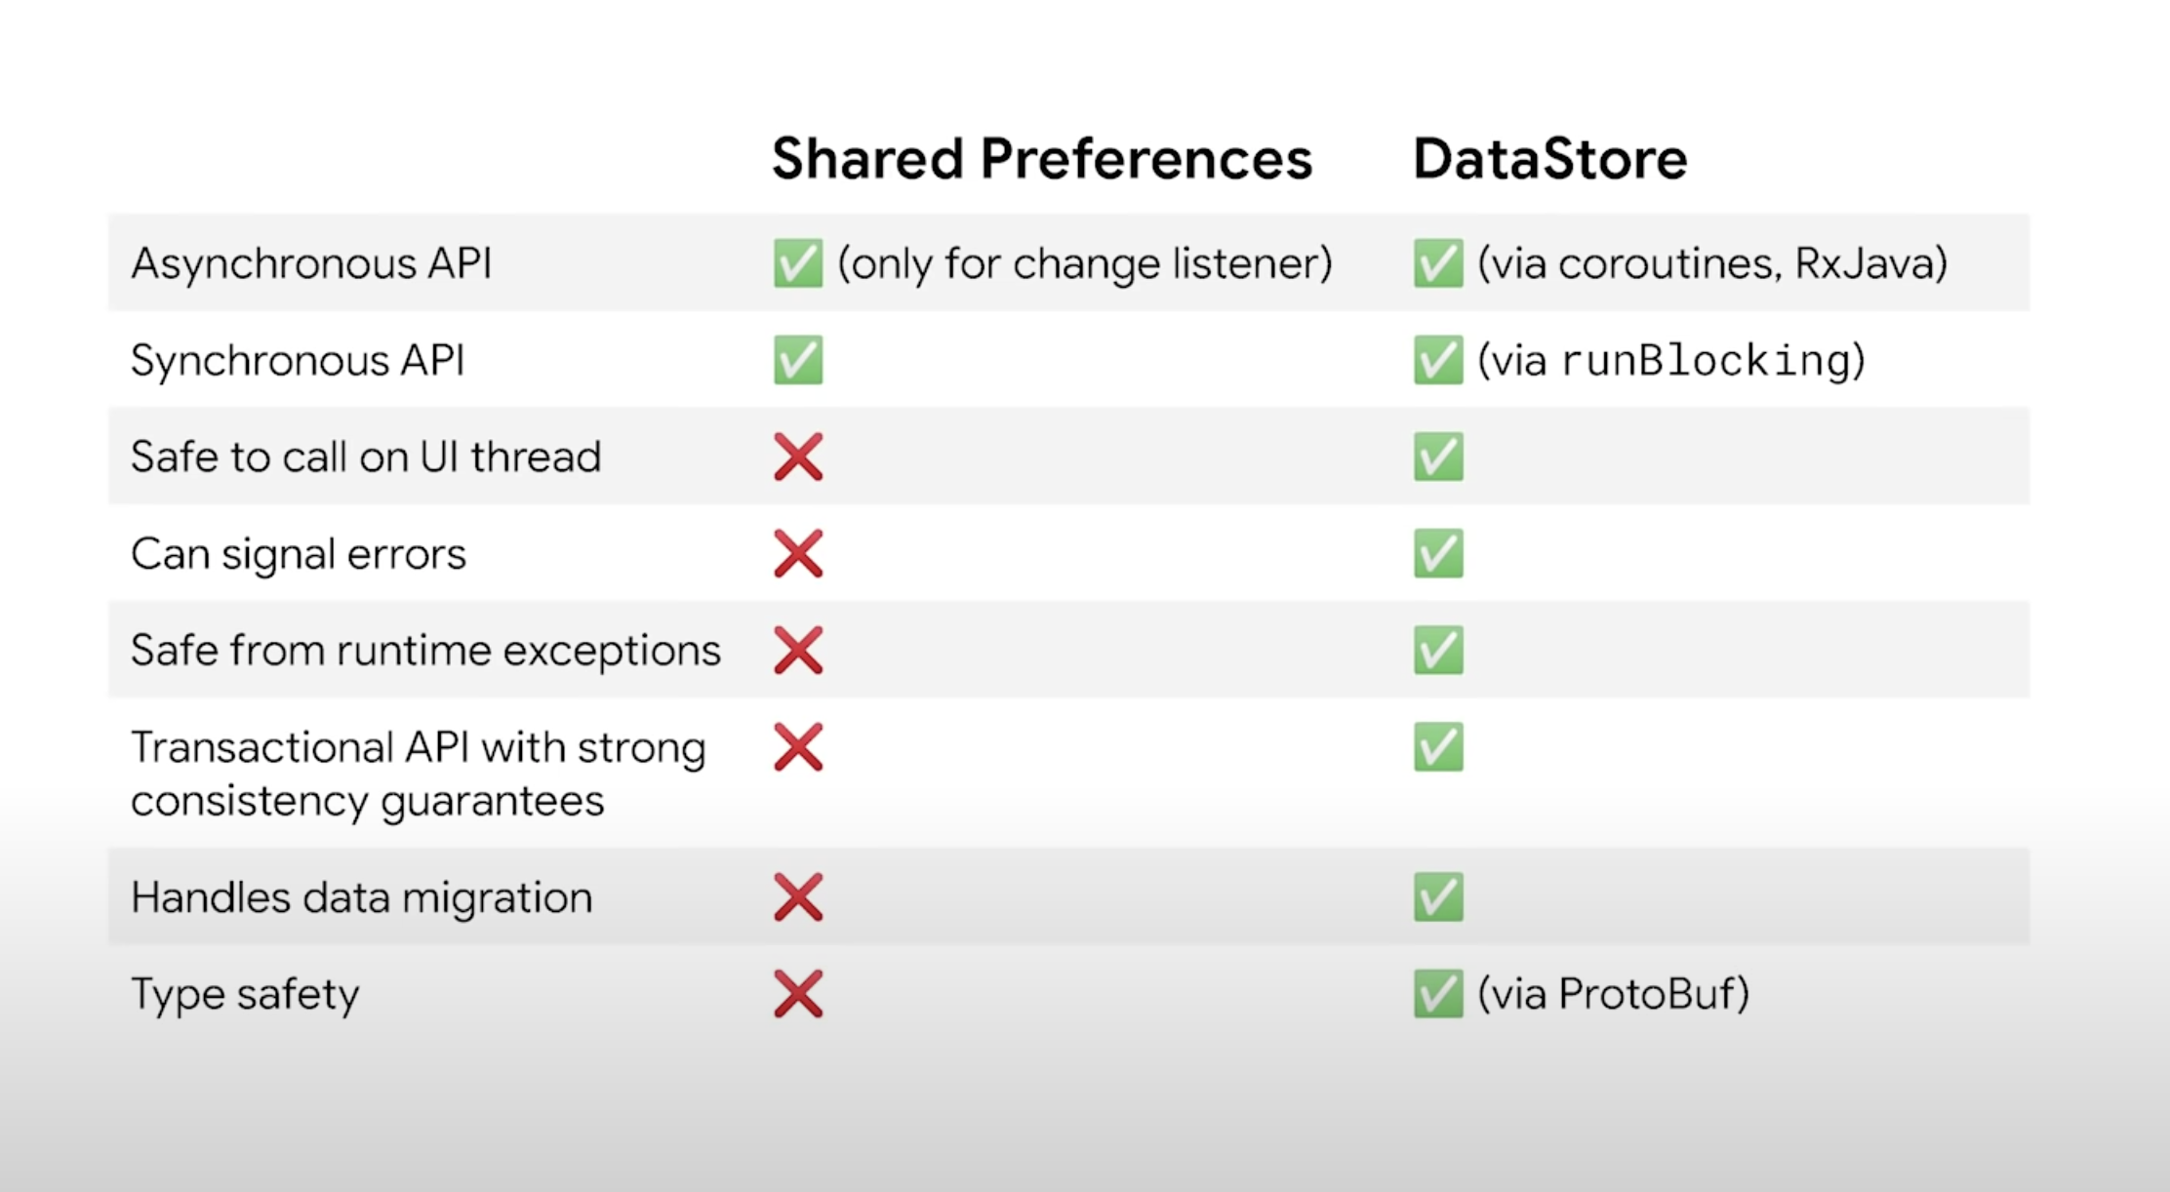
Shared Preferences vs Data Store

Slide 5
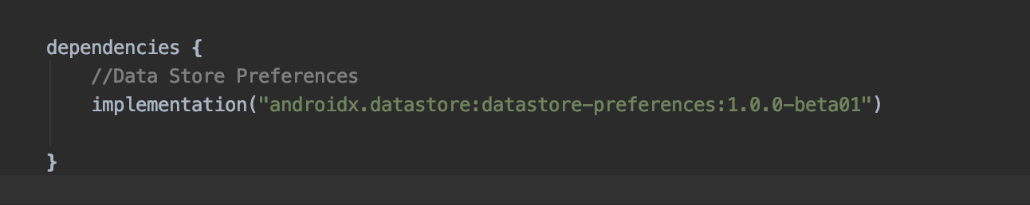
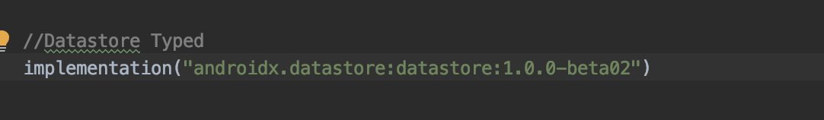
Setup
Data Store Preference
Data Store Typed

Slide 6
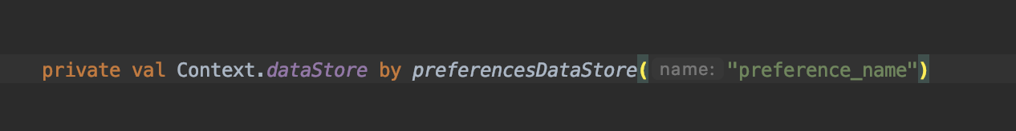
Create Data Store Preference

Slide 7
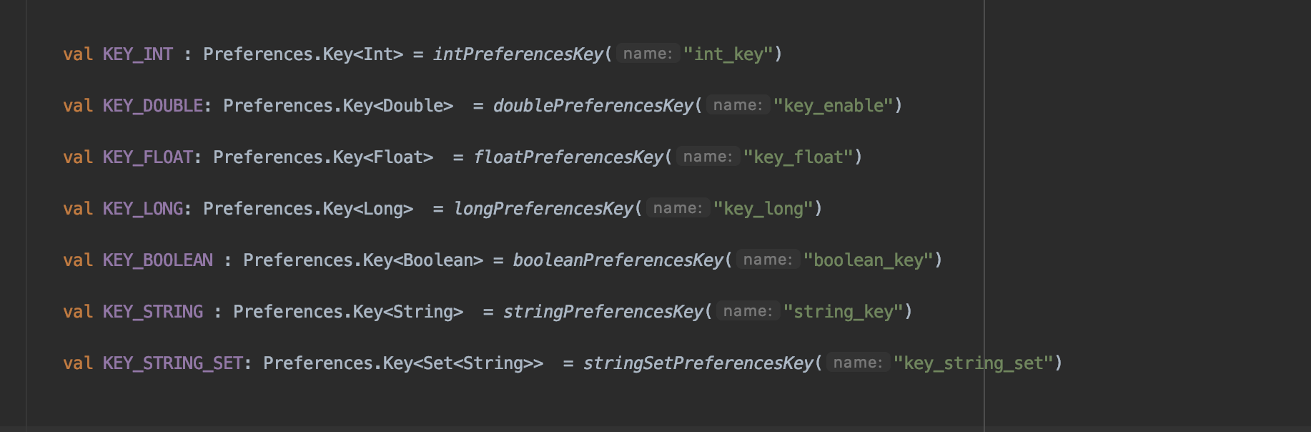
Define Preferences Key

Slide 8
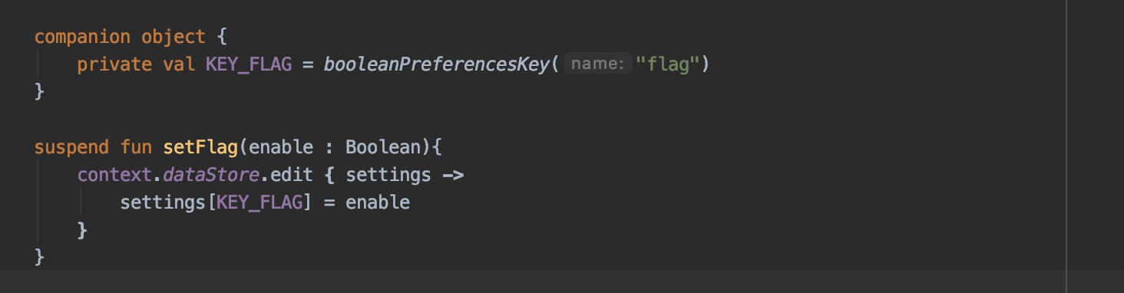
Write Preference
MutablePreferences

Slide 9
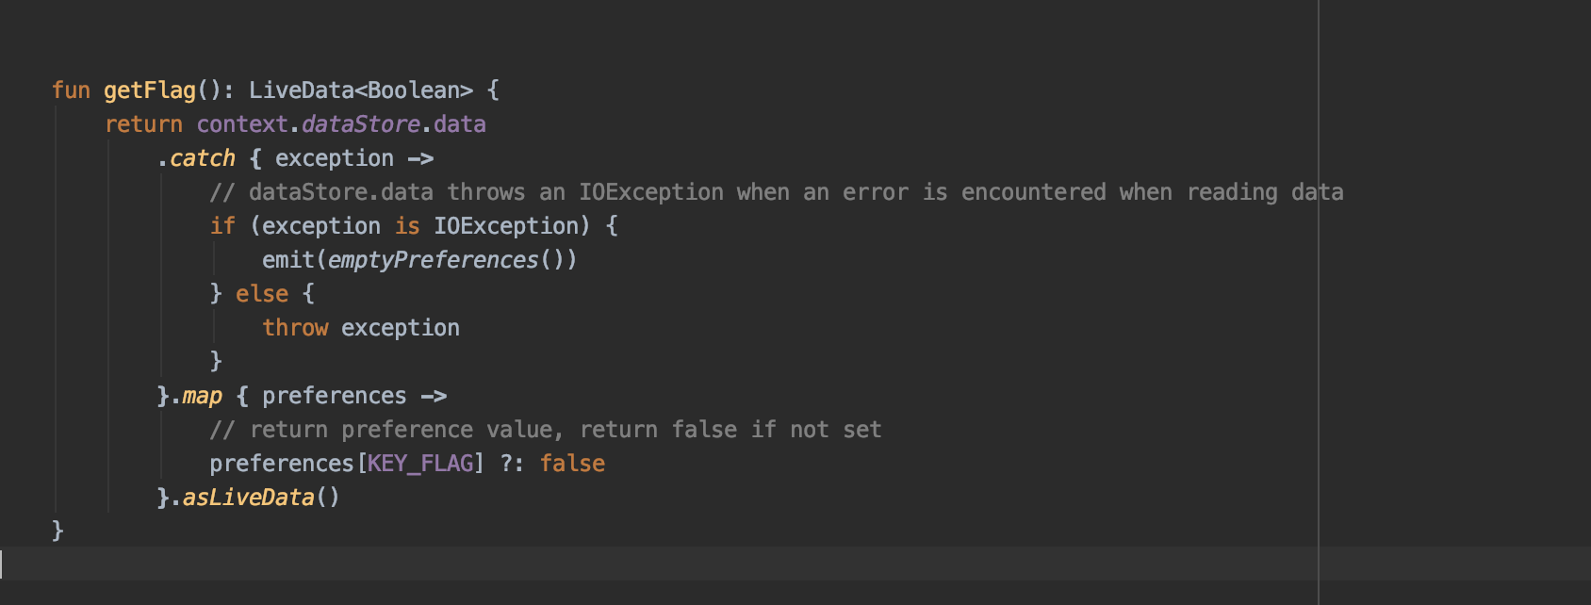
Reading Preference

Slide 10
Read Synchronously

Slide 11
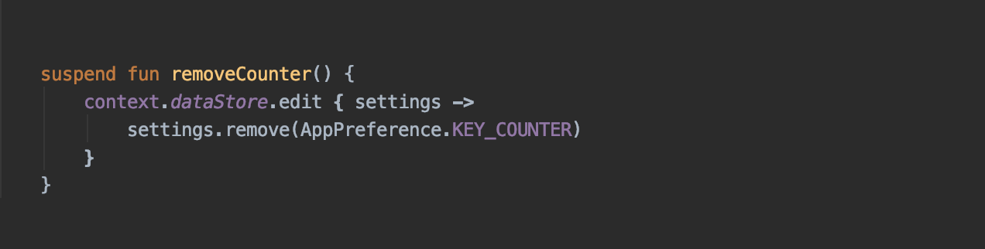
Remove Preference

Slide 12
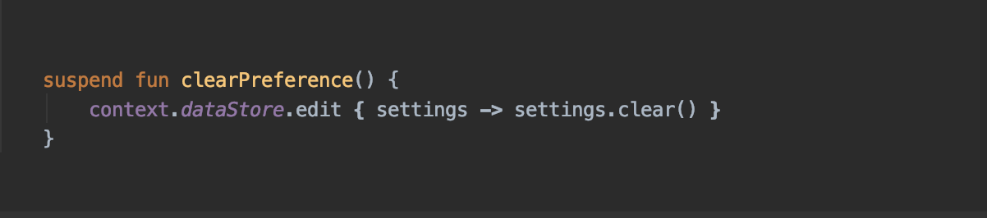
Clear Preference

Slide 13
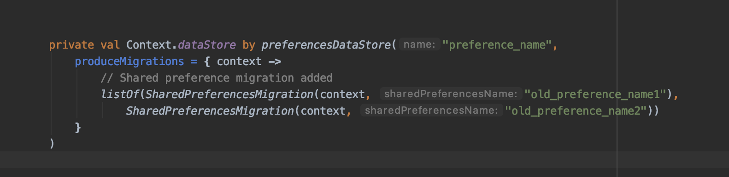
Migration

