Slide 1
Data Store Android

Slide 2
Basics
Why to migrate?
Setup
Read/write
Demo
Questions?

Slide 3
Data Store
Latest way to store preference/typed objects -Its a data storage solution that allows you to store key-value pairs or typed objects
Its not a Database. - Ideal for small, simple datasets and does not support partial updates or referential integrity

Slide 4
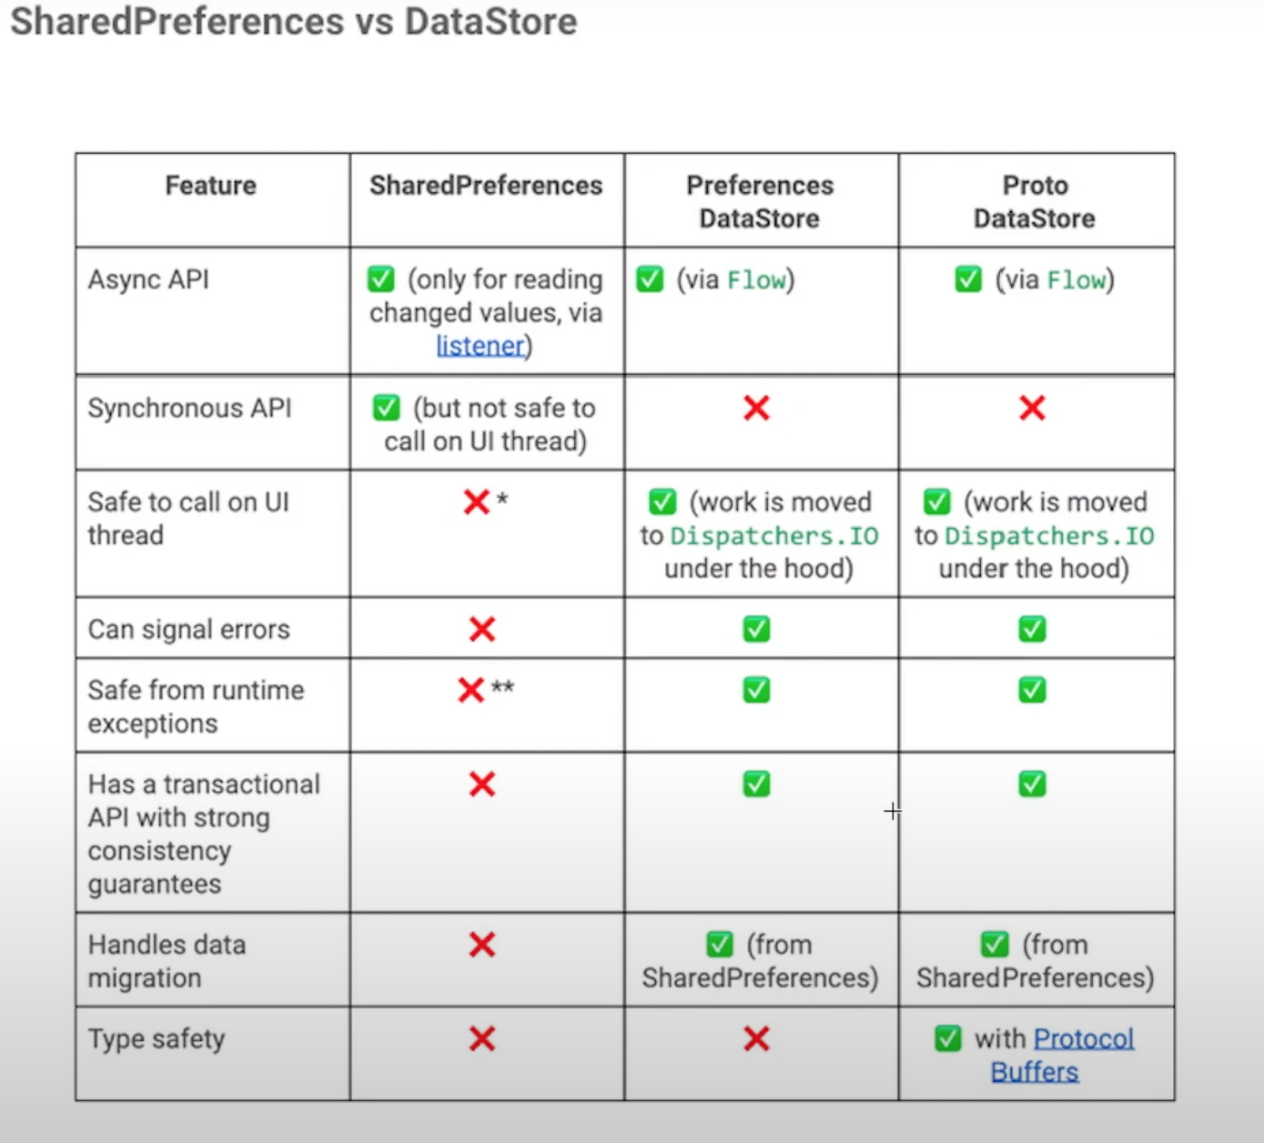
Shared Preferences vs Data Store

Slide 5
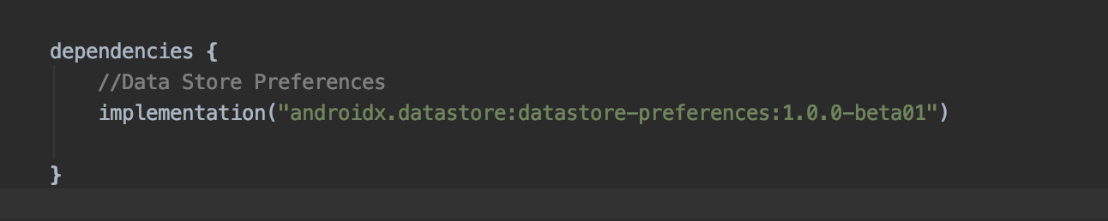
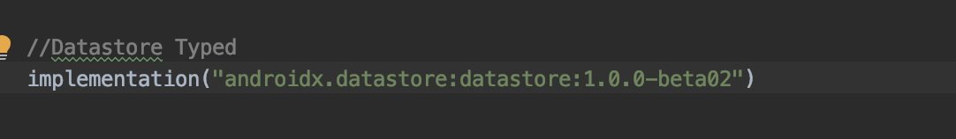
Setup
Data Store Preference
Data Store Typed

Slide 6
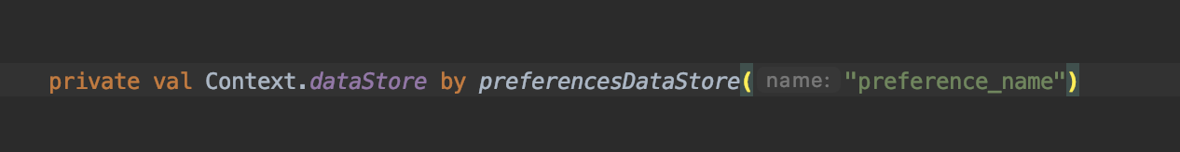
Create Data Store Preference

Slide 7
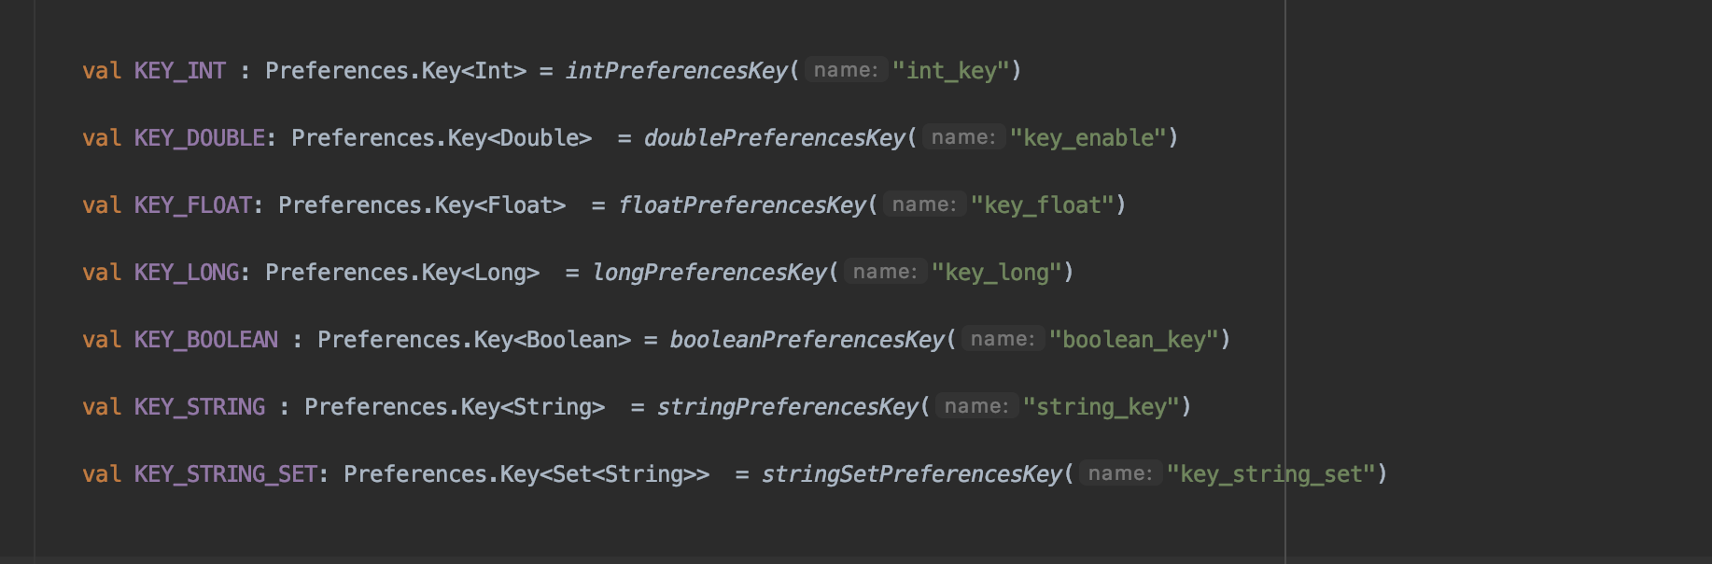
Define Preferences Key

Slide 8
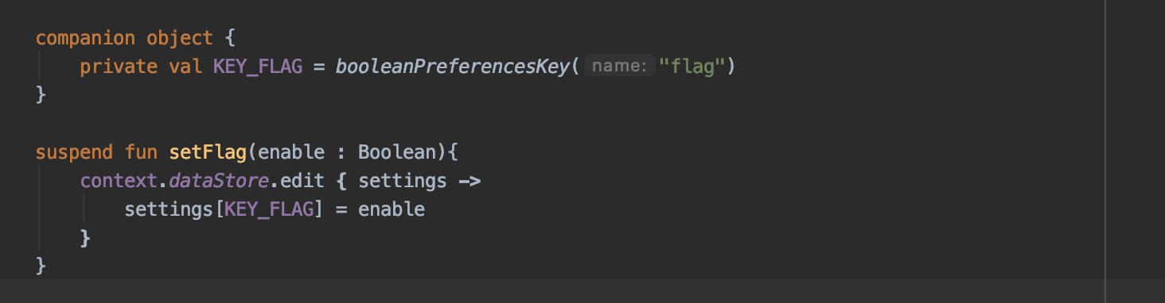
Write Preference
Mutable Preference

Slide 9
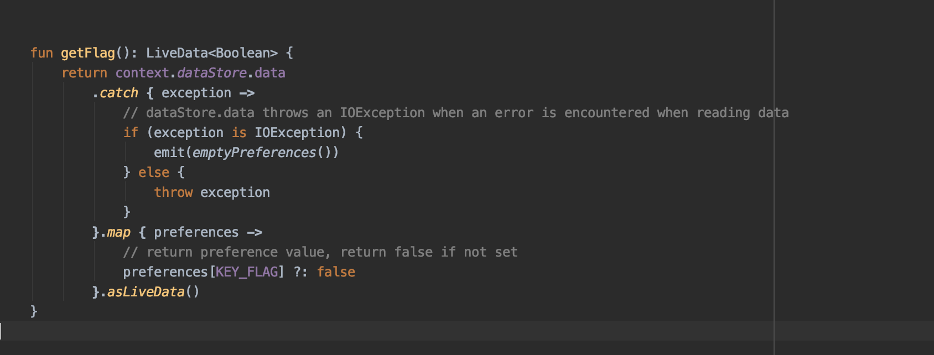
Reading Preference

Slide 10
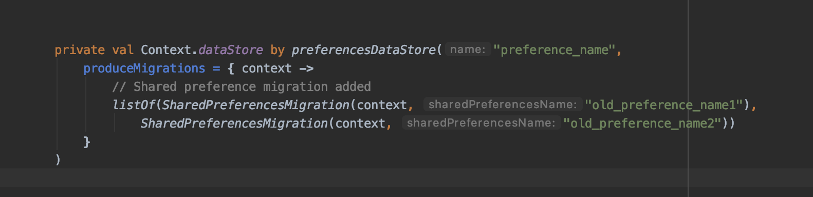
Migration

Slide 11
Proto Data Store

Slide 12
Prerequisites
Protocol Buffers (Protobuf)

Slide 13
What are protocol buffers ?
Language neutral
Platform neutral
Like xml but smaller faster and simpler
Data needs to structured only once can also be called as schema
Once structured, read, write and updation can be performed easily using special generated code.
Languages supported: Java/Kotlin, Python, Objective-C, C++, C#, Dart, Go and Ruby

Slide 14
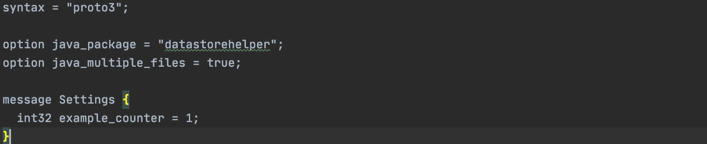
Example of a Proto file -
This file is saved by the extension of “.proto”

Slide 15
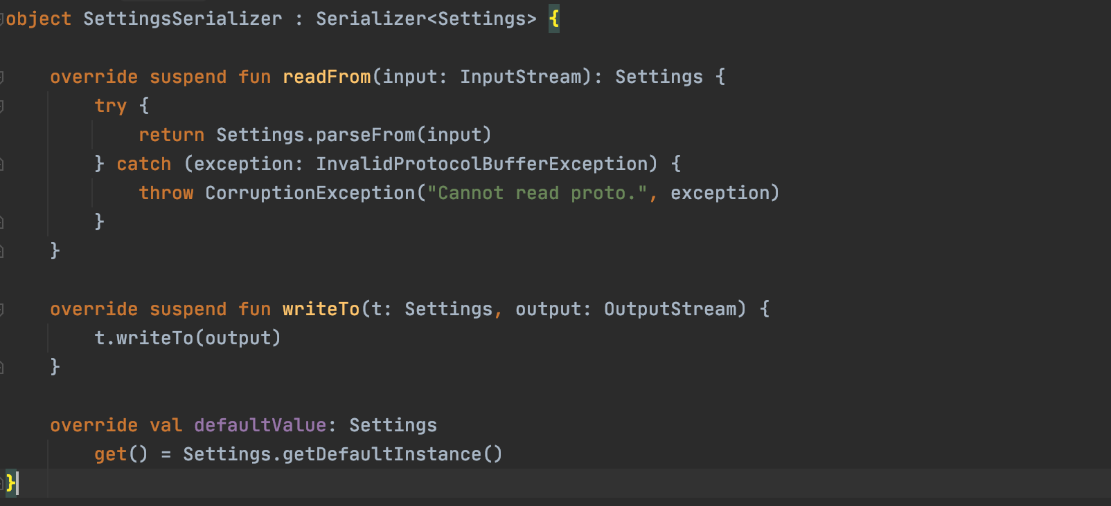
Setting up Serializer

Slide 16
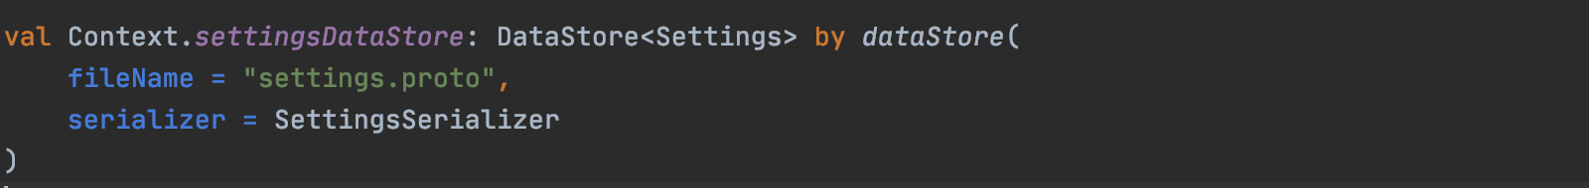
Setting up Data Store

Slide 17
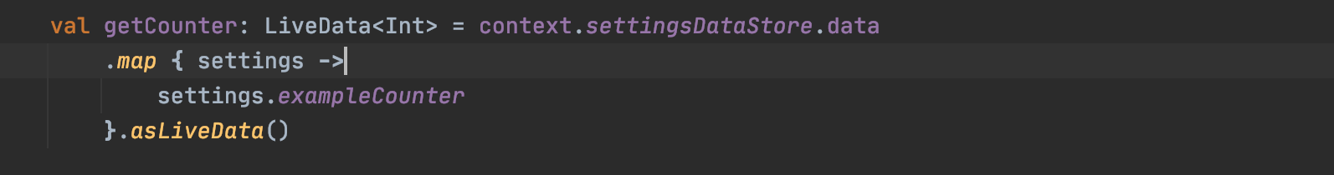
Read value

Slide 18
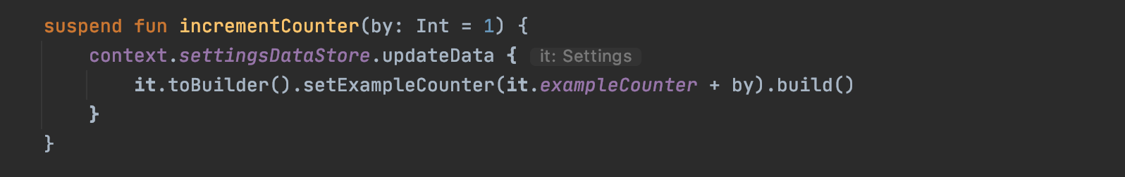
Update value

Slide 19
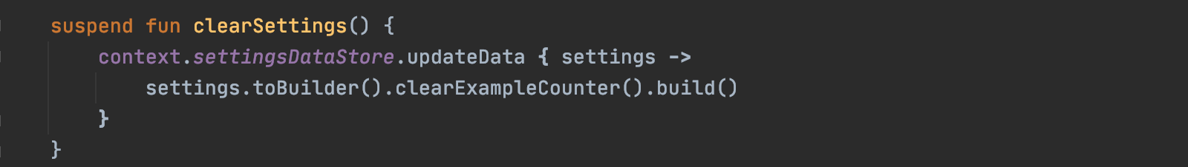
Clear settings

Slide 20
Synchronous call to fetch a value

Slide 21
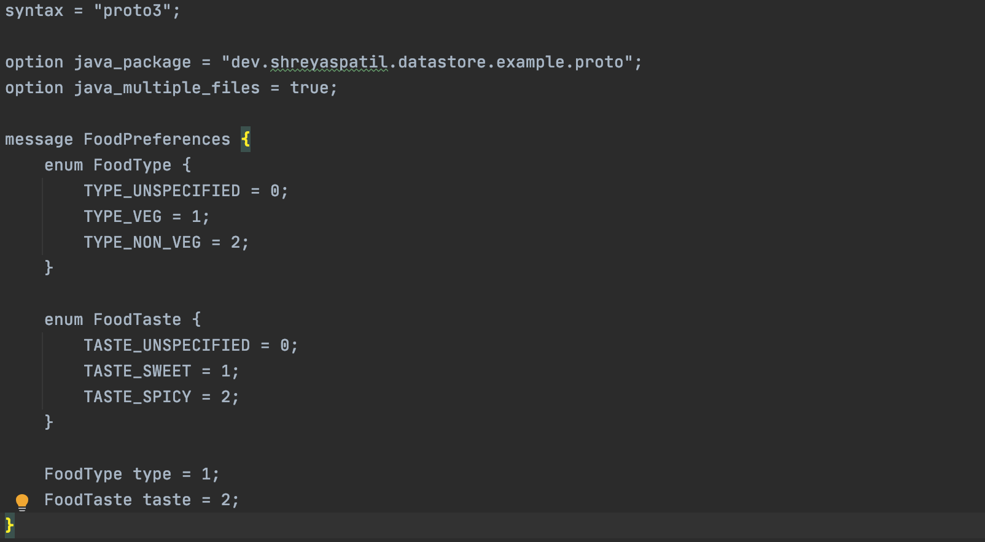
How to use data store as a form of Data Model

Slide 22
Demo

Slide 23
Questions?

Slide 24
Thank you!

