Slide 1
Data Store Android

Slide 2
Basics
Why to migrate?
Setup
Read/write
Demo
Questions?

Slide 3
Data Store
Latest way to store preference/typed objects -Its a data storage solution that allows you to store key-value pairs or typed objects
Its not a Database. - Ideal for small, simple datasets and does not support partial updates or referential integrity

Slide 4
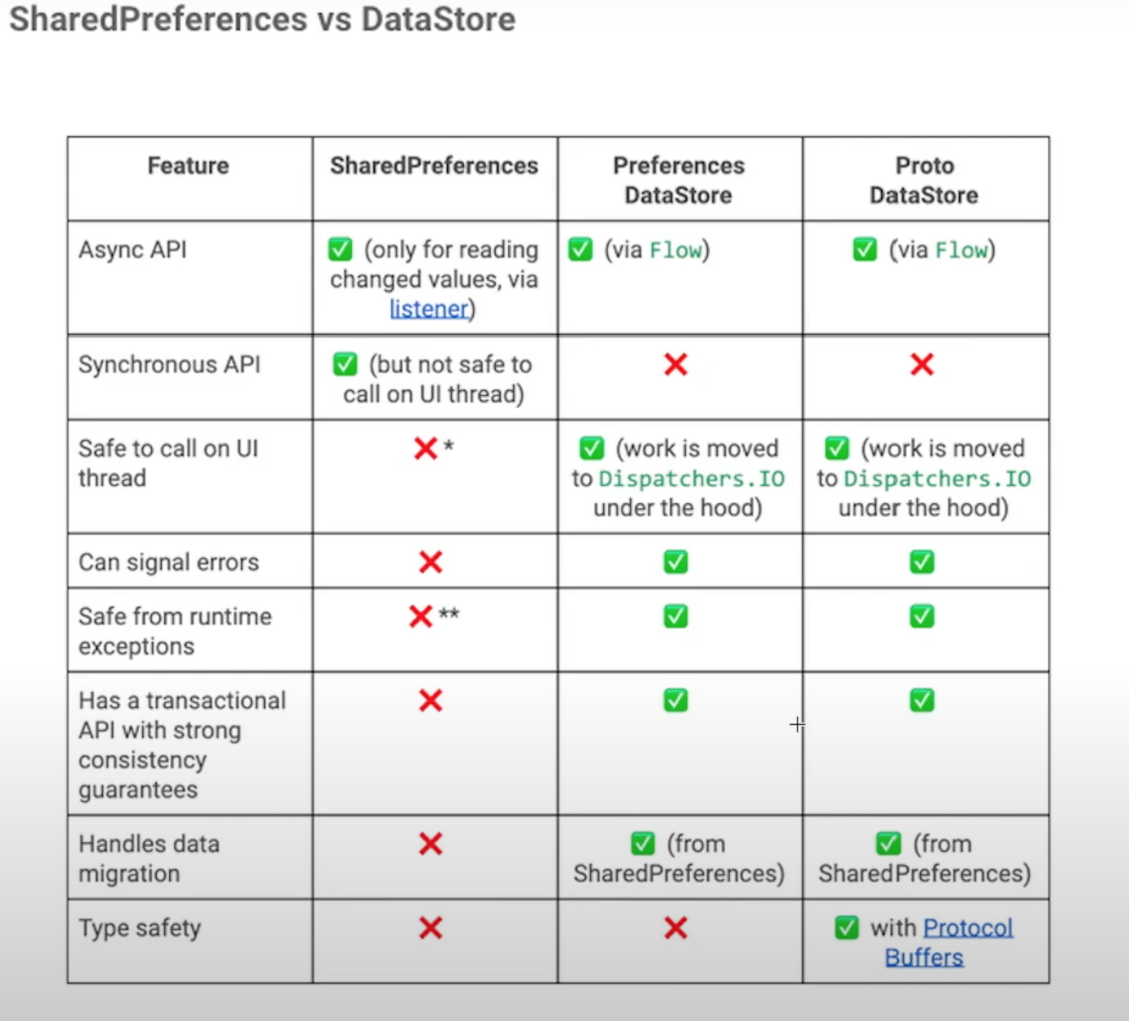
Shared Preferences vs Data Store

Slide 5
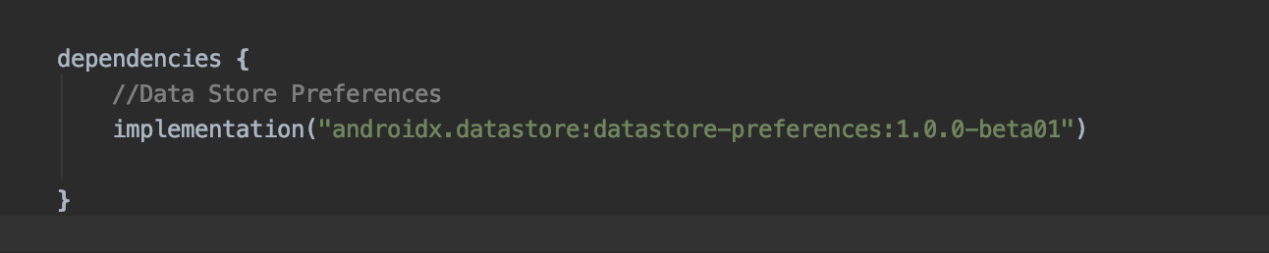
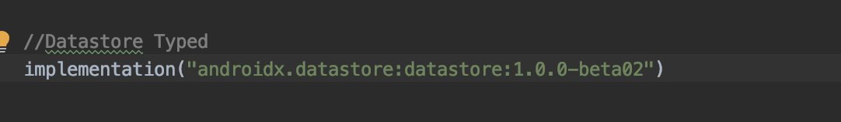
Setup
Data Store Preference
Data Store Typed

Slide 6
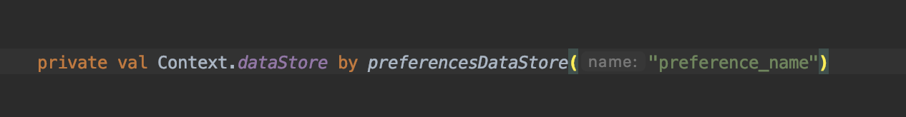
Create Data Store Preference

Slide 7
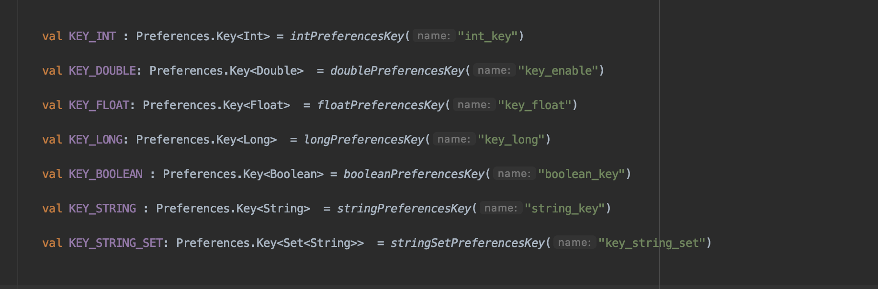
Define Preferences Key
Unique Key

Slide 8
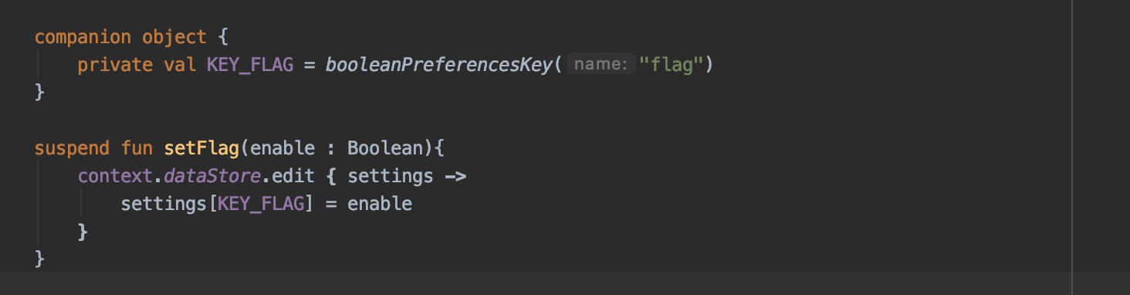
Write Preference
Mutable Preference

Slide 9
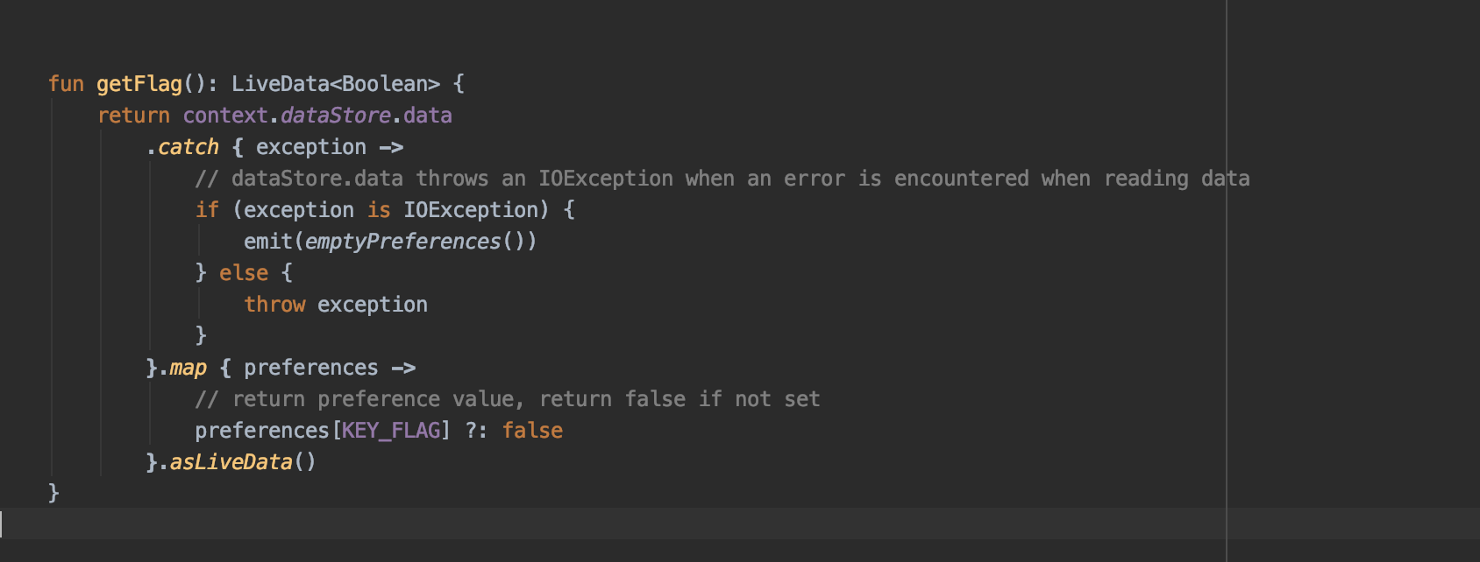
Reading Preference
data : Flow<T>
Return default value
Return as a Live Data

Slide 10
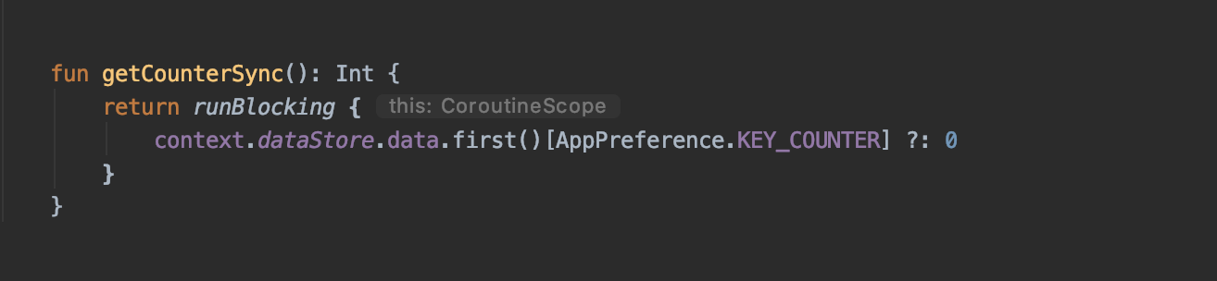
Read Synchronously

Slide 11
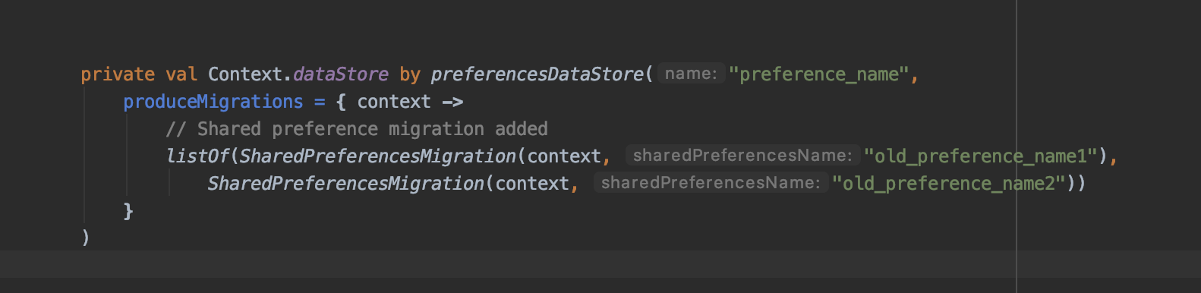
Migration
Shared preference files

Slide 12
Proto Data Store

Slide 13
Prerequisites
Protocol Buffers (Protobuf)

Slide 14
What are protocol buffers ?
Language neutral
Platform neutral
Like xml but smaller faster and simpler
Data needs to structured only once can also be called as schema
Once structured, read, write and updation can be performed easily using special generated code.
Languages supported: Java/Kotlin, Python, Objective-C, C++, C#, Dart, Go and Ruby

Slide 15
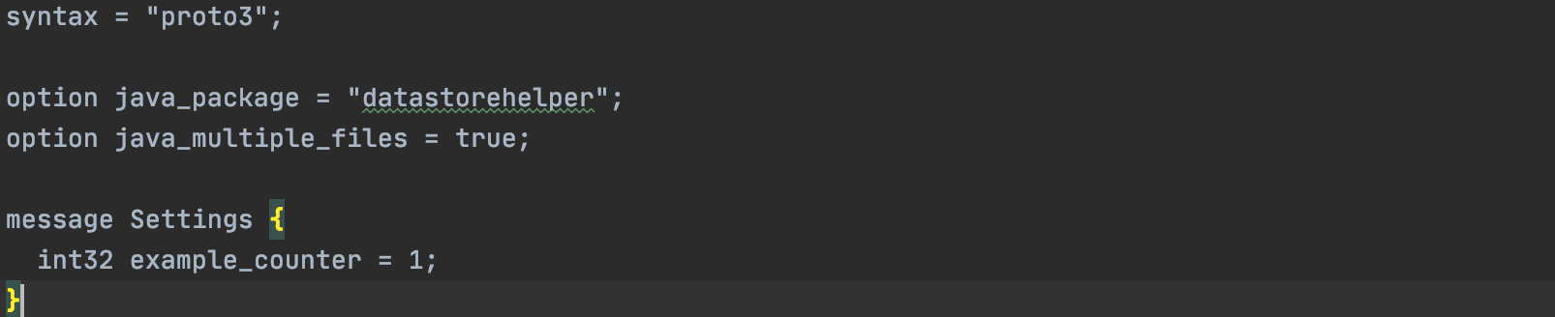
Example of a Proto file -
This file is saved by the extension of “.proto”

Slide 16
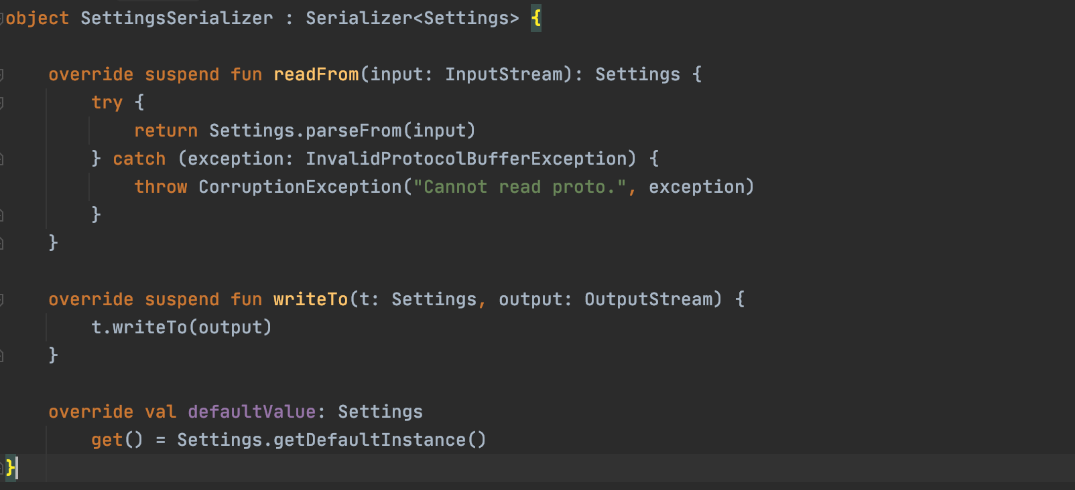
Setting up Serializer

Slide 17
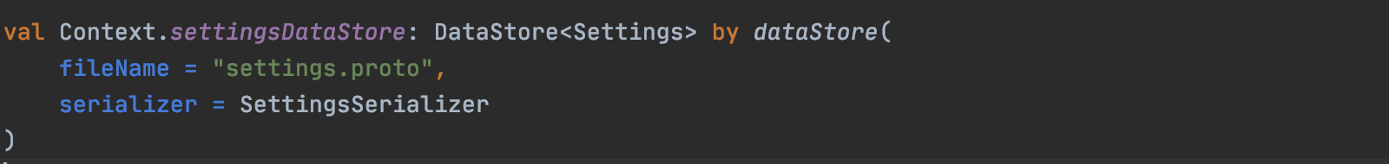
Setting up Data Store

Slide 18
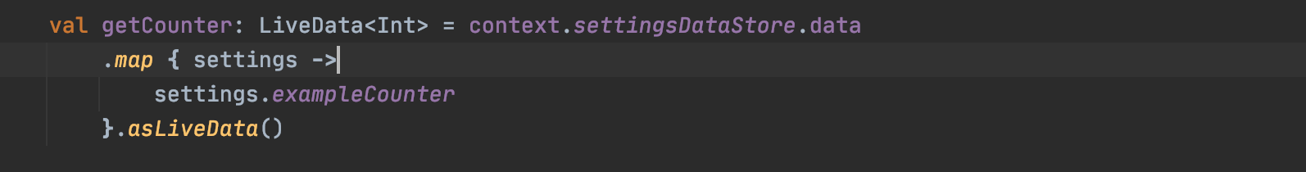
Read value

Slide 19
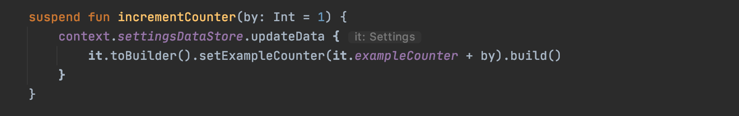
Update value

Slide 20
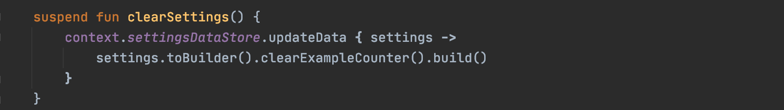
Clear settings

Slide 21
Synchronous call to fetch a value

Slide 22
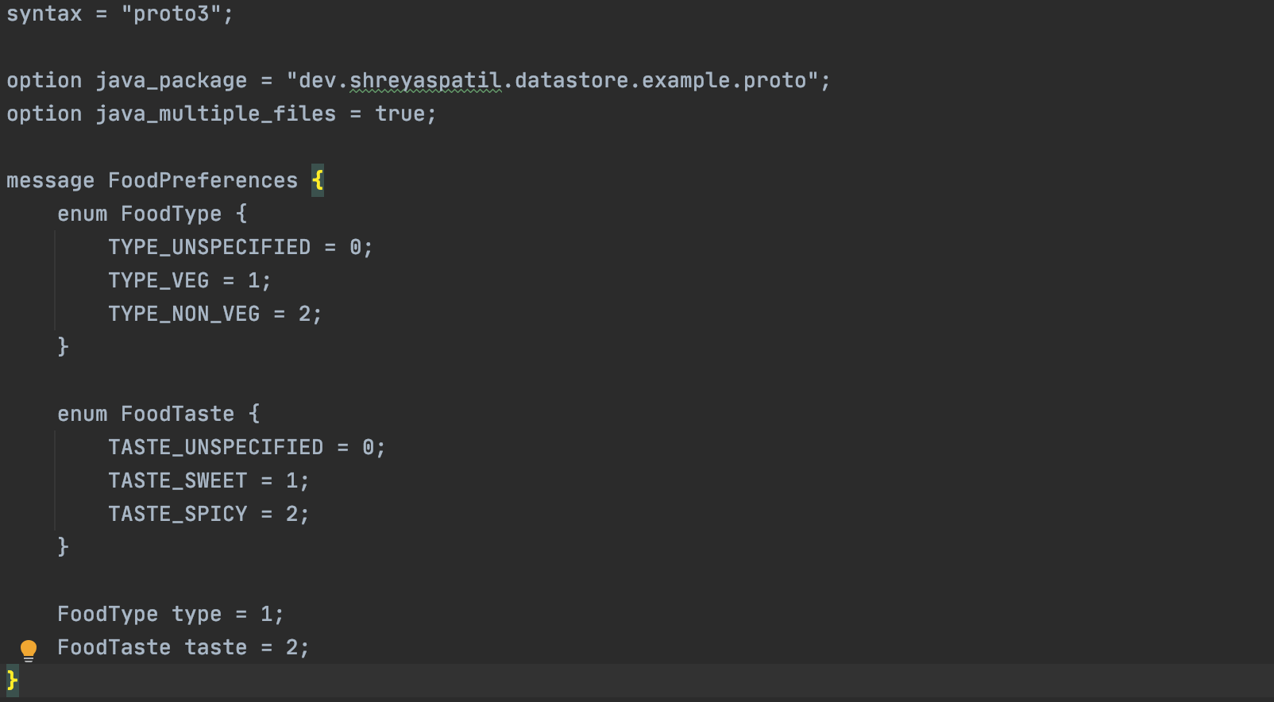
How to use data store as a form of Data Model

Slide 23
Demo

Slide 24
Questions?

Slide 25
Thank you!

