Slide 1
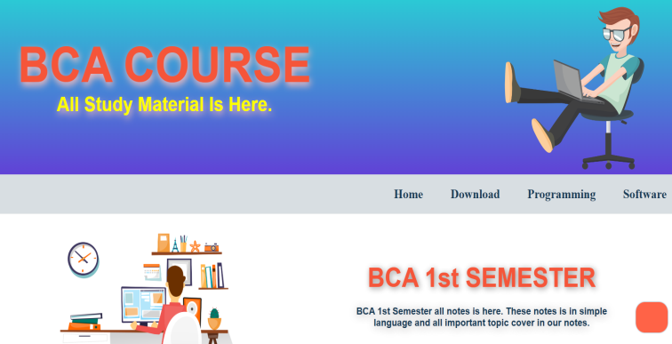
RBMI Group Of Institutions Bareilly
BCA Study Meterial
Presented By
Guided By
Pratik Prakash Sharma
Arpit Kumar
Sanjeev Kumar
Muskan
Mr. Vimal Kumar Sharma
Submitted for the partial fulfillment
of
Bachelors In Computer Application

Slide 2
Abstract
The aim of this project is to develop a website that serves as a centralized platform for accessing comprehensive notes for the BCA course. The website aims to address the need for easily accessible and organized study materials for BCA students. By leveraging modern web technologies, the website offers a user-friendly interface to help students find relevant notes quickly.
The project involves a systematic approach to collect, curate, and categorize course-specific notes from reliable sources. These notes cover a wide range of subjects, including programming languages, database management, software engineering, and computer networks.

Slide 3
Introduction
Context:
In today's digital era, college students greatly benefit from easy access to reliable study materials.
BCA students, in particular, require comprehensive notes to understand complex concepts and stay updated in computer science.

Slide 4
Objective
Centralize Study Materials: Create a centralized platform where BCA students can access comprehensive notes for their coursework.
Easy Access: Provide a user-friendly interface that allows students to quickly and easily find and access relevant study materials.
Responsive Design: Develop a website that is responsive and adapts to different devices, ensuring students can access the notes from desktops, laptops, tablets, and smartphones.
User Personalization: Implement a user registration system that enables students to create personalized accounts and bookmark their favorite notes.
Enhance Learning Experience: Provide a reliable and comprehensive resource that simplifies the learning process and supports students in their academic journey.

Slide 5
Tools and Technologies
Tools: Vs Code editor, Photoshop,
Extension: Live Server
Programming Language: HTML, CSS, JavaScript.

Slide 6
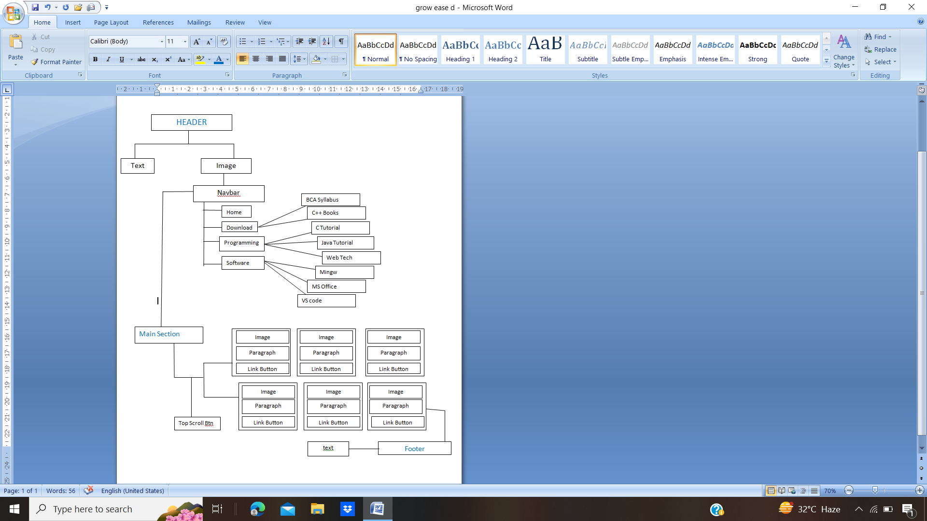
Structure of website

Slide 7
Design of website
https://clg-project-pratik.netlify.app/

Slide 8


