Slide 1
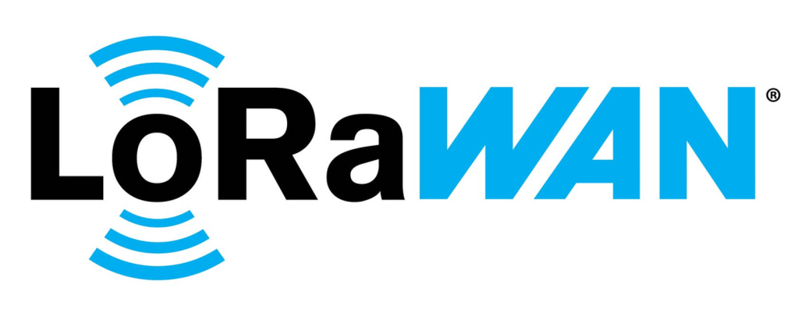
Project Objectives and Scope
LoRaWAN Fundamentals
& Environmental Impact
Machine Learning Modeling
Real-Time Visualization & Dashboard
To survey the state-of-the-art in LoRaWAN technology fundamentals and the impact of indoor environmental parameters on signal degradation.
To apply machine learning models such as Multiple Linear Regression, Random Forest, and XGBoost to predict signal performance (path loss) based on environmental input.
❖ To develop a cross-platform desktop application for real-time visualization of environmental and signal metrics.
LoRaWAN in Indoor Office Environments :Environmental Effects on Path Loss and Signal Reliability
22.07.2025

Slide 2
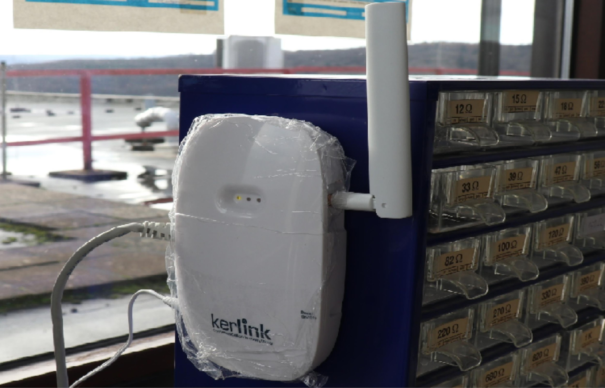
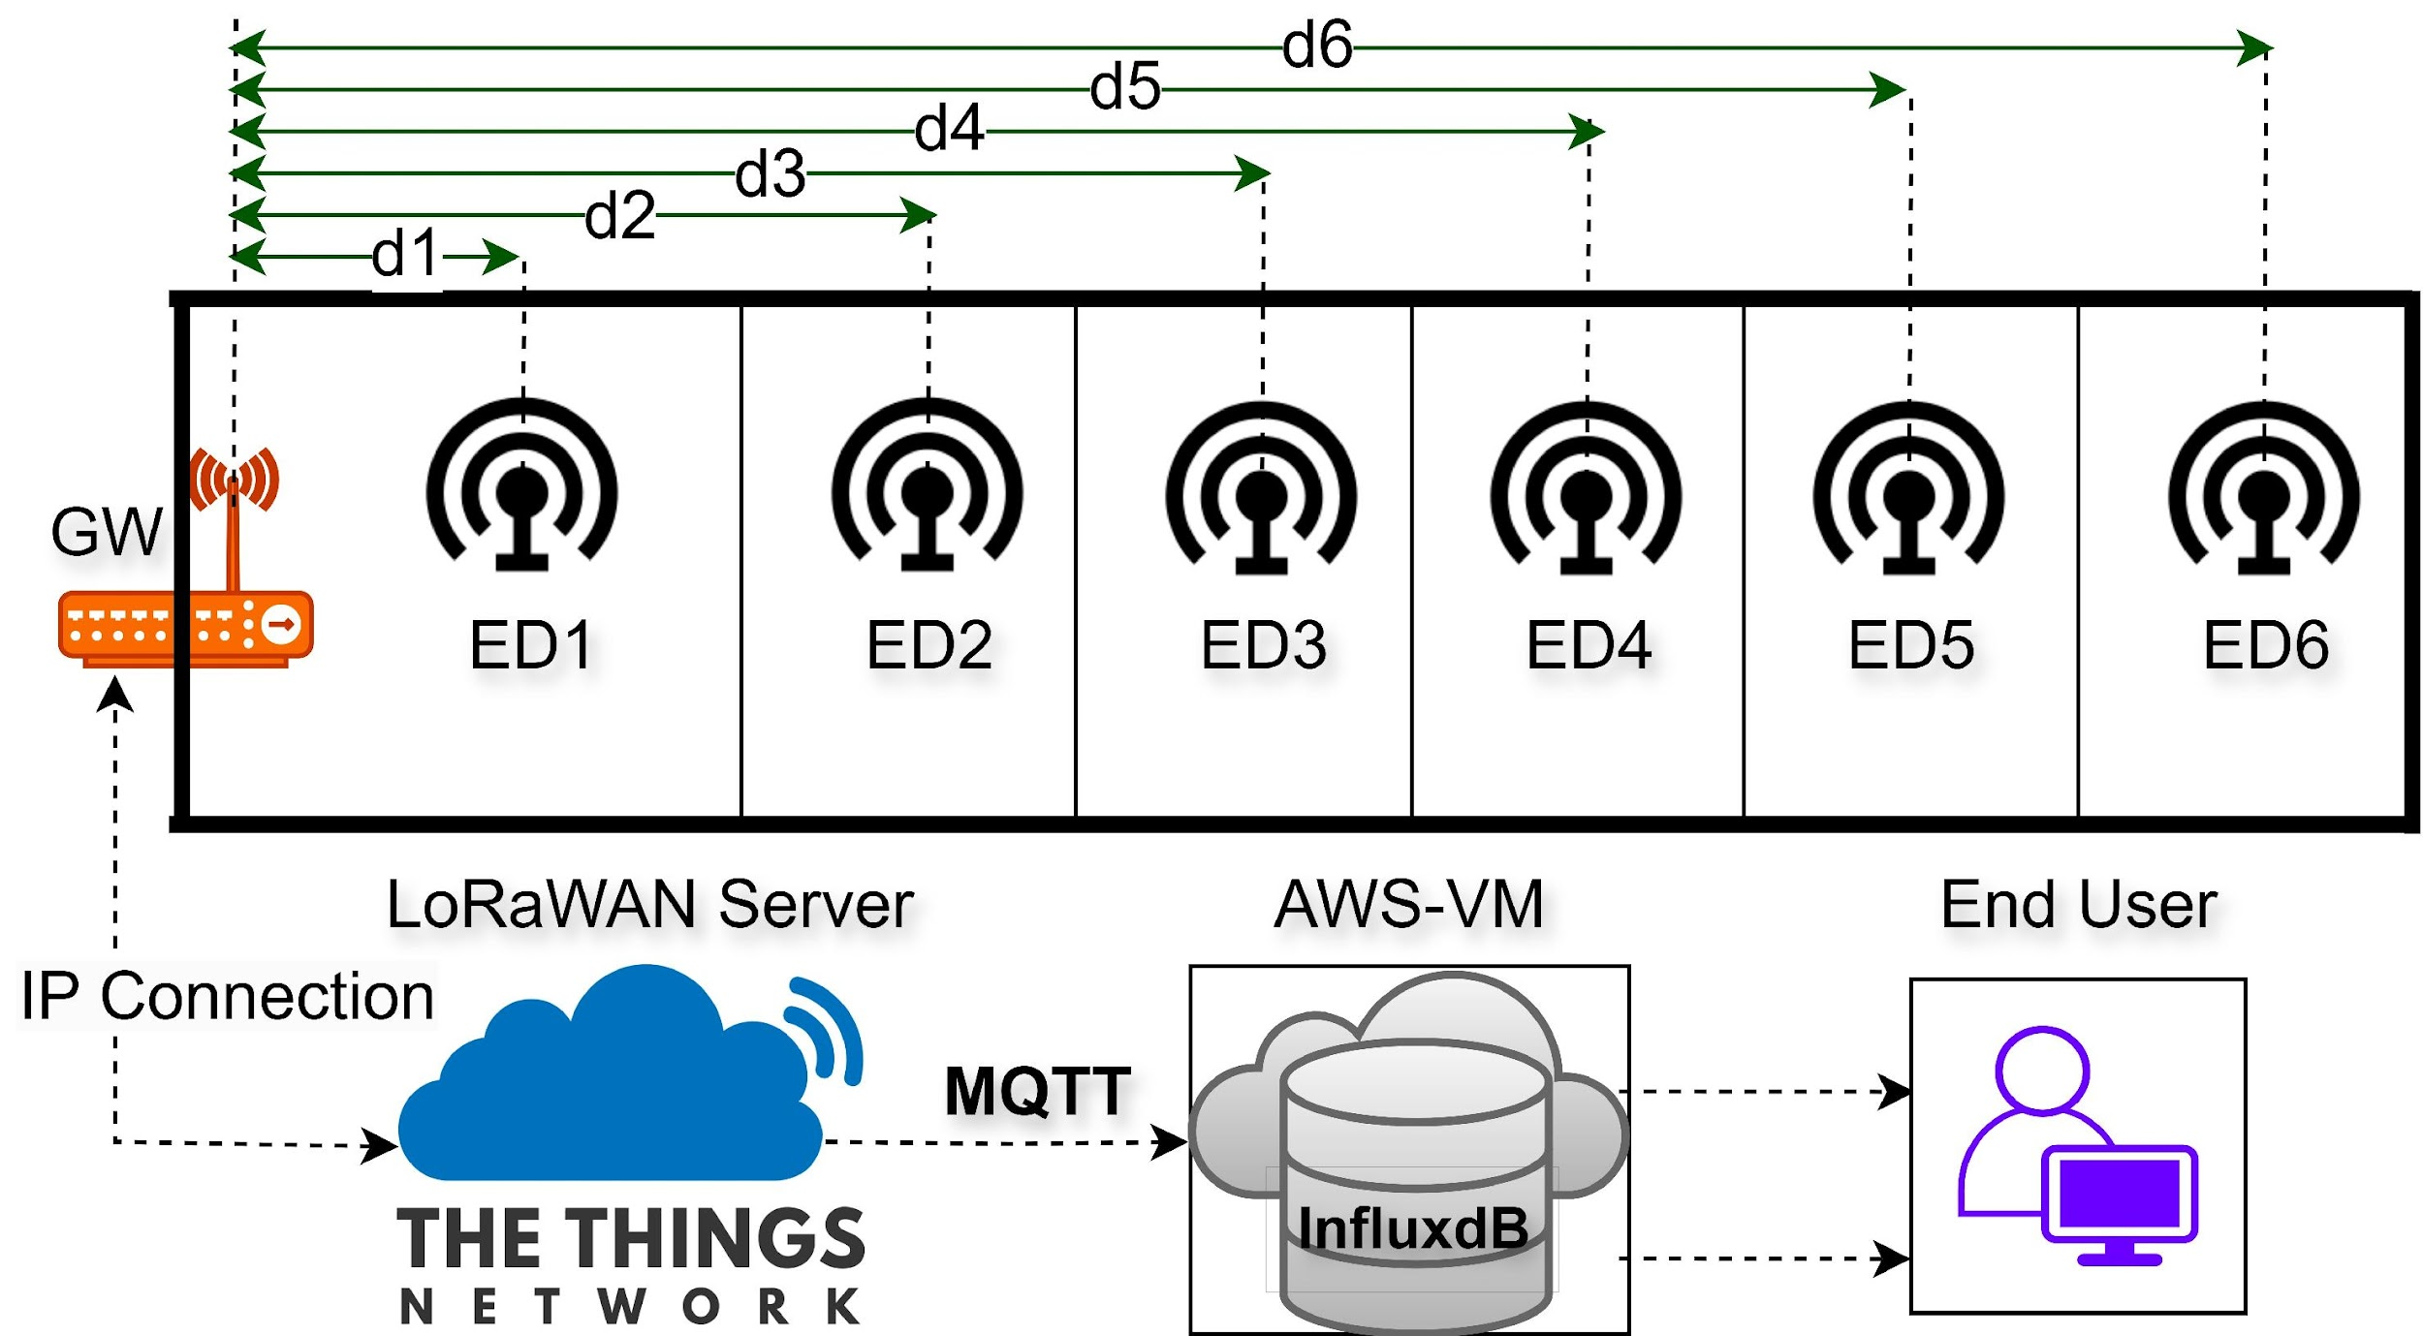
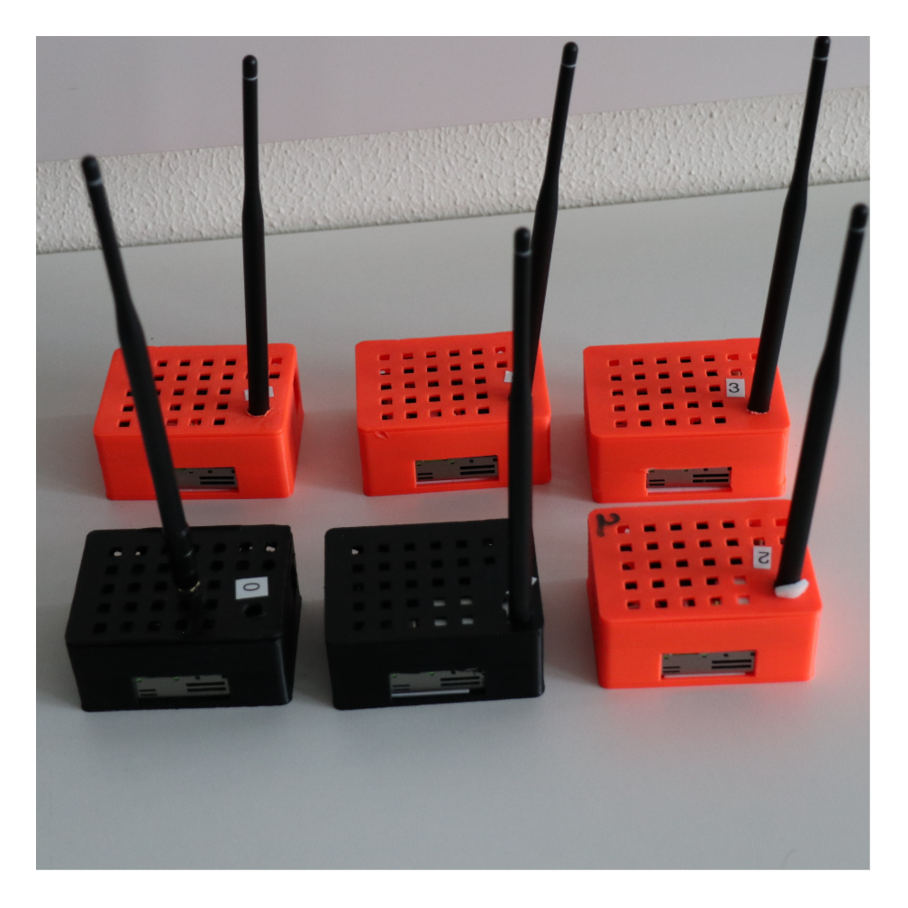
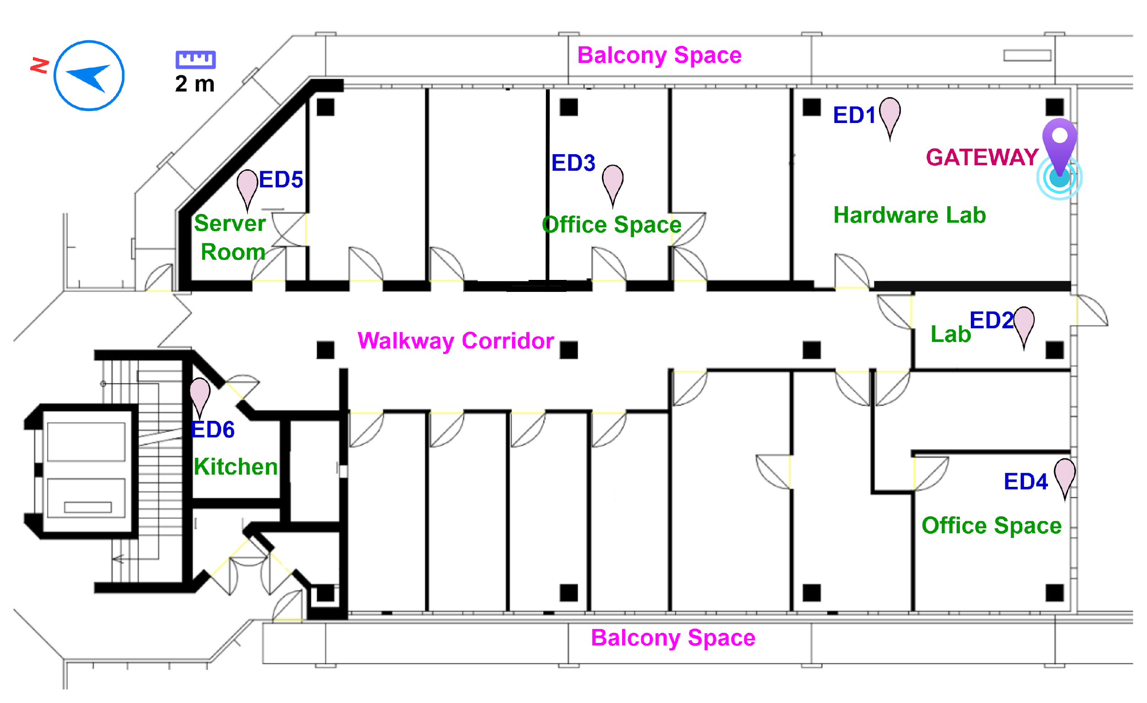
Data Collection: Sensor Network Design and Deployment
Indoor structural materials: Brick/concrete walls, wooden partitions, semi-open corridor.
Deployment: 8th floor, ~240m² in the Holderlin Campus(290m above sea level); (868 MHz)
Duration: 4-month campaign.
Dataset: 1,328,334 rows.
Packet Interval: Every 60 s.
Primary parameters: LoRaWAN metadata + Environmental parameters.
Obiri, N. M., & Van Laerhoven, K. (2024). A Comprehensive Data Description for LoRaWAN Path Loss Measurements in an Indoor Office Setting. IEEE Access. DOI: 10.1109/ACCESS.2024.0429000
LoRaWAN in Indoor Office Environments :Environmental Effects on Path Loss and Signal Reliability
22.07.2025
Notes:
"Each device: Arduino MKR WAN 1310 (LoRa radio), Sensirion SPS30 (Particulate Matter), Sensirion SCD41 (CO₂, Temperature, Humidity), Adafruit BME280 (Barometric Pressure).
Gateway: Kerlink indoor gateway.

Slide 3
Data Collection with Federated learning
Federated learning enables 6 Arduino nodes to:
collaboratively train one shared model by keeping raw sensor data local and
exchanging only compact model updates (gradients/weights) that a central server aggregates,
eliminating the need to transmit large datasets while respecting LoRaWAN's severe downlink constraints.
Main processes for our project:
1. On-Device Local Training:
Each Arduino node independently trains a TinyML model using its own local sensor data (temperature, humidity, CO₂, PM2.5) and link metrics (RSSI, SNR, SF) to predict path loss without sharing raw measurements​.
2. Federated Aggregation
The central server (FL orchestrator) collects model updates from participating nodes via LoRaWAN uplinks and aggregates them using FedAvg to create an improved global model​
3. Global Model Distribution
The server distributes the updated global model back to nodes via constrained LoRaWAN downlinks (~10/day on TTN), enabling all devices to benefit from collective learning while respecting duty-cycle limits​
These three tasks form a continuous cycle: Learn locally → Aggregate centrally → Synchronize globally
Obiri, N. M., & Van Laerhoven, K. (2024). A Comprehensive Data Description for LoRaWAN Path Loss Measurements in an Indoor Office Setting. IEEE Access. DOI: 10.1109/ACCESS.2024.0429000
LoRaWAN in Indoor Office Environments :Environmental Effects on Path Loss and Signal Reliability

Slide 4
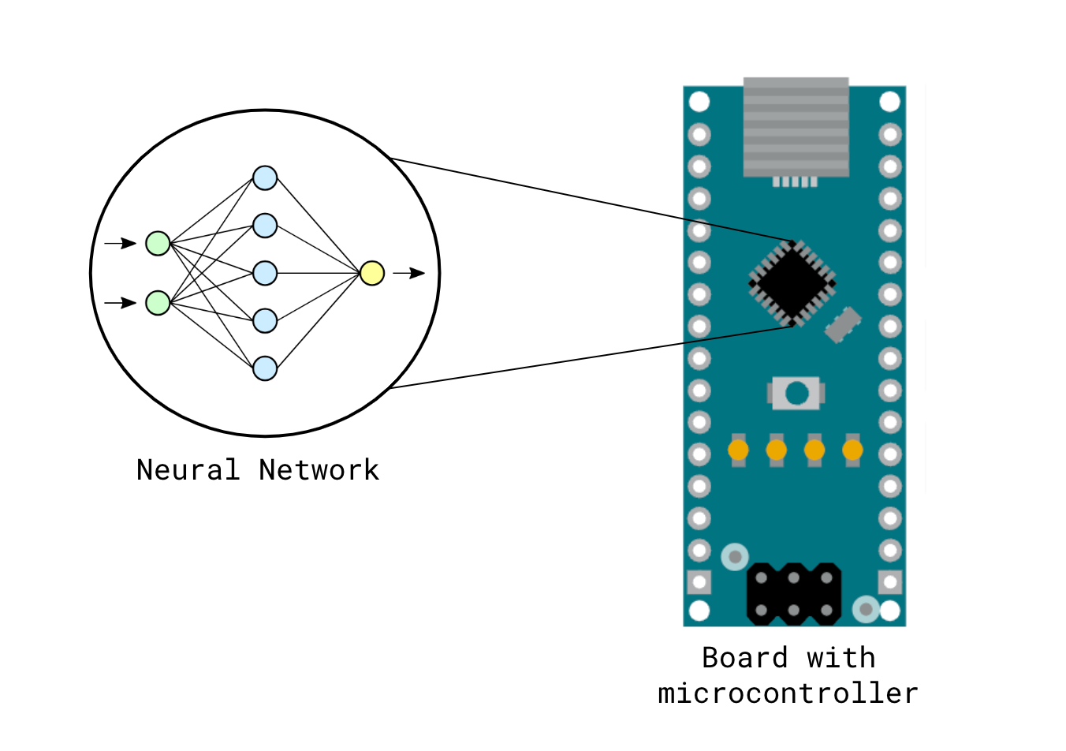
TinyML at our node:
TinyML on our end device is mainly used to run a small ML model locally (on the Arduino) so the node can predict path loss/link quality in real time and make decisions without relying on the cloud.
On-device inference: The node uses a TinyML/TFLite-style model to turn current sensor + radio context into an immediate prediction (e.g., expected path loss or link state).​​
Local learning (for FL): The node can compute small training updates from its recent local samples, then share only those updates (not raw data) during federated rounds.​​
Communication-aware actions: The prediction can drive behavior like reducing uplinks when conditions are stable and increasing reporting when the link is degrading.
TinyML can enable smart data reduction (event-triggered uplinks, anomaly/change detection, sending summaries/features instead of raw streams) so we transmit less over LoRaWAN
Obiri, N. M., & Van Laerhoven, K. (2024). A Comprehensive Data Description for LoRaWAN Path Loss Measurements in an Indoor Office Setting. IEEE Access. DOI: 10.1109/ACCESS.2024.0429000

Slide 5
TinyML at our node vs heavy offline ML model
BENEFITS:
Predict “link health / expected path loss now” from local sensor + radio context, then act immediately (e.g., transmit only on change, raise reporting when degradation is predicted, reduce uplinks when stable).​
Reduce unnecessary LoRaWAN traffic and energy use by making transmissions event-triggered instead of always periodic, which fits your “communication-aware intelligence” goal.​
Serve as the “client model” for FL rounds: the node computes small updates from its local data, instead of sending raw data streams.
What we gain vs our last project
Continuous adaptation (not “train once”)
TinyML’s biggest practical edge benefit is local processing:
Communication efficiency and privacy as a side effect:

