Slide 1
Memcached Prototype Architecture
Kimon Karras, Lisa Liu, Michaela Blot
March 2014

Slide 2

Memcached Functionality Recap
Many popular websites share a similar basic architecture
Memcached is used by 85% of top 20 websites, 50% of top 5000 websites, up to 30% of servers in data centers
Users
Users
Users
Memcached clients
Web Servers
Web Servers
Web Servers
Return value
Get value @key
Memcached servers
In-memory Cache Layer (x86)
Database
In-memory cache relieves access load on main, disk-based SQL database, pushing scalability problem back to the web tier

Slide 3
FPGA-based Dataflow Architecture
1. Receives network packets
6. Send packets to the network
Network
Interface
(10Gbps Ethernet)
5. Compose the outgoing packet
FPGA
UDP/TCP
Offload Engines
Request
Parser
Hash
Table
Value Store
Response Formatter
Memcached Pipeline
DRAM Controller
4. Write/Read values into the memory
Standardized interface:
Key, value, meta-data
3. Retrieve value address from hash table
DRAM
Implemented in Vivado HLS
Hash
Table
Value Store
Notes:
Host code C: 565
Memcached RTL:
Binary Parser: 703
ASCII parser: 2741
Hash table: 3415
Value store: 2336
Binary Response: 396
ASCII Response: 2545
Others: 999+ 2357+459=3815
Total RTL: 16k

Slide 4
Design Basics
Operating Frequency: 156 MHz
All I/O uses AXI4 Streams.
I/O Buses are 184 bits wide.
They adhere to the following format:
0:63 – data
64:66 – modulo (indicates the number of valid bytes in the data part)
67 – EOP
68 – SOP
69:183 – network-related metadata
Not all of the metadata bits are used.
Memory access uses 4 bus pairs.
2 in the Hash Table (1 WR & 1 RD) & 2 in the Value Store (1WR & 1 RD)
Each pair has a 512 bit wide data bus
And a 24 bit command bus. The lower 10 bits make up the address & the following 8 the number of data words to be read to or written from.

Slide 5
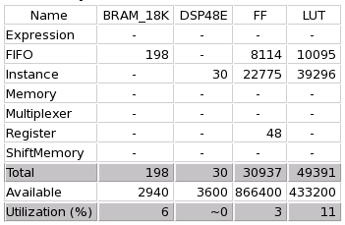
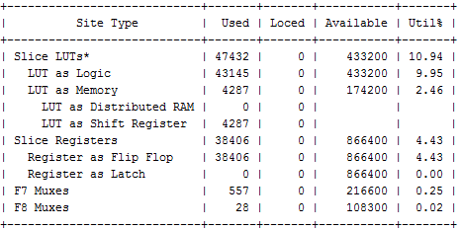
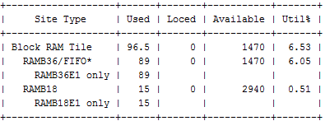
Design Resource Utilization
Memcached Pipeline Resource Use
After HLS Synthesis:
After Vivado Synthesis:

Slide 6
Request Parser Architecture

Slide 7
Request Parser Architecture
Request Parser
Packet in
internal
unified format
Memcached requests
Protocol Detection
Merge
Binary Parser
ASCII Parser
Protocol Detection recognizes if the incoming packet is binary or ASCII and routes it accordingly.
The corresponding parser completes the processing
The merge module then recombines them and sends them into the pipeline.

Slide 8
Request Parser Module & Signal Names
RequestParser
rp_sel2bin
rp_bin2sel
Parser
Input
Selection
binaryParser
Parser
Output
Selection
inData
outData
asciiParser
rp_sel2ascii
rp_ascii2sel
rp_packetSeqBuffer
All signals one the block diagram are HLS streams.
The rp_packetSeqBuffer stream allows the ParserOutputSelection to maintain the same request order at the output side. It’s only 1 bit wide and identifies which parser processed a request.

Slide 9
Binary Parser

Slide 10
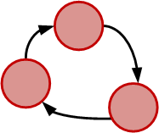
Binary Parser Architecture
Consists of 2 FSMs, one reading data in & reformatting them and writing them to the output
Metadata
metadataBuffer_rp
Metadata
keyBuffer_rp
valueBuffer_rp
outData
inData
FSM
FSM
bp_f
bp_r
It extracts and realigns key and value from the incoming request.
Other information (key length, value length, operation type, etc.) are stored in the metadata.

Slide 11
ASCII Parser

Slide 12
ASCII Parser Architecture
Pipelined design
Each stage filters the data which it processes and passes on the rest.
All collected data is placed into queues.
The output logic fetches the data and outputs them in the memcached pipeline format.
Sideband channel
Packet
Input
OpCode Extraction
Key Extraction
Flags Extraction
Expiraton
Extraction
Value Lengh
Extraction
Value
Extraction
Key
Flags
Expiry
V Length
Value
Field Conversion
Field Conversion
Juggler
Field Conversion
Parser Output Formatter
Internal Pipeline Word

Slide 13
ASCII Parser Modules & Signals
op2keyGet
Key2
flagsExt
flagsExt2ExpExt
expExt2
vlExt
Value
vlExt2value
inData
ap_operation
ID
ap_keyStreamSet
ap_flags
Extractor
ap_expiry
Extractor
ap_value
Length
Extractor
ap_valueStream
Flags
StartLoc
Exp
StartLoc
vlStart
Loc
Value
StartLoc
op2keySet
flagExt2
flagConv
expExt2
expConv
vlExt2
vlJug
value
Buffer
keyLength
BufferSet
keyBuffer
Set
ap_value
LengthJuggler
ap_keyStreamGet
ap_ascii2bin
Converter
ap_ascii2bin
Converter
vlJug2
vlConv
ap_ascii2bin
Converter
keyLength
BufferGet
keyBuffer
Get
flags
Buffer
expiry
Buffer
valueLengthBuffer
ap_outputLogic
outData

Slide 14
Hash Table Architecture

Slide 15
Hash Table Architecture
4. Sends a read command to the memory.
5. Compares key length & key read from the hash table with the one in the request & decides if there is a match
1. Stores Key, Value & metadata. Resizes Key. Creates HT metadata
DRAM
Cmd.
DRAM
Data
DRAM
Cmd & Data
Input
Logic
Concurrency Control Filter
Mem. Read
Compare
Mem.
Write
Output Logic
Hash Function
2. Checks for race conditions between SET & GET operations due to memory latency
6. Updates the hash table entry if SET/DEL. Forwards the value pointer in GET
3. Hashes the key to produce the hash table memory address to access.
Original Packet Data
7. Injects value store address into the packet & forwards it.

Slide 16
Hash Table Architecture
*
comp2memWrMemData
memRdData
*
memRdCtrl
memWrData
comp2memWrStatus
memWrCtrl
memRd2compMd
comp2memWrKey
ht_inData
cc2memRdMd
ht_outData
ht_input
Logic
Concurrency
Control
mem
Read
ht_compare
*
memWrite
ht_outputLogic
in2ccMd
*
in2cc
in2hash
cc2memRd
memRd2comp
comp2memWrMd
memWr2out
hashKey
Resizer
bobJ
dec2cc
hash2cc
Function is inlined into top
in2hashKeyLength
hash
hashMdBuffer
hashKeyBuffer
hashValueBuffer

Slide 17
Value Store Architecture

Slide 18
Value Store Architecture
4. Sends a read request to the Value Store.
5. Receives Data & converts them to 64-bit words.
DRAM
Cmd.
DRAM
Data
1. Checks for & avoids race conditions between gets and sets.
Dispatch
Receive
6. Depending on the operation, recombines key, value & metadata accordingly & forwards it.
Access Control
Demux
Set
Path
Remux
DRAM
Cmd.
DRAM
Data
2. Stores Key & metadata. Forwards value address to the Dispatch for GETs. Sends value address & values to the Set Path for SETs.
3. Used by SETs only. Aggregates new value into 512 bit words & writes them to the value store.
Original Packet Data

Slide 19
Value Store Architecture
DRAM
Data
DRAM Cmd.
Function is inlined into top
getPath
Demux2
getPath
Dispatch
disp2rec
Receive
getPath2remux
filterPopGet
filterPopSet
Demux2
setPath
Metadata
inData
access Control
demux
setPath
remux
outData
Demux2
setPath
Value
accCtrl2demux
DRAM
Cmd.
DRAM
Data
keyBuffer
metadataBuffer

Slide 20
Response Formatter Architecture

Slide 21
Response Formatter Architecture
Response Formatter
Packet in
internal
unified format
Protocol Detection
Merge
Binary Resp.
Memcached Response
ASCII Resp.
Works in the exact opposite way as the request parser
Also contains a protocol detection module & a merge module, which perform the exact same functionality as in the request parser.

Slide 22
Response Formatter Module & Signal Names
responseFormatter
response
Input
Selection
rf_sel2bin
rf_bin2sel
response
Output Selection
binaryResponse
responseFormatterInData
responseFormatteroutData
asciiResponse
rf_sel2ascii
rf_ascii2sel
rf_packeSeqBuffer
All signals one the block diagram are HLS streams.
The rp_packetSeqBuffer stream allows the ParserOutputSelection to maintain the same request order at the output side. It’s only 1 bit wide and identifies which parser processed a request.

Slide 23
Binary Formatter

Slide 24
Binary Response Formatter Architecture
Consists of 2 FSMs, one reading data in & reformatting them and writing them to the output
Metadata
metadataBuffer_rp
Metadata
keyBuffer_rp
valueBuffer_rp
outData
inData
FSM
FSM
bp_f
bp_r
Stores key, value & metadata coming from the bus into streams.
Output FSM then composes the appropriate response packet.

Slide 25
ASCII Formatter

Slide 26
ASCII Response Architecture
Metadata
Key
Value
Internal Memcached Pipeline
Response Input
Flags
Value Length
Flags Conversion
V Length Conversion
Op
Flags Count
V Length Count
Status Buffer
Key Buffer
Value Buffer
opCode Buffer
Merge_s1
V Length Juggler
Merge_s2
Network
Output
Response Output

Slide 27
ASCII Response Architecture
Stores key & value. Extracts relevant metadata field (flags, value length, op code).
2. Convertes the value length field from binary to ASCII
Response Input
2. Convertes the flags field from binary to ASCII
3. Counts the number of valid bytes in the ASCII value length field
Flags Conversion
V Length Conversion
3. Counts the number of valid bytes in the ASCII flags field
Flags Count
V Length Count
Key Buffer
Value Buffer
Status Buffer
Merge Stage 1
V Length Juggler
opCode Buffer
4. Merges flags & delimiting characters
5. Juggles the value length bytes to convert from big to little endian
Merge Stage 2
6. Adds value length & delimiting characters into the result of the previous merge state
Response Output
7. Combines all the various fields together to create the response packet.

Slide 28
ASCII Response Module & Signal Names
inData
inputLogic
flgasExt2flagsConv
vlExt2vlConv
Ascii2bin
Flags
Ascii2bin
ValueLength
flagsConv2ol
vlConv2ol
flagsCount
ValueLength
Count
flagsLength2mergeS1
KeyBuffer
ValueBuffer
flagsCount2mergeS1
vlCount2vlJug
vlCountLength2vlJug
statusBuffer
merge_s1
ValueLength
Juggler
opCodeBuffer
merge12merge2Length
merge12merge2
vlJug2merge
vlJugLength2merge
merge_s2
mergedField
mergedLength
outputLogic
outData

Slide 29
Design Limitations
Only supports 4 basic commands:
SET
GET
DELETE
FLUSH
Does nor perform memory allocation. Hash value is truncated to derive the memory value.
Hash Table & Value Store are currently stored in BRAM.
Max. supported value size: 1024 Bytes
Max supported key size: 128 Bytes

Slide 30
Vivado Project

Slide 31
RTL Project Diagram
4. These 4 modules convert the memcached mem. access I/F to the AXI datamover one. Supports an ETH/IP/UDP header stack only
DRAM
memcachedPrototype
MIG
2. Convert AXI4S Keep & Last signals to memcached SOP/EOP/modulo ones
Hash Table RD Adapter
Hash Table WR Adapter
Value Store RD Adapter
Value Store WR Adapter
Receives & sends network data
3. Strips packet header away & stores network data (IP, MAC, etc.)
HLS Blocks
ETH
MAC
Ethernet Converter In
Network Extractor
Memcached
IP Cores
5. Recomposes the ETH/IP/UDP stack from the metadata received from the memcached pipeline.
4. Converts SOP/EOP/modulo signals back to AXI4S Keep & last ones.
Ethernet Converter Out
Network Composer
axis_outStream
All signals on this diagram are AXI4 Streams

Slide 32
RTL Project Diagram
DRAM
memcachedPrototype
MIG
Hash Table RD Adapter
Hash Table WR Adapter
Value Store RD Adapter
Value Store WR Adapter
axis_inStream
ETH
MAC
axis_i_0
Ethernet Converter In
Network Extractor
Memcached
axis_inExtractor
axis_outComposer
Ethernet Converter Out
Network Composer
axis_o_0
axis_outStream
All signals on this diagram are AXI4 Streams

Slide 33
Memcached Code Package (1)
Consists of:
Vivado HLS 2013.4 Memcached Pipeline Project
Vivado 2013.4 RTL project for the VC709 board
2-stage Verification :
C Simulation
RTL Simulation
Simulations consists of:
3 patterns of SET & GET operations (SEQ1, SEQ2 & SEQ3)
2 patterns testing failed SETs & GETs, as well as DELETEs & FLUSHes (ALLOPS, MANYSETS)
Each pattern has 2 different input throughputs (1 & 12 Gbps) (Suffixes R01 & R12 respectively)
Each pattern has an ASCII & a binary variant (Suffixes TXT & BIN respectively)
RTL simulations also use 4 backpressure patterns per pattern (Suffixes BPRNO, BPR15-08, BPR20-07 & BPRRAND01).
In total there are:
20 C simulations
64 RTL simulations

Slide 34
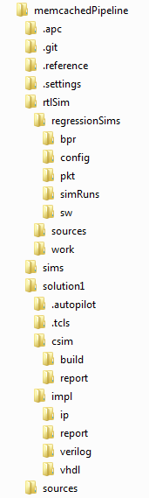
Memcached Code Package – Folder Structure
Backpressure input files for RTL simulation
RTL simulation configuration files
Packet input & output files for RTL simulation
RTL simulation results
Scripts for the RTL simulation
RTL sources for RTL regression tests
Scripts, input & output files for C-based regression tests
Location of executable for C Simulation
Location of exported IP core
Memcached C++ Source Files

Slide 35
Creating a Vivado HLS project
There are two ways to run VHLS:
Project mode
Projectless mode
To use the former, open the GUI, create a project and add the source files.
To use the latter, run the run_hls.tcl script provided in the package.
This will create a project, add the files, compile them for C simulation, as well as synthesize and subsequently export the memcached pipeline as an IP core.
Using this option will cause the directory structure to deviate slightly from the one in the previous slide.

Slide 36
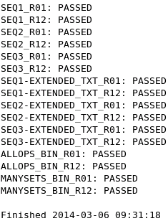
Running C Simulations
Edit memcachedPipeline/sims/env.cSim to reflect the appropriate values for your system.
Launch memcachedPipeline/sims/memtest_deploy.py env.cSim
All test are run and a summary of the results is shown.
Output files end in the suffix –sim.result.txt
Report files of the compare between sim output and golden output have the suffix –sim.verification.txt
Hopefully you will get something like this:

Slide 37
C Simulation Architecture
Mirrors that of the BRAM version of the real-life system.
Memcached TB
BRAM Model Hash Table
BRAM Model Value Store
Request
Parser
Hash
Table
Value Store
Response Formatter
Memcached Pipeline
Non-synthesizable Code
Synthesizable Code

Slide 38
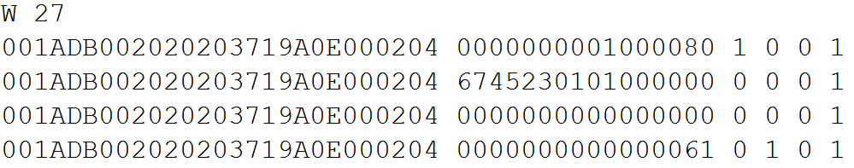
C Simulation Input File Format
Injects a number of idle cycles into the simulation (in this case 27)
Modulo
SOP
Each line is read in per to function call (practically per clock cycle)
EOP
Network metadata (MAC, IP, port numbers, etc..)
Packet (memcached) data
Valid
Output file looks identical (without the wait lines)

Slide 39
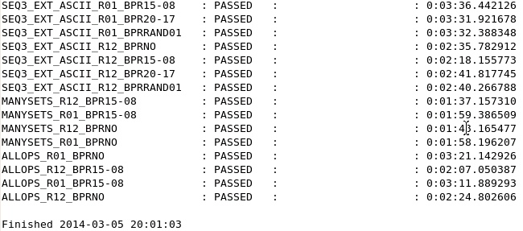
Running RTL Simulations
Edit memcachedPipeline/rtlSim/regressionSims/sw/env.server to reflect the appropriate values for your system.
Launch memcachedPipeline/rtlSim/regressionSims/sw/memtest_deploy.py env.server
All test are run and a summary of the results is shown.
Output files end in the suffix –sim.result.txt
Report files of the compare between sim output and golden output have the suffix –sim.verification.txt
Results should look like this:

Slide 40
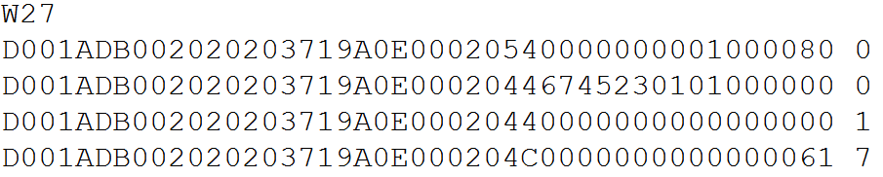
RTL Simulation Output File Format
Injects a number of idle cycles into the simulation (in this case 27)
SOP, EOP & modulo are in this byte
Each line is read in per to function call (practically per clock cycle)
Network metadata (MAC, IP, port numbers, etc..)
Packet (memcached) data
1 is previous to last word, 7 is last word in a packet
Output file looks identical (without the wait lines)

