Slide 1
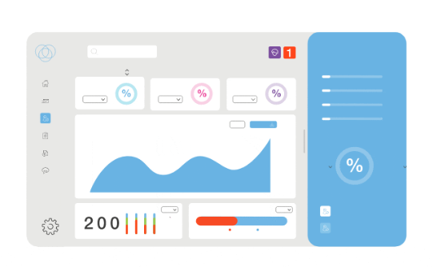
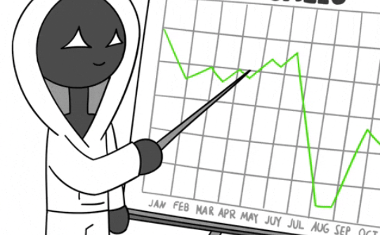

Sales Dashboard: Unlocking Insights Across Regions and Stores
Data-Driven Decisions
Regional Performance
Strategic Advantage
Actionable insights for strategic decision-making
Unlocking regional and store-level insights.
Powerful insights to drive success
Notes:
1

Slide 2
Key Performance Indicators (KPIs)
Total Revenue
Average revenue
Total transactions
Total country
Overall sales performance across all regions and stores.
The average revenue generated.
The total number of transactions achieved.
The total number of country we currently supply.
Notes:
2

Slide 3



Revenue Breakdown by Region
USA
2
Steady growth potential.
Asia
1
Highest revenue contribution.
UK
3
Emerging market with significant upside.
Notes:
3

Slide 4


Revenue Trends Over Time
1
Q1
Asia has maximum growth.
2
Q2
Seasonal dip in revenue.
3
Q3
More dip in revenue.
4
Q4
Slow but steady growth in revenue.
Notes:
4

Slide 5

Top Performing Stores by Region
Store 1
Store 2
Consistent high sales and customer satisfaction.
deep drive in revenue scale.
Store 3
Store 4
Steady graph of dropping revenue.
second after store 1.
Notes:
5

Slide 6




Challenges and Opportunities by Region
US
UK
Asia
Competition from online retailers.
Potential impact of Brexit on supply chain.
Navigating diverse cultural and regulatory landscapes.
Notes:
6

Slide 7



Actionable Insights and Recommendations
1
Focus on Customer Experience
2
Optimize Online Presence
3
Expand into New Markets
Notes:
7

Slide 8


Next Steps and Q&A
We will implement the recommendations and monitor progress closely. Please feel free to ask any questions.
Notes:
8

