Slide 1
Amazon Sales Data Analysis
The “Amazon Sales Data Analysis” is a Power Bi project which consist of 3 pages:
Overview
Product
Product view
Overview
It shows all the product in the left side from which one will select which product he wants to analyze.
After that one can choose for which status he want to analyse the product by selecting from the “Status Bar”.
In the right side there is two buttons to toggle between Sales and Units .
One the top there are “Gross sales”, “Sales” and “Seller count” is showing for better understanding of the data.
Product
Product page tells you in that particular category how many product are listed.
And hovering between the products tells you the details about that particular product.
Product View
This page gives ultimate details about the Product along with Total unit of sales , Total Amount generated from sales and no of Returns (loss).
You can select the date from which to which you want to see the results.

Slide 2
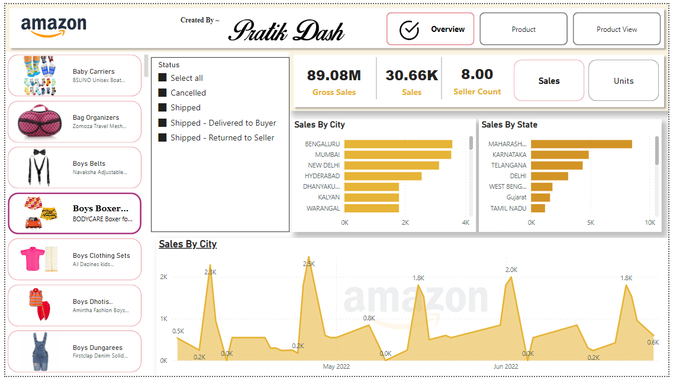

Slide 3
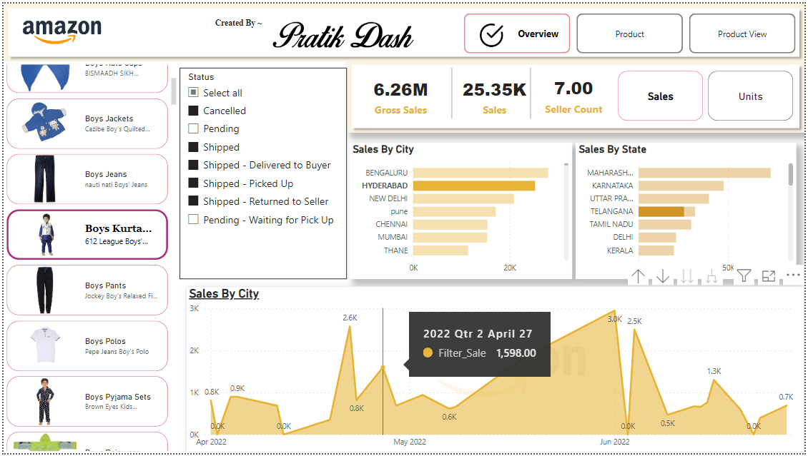

Slide 4
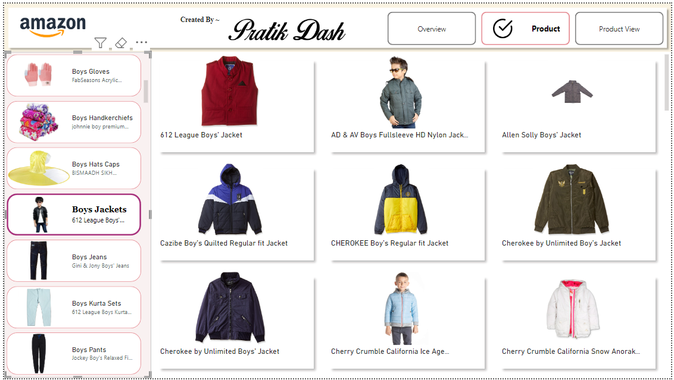

Slide 5
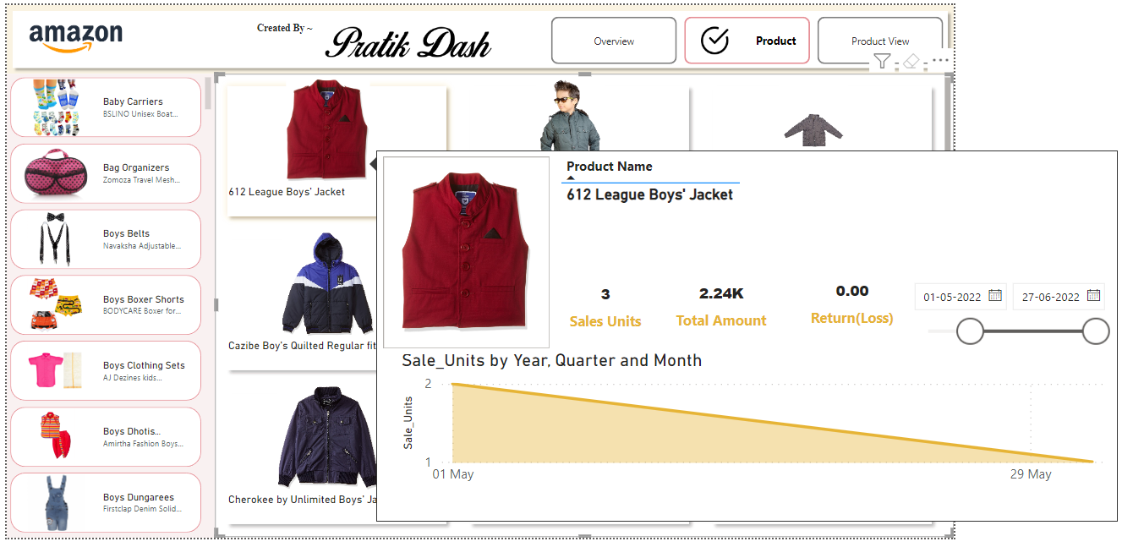
When You “Hover” into any Product :

Slide 6
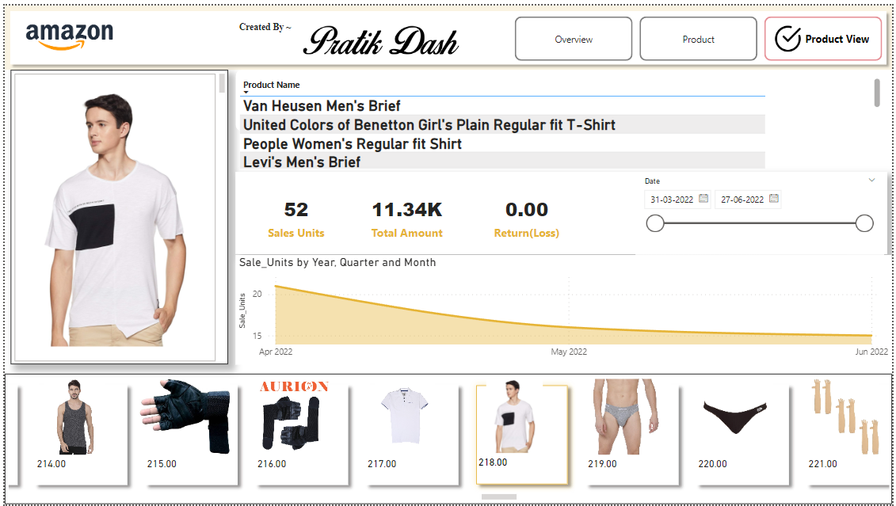

Slide 7
The End

