Slide 1
ABC Ltd Initiation Note
ABC Ltd | BUY
Rating BUY
CMP INR 420.0
TP INR 515.0

Slide 2
Investment Thesis
ABC Ltd is emerging as a scaled specialty chemicals platform with improving mix, stronger export penetration, and disciplined capacity expansion.
- ABC Ltd is emerging as a scaled specialty chemicals platform with improving mix, stronger export penetration, and disciplined capacity expansion.
- - Demand visibility remains healthy across key end markets.
- - Raw material volatility could pressure gross margins.

Slide 3
ABC Ltd At A Glance
ABC Ltd is a specialty chemicals manufacturer focused on export-led growth and margin expansion.
CMP INR 420.0
TP INR 515.0
Upside 22.6%

Slide 4
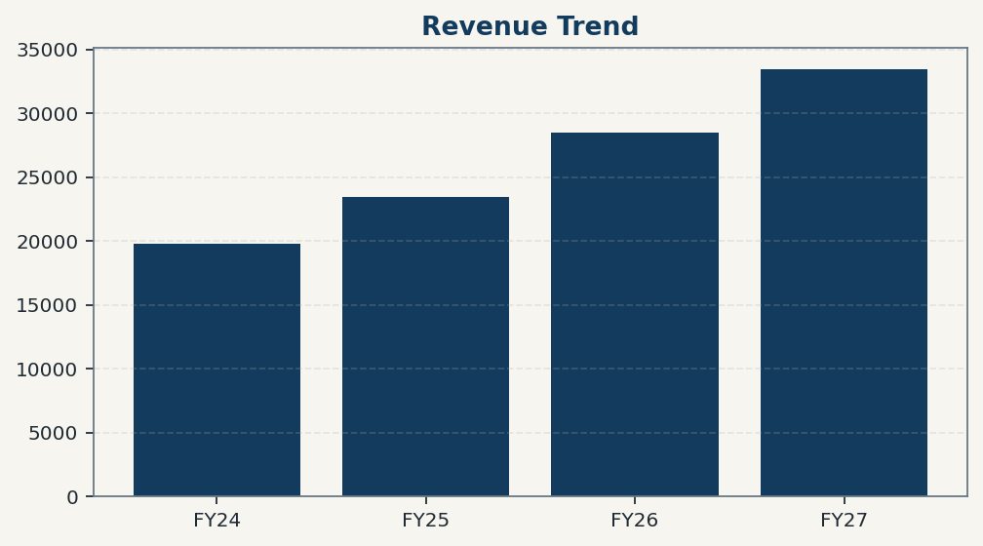
Financial Trend Overview
Revenue and profitability trends should be grounded in deterministic model outputs.

Slide 5
Revenue Summary Table
Period | Value
FY24 | 19800
FY25 | 23500
FY26 | 28500
FY27 | 33450

Slide 6
Risks And Catalysts
- - Raw material volatility could pressure gross margins.
- - Delays in utilization ramp-up may push out earnings conversion.
- - Export demand softness could affect near-term growth.

Slide 7
Disclaimer
For internal research workflow validation only. Final legal disclaimer copy will be supplied from approved assets.

