Slide 1
XYZ Finance Ltd Update Note
XYZ Finance Ltd | BUY
Rating BUY
CMP INR 178.0
TP INR 225.0

Slide 2
Investment Thesis
XYZ Finance is delivering consistent secured-loan growth while preserving balance-sheet discipline and improving profitability.
- XYZ Finance is delivering consistent secured-loan growth while preserving...
- - Branch productivity is improving across newer cohorts.
- - Competitive intensity could pressure spreads.

Slide 3
XYZ Finance Ltd At A Glance
XYZ Finance Ltd is a diversified NBFC with a growing secured retail loan franchise and improving return ratios.
CMP INR 178.0
TP INR 225.0
Upside 26.4%

Slide 4
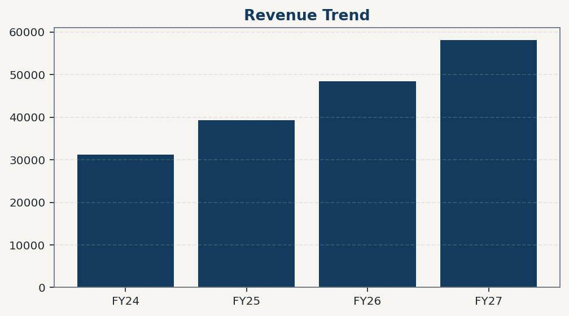
Financial Trend Overview
Revenue and profitability trends should be grounded in deterministic model outputs.

Slide 5
Revenue Summary Table
Period | Value
FY24 | 31200
FY25 | 39250
FY26 | 48500
FY27 | 58100

Slide 6
Risks And Catalysts
- - Competitive intensity could pressure spreads.
- - Asset-quality normalization may take longer than expected.
- - Execution slippage in new geographies may slow disbursement momentum.

Slide 7
Disclaimer
For internal research workflow validation only. Final legal disclaimer copy will be supplied from approved assets.

