Slide 1

BUY
Motilal Oswal Financial Services Initiation Note
Motilal Oswal Financial Services Ltd | BUY
Rating
BUY
CMP
INR 720.0
TP
INR 920.0
Tikona Capital | SEBI Registration No.: INH000069807

Slide 2
MOTILALOFS | Pratik Gupta | 2026-04-28
Investment Thesis
Motilal Oswal Financial Services is one of the most diversified capital-markets franchises in India, with a structurally improving mix of annuity-style asset management and wealth fees offsetting cyclicality in broking and investment banking. The next leg of growth is being driven by strong client additions, AUM compounding in AMC and PWM, and operating leverage in housing finance.
- Motilal Oswal Financial Services is one of the most diversified capital-markets franchises in India, with a structurally improving...
- Wealth and AMC are scaling annuity revenues, reducing earnings volatility.
- Retail broking continues to gain incremental market share among active clients.
- Housing finance has turned the corner on asset quality with disciplined growth.
- Proprietary book provides a credible long-term capital allocation tailwind.
Tikona Capital | SEBI Registration No.: INH000069807
Page 2 of 16

Slide 3
MOTILALOFS | Pratik Gupta | 2026-04-28
Motilal Oswal Financial Services Ltd At A Glance
Motilal Oswal Financial Services is a diversified financial services group with leadership in retail broking, asset management, wealth management, investment banking, and housing finance, supported by a meaningful proprietary investment book.
CMP INR 720.0
TP INR 920.0
Upside 27.8%
Tikona Capital | SEBI Registration No.: INH000069807
Page 3 of 16

Slide 4
MOTILALOFS | Pratik Gupta | 2026-04-28
Industry Overview
Indian capital-markets franchises continue to benefit from rising household equity allocation, demat additions, and SIP penetration. Wealth and asset-management economics are migrating toward fee-based annuity revenue, narrowing the cyclicality gap with private banks.
- Indian capital-markets franchises continue to benefit from rising household equity allocation, demat additions, and SIP pen...
Tikona Capital | SEBI Registration No.: INH000069807
Page 4 of 16

Slide 5
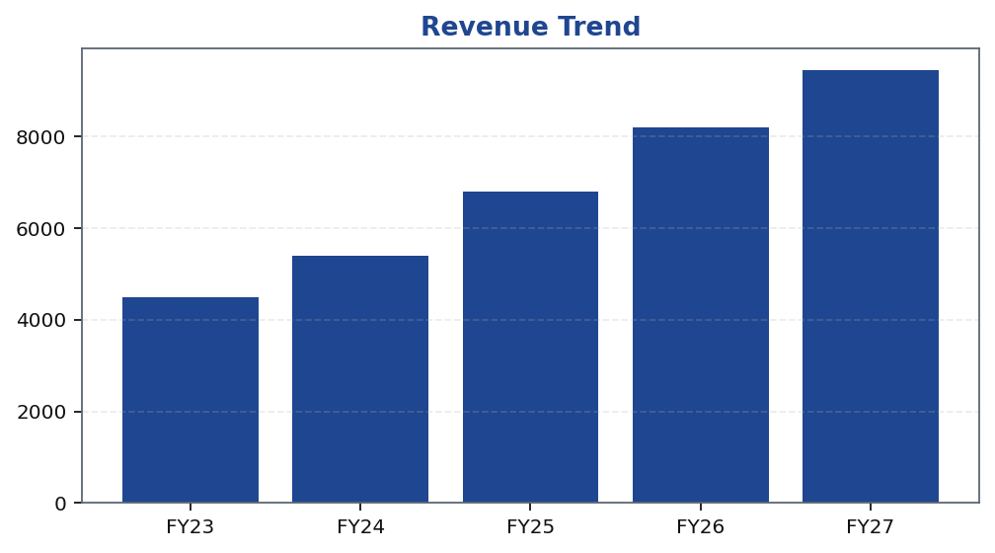
MOTILALOFS | Pratik Gupta | 2026-04-28
Financial Trend Overview
Revenue and profitability trends are grounded in deterministic model outputs.
Tikona Capital | SEBI Registration No.: INH000069807
Page 5 of 16

Slide 6
MOTILALOFS | Pratik Gupta | 2026-04-28
Revenue Summary Table
Period | Value
FY23 | 4500.0
FY24 | 5400.0
FY25 | 6800.0
FY26 | 8200.0
FY27 | 9450.0
Tikona Capital | SEBI Registration No.: INH000069807
Page 6 of 16

Slide 7
MOTILALOFS | Pratik Gupta | 2026-04-28
Quarterly Performance
Recent quarters demonstrate steady revenue and earnings progression.
Quarter | Revenue (INR Cr)
Q1FY25 | 1580.0
Q2FY25 | 1690.0
Q3FY25 | 1740.0
Q4FY25 | 1790.0
Q1FY26 | 1925.0
Tikona Capital | SEBI Registration No.: INH000069807
Page 7 of 16

Slide 8
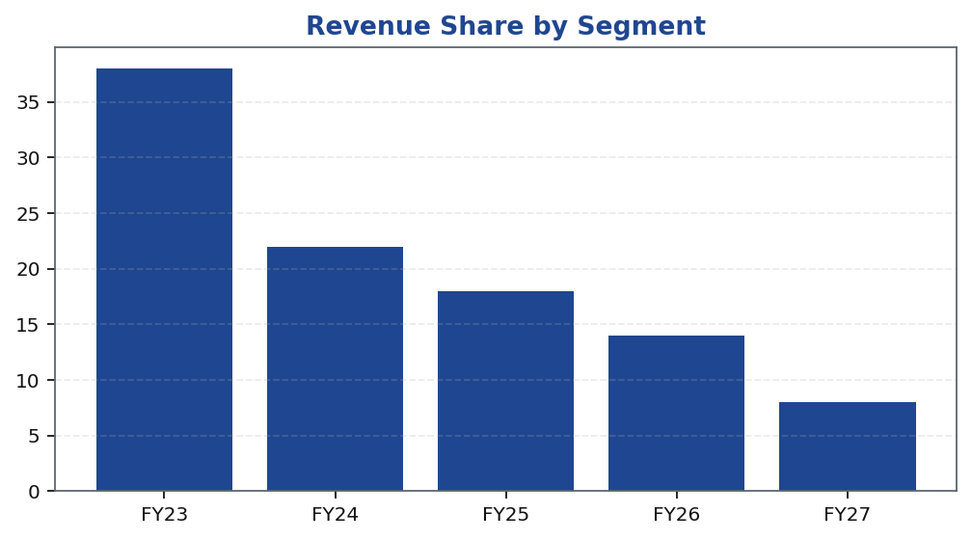
MOTILALOFS | Pratik Gupta | 2026-04-28
Segment Mix
Segment composition reveals diversification and where future growth is concentrated.
Tikona Capital | SEBI Registration No.: INH000069807
Page 8 of 16

Slide 9
MOTILALOFS | Pratik Gupta | 2026-04-28
Key Ratios
Margin trajectory and return profile underpin the valuation case.
Ratio | FY23 | FY24 | FY25 | FY26 | FY27
EBITDA Margin | 42.0 | 47.5 | 50.2 | 53.0 | 54.0
PAT Margin | 31.8 | 38.0 | 36.9 | 37.2 | 37.9
ROE | 22.0 | 24.5 | 25.7 | 26.4 | 27.1
ROA | 9.0 | 10.5 | 11.4 | 12.1 | 12.6
Net D/E | 0.6 | 0.5 | 0.4 | 0.4 | 0.3
Tikona Capital | SEBI Registration No.: INH000069807
Page 9 of 16

Slide 10
MOTILALOFS | Pratik Gupta | 2026-04-28
Peer Comparison
Target company highlighted with an asterisk; multiples are illustrative.
Company | MCap (Cr) | P/E | EV/EBITDA | P/B | ROE | Rev Growth
Motilal Oswal Financial Services * | 43200.0 | 14.1x | 9.9x | 3.7x | 26.4% | 21.0%
ICICI Securities | 27800.0 | 12.3x | 8.5x | 4.4x | 35.6% | 14.0%
Angel One | 24500.0 | 18.8x | 12.1x | 5.9x | 32.4% | 28.0%
IIFL Securities | 7800.0 | 11.4x | 7.6x | 2.9x | 24.1% | 12.0%
Nuvama Wealth Management | 22600.0 | 22.5x | 14.8x | 5.1x | 22.8% | 31.0%
Anand Rathi Wealth | 18900.0 | 38.4x | 27.2x | 14.6x | 41.9% | 33.0%
Tikona Capital | SEBI Registration No.: INH000069807
Page 10 of 16

Slide 11
MOTILALOFS | Pratik Gupta | 2026-04-28
Valuation — Methods Summary
Target price is a weighted blend of SOTP, P/E, and DCF estimates.
Method | Low | Base | High | Weight
Sum-of-the-Parts | 820.0 | 920.0 | 1050.0 | 60.0%
P/E (FY27 EPS) | 780.0 | 900.0 | 1020.0 | 25.0%
DCF | 750.0 | 880.0 | 1010.0 | 15.0%
Tikona Capital | SEBI Registration No.: INH000069807
Page 11 of 16

Slide 12
MOTILALOFS | Pratik Gupta | 2026-04-28
DCF Summary
DCF assumes mid-cycle margins, normalized capex intensity, and a steady-state terminal return profile.
WACC 12.5
Terminal g 5.0
Tikona Capital | SEBI Registration No.: INH000069807
Page 12 of 16

Slide 13
MOTILALOFS | Pratik Gupta | 2026-04-28
Scenario Analysis
Scenario | Rev CAGR | EBITDA Mgn | Target Price | Probability
Bull | 22.0% | 56.0% | 1080.0 | 25.0%
Base | 18.0% | 53.5% | 920.0 | 55.0%
Bear | 11.0% | 47.0% | 660.0 | 20.0%
Tikona Capital | SEBI Registration No.: INH000069807
Page 13 of 16

Slide 14
MOTILALOFS | Pratik Gupta | 2026-04-28
Key Catalysts
- Sustained AMC AUM growth and improvement in industry market share. - PWM net-new-money momentum and yield resilience. - Operating leverage as broking technology spend matures. - Recovery in capital-markets activity boosting investment banking and broking.
- Sustained AMC AUM growth and improvement in industry market share.
- PWM net-new-money momentum and yield resilience.
- Operating leverage as broking technology spend matures.
- Recovery in capital-markets activity boosting investment banking and broking.
Tikona Capital | SEBI Registration No.: INH000069807
Page 14 of 16

Slide 15
MOTILALOFS | Pratik Gupta | 2026-04-28
Risks And Catalysts
- Cyclical drawdowns in capital-markets activity hurt broking revenue.
- Mark-to-market on the proprietary book can introduce earnings volatility.
- Regulatory tightening on broking pricing or distribution economics.
- Competitive intensity from discount brokers compressing yields.
- Housing finance asset-quality slippage in stressed credit cycles.
Tikona Capital | SEBI Registration No.: INH000069807
Page 15 of 16

Slide 16
MOTILALOFS | Pratik Gupta | 2026-04-28
Disclaimer
For internal research workflow validation only. Final legal disclaimer copy will be supplied from approved assets.
Tikona Capital | SEBI Registration No.: INH000069807
Page 16 of 16

