Slide 1

BUY
Motilal Oswal Financial Services Initiation Note
Motilal Oswal Financial Services Ltd | BUY
Rating
BUY
CMP
INR 822.9
TP
INR 1127.0
Tikona Capital | SEBI Registration No.: INH000069807

Slide 2
MOFSL | Pratik Gupta | 2026-04-28
Investment Thesis
BUY with SAARTHI Score of 72/100. Motilal Oswal Financial Services represents a compelling investment opportunity driven by its accelerating transformation from a cyclical broking firm into a high-quality, annuity-driven financial services platform. Annual Recurring Revenue (ARR) now constitutes 65% of total net revenues — with management guiding for further increases — fundamentally re-rating the quality of the earnings base. CMP of INR 822.90 offers a 37% discount to analyst consensus target of INR 1,127, with a probability-weighted target of INR 1,109.
- BUY with SAARTHI Score of 72/100. Motilal Oswal Financial Services represents a compelling investment opportunity driven by its acc...
- ARR contribution at 65% of total net revenues, reducing cyclical broking volatility
- Q2FY25 profits up 123% YoY with 46% revenue growth and 48% ROE
- Total AUM at INR 1.77 lakh crore (+46% YoY); 91% of AUM outperforming benchmarks over 3 years
- Private Wealth AUM at INR 1.96 lakh crore (+31% YoY); family count up 41% YoY
- Long-term credit rating upgraded to AA+ (Stable) by ICRA
Tikona Capital | SEBI Registration No.: INH000069807
Page 2 of 19

Slide 3
MOFSL | Pratik Gupta | 2026-04-28
SAARTHI Investment Quality Score — 72/100
Proprietary 7-dimension framework. Overall score 72/100 (BUY (70-84 range)).
Code | Dimension | Score | Key Evidence
S | Scalability of Core Engine | 12/15 | AMC AUM +33% YoY to INR 1.89L Cr with INR 11,610 Cr net flows.
A1 | Addressable Market & Adjacency | 9/10 | India private credit hit USD 9.0 Bn in H1 2025 (+53% YoY).
A2 | Asymmetric Pricing Power | 10/15 | Diversified mix offset 24% brokerage decline, validating partial pricing-power hedge.
R | Reinvestment Quality | 13/15 | PWM AUM +31% YoY to INR 1.96L Cr; family count +41%; PAT +14% (9M).
T | Track Record Through Adversity | 8/10 | Despite repeated SEBI interventions, AUM and ARR base continue to compound — institutional resilience.
H | Human Capital & Institutional DNA | 9/10 | Rashtriya Samman Patra recipient (top tax-payer FY95–FY99) signals early ethical commercial success.
I | Inflection Point Identification | 11/15 | ARR at 65% of net revenues (up from 61%); management guiding higher — measurable inflection.
Tikona Capital | SEBI Registration No.: INH000069807
Page 3 of 19

Slide 4
MOFSL | Pratik Gupta | 2026-04-28
Motilal Oswal Financial Services Ltd At A Glance
Motilal Oswal Financial Services, founded in 1987 by Motilal Oswal and Raamdeo Agrawal, has evolved from a research-driven equity broking house into one of India's most comprehensive financial services platforms. The company spans Capital Markets, Asset & Wealth Management, Housing Finance, and Alternative Investments, serving over 1,600,000 customers across 550+ cities through 2,500+ business locations. Research coverage of 300+ companies remains the firm's enduring competitive moat.
CMP INR 822.9
TP INR 1127.0
Upside 37.0%
Tikona Capital | SEBI Registration No.: INH000069807
Page 4 of 19

Slide 5
MOFSL | Pratik Gupta | 2026-04-28
Industry Overview
Indian Financial Services is a strategic shock absorber for the growth story. India is expected to have 16.57 lakh HNWIs by 2027 and become the fourth-largest private wealth market by 2028, with a 58.4% projected rise in UHNWIs. The financial services sector is projected to nearly double profits by FY30, led by NBFCs growing at 16% annually. Mutual fund penetration at just 5–6% reflects substantial latent growth opportunity. Private credit hit a record USD 9.0 billion in H1 2025, up 53% YoY.
- Mutual fund penetration at 5-6% — massive latent opportunity
- Financial savings shifting from gold/real estate to financial assets
- BSE-listed companies grew from 135 (1995) to 5,328 (Feb 2025)
- Private wealth set to be 4th-largest globally by 2028
- NBFCs growing at 16% annually with improving asset quality
- Demographic dividend — large working-age population entering peak earning
Tikona Capital | SEBI Registration No.: INH000069807
Page 5 of 19

Slide 6
MOFSL | Pratik Gupta | 2026-04-28
Key Highlights
Six themes underpinning the investment view.
- ARR Transformation: ARR at 65% of net revenues (up from 61%); fee-based at 45%. Annuity income reduces transaction-cycle volatility.
- Profitability Momentum: Q2FY25 PAT INR 1,242 Cr (+123% YoY); H1FY26 operating PAT INR 1,088 Cr (+11% YoY); Asset & PWM businesses leading at +32% PAT growth.
- AUM Scale and Outperformance: Total AUM INR 1.77L Cr (+46% YoY). AMC AUM INR 1.89L Cr (+33%) with INR 11,610 Cr net flows. 91% of AUM outperforming benchmarks over 3 years.
- Private Wealth Expansion: PWM AUM INR 1.96L Cr (+31% YoY); family count +41% YoY; PAT +14% (9M). Distribution book +34% YoY to INR 42,775 Cr.
- Valuation Opportunity: CMP INR 822.90 vs consensus TP INR 1,126.67 (max INR 1,200) — 37% upside. Probability-weighted target INR 1,109.
- Credit Upgrade: Long-term credit rating upgraded to AA+ (Stable) by ICRA. Net worth INR 12,871 Cr (+16% YoY).
Tikona Capital | SEBI Registration No.: INH000069807
Page 6 of 19

Slide 7
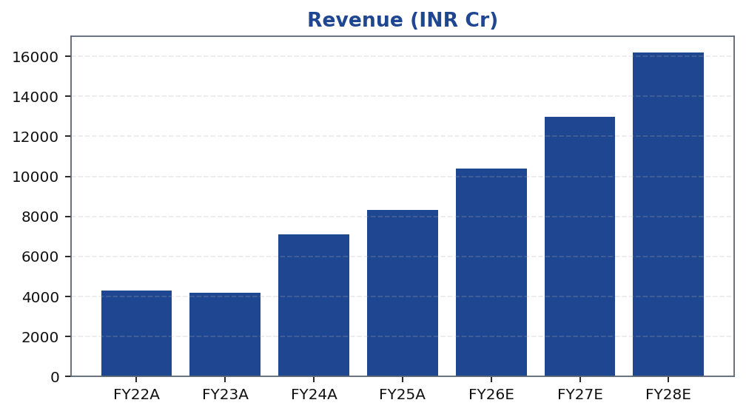
MOFSL | Pratik Gupta | 2026-04-28
Revenue Trend
Revenue trajectory across FY22A–FY28E reflects post-FY22 step-up driven by ARR-led mix shift and AUM scale-up.
Tikona Capital | SEBI Registration No.: INH000069807
Page 7 of 19

Slide 8
MOFSL | Pratik Gupta | 2026-04-28
Annual Financial Summary
Period | Revenue (INR Cr)
FY22A | 4298.0
FY23A | 4178.0
FY24A | 7106.0
FY25A | 8340.0
FY26E | 10402.0
FY27E | 12973.0
FY28E | 16181.0
Tikona Capital | SEBI Registration No.: INH000069807
Page 8 of 19

Slide 9
MOFSL | Pratik Gupta | 2026-04-28
Quarterly Performance
Quarterly trajectory shows the impact of F&O regulatory changes on broking; Q2FY26 declined sharply YoY before stabilising.
Quarter | PAT (INR Cr)
Q2FY25 | 1242.0
Q3FY25 | 715.0
Q4FY25 | 545.0
Q1FY26 | 425.0
Q2FY26 | 401.0
Tikona Capital | SEBI Registration No.: INH000069807
Page 9 of 19

Slide 10
MOFSL | Pratik Gupta | 2026-04-28
Segment Mix
Segment | Scale Metric | Latest | Notes
Capital Markets (Broking + IB) | Brokerage Rev YoY | -24% | Equity, derivatives, commodity, currency trading + institutional services and investment banking. Brokerage now contributes only 30% of total revenue, down from historical highs.
Asset Management | AMC AUM | INR 1.89L Cr (+33% YoY) | Mutual funds and PMS. 91% of AUM outperforming benchmarks over 3 years.
Private Wealth Management | PWM AUM | INR 1.96L Cr (+31% YoY) | HNI/UHNI advisory. Family count up 41% YoY.
Housing Finance | Loan Book | INR 6,630 Cr (+25% YoY) | Retail mortgage lending — affordable and mid-segment.
Alternative Investments | Carry Income | INR 58 Cr recurring | Private credit, real estate, alternatives.
Tikona Capital | SEBI Registration No.: INH000069807
Page 10 of 19

Slide 11
MOFSL | Pratik Gupta | 2026-04-28
Key Ratios
Margin and return profile across the forecast period; valuation multiples compressing as earnings scale.
Ratio | FY22A | FY23A | FY24A | FY25A | FY26E | FY27E | FY28E
EBITDA Margin | 49.3 | 44.9 | 57.4 | 54.5 | 52.3 | 52.3 | 52.3
PAT Margin | 30.5 | 22.3 | 34.4 | 30.0 | 29.5 | 30.7 | 31.7
RoE | 23.0 | 15.0 | 28.0 | 23.0 | 22.0 | 23.0 | 24.0
RoCE | 19.0 | 13.0 | 21.0 | 19.0 | 18.0 | 18.0 | 19.0
RoIC | 92.0 | 78.0 | 119.0 | 87.0 | 35.0 | 24.0 | 24.0
P/E | 37.5 | 52.3 | 20.1 | 19.7 | 16.1 | 12.4 | 9.6
P/B | 8.7 | 7.8 | 5.6 | 4.5 | 3.6 | 2.9 | 2.3
EV/EBITDA | 9.0 | 10.3 | 9.5 | 11.4 | 12.7 | 10.5 | 8.8
Tikona Capital | SEBI Registration No.: INH000069807
Page 11 of 19

Slide 12
MOFSL | Pratik Gupta | 2026-04-28
Valuation — Methods Summary
Probability-weighted target price reconciles bull, base, and bear cases.
Case | Target | Weight | Basis
Bull Case | 1400.0 | 30.0% | 28x P/E on FY27E EPS of INR 50; ARR > 70%, AMC +40% YoY.
Base Case | 1127.0 | 50.0% | 24x P/E on FY27E EPS of INR 47; ARR stable at 65%, steady AUM.
Bear Case | 630.0 | 20.0% | 18x P/E on depressed FY27E EPS of INR 35; sustained regulatory headwinds.
Tikona Capital | SEBI Registration No.: INH000069807
Page 12 of 19

Slide 13
MOFSL | Pratik Gupta | 2026-04-28
Scenario Analysis
Case | Rev CAGR | EBITDA Mgn | Target Price | Probability | Drivers
Bull | 27.5% | 55.0% | 1400.0 | 30.0% | ARR > 70%, AMC AUM +40% YoY, regulatory clarity.
Base | 16.0% | 51.0% | 1127.0 | 50.0% | ARR steady at 65%, AUM compounding, stable regulation.
Bear | 6.0% | 45.0% | 630.0 | 20.0% | Sustained F&O headwinds, fintech share loss.
Tikona Capital | SEBI Registration No.: INH000069807
Page 13 of 19

Slide 14
MOFSL | Pratik Gupta | 2026-04-28
Key Catalysts
- ARR contribution crossing 70% of revenues, triggering valuation re-rating from broking to asset management multiples - Sustained AMC AUM growth above 25% YoY with net flows exceeding INR 10,000 crore annually - Private wealth AUM growth above 25% YoY with family count expansion - Operating leverage improvement with cost-to-income ratio declining - Regulatory clarity on F&O trading norms
- ARR contribution crossing 70% of revenues, triggering valuation re-rating from broking to asset management multiples
- Sustained AMC AUM growth above 25% YoY with net flows exceeding INR 10,000 crore annually
- Private wealth AUM growth above 25% YoY with family count expansion
- Operating leverage improvement with cost-to-income ratio declining
- Regulatory clarity on F&O trading norms
Tikona Capital | SEBI Registration No.: INH000069807
Page 14 of 19

Slide 15
MOFSL | Pratik Gupta | 2026-04-28
Management Team
Founder-led leadership with deep institutional DNA across nearly four decades.
Name | Role | Background
Raamdeo Agrawal | Chairman, MOFSL & Chairman, AMC | Co-founder (1987). Creator of the QGLP investment process and 'Buy Right, Sit Tight' framework. Built one of India's most respected investment research franchises. Widely cited investment thinker.
Motilal Oswal | Founder, Chairman & MD | Co-founder (1987). Led the firm's transformation from broking house into a comprehensive financial services platform. Recipient of Rashtriya Samman Patra for being among the highest taxpayers FY95–FY99.
Navin Agarwal | Executive Board — Strategy & Capital Allocation | Joined 2000. Drives business strategy and capital allocation across the Group, building market-leading positions through disciplined deployment.
Ajay Menon | Executive — Operations, Compliance, Risk & Technology | Joined 1998. 27+ years in Indian capital markets. Cornerstone of operational excellence and technology initiatives across the Group.
Tikona Capital | SEBI Registration No.: INH000069807
Page 15 of 19

Slide 16
MOFSL | Pratik Gupta | 2026-04-28
Forensic / Governance — Monitor Closely
Recurring regulatory matters are operational rather than fraudulent. Despite SEBI interventions, structural lapses suggest deeper governance attention needed in risk management. Pattern warrants monitoring but does not impair the business model.
Matter | Description | Severity
SEBI — Margin Reporting Violations | INR 7 lakh penalty for margin reporting, collection violations, and other regulatory lapses found during inspection. | Low
SEBI — Client Fund Misutilization (2022) | INR 25 lakh fine for misutilization of client funds and inaccurate margin reporting. | Medium
NSEL — Misselling Accusations | Accused alongside other top brokers of misselling NSEL contracts, KYC manipulation, client code modification, and illegal transactions per SFIO/EOW findings. | High (Historical)
SEBI — Not Fit and Proper (Commodities) | Declared 'not fit and proper' as commodity derivative broker in Feb 2019 based on SFIO/EOW recommendations. | High (Historical)
Unauthorized Terminal Operations | 13 NSE and 9 BSE terminals operating from undeclared locations including an unreported branch in Delhi. | Medium
Tikona Capital | SEBI Registration No.: INH000069807
Page 16 of 19

Slide 17
MOFSL | Pratik Gupta | 2026-04-28
Trading Strategy
Entry: INR 800-850. 15-20% discount to analyst consensus target — margin of safety. Position size: 3-5% of portfolio (institutional). Review: Quarterly. Downside exit: Stop-loss at INR 750 (-8% from CMP) on technical break with high volume. Upside exit: Sell 50% at INR 1,100-1,150 (30-40% gains) / Sell remaining at INR 1,200+ if multiples expand beyond 25x P/E.
- ARR contribution above 60% of net revenues
- AMC AUM growth above 25% YoY with net flows > INR 10,000 Cr
- PWM AUM growth above 25% YoY with family count expansion
- Cost-to-income ratio declining
- SEBI compliance with no major enforcement actions
Tikona Capital | SEBI Registration No.: INH000069807
Page 17 of 19

Slide 18
MOFSL | Pratik Gupta | 2026-04-28
Key Risks
- SEBI regulatory headwinds on F&O trading norms compressing cyclical broking revenues
- Q2FY26 profit declined 67.6% YoY and revenue 34.9% YoY due to regulatory changes — residual cyclicality
- Competitive intensity from discount brokers and fintech platforms compressing yields
- Forensic / governance: recurring SEBI matters require monitoring (Monitor Closely category)
- Mark-to-market volatility on the proprietary book
- Housing finance asset-quality slippage in stressed credit cycles
Tikona Capital | SEBI Registration No.: INH000069807
Page 18 of 19

Slide 19
MOFSL | Pratik Gupta | 2026-04-28
Disclaimer
For internal research workflow validation only. Final legal disclaimer copy will be supplied from approved assets.
Tikona Capital | SEBI Registration No.: INH000069807
Page 19 of 19

