Slide 1

BUY
XYZ Finance Ltd Update Note
XYZ Finance Ltd | BUY
Rating
BUY
CMP
INR 178.0
TP
INR 225.0
Tikona Capital | SEBI Registration No.: INH000069807

Slide 2
XYZ | Amit Rao | 2026-04-28
Investment Thesis
XYZ Finance is delivering consistent secured-loan growth while preserving balance-sheet discipline and improving profitability.
- XYZ Finance is delivering consistent secured-loan growth while preserving balance-sheet discipline and improving profitability.
- Branch productivity is improving across newer cohorts.
- The secured mix is supporting credit-cost stability.
- Funding access remains adequate for the next growth phase.
- Competitive intensity could pressure spreads.
- Asset-quality normalization may take longer than expected.
Tikona Capital | SEBI Registration No.: INH000069807
Page 2 of 7

Slide 3
XYZ | Amit Rao | 2026-04-28
XYZ Finance Ltd At A Glance
XYZ Finance Ltd is a diversified NBFC with a growing secured retail loan franchise and improving return ratios.
CMP INR 178.0
TP INR 225.0
Upside 26.4%
Tikona Capital | SEBI Registration No.: INH000069807
Page 3 of 7

Slide 4
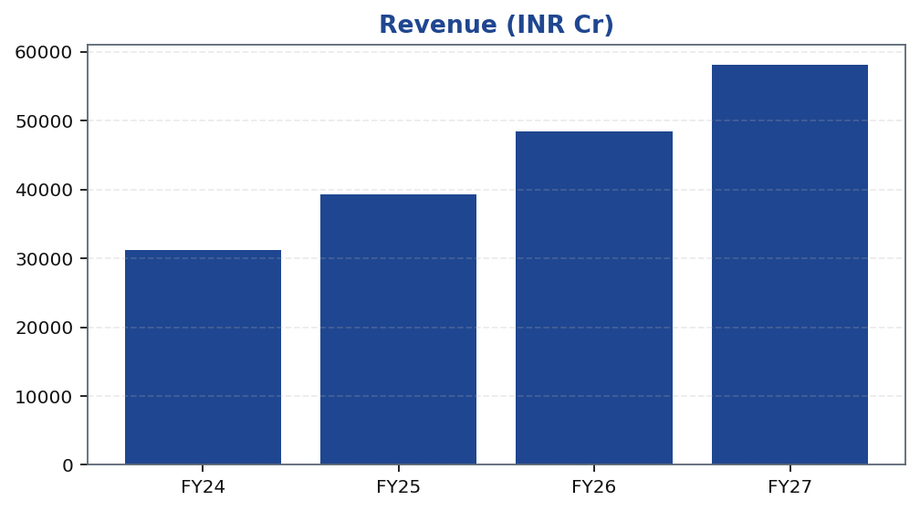
XYZ | Amit Rao | 2026-04-28
Revenue Trend
Revenue trajectory across FY22A–FY28E reflects post-FY22 step-up driven by ARR-led mix shift and AUM scale-up.
Tikona Capital | SEBI Registration No.: INH000069807
Page 4 of 7

Slide 5
XYZ | Amit Rao | 2026-04-28
Annual Financial Summary
Period | Revenue (INR Cr)
FY24 | 31200.0
FY25 | 39250.0
FY26 | 48500.0
FY27 | 58100.0
Tikona Capital | SEBI Registration No.: INH000069807
Page 5 of 7

Slide 6
XYZ | Amit Rao | 2026-04-28
Key Risks
- Competitive intensity could pressure spreads.
- Asset-quality normalization may take longer than expected.
- Execution slippage in new geographies may slow disbursement momentum.
Tikona Capital | SEBI Registration No.: INH000069807
Page 6 of 7

Slide 7
XYZ | Amit Rao | 2026-04-28
Disclaimer
For internal research workflow validation only. Final legal disclaimer copy will be supplied from approved assets.
Tikona Capital | SEBI Registration No.: INH000069807
Page 7 of 7

