Slide 1

BUY
Motilal Oswal Financial Services — Initiation Note
MOFSL | BUY | Annuity re-rating in progress
Rating
BUY
CMP (INR)
INR 822.9
Target Price (INR)
INR 1127.0
Tikona Capital | SEBI Registration No.: INH000069807

Slide 2
MOFSL | Pratik Gupta | 2026-04-28
Investment Thesis
We initiate coverage on MOFSL with a BUY rating. The franchise is executing a structural migration from transactional broking revenues toward an annuity-driven mix anchored in AMC, private wealth, and alternative investments. ARR now represents the majority of net revenues, materially de-risking the earnings base. Current valuation does not fully reflect this quality shift, creating a meaningful upside opportunity to our target price.
- ARR contribution at a majority of net revenues reduces dependence on volatile broking and F&O volumes.
- Total AUM compounding strongly YoY with category-leading benchmark outperformance across AMC strategies.
- Private Wealth franchise growing family count and AUM faster than industry, diversifying revenue streams.
- Operating leverage from a largely fixed cost base supports margin expansion as annuity mix rises.
- AA+ credit upgrade by ICRA endorses balance-sheet strength and capacity for disciplined reinvestment.
- Probability-weighted target prices in regulatory risk while retaining material upside to the base case.
Tikona Capital | SEBI Registration No.: INH000069807
Page 2 of 21

Slide 3
MOFSL | Pratik Gupta | 2026-04-28
Company Snapshot
Founded in 1987, Motilal Oswal Financial Services has evolved from a research-led equity broking house into one of India's most comprehensive financial services platforms. Its four pillars — Capital Markets, Asset & Wealth Management, Housing Finance, and Alternative Investments — serve over 1.6 million customers across 550+ cities. Research coverage of 300+ companies remains the firm's enduring competitive moat.
CMP (INR) INR 822.9
Target Price (INR) INR 1127.0
Upside (%) 37.0%
Total AUM (₹ lakh cr) 1.8
Tikona Capital | SEBI Registration No.: INH000069807
Page 3 of 21

Slide 4
MOFSL | Pratik Gupta | 2026-04-28
Key Highlights
- ARR Mix Shift: Annual Recurring Revenue now constitutes the majority of net revenues, fundamentally improving earnings quality.
- AUM Compounding: Total AUM growing strongly YoY with 91% of AMC AUM outperforming benchmarks over three years.
- Wealth Expansion: Private Wealth AUM growing above 30% YoY with family count expanding ahead of industry averages.
- Credit Upgrade: Long-term rating upgraded to AA+ (Stable) by ICRA, affirming balance-sheet resilience.
- Reinvestment Discipline: Reinvestment Quality scored 13/15 on SAARTHI, reflecting capital allocation into high-ROIC fee businesses.
- Valuation Discount: CMP trades at a significant discount to probability-weighted target, offering a favourable risk-reward entry.
Tikona Capital | SEBI Registration No.: INH000069807
Page 4 of 21

Slide 5
MOFSL | Pratik Gupta | 2026-04-28
Industry Overview — Indian Capital Markets & Wealth...
Indian financial services is at an inflection point, driven by rising financialisation of household savings, deepening capital markets, and rapidly expanding high-net-worth segments. India is projected to become the fourth-largest private wealth market by 2028. Mutual fund penetration remains at just 5–6% of GDP, implying substantial latent demand. Private credit reached a record USD 9.0 billion in H1 2025, up 53% YoY, reflecting the broadening of India's alternative investment ecosystem.
- India projected to have 16.57 lakh HNWIs by 2027, expanding the addressable wealth management market.
- UHNWI count expected to rise 58.4%, widening the opportunity for private wealth and alternative products.
- Mutual fund penetration at 5–6% of GDP leaves substantial headroom for AUM growth over the next decade.
- Private credit at record USD 9.0 billion in H1 2025 validates demand for alternative fixed-income strategies.
- NBFC sector profits projected to nearly double by FY30, supporting fee and NIM growth across lending platforms.
- Increasing retail investor participation post-pandemic deepens broking and distribution revenue pools.
Tikona Capital | SEBI Registration No.: INH000069807
Page 5 of 21

Slide 6
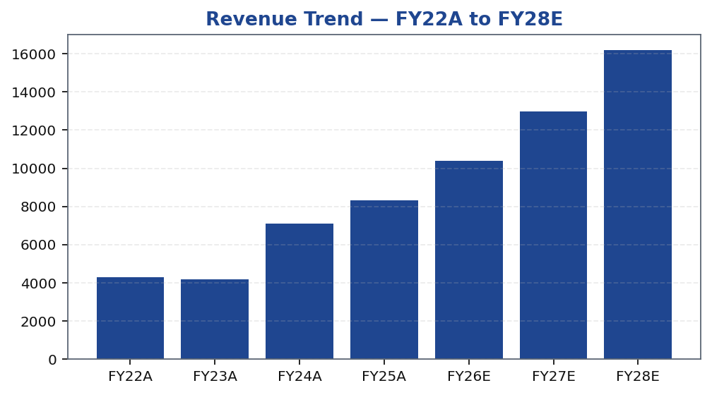
MOFSL | Pratik Gupta | 2026-04-28
Segment Revenue & EBITDA Mix
Asset & Wealth Management now contributes the largest share of revenues with higher EBITDA margins than the Capital Markets segment. The growing weight of AMC management fees and PWM advisory fees tilts the mix toward ARR, while Housing Finance and Alternatives provide additional diversification beyond equity market cycles.
Tikona Capital | SEBI Registration No.: INH000069807
Page 6 of 21

Slide 7
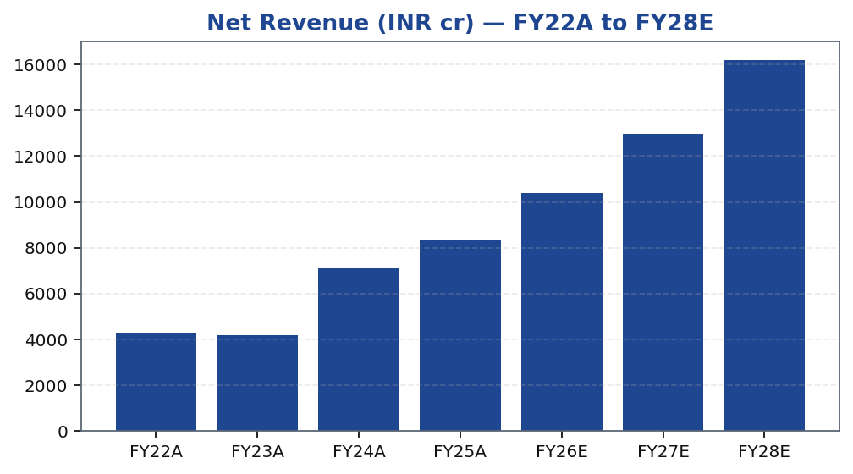
MOFSL | Pratik Gupta | 2026-04-28
Revenue Growth Trajectory
Consolidated revenues have compounded strongly, with annuity fees from AMC and private wealth growing faster than cyclical broking income. Forward estimates reflect continued AUM-linked fee growth partly offset by regulatory headwinds on F&O volumes. The cost base remains largely fixed, enabling operating leverage as ARR scales.
Tikona Capital | SEBI Registration No.: INH000069807
Page 7 of 21

Slide 8
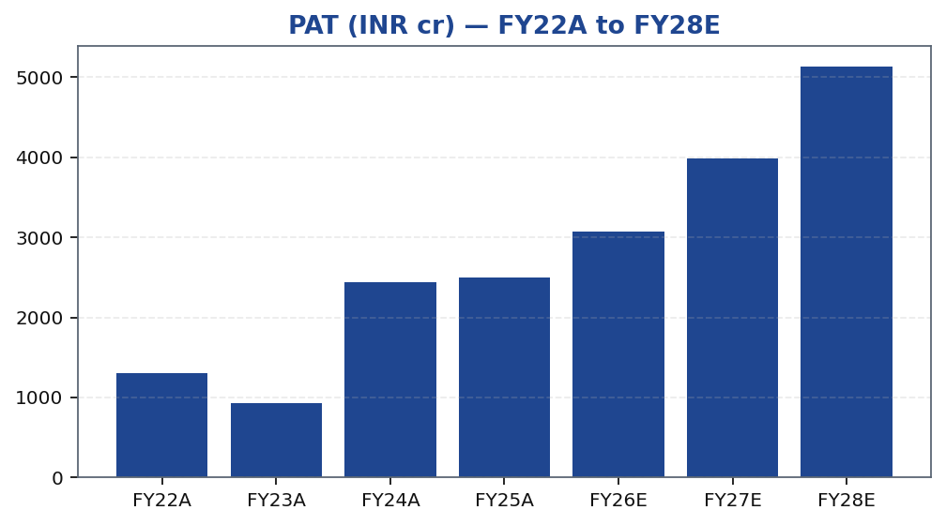
MOFSL | Pratik Gupta | 2026-04-28
Profitability — PAT and EBITDA Trends
EBITDA and PAT growth have been strong in recent periods, with Q2FY25 profits rising sharply YoY. However, Q2FY26 saw a meaningful YoY decline due to SEBI regulatory changes on F&O norms — underscoring residual cyclicality in the broking segment. The forward trajectory assumes continued fee income growth offsetting volume-related revenue compression.
Tikona Capital | SEBI Registration No.: INH000069807
Page 8 of 21

Slide 9
MOFSL | Pratik Gupta | 2026-04-28
Quarterly Performance Snapshot
Quarterly profits exhibit meaningful variability driven by F&O volumes, market levels and mark-to-market movements on the proprietary book. Q2FY26 profit declined due to SEBI regulatory changes. The rising ARR mix should dampen this volatility over time, but investors should model for quarter-on-quarter swings in the near term.
Quarter | PAT (INR cr)
Q2FY25 | 1242.0
Q3FY25 | 715.0
Q4FY25 | 545.0
Q1FY26 | 425.0
Q2FY26 | 401.0
Tikona Capital | SEBI Registration No.: INH000069807
Page 9 of 21

Slide 10
MOFSL | Pratik Gupta | 2026-04-28
Key Ratios — Margins, Returns and Multiples
Ratio | Unit | FY22A | FY23A | FY24A | FY25A | FY26E | FY27E | FY28E
EBITDA Margin | % | 49.3 | 44.9 | 57.4 | 54.5 | 52.3 | 52.3 | 52.3
PAT Margin | % | 30.5 | 22.3 | 34.4 | 30.0 | 29.5 | 30.7 | 31.7
RoE | % | 23.0 | 15.0 | 28.0 | 23.0 | 22.0 | 23.0 | 24.0
RoCE | % | 19.0 | 13.0 | 21.0 | 19.0 | 18.0 | 18.0 | 19.0
RoIC | % | 92.0 | 78.0 | 119.0 | 87.0 | 35.0 | 24.0 | 24.0
P/E | x | 37.5 | 52.3 | 20.1 | 19.7 | 16.1 | 12.4 | 9.6
P/B | x | 8.7 | 7.8 | 5.6 | 4.5 | 3.6 | 2.9 | 2.3
EV/EBITDA | x | 9.0 | 10.3 | 9.5 | 11.4 | 12.7 | 10.5 | 8.8
Tikona Capital | SEBI Registration No.: INH000069807
Page 10 of 21

Slide 11
MOFSL | Pratik Gupta | 2026-04-28
Peer Comparison — Capital Markets & Wealth Platforms
Method | Bear (INR) | Base (INR) | Bull (INR) | Weight | Notes
Bull Case | 1400.0 | 1400.0 | 1400.0 | 30.0% | 28x P/E on FY27E EPS of INR 50; ARR > 70%, AMC +40% YoY.
Base Case | 1127.0 | 1127.0 | 1127.0 | 50.0% | 24x P/E on FY27E EPS of INR 47; ARR stable at 65%, steady AUM.
Bear Case | 630.0 | 630.0 | 630.0 | 20.0% | 18x P/E on depressed FY27E EPS of INR 35; sustained regulatory headwinds.
Tikona Capital | SEBI Registration No.: INH000069807
Page 11 of 21

Slide 12
MOFSL | Pratik Gupta | 2026-04-28
Valuation Summary
Our base-case target is derived from a blended P/E and P/B valuation applied to FY26E–FY27E estimates, with a probability-weighted target that accounts for regulatory risk scenarios. The current market price implies a significant discount to this target. As the ARR mix crosses 70%, we expect the market to re-rate the stock toward asset management multiples fr...
CMP (INR) INR 822.9
Target Price (INR) INR 1127.0
Upside (%) 37.0%
Prob-Weighted Target (INR) 1109.0
P/E FY26E (x) 16.1
P/B FY26E (x) 3.6
Tikona Capital | SEBI Registration No.: INH000069807
Page 12 of 21

Slide 13
MOFSL | Pratik Gupta | 2026-04-28
DCF Assumptions and Output
Our DCF model discounts free cash flows over a ten-year explicit forecast period followed by a terminal value. The model captures the structural shift in revenue mix, with higher ARR businesses attracting a lower cost of equity as earnings visibility improves. Sensitivity to WACC and terminal growth rate brackets the intrinsic value range used in scenario analysis.
RoE FY26E (%) 22.0
RoCE FY26E (%) 18.0
EPS FY26E (INR) 51.2
BVPS FY26E (INR) 229.8
Tikona Capital | SEBI Registration No.: INH000069807
Page 13 of 21

Slide 14
MOFSL | Pratik Gupta | 2026-04-28
Scenario Analysis — Bear, Base and Bull Cases
Scenario | Rev CAGR | EBITDA Margin | Target Price (INR) | Probability | Key Assumption
Bull | 27.5% | 55.0% | 1400.0 | 30.0% | ARR > 70%, AMC AUM +40% YoY, regulatory clarity.
Base | 16.0% | 51.0% | 1127.0 | 50.0% | ARR steady at 65%, AUM compounding, stable regulation.
Bear | 6.0% | 45.0% | 630.0 | 20.0% | Sustained F&O headwinds, fintech share loss.
Tikona Capital | SEBI Registration No.: INH000069807
Page 14 of 21

Slide 15
MOFSL | Pratik Gupta | 2026-04-28
SAARTHI Scorecard — 72/100
MOFSL scores 72/100 on the SAARTHI framework, reflecting strong scores on growth quality, reinvestment discipline, and AUM outperformance. Forensic and governance dimensions are flagged as requiring ongoing monitoring given recurring SEBI matters. The overall score is consistent with a BUY view on a risk-adjusted basis.
Total AUM YoY (%) 46.0
ARR % of Revenue 65.0
Credit Rating AA+ (Stable) ICRA
Code | Dimension | Score | Assessment | Evidence
S | Scalability of Core Engine | 12/15 | ARR at 61% of net revenues; fee-based at 45%. H1FY26 operating PAT INR 1,088 Cr (+11% YoY) on net revenue INR 2,888 Cr (+15%). Asset-light fee model scales without proportional cost growth. F&O constraints limit broking scalability near-term. | AMC AUM +33% YoY to INR 1.89L Cr with INR 11,610 Cr net flows.
A1 | Addressable Market & Adjacency | 9/10 | 16.57L HNWIs by 2027; India 4th-largest private wealth market by 2028 (+58.4% UHNWIs). Sector profits to nearly double by FY30. MF penetration at 5–6%. Massive TAM with adjacency expansion across capital markets, wealth, housing, alternatives. | India private credit hit USD 9.0 Bn in H1 2025 (+53% YoY).
A2 | Asymmetric Pricing Power | 10/15 | 91% of AUM outperforming benchmarks over 3 years gives pricing power in PMS/wealth. Brokerage revenue down 24% from regulatory changes — fee compression in cyclical segment. Discount brokers and fintech limit pricing in commoditized broking. | Diversified mix offset 24% brokerage decline, validating partial pricing-power hedge.
R | Reinvestment Quality | 13/15 | MCap INR 49,079 Cr (+24.8% YoY); P/E 24.2; P/B 3.82. Strong RoCE; disciplined allocation into high-return fee businesses. Reinvestment in tech, talent, distribution, research generates sustainable advantage. | PWM AUM +31% YoY to INR 1.96L Cr; family count +41%; PAT +14% (9M).
T | Track Record Through Adversity | 8/10 | Q2FY25 PAT INR 1,242 Cr (+123% YoY), 46% revenue growth, 48% RoE — recovery and execution. Q2FY26 PAT -67.6% YoY, revenue -34.9% YoY shows residual cyclicality from F&O regulation. Continuity across cycles maintained. | Despite repeated SEBI interventions, AUM and ARR base continue to compound — institutional resilience.
H | Human Capital & Institutional DNA | 9/10 | Raamdeo Agrawal: QGLP creator, 'Buy Right, Sit Tight' framework. Navin Agarwal (since 2000): business strategy and capital allocation. Ajay Menon (27+ yrs): operations, compliance, risk, technology. Founding duo across nearly four decades — rare DNA in Indian financial services. | Rashtriya Samman Patra recipient (top tax-payer FY95–FY99) signals early ethical commercial success.
I | Inflection Point Identification | 11/15 | Consensus TP INR 1,126.67 (max INR 1,200) vs CMP INR 822.90 — 37% upside; market not yet pricing ARR re-rating. Credit rating upgraded to AA+ (Stable) by ICRA. ARR > 70% would trigger re-rating from broking to asset-management multiples within 6–18 months. | ARR at 65% of net revenues (up from 61%); management guiding higher — measurable inflection.
Tikona Capital | SEBI Registration No.: INH000069807
Page 15 of 21

Slide 16
MOFSL | Pratik Gupta | 2026-04-28
Management Team
The company is led by its founders, Motilal Oswal and Raamdeo Agrawal, who bring over three decades of capital markets experience. Their continued active involvement provides strategic continuity, a long-term orientation, and sustained commitment to the research-driven investment philosophy underpinning the franchise.
Name | Role | Background
Raamdeo Agrawal | Chairman, MOFSL & Chairman, AMC | Co-founder (1987). Creator of the QGLP investment process and 'Buy Right, Sit Tight' framework. Built one of India's most respected investment research franchises. Widely cited investment thinker.
Motilal Oswal | Founder, Chairman & MD | Co-founder (1987). Led the firm's transformation from broking house into a comprehensive financial services platform. Recipient of Rashtriya Samman Patra for being among the highest taxpayers FY95–FY99.
Navin Agarwal | Executive Board — Strategy & Capital Allocation | Joined 2000. Drives business strategy and capital allocation across the Group, building market-leading positions through disciplined deployment.
Ajay Menon | Executive — Operations, Compliance, Risk & Technology | Joined 1998. 27+ years in Indian capital markets. Cornerstone of operational excellence and technology initiatives across the Group.
Tikona Capital | SEBI Registration No.: INH000069807
Page 16 of 21

Slide 17
MOFSL | Pratik Gupta | 2026-04-28
Forensic Assessment — Monitor Closely
MOFSL is categorised as Monitor Closely on the forensic dimension. Recurring SEBI proceedings and compliance matters are not individually material to the investment case at present, but represent a risk factor that warrants ongoing monitoring. Investors should review regulatory disclosures on a quarterly basis alongside the company's compliance track record.
Matter | Description | Severity
SEBI — Margin Reporting Violations | INR 7 lakh penalty for margin reporting, collection violations, and other regulatory lapses found during inspection. | Low
SEBI — Client Fund Misutilization (2022) | INR 25 lakh fine for misutilization of client funds and inaccurate margin reporting. | Medium
NSEL — Misselling Accusations | Accused alongside other top brokers of misselling NSEL contracts, KYC manipulation, client code modification, and illegal transactions per SFIO/EOW findings. | High (Historical)
SEBI — Not Fit and Proper (Commodities) | Declared 'not fit and proper' as commodity derivative broker in Feb 2019 based on SFIO/EOW recommendations. | High (Historical)
Unauthorized Terminal Operations | 13 NSE and 9 BSE terminals operating from undeclared locations including an unreported branch in Delhi. | Medium
Tikona Capital | SEBI Registration No.: INH000069807
Page 17 of 21

Slide 18
MOFSL | Pratik Gupta | 2026-04-28
Key Risks
- SEBI F&O regulatory tightening compressing derivatives volumes could persistently reduce Capital Markets segment revenues.
- Competitive pressure from discount brokers and fintech platforms may erode yield per transaction over time.
- Mark-to-market volatility on the proprietary investment book introduces earnings variability not captured in operating metrics.
- Housing finance asset-quality deterioration in a stressed credit cycle could raise credit costs and depress NBFC segment returns.
- Governance and compliance matters flagged in the forensic assessment could escalate, introducing headline and regulatory risk.
- A sustained equity market correction would compress AUM and fee revenues across AMC and private wealth simultaneously.
Tikona Capital | SEBI Registration No.: INH000069807
Page 18 of 21

Slide 19
MOFSL | Pratik Gupta | 2026-04-28
Key Catalysts
Several identifiable milestones could serve as re-rating triggers as the transformation toward an annuity-driven model matures. Crossing the 70% ARR threshold is the most consequential, as it would likely shift the market's comparator set from broking peers to asset management peers, implying a higher multiple on the same earnings stream.
- ARR contribution crossing 70% of net revenues, prompting re-rating from broking to AMC multiples.
- Sustained AMC AUM growth above 25% YoY with net flows exceeding meaningful thresholds annually.
- Private Wealth AUM growth above 25% YoY with continued family count expansion above industry averages.
- Operating leverage materialising with cost-to-income ratio declining as the fixed cost base is absorbed.
- Regulatory clarity on F&O norms removing overhang on Capital Markets segment revenue forecasts.
Tikona Capital | SEBI Registration No.: INH000069807
Page 19 of 21

Slide 20
MOFSL | Pratik Gupta | 2026-04-28
Trading Strategy — Entry, Review and Exit Framework
CMP (INR) INR 822.9
Target Price (INR) INR 1127.0
Upside (%) 37.0%
The investment case is premised on a 12–18 month re-rating horizon. Entry is supported at current levels given the discount to probability-weighted target. Review triggers are tied to ARR mix trajectory and AUM growth, not short-term earnings prints, given known quarterly volatility from F&O regulatory changes.
- Entry: Initiate positions at or below current market price; the risk-reward is attractive relative to the probability-weigh...
- Add: Accumulate on weakness triggered by market-wide corrections or near-term regulatory noise rather than structural deter...
- Review: Revisit thesis if ARR growth stalls below 60% of revenues or AUM flows disappoint for two consecutive quarters.
- Exit: Reduce exposure if forensic matters escalate materially, a key management departure occurs, or F&O revenue impairment...
- Time Horizon: 12–18 months for base-case re-rating; patience required through near-term earnings volatility.
Tikona Capital | SEBI Registration No.: INH000069807
Page 20 of 21

Slide 21
MOFSL | Pratik Gupta | 2026-04-28
Disclaimer
This report has been prepared by Tikona Capital, a SEBI-registered research analyst. It is for informational purposes only and does not constitute an offer or solicitation to buy or sell any securities. Investment in securities is subject to market risks. Past performance is not a guarantee of future results. Readers should consult their financial advisors before making investment decisions. The analyst and firm may hold positions in the securities discussed. The renderer will substitute approved SEBI boilerplate disclosure in the final document.
Tikona Capital | SEBI Registration No.: INH000069807
Page 21 of 21

