Slide 1

BUY
Motilal Oswal Financial Services — Initiation Note
MOFSL | BUY | Annuity-Led Re-Rating in Progress
Rating
BUY
CMP (INR)
INR 822.9
Target Price (INR)
INR 1127.0
Tikona Capital | SEBI Registration No.: INH000069807

Slide 2
MOFSL | Pratik Gupta | 2026-04-28
Investment Thesis
We initiate on MOFSL with a BUY. The franchise is structurally migrating from cyclical broking revenue toward an annuity-driven mix. ARR now constitutes 65% of net revenues, fundamentally improving earnings quality. The market has yet to price this shift, leaving meaningful upside to analyst consensus.
- ARR at 65% of net revenues with management guiding for further expansion, de-risking the earnings base.
- Total AUM compounding strongly YoY, with 91% of AMC AUM outperforming benchmarks over three years.
- Private Wealth AUM growing rapidly with a significant increase in family count, raising annuity fee visibility.
- AA+ (Stable) credit upgrade from ICRA endorses balance-sheet strength and reinvestment capacity.
- Probability-weighted target reflects a balanced view across regulatory scenarios.
- Reinvestment Quality score of 13/15 signals disciplined capital allocation into fee-based businesses.
Tikona Capital | SEBI Registration No.: INH000069807
Page 2 of 22

Slide 3
MOFSL | Pratik Gupta | 2026-04-28
Company Snapshot
Founded in 1987, MOFSL has evolved from a research-driven equity broker into a comprehensive financial-services platform spanning Capital Markets, Asset & Wealth Management, Housing Finance, and Alternative Investments. The firm serves over 1.6 million customers across 550+ cities via 2,500+ business locations, with research coverage of 300+ companies as an enduring competitive moat.
CMP (INR) INR 822.9
Target Price (INR) INR 1127.0
Upside (%) 37.0%
Total AUM (lakh cr) 1.8
Tikona Capital | SEBI Registration No.: INH000069807
Page 3 of 22

Slide 4
MOFSL | Pratik Gupta | 2026-04-28
Industry Overview — Indian Capital Markets & Wealth
India's financial services sector is entering a structural expansion phase. The country is expected to have 16.57 lakh HNWIs by 2027 and become the fourth-largest private wealth market by 2028. Mutual fund penetration at 5–6% of GDP reflects substantial latent opportunity, while private credit hit a record USD 9.0 billion in H1 2025, up 53% YoY. Financial-sector profits are projected to nearly double by FY30.
- UHNWI population projected to rise 58.4%, expanding the addressable private wealth market.
- NBFC sector expected to grow at 16% annually, underpinning demand for capital-market intermediation.
- Mutual fund penetration at 5–6% versus 15–20% in developed markets signals a long runway.
- Private credit reaching record volumes diversifies institutional demand beyond public equity.
- Retail equity participation rising steadily, supporting broking and distribution volumes.
- Regulatory emphasis on investor protection and product suitability favours established, compliant platforms.
Tikona Capital | SEBI Registration No.: INH000069807
Page 4 of 22

Slide 5
MOFSL | Pratik Gupta | 2026-04-28
Key Highlights — Why MOFSL Now
- ARR Mix Inflection: Annuity revenues at 65% of net revenues, guided higher, re-rating earnings quality.
- AUM Scale: Total AUM growing strongly YoY with 91% of AMC AUM outperforming three-year benchmarks.
- Wealth Engine: Private Wealth AUM expanding with family count up sharply, deepening fee revenue visibility.
- Balance-Sheet Strength: AA+ (Stable) upgrade by ICRA validates capital adequacy and reinvestment capacity.
- Cyclicality Buffer: Diversified platform absorbs broking volatility via asset and wealth management cushion.
- Valuation Discount: CMP implies a material discount to analyst consensus, offering an asymmetric entry point.
Tikona Capital | SEBI Registration No.: INH000069807
Page 5 of 22

Slide 6
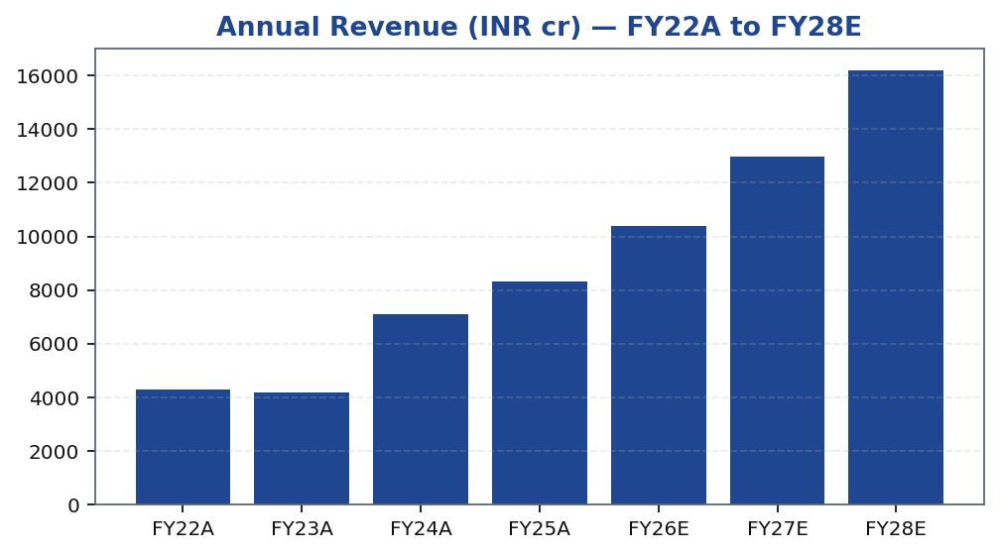
MOFSL | Pratik Gupta | 2026-04-28
Segment Mix — Revenue and EBITDA Contribution
MOFSL's revenue mix is diversifying away from transactional broking toward recurring asset and wealth management fees. The Asset Management and Private Wealth segments together account for a growing share of both revenues and EBITDA, structurally improving earnings predictability across market cycles.
Segment | Rev Share (%) | EBITDA Share (%) | Growth | AUM Metric | AUM Value | Description
Capital Markets (Broking + IB) | 30.0% | - | - | Brokerage Rev YoY | -24% | Equity, derivatives, commodity, currency trading + institutional services and investment banking. Brokerage now contributes only 30% of total revenue, down from historical highs.
Asset Management | - | - | - | AMC AUM | INR 1.89L Cr (+33% YoY) | Mutual funds and PMS. 91% of AUM outperforming benchmarks over 3 years.
Private Wealth Management | - | - | - | PWM AUM | INR 1.96L Cr (+31% YoY) | HNI/UHNI advisory. Family count up 41% YoY.
Housing Finance | - | - | - | Loan Book | INR 6,630 Cr (+25% YoY) | Retail mortgage lending — affordable and mid-segment.
Alternative Investments | - | - | - | Carry Income | INR 58 Cr recurring | Private credit, real estate, alternatives.
Tikona Capital | SEBI Registration No.: INH000069807
Page 6 of 22

Slide 7
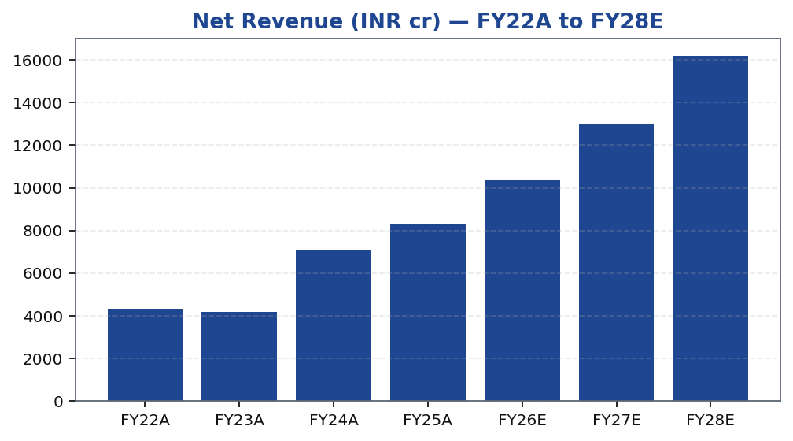
MOFSL | Pratik Gupta | 2026-04-28
Revenue Growth Trajectory
MOFSL's revenue has compounded significantly across the review period, driven by AUM expansion in asset management and private wealth. Fee-based revenues are increasingly dominant, reducing dependence on transaction volumes. FY26E and beyond reflect continued AUM-led growth with operating leverage benefits.
Tikona Capital | SEBI Registration No.: INH000069807
Page 7 of 22

Slide 8
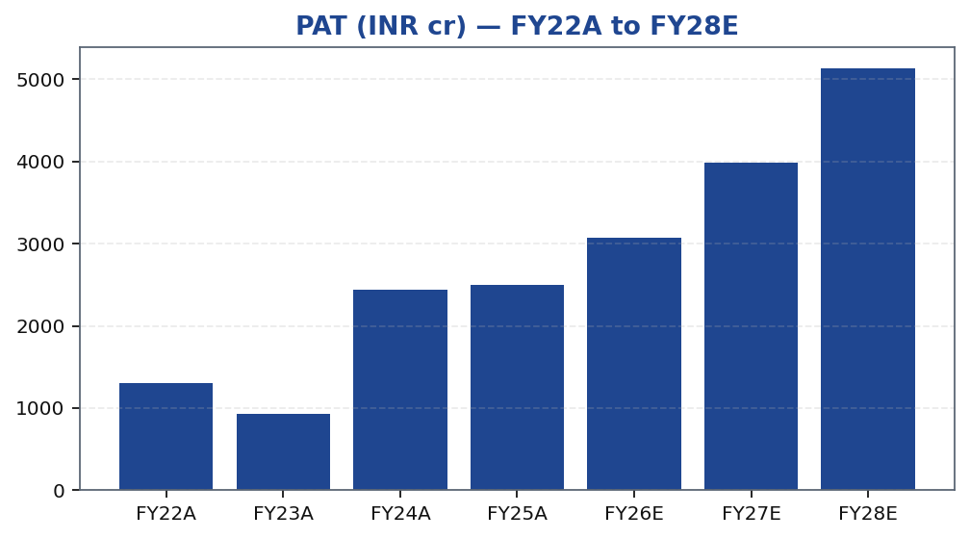
MOFSL | Pratik Gupta | 2026-04-28
Profitability — PAT Trend
PAT has compounded strongly over the medium term, supported by AUM fees and operating leverage. Q2FY26 saw a meaningful YoY decline driven by regulatory changes to F&O norms — illustrating residual cyclicality. The broking segment's share of earnings is expected to moderate as AMC and wealth contributions grow, improving through-cycle earnings stability.
Tikona Capital | SEBI Registration No.: INH000069807
Page 8 of 22

Slide 9
MOFSL | Pratik Gupta | 2026-04-28
Quarterly PAT — Cyclicality and Recovery Pattern
Quarterly PAT reflects the impact of SEBI regulatory changes on F&O norms in H1FY26. The AMC and wealth segments provide a partial offset; recovery trajectory depends on normalisation of broking volumes and continued AUM growth.
Quarter | PAT (INR cr)
Q2FY25 | 1242.0
Q3FY25 | 715.0
Q4FY25 | 545.0
Q1FY26 | 425.0
Q2FY26 | 401.0
Tikona Capital | SEBI Registration No.: INH000069807
Page 9 of 22

Slide 10
MOFSL | Pratik Gupta | 2026-04-28
Key Financial Ratios — FY22A to FY28E
Ratio | Unit | FY22A | FY23A | FY24A | FY25A | FY26E | FY27E | FY28E
EBITDA Margin | % | 49.3 | 44.9 | 57.4 | 54.5 | 52.3 | 52.3 | 52.3
PAT Margin | % | 30.5 | 22.3 | 34.4 | 30.0 | 29.5 | 30.7 | 31.7
RoE | % | 23.0 | 15.0 | 28.0 | 23.0 | 22.0 | 23.0 | 24.0
RoCE | % | 19.0 | 13.0 | 21.0 | 19.0 | 18.0 | 18.0 | 19.0
RoIC | % | 92.0 | 78.0 | 119.0 | 87.0 | 35.0 | 24.0 | 24.0
P/E | x | 37.5 | 52.3 | 20.1 | 19.7 | 16.1 | 12.4 | 9.6
P/B | x | 8.7 | 7.8 | 5.6 | 4.5 | 3.6 | 2.9 | 2.3
EV/EBITDA | x | 9.0 | 10.3 | 9.5 | 11.4 | 12.7 | 10.5 | 8.8
Tikona Capital | SEBI Registration No.: INH000069807
Page 10 of 22

Slide 11
MOFSL | Pratik Gupta | 2026-04-28
Peer Context — Relative Valuation Positioning
MOFSL's current valuation multiples reflect a discount to the asset management peer group, consistent with residual broking cyclicality. As ARR mix expands toward 70%+, we expect a re-rating toward AMC-comparable multiples. The P/E and P/B metrics below reflect FY26E estimates and provide a basis for monitoring relative value.
P/E FY26E (x) 16.1
P/B FY26E (x) 3.6
EV/EBITDA FY26E (x) 12.7
RoE FY26E (%) 22.0
Tikona Capital | SEBI Registration No.: INH000069807
Page 11 of 22

Slide 12
MOFSL | Pratik Gupta | 2026-04-28
Valuation Summary — BUY, Target Price INR 1,127
Our target price is derived through a blended valuation approach weighting P/E, P/B, and sum-of-parts methodologies. The probability-weighted target accounts for regulatory scenarios across broking and AMC segments. Current market price implies a material discount relative to intrinsic value, driven by near-term F&O regulatory concerns we view as transitory.
Target Price (INR) INR 1127.0
Upside (%) 37.0%
Prob-Weighted TP (INR) 1109.0
P/E FY26E (x) 16.1
Tikona Capital | SEBI Registration No.: INH000069807
Page 12 of 22

Slide 13
MOFSL | Pratik Gupta | 2026-04-28
Valuation Bands — Method-by-Method Reconciliation
Method | Low (INR) | Base (INR) | High (INR) | Weight (%) | Notes
Bull Case | 1400.0 | 1400.0 | 1400.0 | 30.0% | 28x P/E on FY27E EPS of INR 50; ARR > 70%, AMC +40% YoY.
Base Case | 1127.0 | 1127.0 | 1127.0 | 50.0% | 24x P/E on FY27E EPS of INR 47; ARR stable at 65%, steady AUM.
Bear Case | 630.0 | 630.0 | 630.0 | 20.0% | 18x P/E on depressed FY27E EPS of INR 35; sustained regulatory headwinds.
Tikona Capital | SEBI Registration No.: INH000069807
Page 13 of 22

Slide 14
MOFSL | Pratik Gupta | 2026-04-28
DCF Framework — Key Assumptions and Outputs
The DCF model underpins a cross-check of the multiple-based target price. Key drivers include AUM growth, management fee yield on AMC and wealth books, and operating leverage from a largely fixed cost base. Terminal value is sensitive to ARR mix at horizon end; higher ARR penetration supports a lower cost of equity assumption.
EPS FY26E (INR) 51.2
RoE FY26E (%) 22.0
RoCE FY26E (%) 18.0
P/B FY26E (x) 3.6
Tikona Capital | SEBI Registration No.: INH000069807
Page 14 of 22

Slide 15
MOFSL | Pratik Gupta | 2026-04-28
Scenario Analysis — Regulatory and Growth Outcomes
Scenario | Revenue CAGR (%) | EBITDA Margin (%) | Target Price (INR) | Probability (%) | Key Assumptions
Bull | 27.5% | 55.0% | 1400.0 | 30.0% | ARR > 70%, AMC AUM +40% YoY, regulatory clarity.
Base | 16.0% | 51.0% | 1127.0 | 50.0% | ARR steady at 65%, AUM compounding, stable regulation.
Bear | 6.0% | 45.0% | 630.0 | 20.0% | Sustained F&O headwinds, fintech share loss.
Tikona Capital | SEBI Registration No.: INH000069807
Page 15 of 22

Slide 16
MOFSL | Pratik Gupta | 2026-04-28
SAARTHI Score 72/100 — Investment Quality Assessment
MOFSL scores 72/100 on the SAARTHI framework, reflecting strong reinvestment quality (13/15), above-average franchise durability, and a balanced risk profile. The primary drag is residual cyclicality in broking revenues and active SEBI monitoring, both acknowledged in the risk framework.
ARR % of Revenue 65.0
Fee-Based % of Revenue 45.0
Code | Dimension | Score | Assessment | Evidence
S | Scalability of Core Engine | 12/15 | ARR at 61% of net revenues; fee-based at 45%. H1FY26 operating PAT INR 1,088 Cr (+11% YoY) on net revenue INR 2,888 Cr (+15%). Asset-light fee model scales without proportional cost growth. F&O constraints limit broking scalability near-term. | AMC AUM +33% YoY to INR 1.89L Cr with INR 11,610 Cr net flows.
A1 | Addressable Market & Adjacency | 9/10 | 16.57L HNWIs by 2027; India 4th-largest private wealth market by 2028 (+58.4% UHNWIs). Sector profits to nearly double by FY30. MF penetration at 5–6%. Massive TAM with adjacency expansion across capital markets, wealth, housing, alternatives. | India private credit hit USD 9.0 Bn in H1 2025 (+53% YoY).
A2 | Asymmetric Pricing Power | 10/15 | 91% of AUM outperforming benchmarks over 3 years gives pricing power in PMS/wealth. Brokerage revenue down 24% from regulatory changes — fee compression in cyclical segment. Discount brokers and fintech limit pricing in commoditized broking. | Diversified mix offset 24% brokerage decline, validating partial pricing-power hedge.
R | Reinvestment Quality | 13/15 | MCap INR 49,079 Cr (+24.8% YoY); P/E 24.2; P/B 3.82. Strong RoCE; disciplined allocation into high-return fee businesses. Reinvestment in tech, talent, distribution, research generates sustainable advantage. | PWM AUM +31% YoY to INR 1.96L Cr; family count +41%; PAT +14% (9M).
T | Track Record Through Adversity | 8/10 | Q2FY25 PAT INR 1,242 Cr (+123% YoY), 46% revenue growth, 48% RoE — recovery and execution. Q2FY26 PAT -67.6% YoY, revenue -34.9% YoY shows residual cyclicality from F&O regulation. Continuity across cycles maintained. | Despite repeated SEBI interventions, AUM and ARR base continue to compound — institutional resilience.
H | Human Capital & Institutional DNA | 9/10 | Raamdeo Agrawal: QGLP creator, 'Buy Right, Sit Tight' framework. Navin Agarwal (since 2000): business strategy and capital allocation. Ajay Menon (27+ yrs): operations, compliance, risk, technology. Founding duo across nearly four decades — rare DNA in Indian financial services. | Rashtriya Samman Patra recipient (top tax-payer FY95–FY99) signals early ethical commercial success.
I | Inflection Point Identification | 11/15 | Consensus TP INR 1,126.67 (max INR 1,200) vs CMP INR 822.90 — 37% upside; market not yet pricing ARR re-rating. Credit rating upgraded to AA+ (Stable) by ICRA. ARR > 70% would trigger re-rating from broking to asset-management multiples within 6–18 months. | ARR at 65% of net revenues (up from 61%); management guiding higher — measurable inflection.
Tikona Capital | SEBI Registration No.: INH000069807
Page 16 of 22

Slide 17
MOFSL | Pratik Gupta | 2026-04-28
Management Profile — Leadership and Governance
MOFSL was co-founded by Motilal Oswal and Raamdeo Agrawal in 1987. Both founders remain actively involved in strategy and capital allocation. The firm's enduring research culture and long-tenured senior leadership have been key differentiators in building franchise equity across market cycles.
Name | Role | Background
Raamdeo Agrawal | Chairman, MOFSL & Chairman, AMC | Co-founder (1987). Creator of the QGLP investment process and 'Buy Right, Sit Tight' framework. Built one of India's most respected investment research franchises. Widely cited investment thinker.
Motilal Oswal | Founder, Chairman & MD | Co-founder (1987). Led the firm's transformation from broking house into a comprehensive financial services platform. Recipient of Rashtriya Samman Patra for being among the highest taxpayers FY95–FY99.
Navin Agarwal | Executive Board — Strategy & Capital Allocation | Joined 2000. Drives business strategy and capital allocation across the Group, building market-leading positions through disciplined deployment.
Ajay Menon | Executive — Operations, Compliance, Risk & Technology | Joined 1998. 27+ years in Indian capital markets. Cornerstone of operational excellence and technology initiatives across the Group.
Tikona Capital | SEBI Registration No.: INH000069807
Page 17 of 22

Slide 18
MOFSL | Pratik Gupta | 2026-04-28
Forensic Assessment — Monitor Closely
MOFSL carries a Monitor Closely classification on governance grounds, reflecting recurring SEBI matters identified through our forensic screen. These matters are tracked rather than viewed as structurally impairment-level concerns. Investors should monitor regulatory disclosures and management commentary each quarter for any material escalation.
Matter | Description | Severity
SEBI — Margin Reporting Violations | INR 7 lakh penalty for margin reporting, collection violations, and other regulatory lapses found during inspection. | Low
SEBI — Client Fund Misutilization (2022) | INR 25 lakh fine for misutilization of client funds and inaccurate margin reporting. | Medium
NSEL — Misselling Accusations | Accused alongside other top brokers of misselling NSEL contracts, KYC manipulation, client code modification, and illegal transactions per SFIO/EOW findings. | High (Historical)
SEBI — Not Fit and Proper (Commodities) | Declared 'not fit and proper' as commodity derivative broker in Feb 2019 based on SFIO/EOW recommendations. | High (Historical)
Unauthorized Terminal Operations | 13 NSE and 9 BSE terminals operating from undeclared locations including an unreported branch in Delhi. | Medium
Tikona Capital | SEBI Registration No.: INH000069807
Page 18 of 22

Slide 19
MOFSL | Pratik Gupta | 2026-04-28
Key Risks and Catalysts
- SEBI regulatory tightening on F&O trading norms could structurally compress broking revenue beyond current estimates.
- Q2FY26 demonstrated residual earnings cyclicality — further regulatory events may repeat the revenue impact pattern.
- Competitive intensity from discount brokers and fintech platforms risks compressing broking yields over time.
- Mark-to-market volatility on the proprietary investment book can distort reported earnings in volatile quarters.
- Housing finance asset-quality slippage in a stressed credit cycle could pressure NBFC-segment earnings.
- Failure of ARR mix to cross 70% would delay the re-rating catalyst central to the investment thesis.
Tikona Capital | SEBI Registration No.: INH000069807
Page 19 of 22

Slide 20
MOFSL | Pratik Gupta | 2026-04-28
Trading Strategy — Entry, Review, and Exit Parameters
CMP (INR) INR 822.9
Target Price (INR) INR 1127.0
Upside (%) 37.0%
The current market price provides an entry opportunity at a material discount to both the analyst target and the probability-weighted scenario. Position sizing should account for residual regulatory uncertainty in broking revenues. We recommend reviewing the thesis at each quarterly result, focusing on ARR mix trajectory and AUM net flows.
- Entry: Accumulate at current market price given the discount to probability-weighted target.
- Add on weakness: Increase position on regulatory-driven dips provided the ARR mix trend remains intact.
- Review trigger: ARR contribution failing to expand toward 70% within four quarters.
- Review trigger: AMC AUM net flows turning negative for two consecutive quarters.
- Exit trigger: SEBI action materially impairing the broking or AMC franchise on a structural basis.
- Exit trigger: Forensic matters escalating to enforcement proceedings with balance-sheet implications.
Tikona Capital | SEBI Registration No.: INH000069807
Page 20 of 22

Slide 21
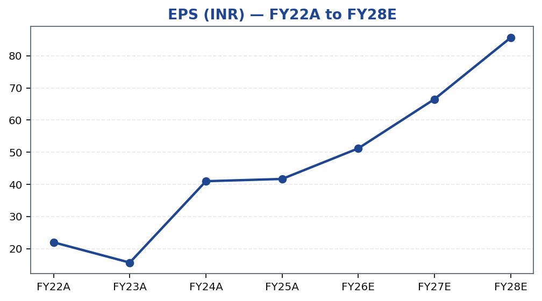
MOFSL | Pratik Gupta | 2026-04-28
EPS Growth Trajectory — FY22A to FY28E
Tikona Capital | SEBI Registration No.: INH000069807
Page 21 of 22

Slide 22
MOFSL | Pratik Gupta | 2026-04-28
Disclaimer
This report has been prepared by Tikona Capital, a SEBI-registered research analyst. The information contained herein is for informational purposes only and does not constitute an offer, solicitation, or recommendation to buy or sell any security. Investors should independently evaluate the merits and risks of any investment. Past performance is not indicative of future results. The analyst or firm may hold positions in securities mentioned. This document is subject to SEBI (Research Analysts) Regulations, 2014. The renderer will substitute approved SEBI-compliant boilerplate disclosures on the final output.
Tikona Capital | SEBI Registration No.: INH000069807
Page 22 of 22

