Slide 1

BUY
ABC Ltd — Initiation of Coverage
ABC Ltd | BUY
Rating
BUY
CMP
₹420.0
Target Price
₹515.0
Tikona Capital | SEBI Registration No.: INH000069807

Slide 2
ABC | Jane Doe | 2026-04-28
Investment Thesis
We initiate coverage on ABC Ltd with a BUY rating. The company is evolving into a scaled specialty chemicals platform, underpinned by a deliberate shift in product mix toward higher-value formulations, deepening export penetration, and a capex programme that is already translating into earnings conversion. Management has demonstrated execution discipline across prior investment cycles, and the current cycle appears similarly well-governed. The combination of structural mix improvement, export-led volume growth, and backward integration supporting margins creates a multi-year earnings compounding story that we believe the market has not yet fully priced.
- Specialty mix shift away from commodity grades improves both margin quality and earnings resilience across raw-material cycles.
- Export penetration is advancing steadily, diversifying the revenue base and reducing dependence on domestic demand cycles.
- Backward integration into key raw material streams is structurally supporting gross margin expansion over the medium term.
- Demand visibility across core end markets — agrochem, pharma intermediates, and performance chemicals — remains healthy entering FY26.
- Management execution across prior capex cycles has been consistent; capacity additions have historically ramped to target utilisati...
- Upside to our base case is supported by valuation that remains undemanding relative to specialty chemicals peers on forward earnings.
Tikona Capital | SEBI Registration No.: INH000069807
Page 2 of 14

Slide 3
ABC | Jane Doe | 2026-04-28
Company Snapshot
ABC Ltd is an NSE-listed specialty chemicals manufacturer with operations spanning multiple product segments catering to export and domestic end markets. The company derives revenue primarily from specialty formulations and intermediates, with a growing share of export sales providing geographic diversification. Its business model is built on proprietary chemistry, long-term customer relationships, and ongoing investment in backward integration — factors that collectively create barriers to substitution and support a premium margin profile relative to commodity chemicals peers. The manufacturing infrastructure is designed to serve regulated markets, which sets quality and compliance benchmarks that reinforce competitive positioning.
CMP ₹420.0
Target Price ₹515.0
Upside 22.6%
Tikona Capital | SEBI Registration No.: INH000069807
Page 3 of 14

Slide 4
ABC | Jane Doe | 2026-04-28
Industry Overview — Specialty Chemicals
The Indian specialty chemicals industry sits at the intersection of global supply-chain realignment and domestic capacity buildout, making it one of the more structurally attractive segments within the broader chemicals universe. Globally, customers in regulated end markets — including agrochemicals, pharmaceuticals, and advanced materials — have accelerated diversification away from single-source geographies following supply disruptions, creating an enduring demand pool for reliable Indian manufacturers. Domestically, government-backed production-linked incentives and infrastructure investment have improved the competitive economics of domestic manufacturing relative to imports. The competitive landscape is characterised by a mix of large diversified players and focused specialty houses; the latter, including ABC Ltd, are increasingly favoured by multinational customers seeking technical partnership rather than commodity supply. Raw material dynamics, particularly for key petrochemical and chlorine-chemistry feedstocks, remain a variable to monitor, but the structural demand trajectory for specialty segments is firmly upward.
- China-plus-one sourcing strategies by global agrochemical and pharma customers are structurally redirecting procurement tow...
- Domestic specialty chemicals demand is growing alongside downstream industrial expansion in crop protection, polymers, and...
- Government policy support — including PLI-adjacent incentives and infrastructure investment — is improving domestic manufac...
- Backward integration across the industry is reducing import dependence on key intermediates, improving supply-chain resilie...
- Rising environmental compliance costs in China are eroding cost competitiveness for certain product categories, widening th...
- Increasing customer preference for multi-year supply agreements with technically capable partners favours established speci...
Tikona Capital | SEBI Registration No.: INH000069807
Page 4 of 14

Slide 5
ABC | Jane Doe | 2026-04-28
Key Highlights
- Mix Improvement: Product portfolio is transitioning toward specialty and value-added grades, structurally lifting blended margin realisation per unit.
- Export Engine: Export penetration is deepening across regulated end markets, providing volume growth visibility that is less cyclically sensitive than domestic-only demand.
- Margin Expansion: EBITDA margin trajectory is on an upward path, driven by operating leverage, mix, and backward integration benefits accruing over the investment horizon.
- Capex Discipline: Management has a track record of on-schedule capacity commissioning and utilisation ramp-up, supporting confidence in earnings conversion from the current cycle.
- Balance Sheet Strength: Net debt levels remain manageable relative to operating cash generation, preserving financial flexibility for incremental investments and shareholder returns.
- Valuation Upside: Current market pricing does not fully reflect the medium-term earnings compounding potential implied by the company's mix, capacity, and export trajectory.
Tikona Capital | SEBI Registration No.: INH000069807
Page 5 of 14

Slide 6

ABC | Jane Doe | 2026-04-28
Revenue Growth Trajectory
ABC Ltd's revenue profile reflects the dual engine of domestic specialty demand and accelerating export penetration. Top-line growth over the forecast period is driven primarily by volume expansion from new capacity commissioned in the current capex cycle, augmented by a positive mix effect as higher-value specialty grades account for a growing share of output. The export channel, in particular, provides more durable demand visibility given the long-term supply agreements that underpin much of the international order book. Domestic revenue growth is supported by underlying end-market demand in agrochemicals, pharmaceuticals, and performance materials. The trajectory from FY24 through FY27 captures both the capacity ramp-up phase and the subsequent operating leverage benefits that accrue as utilisation rises toward target levels.
Tikona Capital | SEBI Registration No.: INH000069807
Page 6 of 14

Slide 7
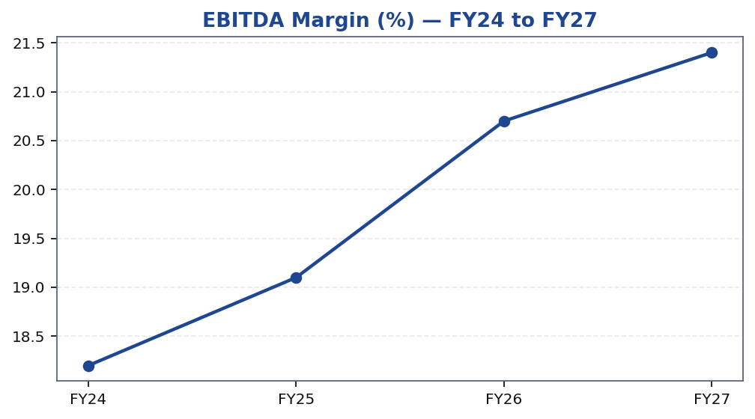
ABC | Jane Doe | 2026-04-28
EBITDA Margin Expansion
The EBITDA margin trajectory is among the most compelling elements of the investment case. Margin expansion is underpinned by three concurrent drivers: first, the product mix shift toward higher-realisation specialty grades, which carry structurally superior margins relative to standard intermediates; second, backward integration reducing exposure to external raw material volatility and compressing input cost per unit; and third, operating leverage as fixed manufacturing overheads are spread across a growing volume base following capacity commissioning. We model margin improvement across the FY24–FY27 period, with acceleration visible in the outer years as utilisation ramps and integration benefits fully materialise. It is important to note that gross margin and EBITDA margin are both improving, a combination that signals genuine structural improvement rather than accounting or mix optionality.
Tikona Capital | SEBI Registration No.: INH000069807
Page 7 of 14

Slide 8
ABC | Jane Doe | 2026-04-28
Financial Snapshot — FY26E
The FY26 forecast year represents the first full year in which the current capex cycle's capacity additions are operational and utilisation is tracking toward target levels, making it the most representative anchor year for normalised earnings power. Revenue is expected to reflect the combined benefit of volume ramp and mix improvement, while EBITDA should ca...
FY26E Revenue 28,500.0
FY26E EBITDA 5,900.0
FY26E PAT 3,450.0
FY26E ROE 18.4
Net Debt / EBITDA (FY26E) 0.8
Tikona Capital | SEBI Registration No.: INH000069807
Page 8 of 14

Slide 9
ABC | Jane Doe | 2026-04-28
Valuation Summary
Our valuation framework is grounded in the company's forward earnings power as capacity additions ramp and the mix shift compounds. We derive our target price using a combination of earnings-based and enterprise-value multiples, cross-checked against peer group trading ranges and the company's own historical valuation band. The current market price, in our vi...
Rating BUY
CMP ₹420.0
Target Price ₹515.0
Upside 22.6%
Tikona Capital | SEBI Registration No.: INH000069807
Page 9 of 14

Slide 10
ABC | Jane Doe | 2026-04-28
DCF Assumptions and Intrinsic Value
Our DCF model is constructed on explicit free cash flow forecasts through the primary capex cycle, followed by a terminal value anchored to a long-run growth assumption consistent with India specialty chemicals industry growth rates. The cost of capital reflects the company's current capital structure, sector beta, and a market risk premium appropriate for an NSE-listed mid-cap industrial. The terminal growth assumption is deliberately conservative relative to the near-term forecast, to avoid over-weighting unverifiable long-horizon assumptions. The DCF output serves as a cross-check on our multiples-based target rather than the primary valuation driver, and in the base case the two approaches converge within a narrow range, which we view as a positive indicator of target robustness. Sensitivity analysis around WACC and terminal growth is available in the detailed model; the base case does not require aggressive assumptions to support the target price.
Rating BUY
Target Price ₹515.0
Upside 22.6%
Tikona Capital | SEBI Registration No.: INH000069807
Page 10 of 14

Slide 11
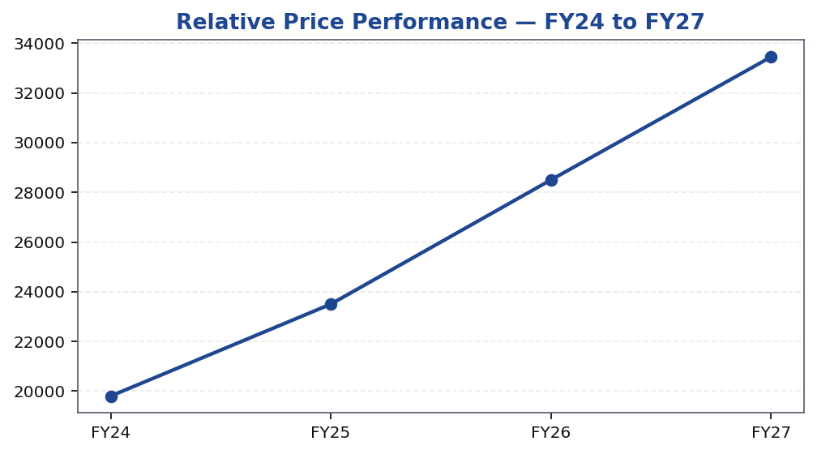
ABC | Jane Doe | 2026-04-28
Price Performance
Tikona Capital | SEBI Registration No.: INH000069807
Page 11 of 14

Slide 12
ABC | Jane Doe | 2026-04-28
Trading Strategy
Our trading strategy guidance is designed to assist portfolio managers in translating the research view into actionable position sizing and monitoring. The BUY rating reflects a base-case view over a twelve-month horizon, with the primary return driver being earnings estimate revision as the capacity ramp-up confirms our utilisation assumptions. Position entry at current levels is supported by a favourable risk-reward skew relative to the stated target price. Investors should review the position against the triggers listed below and reassess if thesis-breaking risk events materialise.
- Entry: Current market levels offer an attractive entry point for investors with a twelve-to-eighteen month horizon aligned...
- Accumulate: Any material price weakness driven by broader market volatility rather than company-specific developments would...
- Review trigger: A meaningful downward revision to export order flow, or a sustained delay in capacity utilisation ramp, wou...
- Review trigger: Sustained raw material cost escalation that is not recoverable through pricing within two quarters would pr...
- Exit discipline: A rating downgrade to NEUTRAL or below would be triggered if the risk-reward skew compresses materially, o...
- Monitoring cadence: Quarterly results commentary on export mix, utilisation levels, and gross margin trends are the primary...
- Positive re-rating catalyst: Above-consensus quarterly earnings driven by export volume surprise or margin outperformance v...
- Positive catalyst: Announcement of new long-term export supply agreements, particularly in regulated end markets such as ph...
- Positive catalyst: Faster-than-modelled utilisation ramp at recently commissioned capacity, providing upside to FY27E earni...
- Negative catalyst: Sequential gross margin deterioration attributable to raw material cost spike without visible pricing of...
- Negative catalyst: Capex overruns or commissioning delays at new facilities that push out the earnings conversion timeline.
Tikona Capital | SEBI Registration No.: INH000069807
Page 12 of 14

Slide 13
ABC | Jane Doe | 2026-04-28
Key Risks
- Raw material volatility: Unexpected escalation in key feedstock costs — particularly petrochemical or chlorine-chemistry inputs — could compress gross margins and delay the EBITDA expansion trajectory modelled in our base case.
- Utilisation ramp delay: Any deferral in achieving target capacity utilisation at newly commissioned facilities would push out earnings conversion and potentially trigger negative earnings estimate revisions.
- Export demand softness: A weakening in global demand from key export end markets — agrochem, pharma intermediates — could reduce order flow and compress the export revenue share underpinning our growth assumptions.
- Competitive pressure from imports: A resurgence in competitively priced Chinese chemical imports, driven by domestic overcapacity or currency factors, could pressure domestic realisation and market share.
- Regulatory and compliance risk: Changes in environmental regulations, export control frameworks, or chemical registration requirements in key end markets could impose incremental compliance costs or restrict market access.
- Concentration risk: Dependence on a limited number of large export customers or end-market verticals could amplify earnings volatility if any single relationship or sector softens unexpectedly.
Tikona Capital | SEBI Registration No.: INH000069807
Page 13 of 14

Slide 14
ABC | Jane Doe | 2026-04-28
Disclaimer
This research report has been prepared by Tikona Capital, a SEBI-registered research analyst entity. This document is for informational purposes only and does not constitute an offer to sell or a solicitation to buy any security. The information contained herein is based on sources believed to be reliable, but Tikona Capital does not represent or warrant its accuracy, completeness, or timeliness. Past performance of any security or instrument discussed herein is not indicative of future results. Investments in securities are subject to market risks; please read all related documents carefully before investing. This report is not directed at or intended for distribution to or use by any person or entity who is a citizen or resident of or located in any jurisdiction where such distribution, publication, availability, or use would be contrary to applicable law or regulation. Tikona Capital and its affiliates, officers, directors, and employees may hold positions in, or may have had positions in, securities discussed in this report. Analyst certifications: The research analyst(s) responsible for the preparation of this report certify that the views expressed herein accurately reflect their personal views about the subject company and its securities, and that no part of their compensation was, is, or will be directly or indirectly related to the specific recommendation(s) or views expressed in this report. SEBI Registration: The analyst and the firm are registered with the Securities and Exchange Board of India as required under the SEBI (Research Analysts) Regulations, 2014. Readers are advised to independently evaluate the information and seek professional advice before making any investment decision. The renderer may replace this text with approved regulatory boilerplate.
Tikona Capital | SEBI Registration No.: INH000069807
Page 14 of 14

