Slide 1

BUY
ABC Ltd — Initiation of Coverage
ABC Ltd | BUY
Rating
BUY
CMP
₹420.0
Target Price
₹515.0
Tikona Capital | SEBI Registration No.: INH000069807

Slide 2
ABC | Jane Doe | 2026-04-28
Investment Thesis
We initiate coverage on ABC Ltd with a BUY recommendation. The company is emerging as a scaled specialty chemicals platform where the confluence of improving product mix, deepening export penetration, and disciplined capacity expansion is structurally lifting earnings quality. Mix shift away from commodity-like grades toward higher-value specialty products is the most important driver of margin improvement, and we believe this trajectory is underappreciated by the market. Backward integration initiatives are progressively reducing raw-material dependence, providing an additional buffer to gross margins as input costs fluctuate. Management has demonstrated consistent execution across prior capex cycles, lending credibility to the current expansion programme. Taken together, these factors underpin our constructive stance and our expectation of meaningful upside to consensus estimates over the medium term.
- Specialty mix enrichment is the primary re-rating lever, shifting the revenue base toward structurally higher-margin product catego...
- Export penetration is deepening as global customers diversify supply chains away from China, creating a multi-year demand runway fo...
- Backward integration into key intermediates progressively insulates gross margins from raw-material price volatility across cycles.
- Capacity expansion is on a disciplined, demand-linked schedule, mitigating the risk of over-investment common in the sector.
- Management's track record of delivering on prior capex commitments provides above-average confidence in execution of the current cy...
- Balance sheet remains investment-grade, preserving financial flexibility for incremental growth investments without diluting equity...
Tikona Capital | SEBI Registration No.: INH000069807
Page 2 of 15

Slide 3
ABC | Jane Doe | 2026-04-28
Company Snapshot
ABC Ltd is a specialty chemicals manufacturer listed on the NSE, with operations spanning multiple high-value chemical product categories oriented toward export-led growth. The company monetises its chemistry expertise through long-term supply arrangements with industrial and agrochemical customers globally, supplemented by domestic institutional sales. Revenue is diversified across end-use segments, reducing dependence on any single vertical. The business model is capital-intensive at the growth stage but generates attractive returns on invested capital once capacity reaches operating utilisation, consistent with the broader specialty chemicals sector dynamic.
CMP ₹420.0
Target Price ₹515.0
Upside 22.6%
Tikona Capital | SEBI Registration No.: INH000069807
Page 3 of 15

Slide 4
ABC | Jane Doe | 2026-04-28
Industry Overview — Specialty Chemicals
The Indian specialty chemicals industry occupies a strategically important position in the global chemical supply chain, with the sector benefiting from a combination of cost competitiveness, improving technical capabilities, and a favourable regulatory environment for exports. The industry is fragmented at the smaller end but increasingly consolidated around a set of scaled, export-oriented players that have invested in backward integration and research capability. Global customers — particularly in Europe, the US, and Japan — are actively diversifying away from single-source Chinese supply, a structural realignment that benefits Indian manufacturers with established quality credentials. Domestic demand from agriculture, pharmaceuticals, textiles, and electronics provides a resilient base load, while export revenues add growth acceleration. Capacity utilisation across the sector has been recovering, and a new capex wave is underway, which will test the discipline of individual operators over the next few years.
- China-plus-one sourcing strategies among global multinationals are creating durable, long-duration order flows for qualifie...
- Domestic end-market growth in agrochemicals, pharma intermediates, and specialty coatings provides a structural base demand...
- Government policy support through PLI schemes and environmental compliance enforcement is raising barriers to entry for low...
- Rising chemistry talent pool and improving R&D infrastructure are enabling Indian producers to address increasingly complex...
- Import substitution opportunities remain significant in several specialty segments where India still relies on imported int...
- Tightening environmental norms in China are raising the cost base of competing producers, narrowing the historic price disa...
Tikona Capital | SEBI Registration No.: INH000069807
Page 4 of 15

Slide 5
ABC | Jane Doe | 2026-04-28
Key Highlights
- Mix Enrichment: Ongoing transition toward higher-value specialty grades is the primary driver of EBITDA margin expansion over the forecast period.
- Export Growth: Deepening relationships with global customers across regulated markets are converting into a more visible, higher-quality revenue stream.
- Backward Integration: Progressive integration into key raw material intermediates is structurally improving gross margin resilience through input-cost cycles.
- Capex Discipline: Expansion is demand-linked and phased, reducing the risk of over-capacity build-up that has historically impaired returns in this sector.
- Financial Health: Leverage remains manageable, with the balance sheet able to fund the growth programme without equity dilution at current earnings levels.
- Management Track Record: Consistent delivery on prior capital allocation commitments supports confidence in guidance for the current expansion cycle.
Tikona Capital | SEBI Registration No.: INH000069807
Page 5 of 15

Slide 6

ABC | Jane Doe | 2026-04-28
Revenue Growth Trajectory
ABC Ltd's revenue trajectory reflects the combined effect of capacity additions coming on stream, improving export realisation, and a gradual but consistent mix shift toward higher-value products. Volume growth has been the dominant contributor historically, with price-mix becoming an increasingly meaningful secondary driver as the specialty share rises. Export revenues have grown faster than the domestic segment, reflecting successful customer additions in key geographies. Management's phased capacity expansion approach is designed to sustain this growth rate without creating structural over-capacity. Our forecast reflects a measured view on volume ramp-up timelines and conservative assumptions on price-mix improvement, leaving headroom for positive estimate revisions should execution remain on track in the coming quarters.
Tikona Capital | SEBI Registration No.: INH000069807
Page 6 of 15

Slide 7
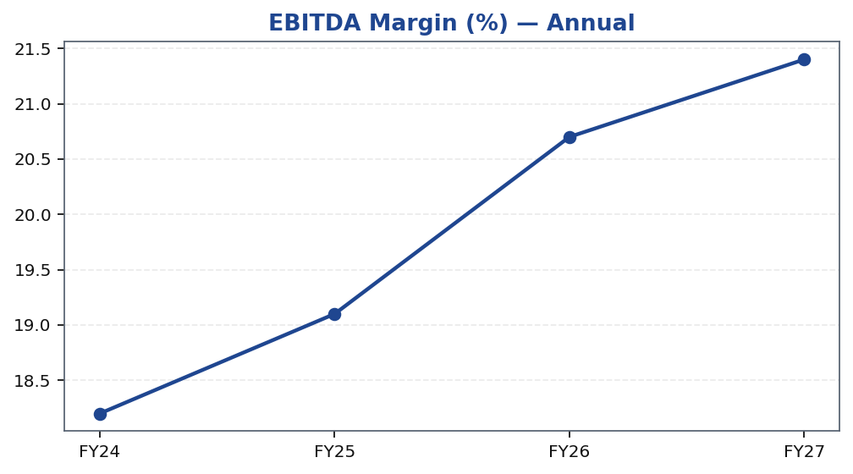
ABC | Jane Doe | 2026-04-28
EBITDA Margin Expansion
EBITDA margin improvement is the centrepiece of the ABC Ltd investment case and the primary reason we expect earnings to grow faster than revenue over the forecast horizon. Three concurrent forces are driving margin expansion: first, a product mix shift toward higher-realisation specialty grades that carry structurally wider spreads; second, backward integration into key raw-material intermediates reducing variable input costs as a percentage of revenue; and third, operating leverage as fixed overheads are spread across a growing revenue base. We note that this expansion is gradual rather than step-change, which we view as more sustainable and less dependent on external commodity tailwinds. Gross margin improvement will typically precede EBITDA margin gains by one to two quarters as integration investments complete, making gross margin the leading indicator to track in quarterly results.
Tikona Capital | SEBI Registration No.: INH000069807
Page 7 of 15

Slide 8
ABC | Jane Doe | 2026-04-28
Valuation Summary
Our valuation framework for ABC Ltd is anchored on a combination of earnings-based multiples and cross-checks against peer group comparables. The primary valuation approach applies an EV/EBITDA multiple to our forward EBITDA estimate, reflecting the capital-intensive nature of the business and the importance of operating cash generation as a value driver. We...
Target Price ₹515.0
Upside 22.6%
FY26E Revenue 28,500.0
FY26E EBITDA 5,900.0
Tikona Capital | SEBI Registration No.: INH000069807
Page 8 of 15

Slide 9
ABC | Jane Doe | 2026-04-28
DCF Cross-Check
Our DCF model serves as a cross-check to the multiples-based primary valuation, providing an intrinsic value anchor independent of market sentiment or peer re-ratings. The model discounts free cash flows over a medium-term explicit forecast period before applying a terminal value. Key assumptions reflect our view on sustainable revenue growth, long-run EBITDA margins as mix enrichment matures, and capital intensity consistent with the company's historical reinvestment profile. We apply a WACC that reflects the equity risk premium for mid-cap Indian industrials, a country risk adjustment, and the company's current debt-equity structure. The terminal growth rate is set conservatively to avoid overstating the long-run value of a capital-intensive manufacturer. The DCF output is broadly consistent with our multiples-based target price, reinforcing our conviction in the BUY recommendation. Sensitivity analysis around WACC and terminal growth rate assumptions is available in the full model.
FY26E PAT 3,450.0
FY26E ROE 18.4
Net Debt / EBITDA (FY26E) 0.8
Tikona Capital | SEBI Registration No.: INH000069807
Page 9 of 15

Slide 10
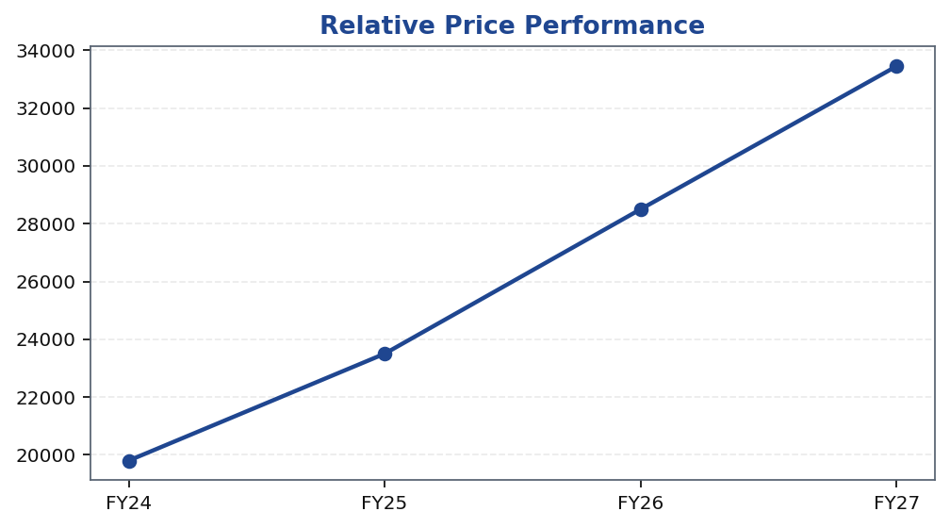
ABC | Jane Doe | 2026-04-28
Price Performance
Tikona Capital | SEBI Registration No.: INH000069807
Page 10 of 15

Slide 11
ABC | Jane Doe | 2026-04-28
Trading Strategy
Our trading strategy for ABC Ltd is designed around the medium-term thesis of margin expansion and re-rating, with clear entry, monitoring, and exit triggers. The current price level presents an attractive risk-reward entry point relative to our base-case target, supported by improving earnings visibility over the next two to three quarters. Investors with a twelve-to-eighteen month horizon are well-positioned at current levels. Near-term volatility should be treated as an accumulation opportunity unless accompanied by adverse changes in fundamentals. Position sizing should reflect individual portfolio risk limits and the inherent volatility of mid-cap specialty chemicals names.
- Entry: Current levels offer a favourable risk-reward entry for medium-term investors with an eighteen-month horizon, aligne...
- Add on Dips: Any price correction driven by broader market or sector sentiment — rather than company fundamentals — represe...
- Review Trigger — Positive: Accelerating export order wins, ahead-of-schedule capacity ramp-up, or gross margin expansion ex...
- Review Trigger — Negative: Significant raw-material cost escalation without offsetting price increases, or meaningful delay...
- Exit: A re-rating to multiples ahead of our high-case scenario, or a deterioration in management guidance credibility, woul...
- Stop-Loss Consideration: A sustained breach of key technical support levels combined with a fundamental earnings downgrade...
Tikona Capital | SEBI Registration No.: INH000069807
Page 11 of 15

Slide 12
ABC | Jane Doe | 2026-04-28
Risks and Catalysts
- Raw material price volatility in key chemical inputs could compress gross margins materially, particularly if the company is unable to pass through cost increases in competitive export markets.
- Delays in utilisation ramp-up for new capacity could defer earnings conversion and push out the timeline for return-on-capital improvement.
- Export demand softness — driven by global economic deceleration or customer inventory destocking — could reduce near-term revenue growth and operating leverage.
- Chinese competitor re-entry or aggressive pricing in key export markets remains a structural risk that could erode the pricing premium on specialty products.
- Regulatory or environmental compliance requirements, both domestically and in export geographies, could impose incremental costs or disrupt production continuity.
- Concentration risk in end-market exposure — should any key customer or vertical experience a significant downturn, the impact on revenue could be disproportionate.
Tikona Capital | SEBI Registration No.: INH000069807
Page 12 of 15

Slide 13
ABC | Jane Doe | 2026-04-28
ESG and Sustainability Considerations
The specialty chemicals sector operates under heightened regulatory and reputational scrutiny on environmental grounds, given the nature of chemical manufacturing processes and waste management obligations. For ABC Ltd, ESG considerations intersect directly with the investment case: environmental compliance is a prerequisite for maintaining export licences and customer relationships in regulated markets such as Europe and the US, where chemical suppliers face rigorous third-party audits. Social factors — including workforce safety, community relations near manufacturing sites, and supply chain labour standards — are monitored by key global customers as part of procurement due diligence. Governance quality is a critical overlay on all investment decisions. We view ESG performance as both a risk factor and a potential positive differentiator for ABC Ltd relative to less compliant peers operating in the same chemical segments.
- Environmental compliance with domestic and export-market standards is a non-negotiable prerequisite for maintaining long-te...
- Waste management and effluent treatment infrastructure quality is a differentiating factor for Indian specialty chemical ex...
- Workforce safety metrics and lost-time injury rates are increasingly scrutinised by global industrial customers conducting...
- Water usage intensity and recycling rates are becoming material disclosure requirements under emerging SEBI ESG reporting n...
- Governance transparency — including related-party disclosure practices and board independence — directly influences the qua...
- Alignment with global sustainability frameworks such as Responsible Care provides a reputational and regulatory risk buffer...
Tikona Capital | SEBI Registration No.: INH000069807
Page 13 of 15

Slide 14
ABC | Jane Doe | 2026-04-28
Analyst View and Conclusion
We initiate coverage on ABC Ltd with a BUY recommendation based on our conviction that the company's mix enrichment strategy, deepening export relationships, and disciplined capacity expansion programme are collectively undervalued by the market at current levels. The three-year earnings trajectory we model reflects conservative assumptions on margin improvement and volume ramp-up, providing a buffer against execution slippage. The most important near-term catalyst is evidence of gross margin expansion as backward integration matures and export volumes scale — this is the metric we would most closely monitor in quarterly results. Risk is balanced by the company's financial health, which limits dilution risk and preserves strategic optionality. Our target price reflects a base-case scenario; upside from a faster-than-expected re-rating or margin outperformance is not fully captured in this estimate. Overall, we view ABC Ltd as a high-quality, medium-term compounding story in the Indian specialty chemicals universe.
- Specialty mix shift is the most durable re-rating lever and is structurally supported by management's product development a...
- Export deepening into regulated markets creates revenue quality and pricing power that commodity-grade competitors cannot e...
- Backward integration progress is the key near-term earnings catalyst — gross margin improvement will be the first visible f...
- Balance sheet strength ensures the growth programme can be funded without equity dilution, preserving per-share value for e...
- Management credibility, demonstrated through prior capex cycle execution, reduces the execution risk discount that the mark...
- Risk-reward at current entry levels is favourable on a twelve-to-eighteen month view, with downside scenarios bounded by th...
Tikona Capital | SEBI Registration No.: INH000069807
Page 14 of 15

Slide 15
ABC | Jane Doe | 2026-04-28
Disclaimer
This research report has been prepared by Tikona Capital, a SEBI-registered research analyst entity, for informational purposes only. It does not constitute an offer to sell or a solicitation to buy any security. The information contained herein has been obtained from sources believed to be reliable, but Tikona Capital makes no representation as to its accuracy or completeness. Past performance is not indicative of future results. Investments in securities markets are subject to market risks; please read all related documents carefully before investing. This report is intended solely for the use of the recipient and may not be redistributed, copied, or reproduced without the prior written consent of Tikona Capital. The analyst(s) responsible for this report certify that the views expressed herein accurately reflect their personal views about the subject company and its securities, and that no part of their compensation was, is, or will be directly or indirectly related to the specific recommendations or views contained in this report. Tikona Capital and its affiliates may hold positions in the securities of the company covered in this report. SEBI Registration Number: to be inserted by compliance. This report should be read in conjunction with all applicable disclosures available on the Tikona Capital website. The renderer may replace this text with firm-approved compliance boilerplate.
Tikona Capital | SEBI Registration No.: INH000069807
Page 15 of 15

